Slide 1
Why Data Visualization Matters ?
Understanding before modeling
Before building any model or running any analysis, you need to see your data
Distributions
outliers,
skewness,
correlations
— these are often invisible in raw tables but immediately obvious in a well-chosen chart.
Students who skip this step build models on assumptions they never verified.

Slide 2
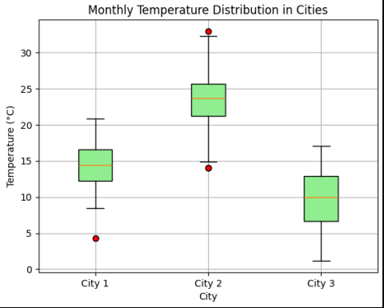
Why Data Visualization Matters ?
Understanding before modeling
Outliers
City1 data = [11, 12, 20, …]
City2 data = [21, 30, 20, …]
City3 data = [5, 10, 15, …]
Numbers like above cannot be visualized.
After boxplot,
We see that city 2 temperature is in higher range and city 3 temperature is lowest range.
City 1 has 1 outlier
City 2 has 2 outliers

Slide 3
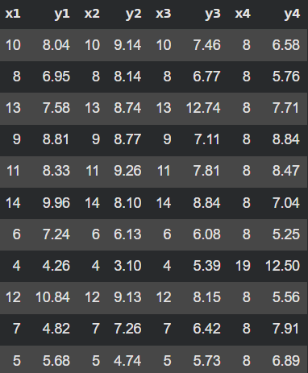
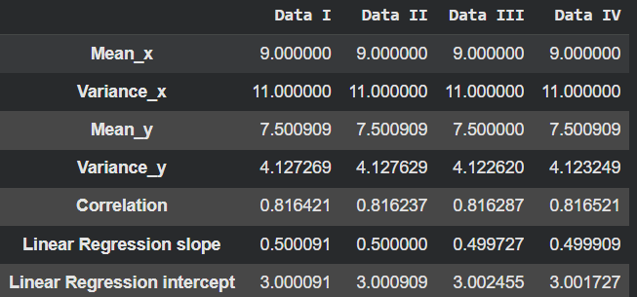
Why Data Visualization Matters ?
Anscombe's Quartet effect
4 datasets with nearly identical summary statistics (mean, variance, correlation) but look completely different when plotted.
This classic example alone justifies teaching visualization as a discipline in itself.

Slide 4
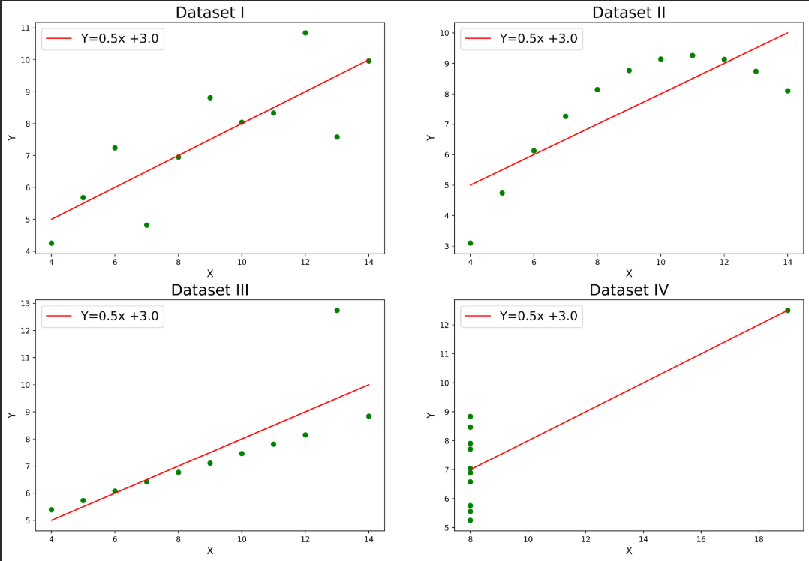
Why Data Visualization Matters ?
Anscombe's Quartet effect

Slide 5
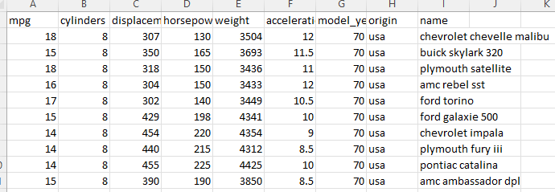
Why Data Visualization Matters ?
Helps Communicate Data to Non-Technical Audience:
Insights that can't be communicated clearly have no impact. A data scientist who can produce a compelling visualization can influence decisions; one who can't is limited to talking to other data scientists. This is especially true when presenting to business stakeholders or policymakers.

Slide 6
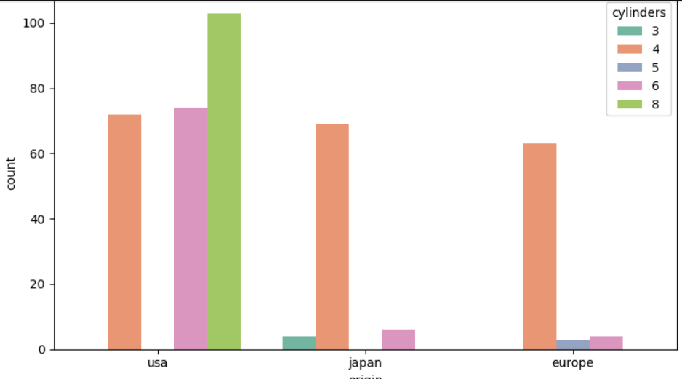
Why Data Visualization Matters ?
Helps Communicate Data to Non-Technical Audience:
Here we can visually see that
Only US has 8 cylinders.
Only Japan has 3 cylinders

Slide 7
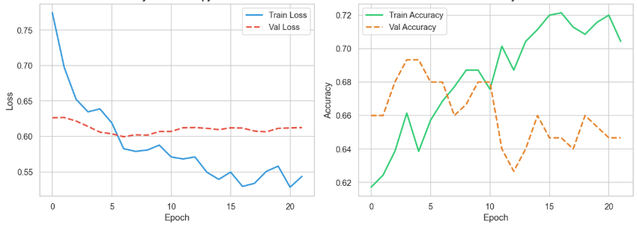
Why Data Visualization Matters ?
Critical for generative AI
In the GenAI era, students need to visualize
embedding spaces (t-SNE, UMAP),
attention weights,
training loss curves, and
evaluation metric distributions.
Without visualization literacy, AI practitioners are flying blind through high-dimensional spaces.

Slide 8
Tool | Best For | Language/ Platform
Matplotlib | Fine-grained control, publication plots | Python
Seaborn | Statistical plots with less code | Python
Plotly / Plotly Express | Interactive charts, dashboards | Python / JS
Tableau | Business BI, drag-and-drop | GUI (no-code)
Power BI | Enterprise reporting | GUI / DAX
D3.js | Custom, web-based interactive viz | JavaScript
ggplot2 | Grammar of graphics, elegant defaults | R
Bokeh | Interactive plots in Python | Python
Streamlit | Rapid data apps with embedded charts | Python
Vega-Lite / Altair | Declarative, grammar-based | Python / JSON
Widely Used Tools

