Slide 1
Confidence Interval
Problem: A company claims their fries have an average weight of 54 g per pack. You buy 25 random packs and weigh them:
41.4, 42.1, 42.6, 43.1, 44.0, 44.7, 45.4, 46.1, 46.8, 47.5, 48.2, 49.3, 50.0, 50.7, 51.8, 52.5, 53.2, 53.9, 54.6, 55.3, 56.0, 56.9, 57.4, 57.9, 58.6
The total of above 25 samples is 1250 g. So, average weight of single pack is 1250/25 = 50 g.
They seem lighter than the claim.
You calculate the standard deviation of above data and it is 8 g.
Can you prove statistically, at 95% confidence that the claim might be false?

Slide 2
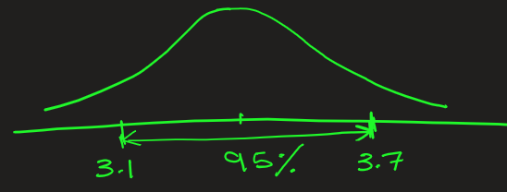
Confidence Interval: Definition
A confidence interval (CI) is a range of values that is likely to contain the true population parameter (like mean, proportion, or difference) with a certain level of confidence.
Confidence is generally expressed as 90%, 95% or 99%.
Example
Suppose you survey 100 students to find their average study time per day.
You find the sample mean = 3.4 hours, with a 95% confidence interval = [3.1, 3.7].
This means that:
We are 95% confident that the true average study time
for all students lies between 3.1 and 3.7 hours.
OR
Given the sample data, there is a 95% probability that the true mean lies between 3.1 and 3.7.

Slide 3
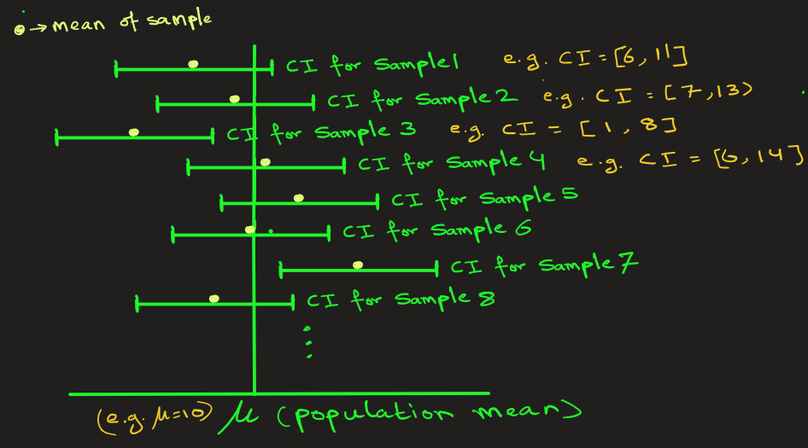
Confidence Interval: Interpretation
95% CI means that if we repeatedly sample from the population and calculate CIs, about 95% of these CIs would contain the true mean μ.
Let’s understand this through an example:
Suppose the pop. mean is μ that we
Attempting to find.
I take sample1 and find its CI = [6,11]
I take sample2 and find its CI = [7,13]
I take sample3 and find its CI = [1,8]
I take sample1 and find its CI = [6,14]
and so on…
95% of these Cis would contain the true mean μ
2) Width of CI tells how precise the
estimate is.
The narrow CI, say [2, 5], is more precise than wider CI, say [2, 30].

Slide 4
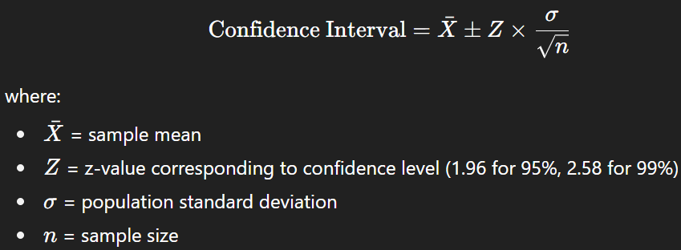
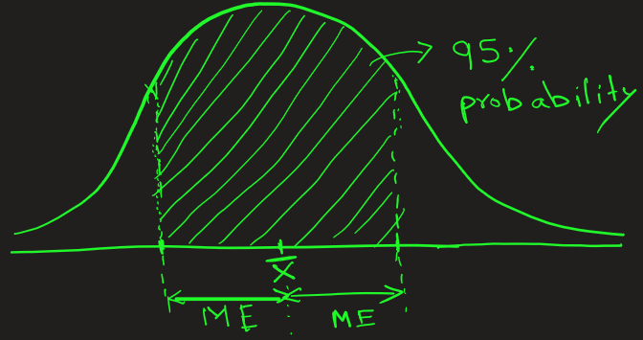
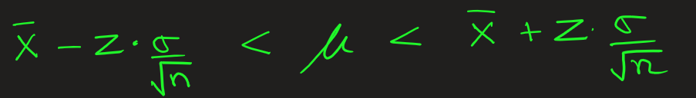

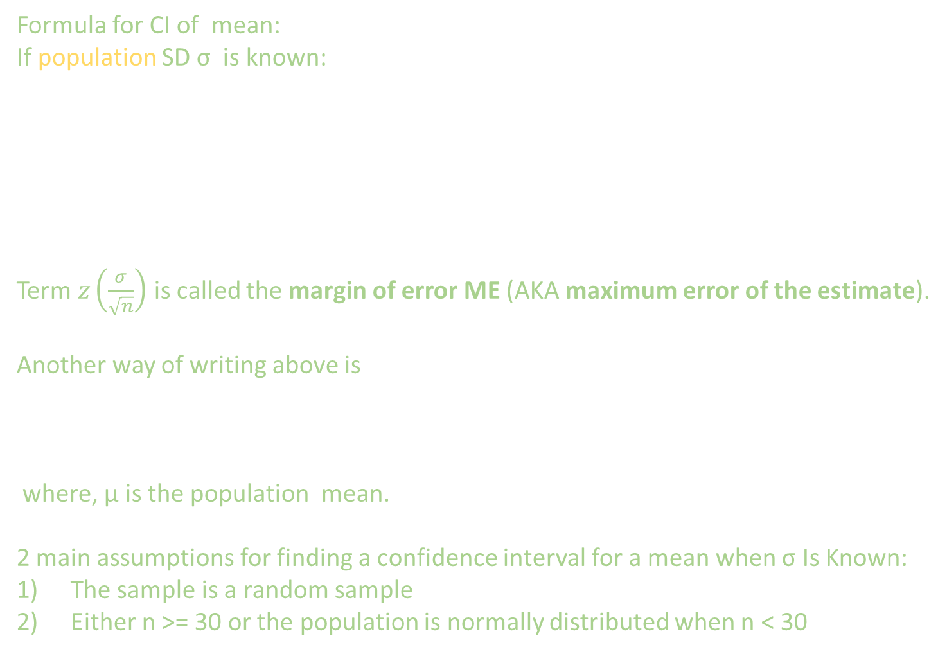
Confidence Interval: Formula for z-distribution
Formula for CI of mean:
If population SD σ is known:
Term $z\left(\frac{σ}{\sqrt{n}}\right)$ is called the margin of error ME (AKA maximum error of the estimate).
Another way of writing above is
where, μ is the population mean.
2 main assumptions for finding a confidence interval for a mean when σ Is Known:
The sample is a random sample
Either n >= 30 or the population is normally distributed when n < 30

Slide 5

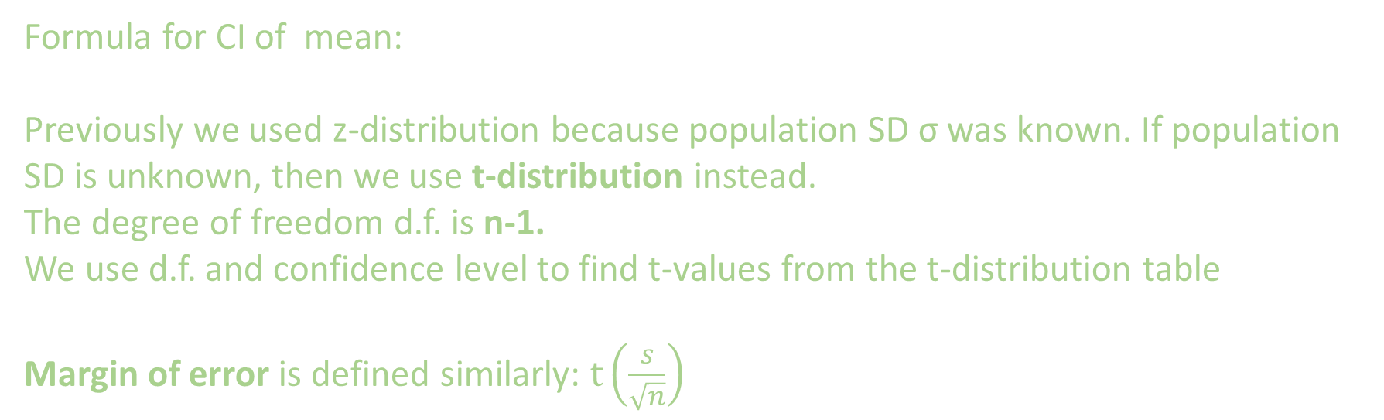
Confidence Interval: Formula For t-distribution
Formula for CI of mean:
Previously we used z-distribution because population SD σ was known. If population SD is unknown, then we use t-distribution instead.
The degree of freedom d.f. is n-1.
We use d.f. and confidence level to find t-values from the t-distribution table
Margin of error is defined similarly: $t\left(\frac{s}{\sqrt{n}}\right)$

Slide 6
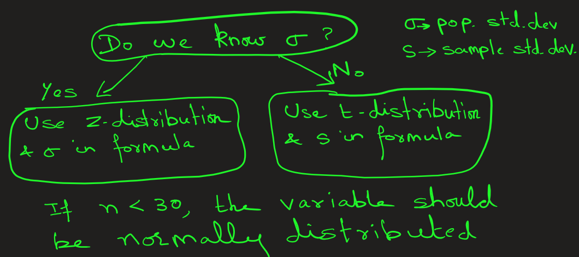
Confidence Interval: When to Use the z or t Distribution

Slide 7
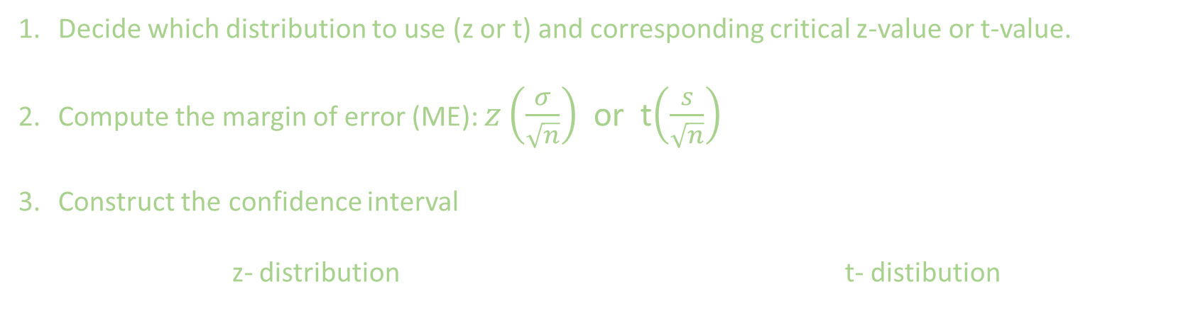
Confidence Interval: Steps
Decide which distribution to use (z or t) and corresponding critical z-value or t-value.
Compute the margin of error (ME): $z\left(\frac{σ}{\sqrt{n}}\right)$ or t$\left(\frac{s}{\sqrt{n}}\right)$
Construct the confidence interval
z- distribution t- distibution

Slide 8
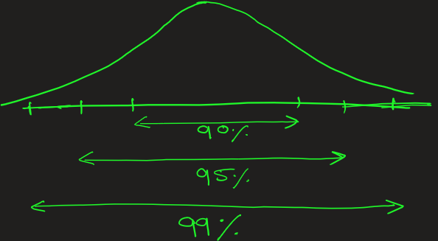
Confidence Interval
Cheat Sheet: Common Confidence Levels, their z-values and their meaning
Confidence Level | Z-Value | Meaning
90% | 1.645 | 90% confident true mean lies in interval; narrow interval
95% | 1.96 | Most commonly used
99% | 2.58 | Very high confidence, but wider interval

Slide 9
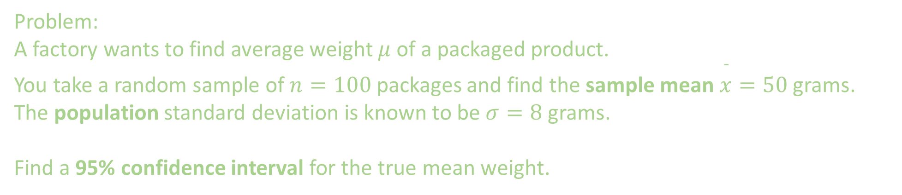
Confidence Interval: Application
Problem:
A factory wants to find average weight $μ$ of a packaged product.
You take a random sample of $n=100$ packages and find the sample mean $\overset{ˉ}{x}=50$ grams. The population standard deviation is known to be $σ=8$ grams.
Find a 95% confidence interval for the true mean weight.
1
3
100
2

Slide 10
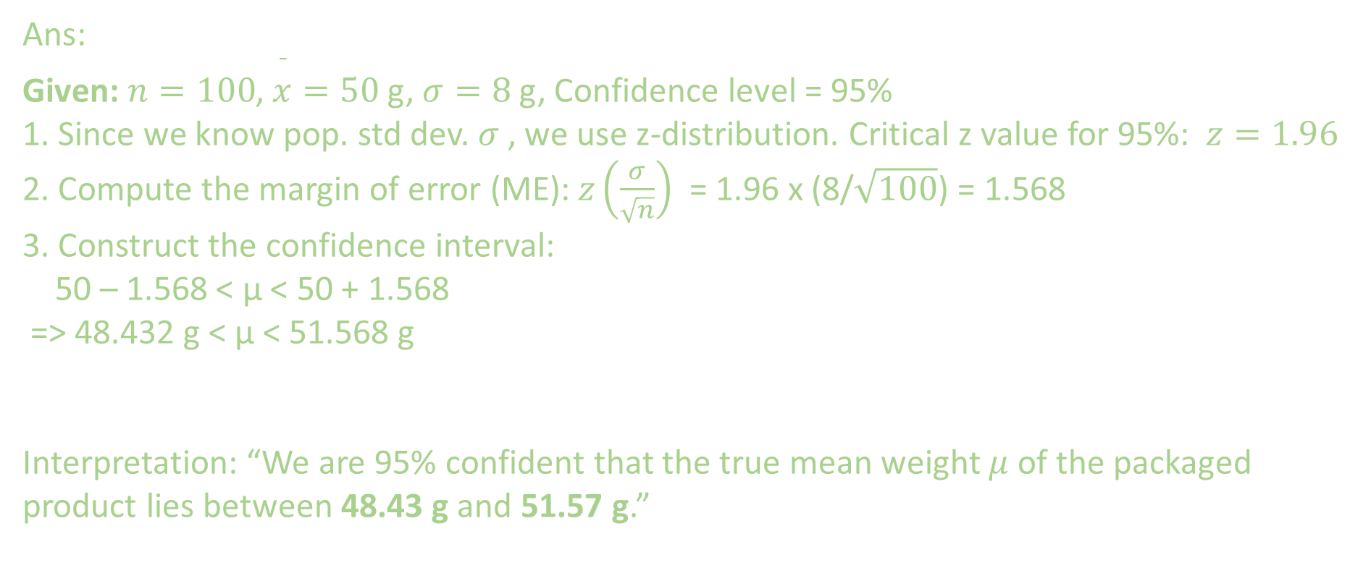
Confidence Interval: Application
Ans:
Given:$n=100$, $\overset{ˉ}{x}=50$ g, $σ=8$ g, Confidence level = 95%
1. Since we know pop. std dev. $σ$, we use z-distribution. Critical z value for 95%: $z=1.96$
2. Compute the margin of error (ME): $z\left(\frac{σ}{\sqrt{n}}\right)$ = 1.96 x (8/$\sqrt{100}$) = 1.568
3. Construct the confidence interval:
50 – 1.568 < μ < 50 + 1.568
=> 48.432 g < μ < 51.568 g
Interpretation: “We are 95% confident that the true mean weight $μ$ of the packaged product lies between 48.43 g and 51.57 g.”

Slide 11
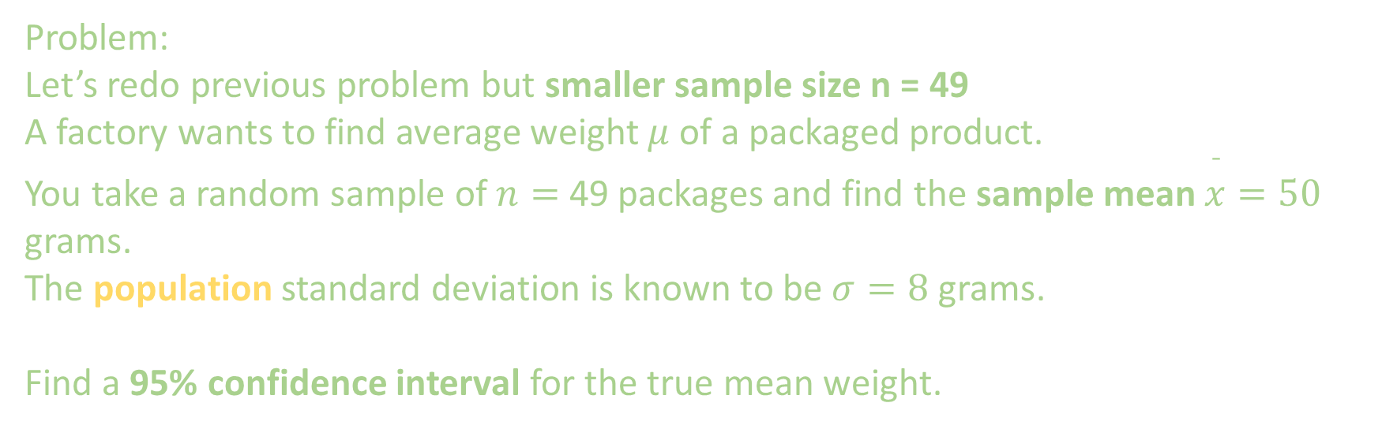
Problem:
Let’s redo previous problem but smaller sample size n = 49
A factory wants to find average weight $μ$ of a packaged product.
You take a random sample of $n=$ 49 packages and find the sample mean $\overset{ˉ}{x}=50$ grams.
The population standard deviation is known to be $σ=8$ grams.
Find a 95% confidence interval for the true mean weight.

Slide 12
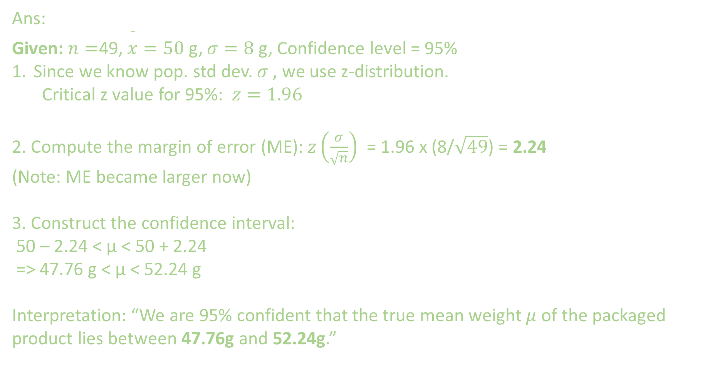
Ans:
Given:$n=$49, $\overset{ˉ}{x}=50$ g, $σ=8$ g, Confidence level = 95%
Since we know pop. std dev. $σ$, we use z-distribution.
Critical z value for 95%: $z=1.96$
2. Compute the margin of error (ME): $z\left(\frac{σ}{\sqrt{n}}\right)$ = 1.96 x (8/$\sqrt{49}$) = 2.24
(Note: ME became larger now)
3. Construct the confidence interval:
50 – 2.24 < μ < 50 + 2.24
=> 47.76 g < μ < 52.24 g
Interpretation: “We are 95% confident that the true mean weight $μ$ of the packaged product lies between 47.76g and 52.24g.”

Slide 13
For n = 100, the CI was [48.43, 51.57 ]
For n = 49, the CI was [47.76, 52.24 ]
Conclusion:
As the sample size decreases, the interval becomes wider,
so the estimate is less precise.

Slide 14
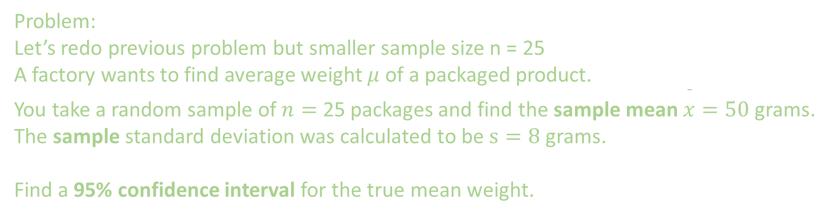
Problem:
Let’s redo previous problem but smaller sample size n = 25
A factory wants to find average weight $μ$ of a packaged product.
You take a random sample of $n=$ 25 packages and find the sample mean $\overset{ˉ}{x}=50$ grams.
The sample standard deviation was calculated to be $s=8$ grams.
Find a 95% confidence interval for the true mean weight.

Slide 15
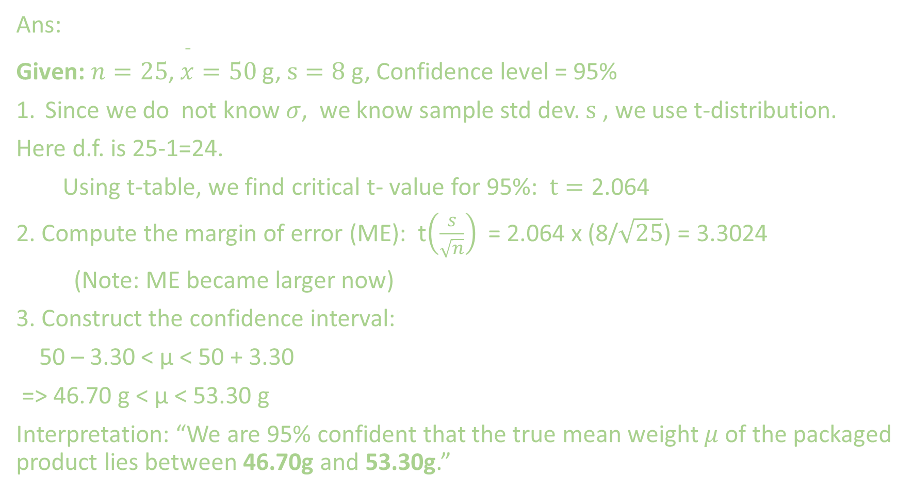
Ans:
Given:$n=25$, $\overset{ˉ}{x}=50$ g, $s=8$ g, Confidence level = 95%
Since we do not know $σ$, we know sample std dev. $s$, we use t-distribution.
Here d.f. is 25-1=24.
Using t-table, we find critical t- value for 95%: $t=\text{2.064}$
2. Compute the margin of error (ME): t$\left(\frac{s}{\sqrt{n}}\right)$ = 2.064 x (8/$\sqrt{25}$) = 3.3024
(Note: ME became larger now)
3. Construct the confidence interval:
50 – 3.30 < μ < 50 + 3.30
=> 46.70 g < μ < 53.30 g
Interpretation: “We are 95% confident that the true mean weight $μ$ of the packaged product lies between 46.70g and 53.30g.”

Slide 16
EXTRA
Ffnbksdfd
Fdslj;f
Fl;ds

Slide 17
Confidence Interval: Why Do We Need CI?
1) Point estimates alone are incomplete
A sample mean (e.g., 3.5 hours) doesn’t tell us how accurate it is.
CI gives a range that quantifies the uncertainty.
2) Accounts for sampling variability
Every sample gives a slightly different result.
CI shows how much variation to expect.
3) Helps in decision-making
Example: If a new medicine’s 95% CI for improvement = [1.2, 2.8], and it doesn’t include 0, we can infer the drug likely has a real effect.
4) Interpretable in real-world terms
Easier to explain uncertainty than p-values.

