Slide 1
RAG
Retrieval-Augmented Generation

Slide 2
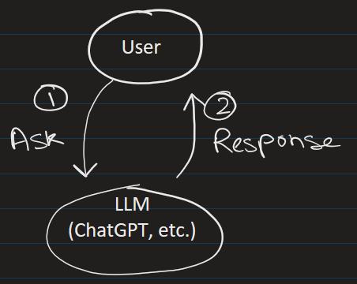
Can ChatGPT or any LLM answer questions about YOUR personal files?
Ans: No!
RAG solves this types of problem.
Personal file

Slide 3
What is RAG?
RAG (Retrieval-Augmented Generation) is a technique in Generative AI where a language model (like GPT) first retrieves relevant information from an external source, and then uses that information to generate a better, more accurate response.
Personal file

Slide 4
Why do we need RAG?
Let’s understand the problem first.
❌ Problem with Normal LLMs
Large Language Models (LLMs):
Are trained on fixed data (training data)
Do not know recent updates
Can sometimes hallucinate (make up answers)
Example: Ask: "What is my company, Loxford Academy, policy?" A normal LLM will either:
Guess ❌
Give generic answer ❌
Normal Flow: Without RAG

Slide 5
How RAG solves this
RAG connects the model to your own data source:
PDFs
Databases, Websites, Company documents
Personal files

Slide 6
Now flow becomes:
User asks question
Search relevant documents and Extract useful information
Generate answer based on your data source
✔ Result:
Accurate answers
Up-to-date information
Personal files

Slide 7
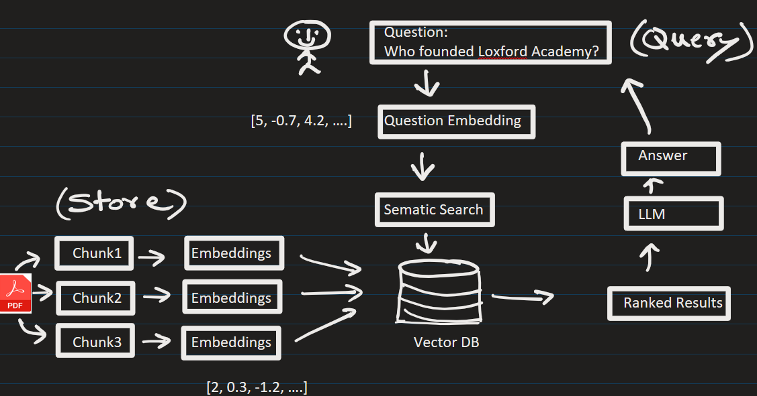




RAG Architecture/Process
Phase A (Populate The Vector DB)
1. Data Collection
Collect documents
(PDFs, text, etc.)
2. Chunking
Break data into small pieces
(chunks)
3. Embeddings
Convert text into vectors using models
4. Storage
Store vectors in a database called Vector DB (e.g., Pinecone, FAISS, etc.)

Slide 8



Phase B ( User Query )
Example of Query:
Who founded Loxford Academy ?
Ranked Results From VectorDB (Similar data):
1) Founder of Loxford Academy are living in Moscow
2) Ms. Lomax and Mr. Thomas founded Loxford Academy in 2018
3) One of the founders of Loxford Academy went to MIT.
1. Retrieval
When user asks a question (query):
Convert query into vector
Find similar data from Vector DB (AKA context)

Slide 9





Phase B ( User Query )
PROMPT:
Answer ONLY from the context.
Context:
{context_from_VectorDB}
Question:
{user_query}
2. Generation
Pass (retrieved data + question + prompt) to LLM
LLM generates final answer and sends it to user

Slide 10





Phase B ( User Query )
Prompt passed to LLM:
PROMPT:
Answer ONLY from the context.
Context:
1) Founders of Loxford Academy are living in Moscow
2) Ms. Lomax and Mr. Thomas founded Loxford Academy in 2018
3) One of the founders of Loxford Academy went to MIT.
Question:
Who founded Loxford Academy ?
LLM responds: Ms. Lomax and Mr. Thomas founded this academy. They both live in Moscow

Slide 11
🔹 Key Benefits
✔ Reduces hallucination ✔ Keeps answers updated ✔ Works with private data

Slide 12
Where is RAG Used?
Chatbots for companies
Customer support systems
Legal document search
Medical record assistants
Internal knowledge assistants

Slide 13
EXTRA
xxxxxxxxxxxxxx

