Slide 1
Claude Code

Slide 2
1) Create a new folder: web_app_demo
You are web app developer. Make an image compression web app (like TinyPNG) that works completely in the browser without any external APIs.
It should:
Have a drag-and-drop interface to upload images
Show before and after file sizes for each image
Allow users to download compressed images
Support common formats: JPG only
Use your AskUserQuestion tool to clarify any details about the features.

Slide 3
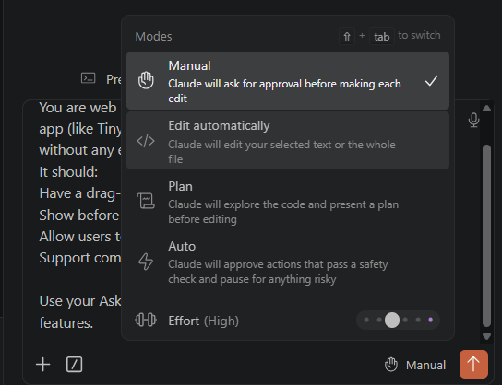


Copy and paste the prompt
Click on Manual -> Plan mode

Slide 4
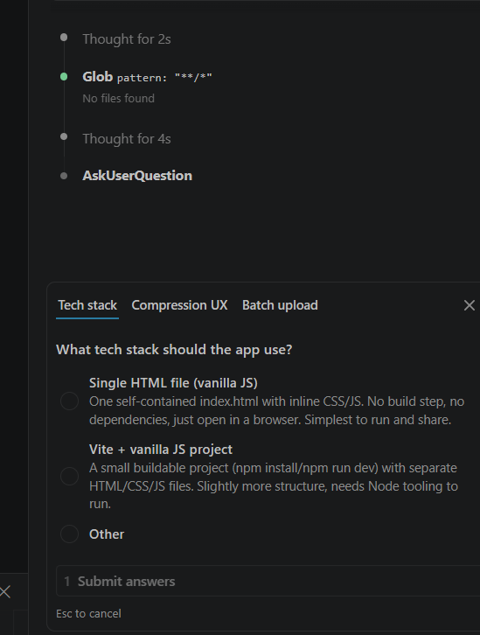
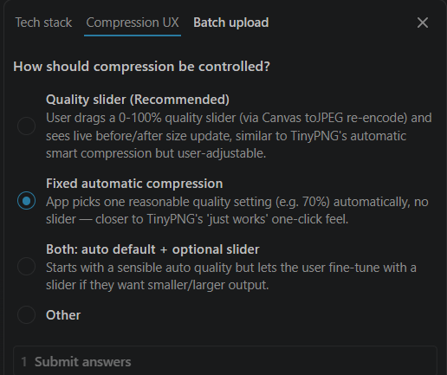





Slide 5
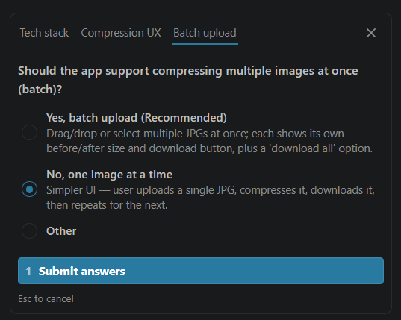


Slide 6
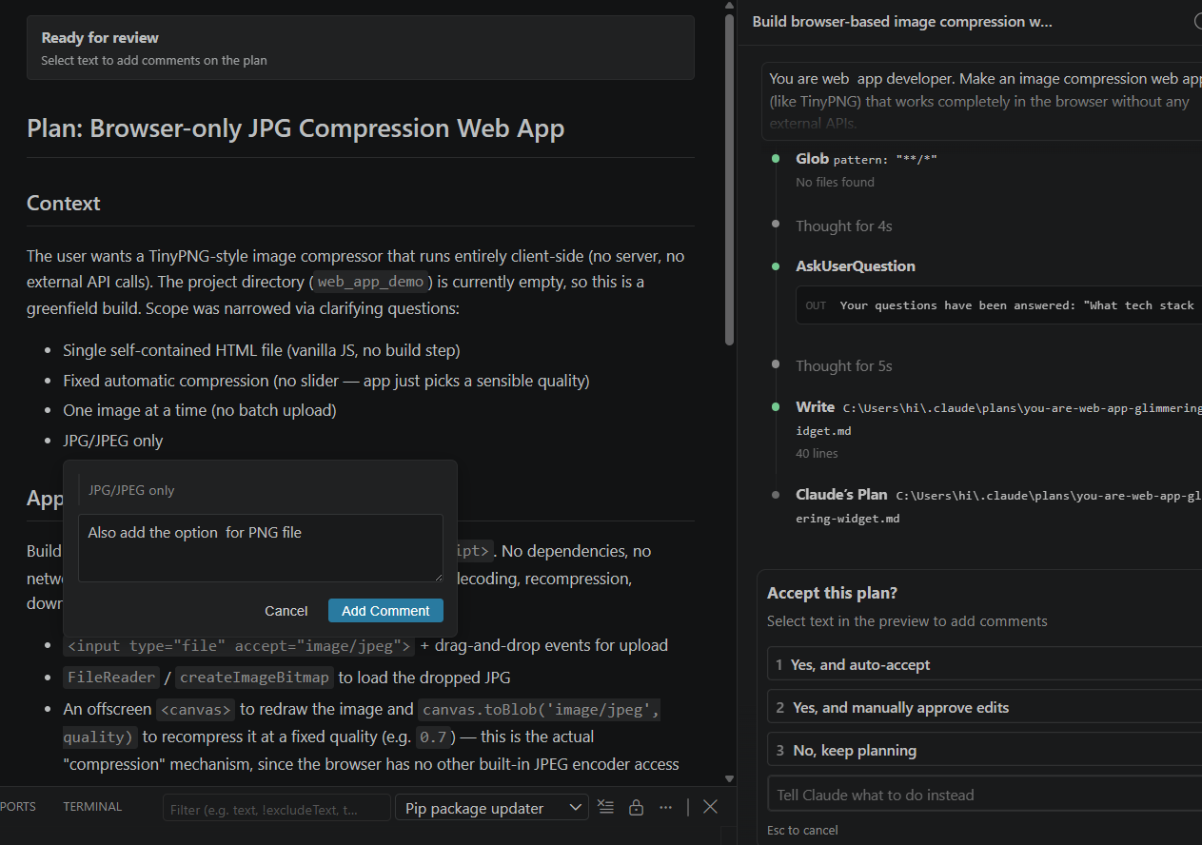
Now it will ask you if you accept -> Scroll up and check if you are satisfied
Add -> Also add the option for PNG file

Slide 7
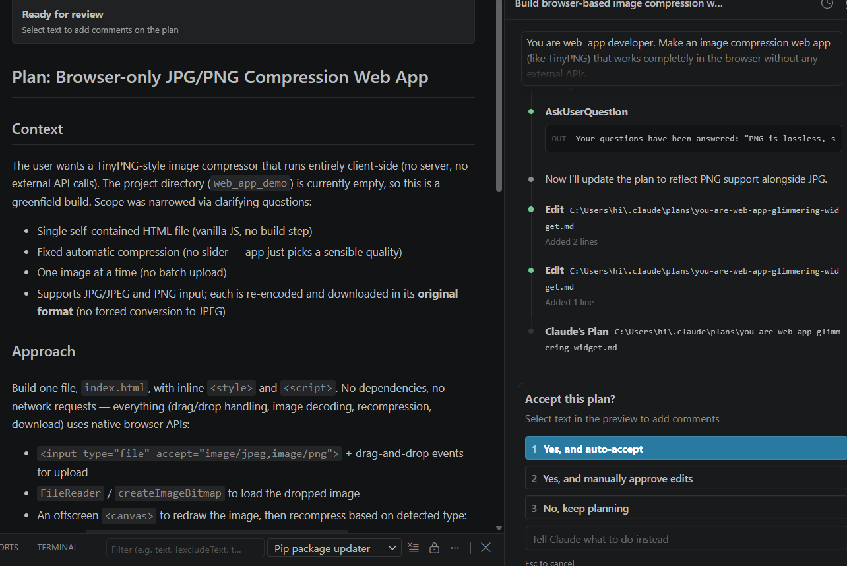



Yes and auto accept

Slide 8
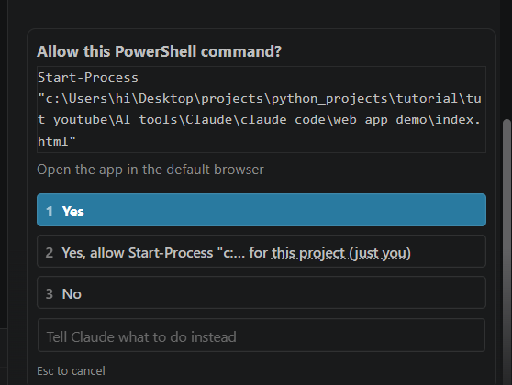



Slide 9
