Slide 1
Claude Code

Slide 2
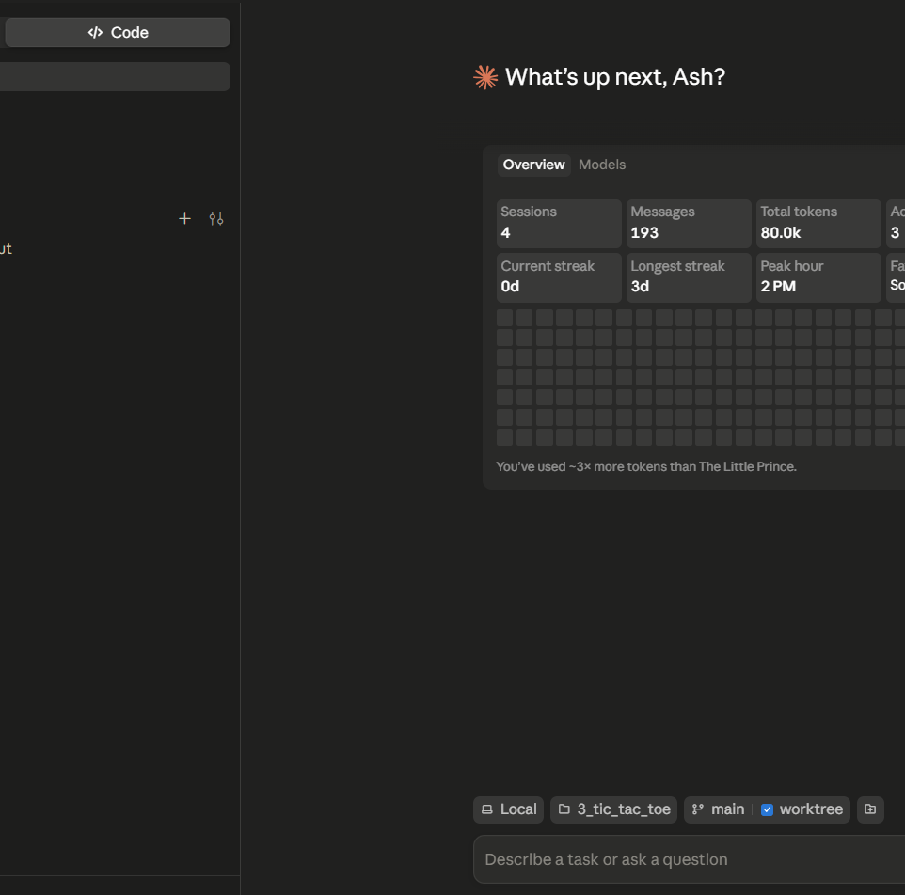




Slide 3
Use following Prompt:
Create a playable browser game that combines a 3x3 Rubik's Cube with Tic Tac Toe. The cube should look like a Rubik's Cube with a black body, but all white stickers. The cube must be fully rotatable by dragging so the player can inspect all sides.
Rules:
Player 1 uses X
Player 2 uses O
On each turn, the active player first places their mark on any empty sticker on the cube. After placing their mark, that player must make exactly one standard move of the cube.
Players continue alternating turns.
A player wins by making 3 of their marks in a row on a single 3x3 face.
Victory is checked only after the rotation is completed, not immediately after placing the mark.

Slide 4
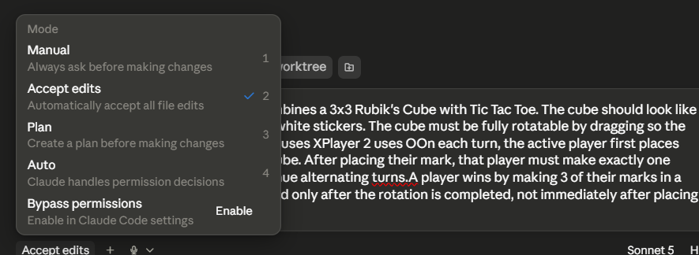

After prompt -> goto Plan mode

Slide 5
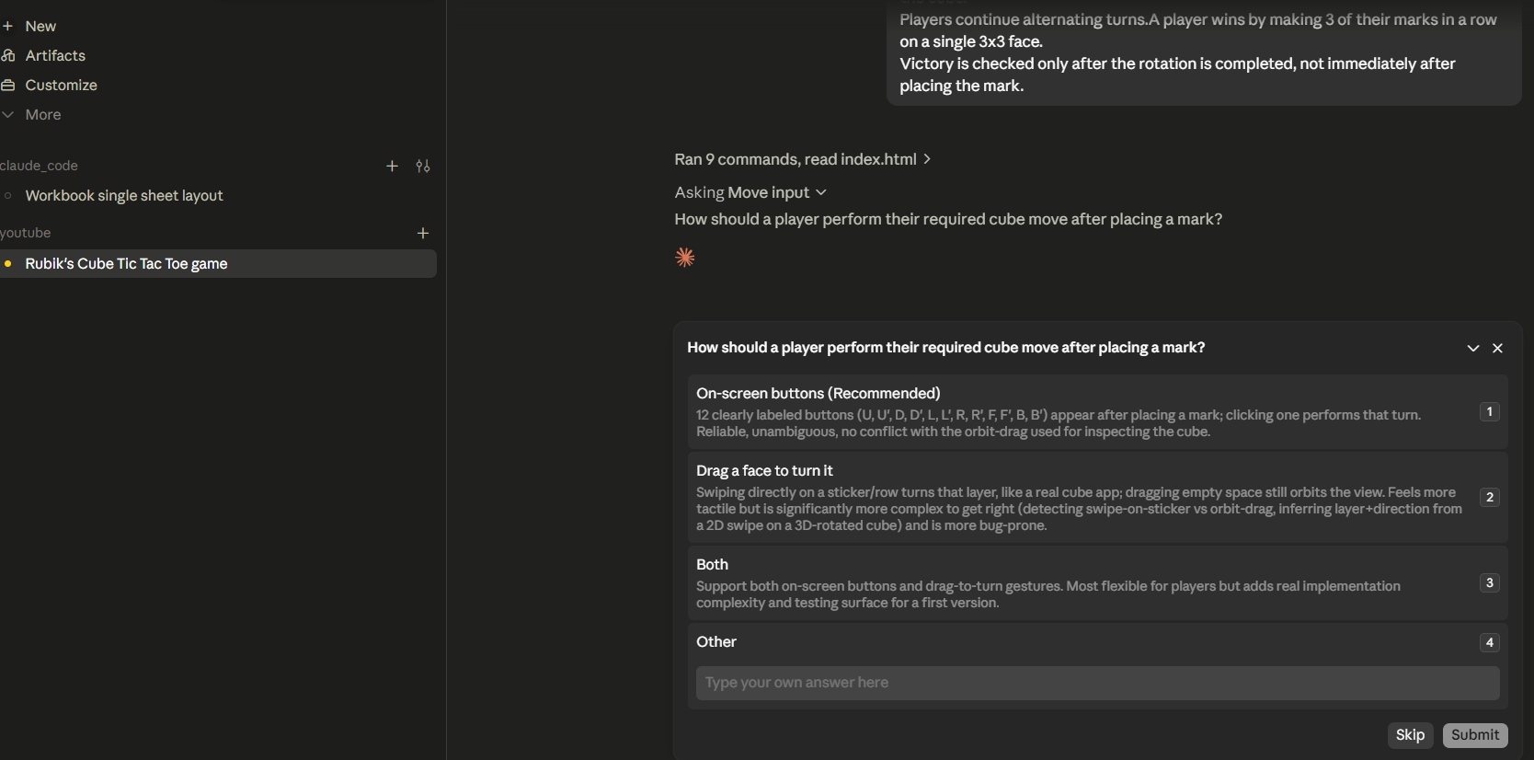
It will ask series of questions – I went with recommended
It may take 5 – 15 minutes for it to build ---- just have patience

Slide 6
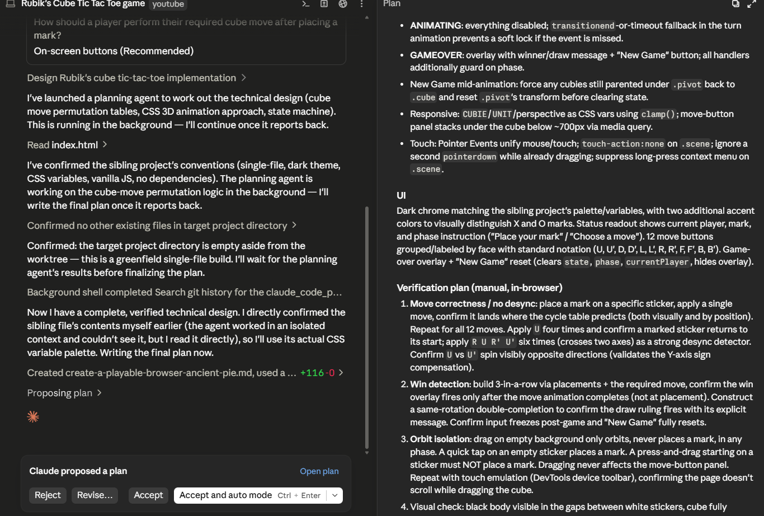
After 15 minutes, received following --- Accept and auto mode

