Slide 1
Some Real-World Application

Slide 2
3 Simple rules of good generic prompt:
INSTRUCTIONS: Define the task and action you want AI to take
CONTEXT: Setting the stage with your role, objectives, background, anything AI should know that's relevant to your task
CONSTRAINTS: Specify any rules, style, tone, length, output format

Slide 3
EXAMPLE of BAD Prompt:
Recommend 5 ways to implement AI in my marketing Agency
Good Prompt:
Instruction:
Recommend 5 ways to implement AI in my business.
Context:
I run a small marketing agency focused on social media and content for local businesses. I want to use AI to save time, improve client deliverables, and increase efficiency across content creation, client communication, reporting, and internal workflows.
Constraints:
Keep recommendations low-cost, easy to implement without technical expertise, and focused on quick wins. No custom-built solutions. Format as a numbered list with a one-sentence explanation for each.

Slide 4
Role: You are a Senior Python Developer and Data Engineer specializing in writing high-performance, production-grade data pipelines. You write clean, memory-efficient code and prioritize error handling.
Task: Write an optimized Python function to calculate the variance of a specific column in a CSV file.
The function must meet the following requirements:
1. Input Parameters: Accept `filename`, `delimiter`, and `column_name`.
2. Functionality: Read the CSV file (default delimiter is a semi-colon ';') and compute the mathematical variance of the specified column (e.g., 'age').
3. Optimization: Optimize for memory efficiency and speed, handling large files
4. Robust Error Handling: Include try-except blocks to gracefully handle:
- File Not Found Error
- Column name does not exist Error
- If the column contains non-numeric data
- Empty files
5. Output: Return the calculated variance as a float.
Include usage example.

Slide 5
[ROLE & CONTEXT]
You are an Executive Research Assistant. Your task is to help a busy CEO quickly digest a long industry report
[TASK & INPUT]
Analyze the attached 3-page document and summarize its core arguments, key findings, and major data points into a single, cohesive paragraph.
[CONSTRAINTS & FORMAT]
Length: The final summary paragraph must be exactly 6 lines long.
Structure: It must be a single, continuous paragraph (no bullet points).
Quality: Avoid generic filler phrases like "This document discusses..." or "In conclusion...". Start directly with the primary thesis.
[INFORMATION PRIORITY]
Focus heavily on the "what" and the "why." Prioritize metrics, financial figures, or statistical trends over general background information or historical context.
[OUTPUT EXPECTATION]
Deliver a high-density, professional, and easily scannable paragraph that captures the absolute essence of the 3 pages.

Slide 6
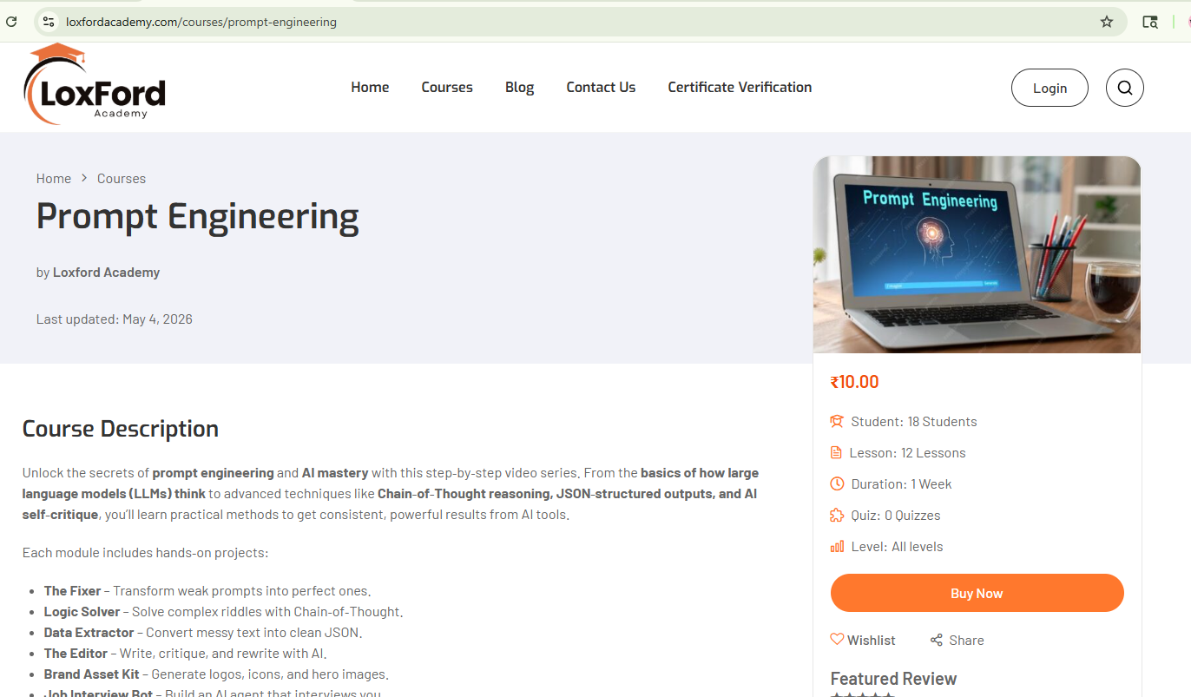
Problem: I want to remove the Student and Quiz part from the RHS menu. I am using wordpress

Slide 7
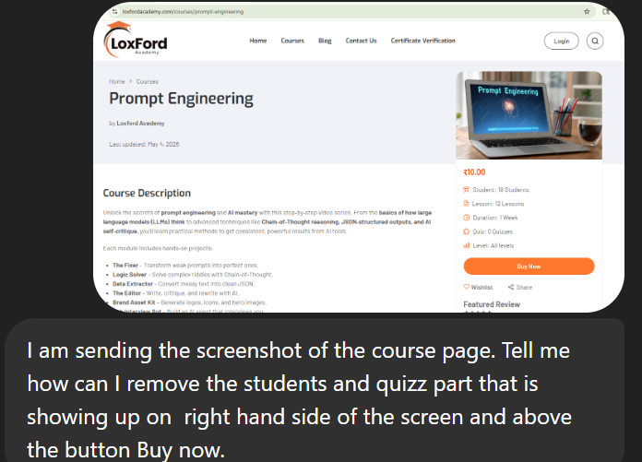

Slide 8
