Slide 1
(On Dev com) CNN

Slide 2
Convolutional Neural Networks (CNNs)
Learning Objective:
Convolutional layers (and ReLU)
Pooling layers, and
Filters (AKA kernels)
Stride
Padding
Flattening
Fully connected layers

Slide 3
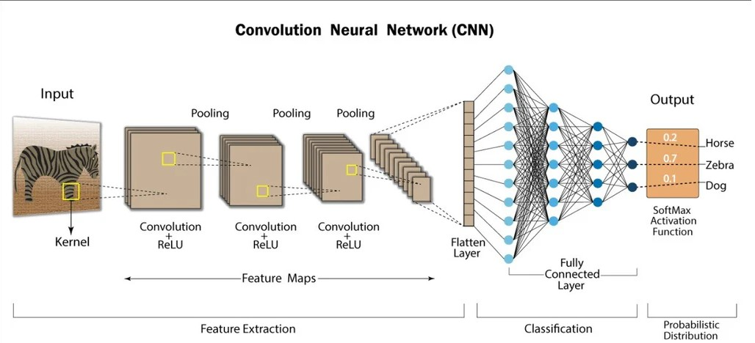
Key Features of Convolutional Neural Networks (CNNs)
CNN has specialized layers like
Convolutional layers (and ReLU)
Pooling layers,
Fully connected layers.

Slide 4
Key Features of Convolutional Neural Networks (CNNs)
Advantages of CNN structure:
Captures spatial hierarchies (local to global features) and is more efficient for image processing than ANN.

Slide 5
Convolution layers
This is the first building block of a CNN. Main mathematical task performed is called convolution, which is the application of a sliding window function to a matrix of pixels representing an image.
The sliding function applied to the matrix is called kernel aka filter aka feature detector. The kernel move over the image.
In the convolution layer, several filters of equal size are applied, and each filter is used to recognize a specific pattern from the image, such as the curving of the digits, the edges, the whole shape of the digits, and more.
The kernels can be square/rectangular matrix

Slide 6
Convolution layers
For example, one filter might be good at
finding straight lines,
another might find curves,
Another could finding edges and so on.
By using several different filters, the CNN can get a good idea of all the different patterns that make up the image.

Slide 7
Convolution layers
Let’s consider the kernel used for the convolution. Say, it is a matrix with a dimension of 3x3. The weights of each element of the kernel is represented in the grid.
Steps in convolution operation:
Apply the kernel matrix from the top-left corner to the right.
Perform element-wise multiplication.
Sum the values of the products.
The resulting value corresponds to the first value (top-left corner) in the convoluted matrix.
Move the kernel down with respect to the size of the sliding window.
Repeat steps 1 to 5 until the image matrix is fully covered.
image
kernel
1 | 2 | 3 | 7
4 | 2 | 0 | 2
9 | 5 | 0 | 8
3 | 7 | 9 | 6
1 | 0 | -1
1 | 0 | -1
1 | 0 | -1
11
1 x 1 + 2 x 0 + 3 x -1 +
4 x 1 + 2 x 0 + 0 x -1 +
9 x 1 + 5 x 0 + 0 x -1
= 11

Slide 8
Input image(4X4)
Kernel(3X3)
1 | 2 | 3 | 7
4 | 2 | 0 | 2
9 | 5 | 0 | 8
3 | 7 | 9 | 6
1 | 0 | -1
1 | 0 | -1
1 | 0 | -1
11
1*1 + 2*0 + 3*-1 +
4*1 + 2*0 + 0*-1 +
9*1 + 5*0 + 0*-1 = 11
1 | 2 | 3 | 7
4 | 2 | 0 | 2
9 | 5 | 0 | 8
3 | 7 | 9 | 6
1 | 0 | -1
1 | 0 | -1
1 | 0 | -1
2*1 + 3*0 + 7*-1 +
2*1 + 0*0 + 2*-1 +
5*1 + 0*0 + 8*-1 = -8
11 | -8
1 | 2 | 3 | 7
4 | 2 | 0 | 2
9 | 5 | 0 | 8
3 | 7 | 9 | 6
1 | 0 | -1
1 | 0 | -1
1 | 0 | -1
11 | -8
?
Assignment for students:
Finish this
1 | 2 | 3 | 7
4 | 2 | 0 | 2
9 | 5 | 0 | 8
3 | 7 | 9 | 6
1 | 0 | -1
1 | 0 | -1
1 | 0 | -1
Assignment for students:
Finish this
11 | -8
? | ?

Slide 9
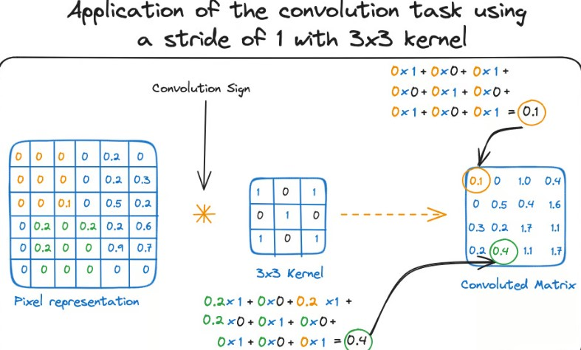
Convolution layers
Stride:
Controls how many steps does kernel move.
E.g1: Stride of 1 makes kernel slide by one row/column at a time
E.g.2: Stride of 2 moves kernel by 2 rows/columns.

Slide 10
Convolution layers
Key points about stride:
A stride of 2 or 3 skips pixels, making the filter jump more, which reduces the output size and speeds up computation.
Effect on output: Larger strides capture broader patterns but reduce detail and output size; smaller strides give more detail but increase computation.

Slide 11
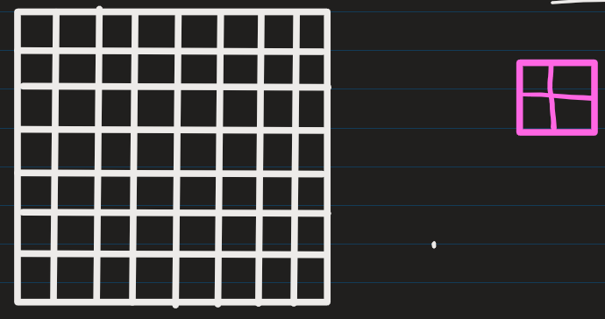
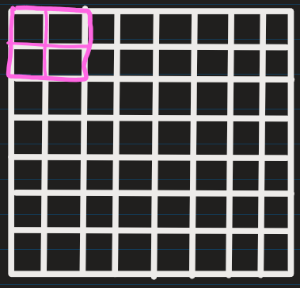
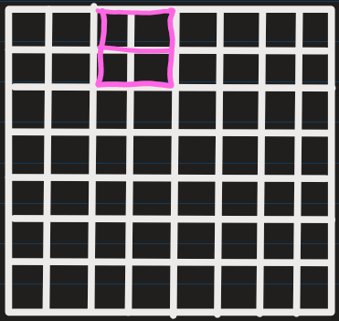
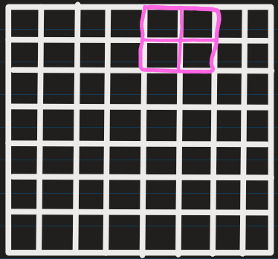
Example: Stride of 2

Slide 12
Convolution layers
Another name for kernel is feature detector because the weights can be fine-tuned to detect specific features in the input image.
For instance:
1) Averaging neighboring pixels kernel can be used to blur the input image.
2) Subtracting neighboring kernel is used to perform edge detection.
Common kernel sizes: 3x3 – most common; 5x5, 7x7 – larger receptive fields

Slide 13
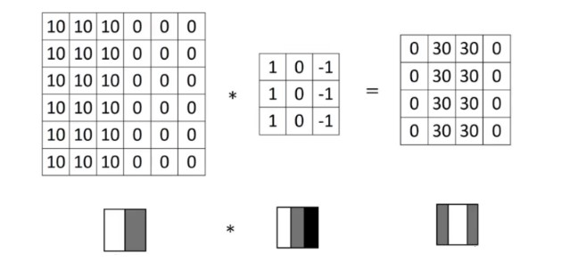
Detecting vertical edges with vertical filter
Value for row=1,col=1 is calculated as =
10*1 + 10*0 + 10*-1 +
10*1 + 10*0 + 10*-1 +
10*1 + 10*0 + 10*-1 = 0
Value for row=1,col=2 is calculated as =
10*1 + 10*0 + 0*-1 +
10*1 + 10*0 + 0*-1 +
10*1 + 10*0 + 0*-1 = 30
How we can detect a vertical edge in an image ?
Higher pixel values represent the brighter portion of the image
Lower pixel values represent the darker portions.

Slide 14


Horizontal filter: Detect horizontal edges
Sobel filter: puts a little bit more weight on the central pixels

Slide 15
There is a straightforward formula that connects the input size n×n and the filter size f×f, resulting in an output size of (n−f+1)×(n−f+1)
Input Image Size: n X n
Output Image Size (n-f+1) X (n-f+1)
Filter Size f X f
Example: Convolving an input image of 6 X 6 dimension with a 3 X 3 filter results in 4 X 4 image.
The dimension of the final convoluted matrix depends on the size of the kernel matrix:
The bigger the sliding window, the smaller the dimension.

Slide 16
Loxford Academy
2 problems when applying convolution:
1. Every time we apply a convolutional operation, the size of the image shrinks
2. Pixels present in the corner of the image are used only a few number of times during convolution as compared to the central pixels.
Hence, we do not focus too much on the corners since that can lead to information loss
Image
Kernel
Output Image
1 | 2 | 3 | 7
4 | 2 | 0 | 2
9 | 5 | 0 | 8
3 | 7 | 9 | 6
1 | 0 | -1
1 | 0 | -1
1 | 0 | -1
11

Slide 17
Loxford Academy
SOLUTION: Apply padding
We pad the image with an additional border, i.e., we add one pixel all around the edges. This means that the original image of size 6x6 will result in 8 X 8 matrix.
Applying convolution of 3 X 3 on 8 X 8 image will result in a 6 X 6 image which is the original shape of the image.
Padding formula:
Input: n X n, Padding: p, Filter size: f X f, → Output size: (n+2p-f+1) X (n+2p-f+1)
0 | 0 | 0 | 0 | 0 | 0 | 0 | 0
0 | 5 | 6 | 56 | 6 | 7 | 8 | 0
0 | 56 | 5 | 56 | 56 | 56 | 56 | 0
0 | 7 | 8 | 76 | 65 | 7 | 88 | 0
0 | 3 | 5 | 45 | 9 | 6 | 0 | 0
0 | 78 | 4 | 5 | 8 | 8 | 5 | 0
0 | 54 | 3 | 1 | 3 | 54 | 6 | 0
0 | 0 | 0 | 0 | 0 | 0 | 0 | 0
5 | 6 | 56 | 6 | 7 | 8
56 | 5 | 56 | 56 | 56 | 56
7 | 8 | 76 | 65 | 7 | 88
3 | 5 | 45 | 9 | 6 | 0
78 | 4 | 5 | 8 | 8 | 5
54 | 3 | 1 | 3 | 54 | 6
Before padding
After padding of 1

Slide 18
Loxford Academy
Common choices for padding:
Valid Padding :
It means no padding. If we are using valid padding, the output will be (n-f+1) X (n-f+1)
5 | 6 | 56 | 6 | 7 | 8
56 | 5 | 56 | 56 | 56 | 56
7 | 8 | 76 | 65 | 7 | 88
3 | 5 | 45 | 9 | 6 | 0
78 | 4 | 5 | 8 | 8 | 5
54 | 3 | 1 | 3 | 54 | 6
5 | 6 | 56 | 6 | 7 | 8
56 | 5 | 56 | 56 | 56 | 56
7 | 8 | 76 | 65 | 7 | 88
3 | 5 | 45 | 9 | 6 | 0
78 | 4 | 5 | 8 | 8 | 5
54 | 3 | 1 | 3 | 54 | 6
Before padding
After No padding

Slide 19
Loxford Academy
Common choices for padding:
2. Same Padding :
Here, we apply padding in such a manner so that the output size is the same as the input size. Solve -> n+2p-f+1 = n. -> We get, p = (f-1)/2.
By using this p padding, we don’t lose a lot of information and the image does not shrink either.
Example: If we have an image of 6X6, and a filter of size 4X4, then we would apply 2 padding
0 | 0 | 0 | 0 | 0 | 0 | 0 | 0 | 0 | 0
0 | 0 | 0 | 0 | 0 | 0 | 0 | 0 | 0 | 0
0 | 0 | 5 | 6 | 56 | 6 | 7 | 8 | 0 | 0
0 | 0 | 56 | 5 | 56 | 56 | 56 | 56 | 0 | 0
0 | 0 | 7 | 8 | 76 | 65 | 7 | 88 | 0 | 0
0 | 0 | 3 | 5 | 45 | 9 | 6 | 0 | 0 | 0
0 | 0 | 78 | 4 | 5 | 8 | 8 | 5 | 0 | 0
0 | 0 | 54 | 3 | 1 | 3 | 54 | 6 | 0 | 0
0 | 0 | 0 | 0 | 0 | 0 | 0 | 0 | 0 | 0
0 | 0 | 0 | 0 | 0 | 0 | 0 | 0 | 0 | 0
5 | 6 | 56 | 6 | 7 | 8
56 | 5 | 56 | 56 | 56 | 56
7 | 8 | 76 | 65 | 7 | 88
3 | 5 | 45 | 9 | 6 | 0
78 | 4 | 5 | 8 | 8 | 5
54 | 3 | 1 | 3 | 54 | 6
Before padding
After padding of 2

Slide 20
Loxford Academy
Common choices for padding:
3. Causal Padding:
This type of padding is used in sequence-to-sequence models and time series forecasting and basically works with the one-dimensional convolutional layers. Causal padding adds elements to the start of the data, which also aids in forecasting the values of early time steps.
(3, 4, 2, 9) -> (0, 0, 0, 0, 3, 4, 2, 9)
(3, 4, 2, 9, 2, 1) -> ( 0, 0, 3, 4, 2, 9, 2, 1)
(5) -> (0, 0, 0, 0, 0, 0, 0, 5)

Slide 21
Some key points about convolution layers:
The more convolution layers the network has, the better the layer is at detecting more abstract features.
Output of kernel operation obtained is of lower dimensions and therefore less computation going forward.

Slide 22
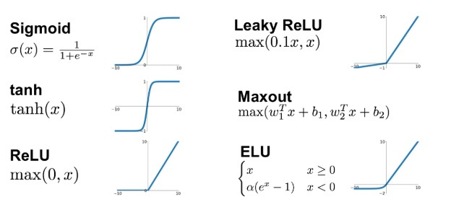
Activation function
A ReLU activation function is applied after each convolution operation.
It helps network learn non-linear relationships between the features in the image
Makes NN more robust for identifying different patterns.
It also helps to mitigate the vanishing gradient problems.

Slide 23
Example of ReLU on an image
ReLU
-56 | -56 | 2 | 56
76 | -65 | 7 | -88
45 | 9 | 6 | 0
5 | -8 | -8 | 5
1 | 3 | 54 | 6
0 | 0 | 2 | 56
76 | 0 | 7 | 0
45 | 9 | 6 | 0
5 | 0 | 0 | 5
1 | 3 | 54 | 6

Slide 24
Pooling layer
The goal of the pooling layer is to pull the most significant features from the convoluted matrix. This is done by applying some aggregation operations, which reduce the dimension of the feature map (convoluted matrix), hence reducing the memory used while training the network.
Pooling is also relevant for mitigating overfitting.
The 2 most common aggregation functions that can be applied are:
Max pooling
Average pooling

Slide 25
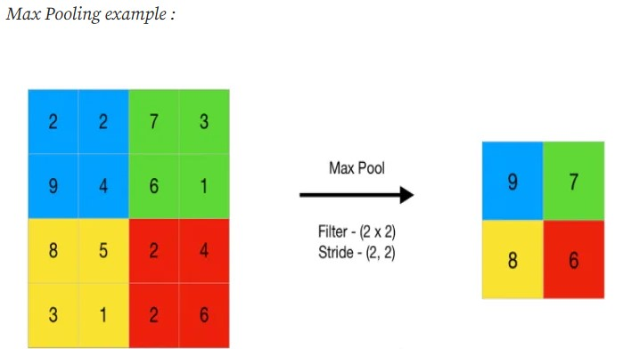
Max pooling
This gives the maximum value of the feature map
This removes any unnecessary features: When you take the highest values from that block of matrix while applying max pool, it accounts for only important features in the output

Slide 26
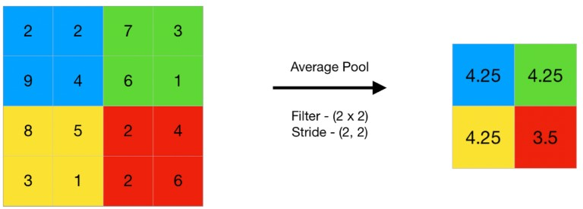
Average pooling
It computes the average of the elements present in the region of feature map covered by the filter.
Average pooling provides a more generalized representation of the input.
It is useful in the cases where preserving the overall context is important

Slide 27
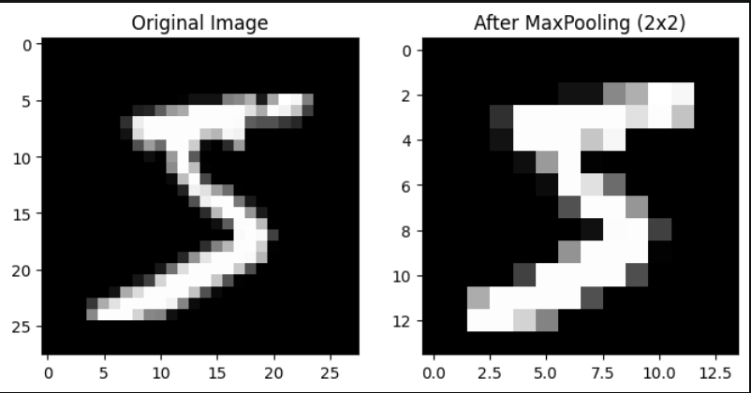
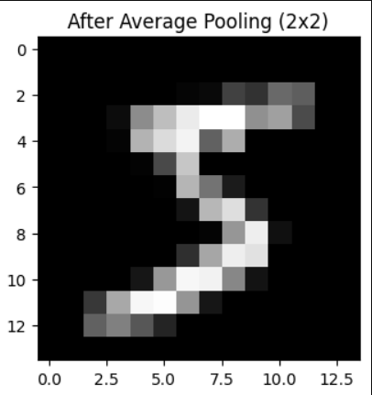
Pooling on 28 X 28 pixel image from MNIST
Advantage of Pooling:
1. Size Reduction: 28×28 → 14×14
2. Computation Reduction: Fewer pixels → faster training
3. Feature Retention: Important structures still visible

Slide 28
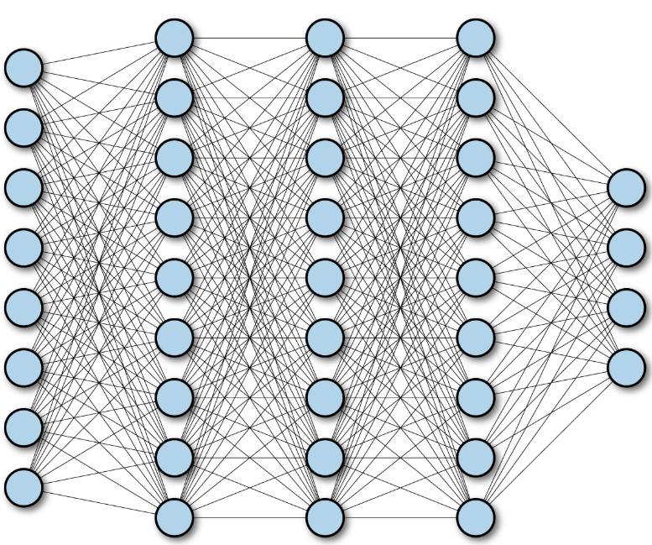
Fully connected layers
A fully connected layer, aka dense layer, in a convolutional neural network (CNN) connects every input node to every output node.
These layers are in the last layer of the convolutional neural network, and their inputs correspond to the flattened one-dimensional matrix generated by the last pooling layer. ReLU activations functions are applied to them for non-linearity.
Finally, a softmax prediction layer is used to generate probability values for each of the possible output labels. The final label predicted is the one with the highest probability score.

Slide 29
Flatten
Flattening is used to convert all the resultant 2-Dimensional arrays from pooled feature maps into a 1D array.
The flattened matrix is fed as input to the fully connected layer to classify the image.
5 | 2 | 6
6 | 7 | 8
9 | 6 | 0
5 | 2 | 6 | 6 | 7 | 8 | 9 | 6 | 0
After flattening
1D array of size 9
2D matrix of size 3X3

Slide 30
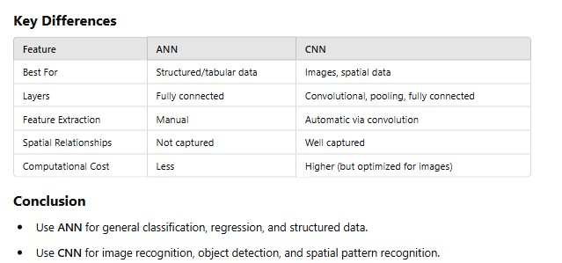
Difference between ANN and CNN

Slide 31
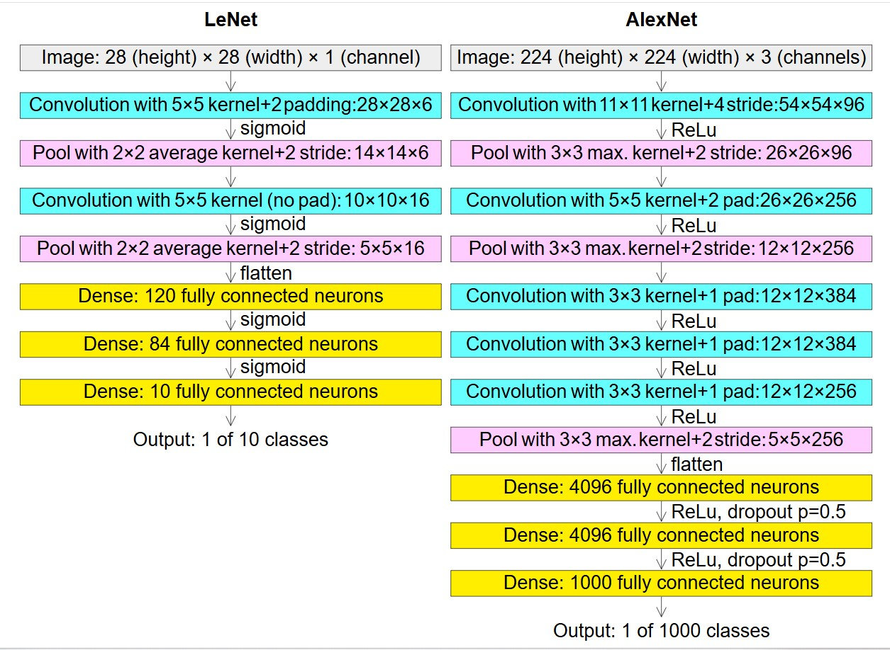
Examples of CNN
Source: wikipedia

Slide 33
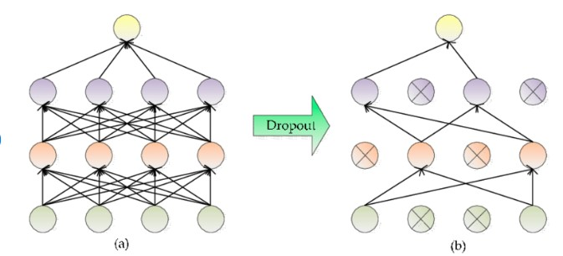
Drop Out (Core Idea):
During training, a fraction of neurons are randomly deactivated
Each training step uses a slightly different network
During testing, all neurons are used
Example : Dropout = 0.5 → 50% neurons turned off randomly
Advantage: Prevents overfitting in neural networks, especially in complex architectures.

Slide 34
Few facts about CNN(p1)
Feedforward networks (MLPs, CNNs) process inputs all at once — they don't depend on previous steps.
Suppose you have 1000 words or pixels.
A feedforward network takes all 1000 together, passes them through layers at the same time (matrix multiplication).
In math terms: matrix × vector — super fast because modern hardware (like GPUs) is built for parallel matrix operations.
No waiting for "previous word" or "previous pixel" — everything is independent at each layer.
This is called parallelism.

Slide 35
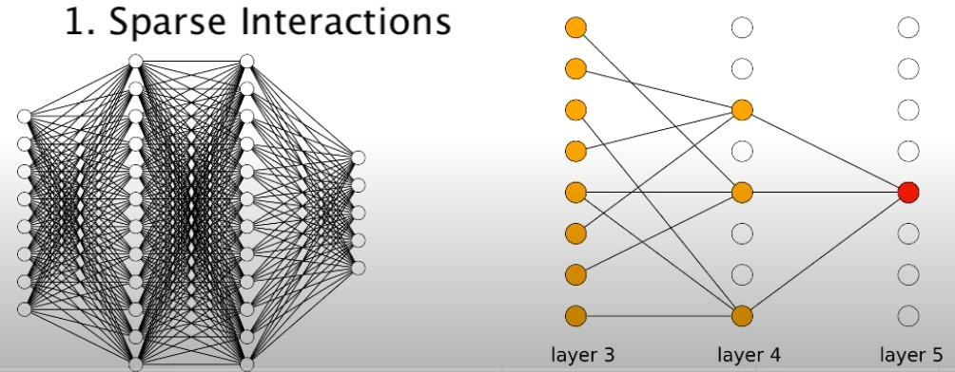
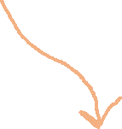
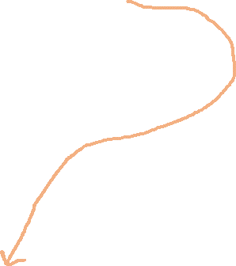
Few facts about CNN(p2)
CNN has sparse interactions
In a fully connected layer, every output neuron is connected to every input neuron — this results in dense interactions.
In contrast, in CNNs:
Each convolutional filter (or kernel) only interacts with a small local region of the input (called the receptive field).
This means a single output value is computed based only on a subset of the input values.
Therefore, not all input features contribute to every output, resulting in sparse connectivity or sparse interactions.
Benefits of Sparse Interactions:
Reduced computational cost
Parameter efficiency

Slide 36
LeNet
LeNet and LeNet-5 are often used interchangeably, but LeNet refers to a family of early Convolutional Neural Networks (CNNs), while LeNet-5 is a specific architecture developed by Yann LeCun in 1989 for handwritten digit recognition.
LeNet-5 is outdated today, replaced by modern CNNs like VGG, and ResNet.
Application of LeNet
Document Processing: LeNet’s model are used in scanning and analyzing documents, parsing and processing different types of information, extracting data from documents, and automating data entry tasks.
Handwriting Recognition: LeNet’s success in recognizing handwritten characters and digits remains fundamental in Optical Character Recognition (OCR) systems used in processing handwritten text
Biometric Authentication: Handwriting recognition capabilities of LeNet have been applied to signature and fingerprint analysis, enabling biometric authentication methods and enhancing security systems.
Real-time Video Analysis: The foundational concepts in LeNet serve as a basis for real-time video analysis, such as object tracking, surveillance systems, facial recognition, and autonomous vehicles.
Image Classification: LeNet’s principles influence modern image classification systems. Applications include classifying and categorizing objects in images for numerous domains, such as identifying objects in photographs, quality control in manufacturing, medical imaging analysis, and security systems for object identification.

Slide 37
EXTRA
Xxxxxxxxxxx
xxxxxxxxxxxx

