Slide 1
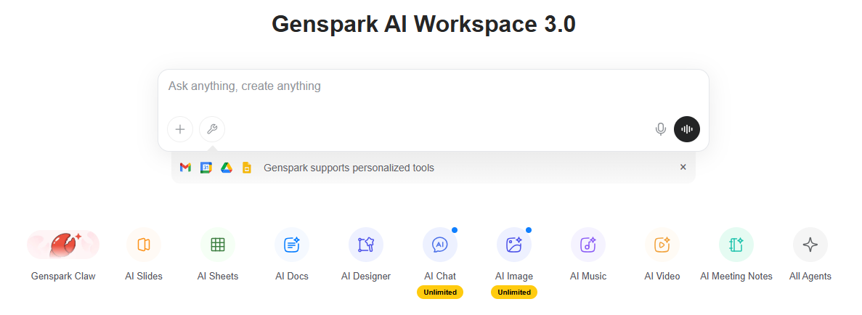
step1

Slide 2
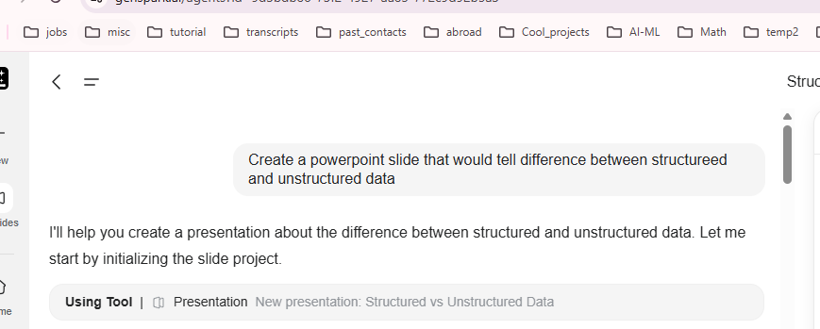
step2

Slide 3
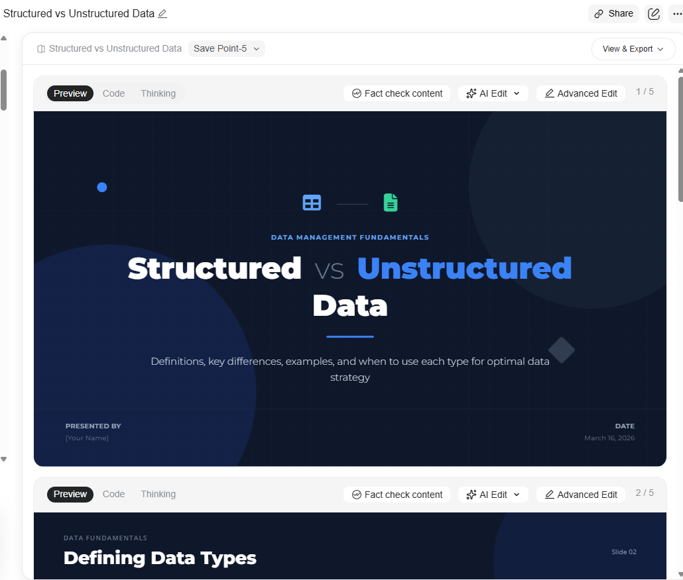
Output:
Slides have html code.
You can copy and paste them

