Slide 1
API Application Programming Interface How To Create An API Endpoint On Local Machine And Access The Endpoint

Slide 2
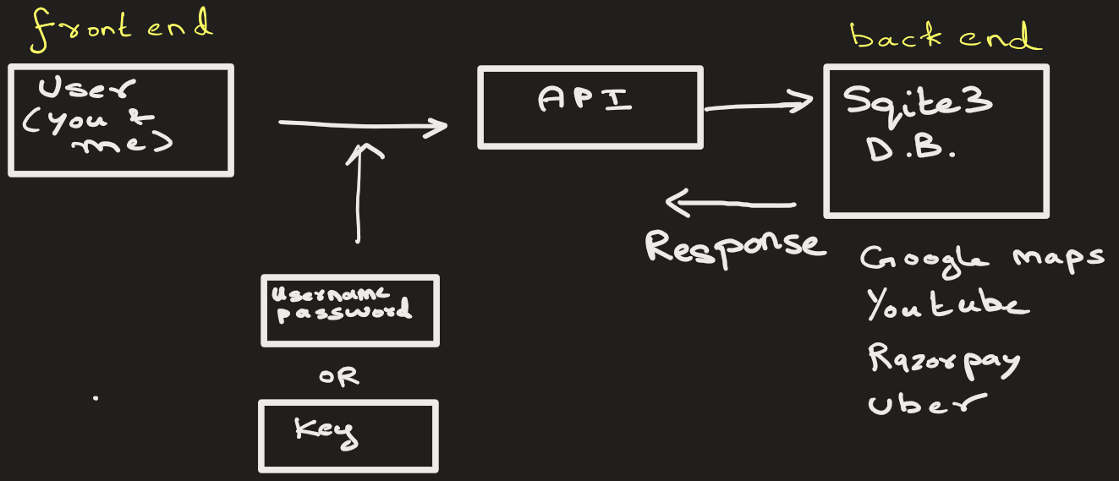
Workflow:
Client(User) → API Endpoint → SQLite DB → Response back to client

Slide 3
1. Install required packages:
python –m pip install fastapi uvicorn
(SQLite is built into Python — no install needed)

Slide 4
2. Simple Use Case
We will build:
An API that stores users
2 endpoints to:
Add a user
Get user by ID
Database: SQLite (users.db)

Slide 5
3. Complete FastAPI Code (single file)
Save as: main.py

Slide 6
4. Run the API Server
In terminal (same folder as main.py):
python –m uvicorn main:app --reload
You’ll see server running at http://127.0.0.1:8000

Slide 7
5. Test Using Browser (Swagger UI)
Open: http://127.0.0.1:8000/docs
This is an auto-generated UI to connect to API.
Add User
Request: POST /add-user Parameters:
name = Ash
email = ash@gmail.com
What happens internally: User → FastAPI → SQLite INSERT
→ Response JSON

Slide 8
Response:
{
"status": "success",
"name": "Ash",
"email": "ash@gmail.com"
}

Slide 9
5. Test Using Browser (Swagger UI)
Open: http://127.0.0.1:8000/docs
This is an auto-generated UI to connect to API.
Get User
Request: GET /get-user/1
Flow: User → API → SQLite SELECT
→ JSON response

Slide 10
6. (ALTERNATIVE) Run client.py
Open command prompt and install requests:
python –m pip install requests
Run client: python -m client
This sends
POST request to add a user
GET request to retrieve a user by id

