Slide 1
AWS Lambda

Slide 2
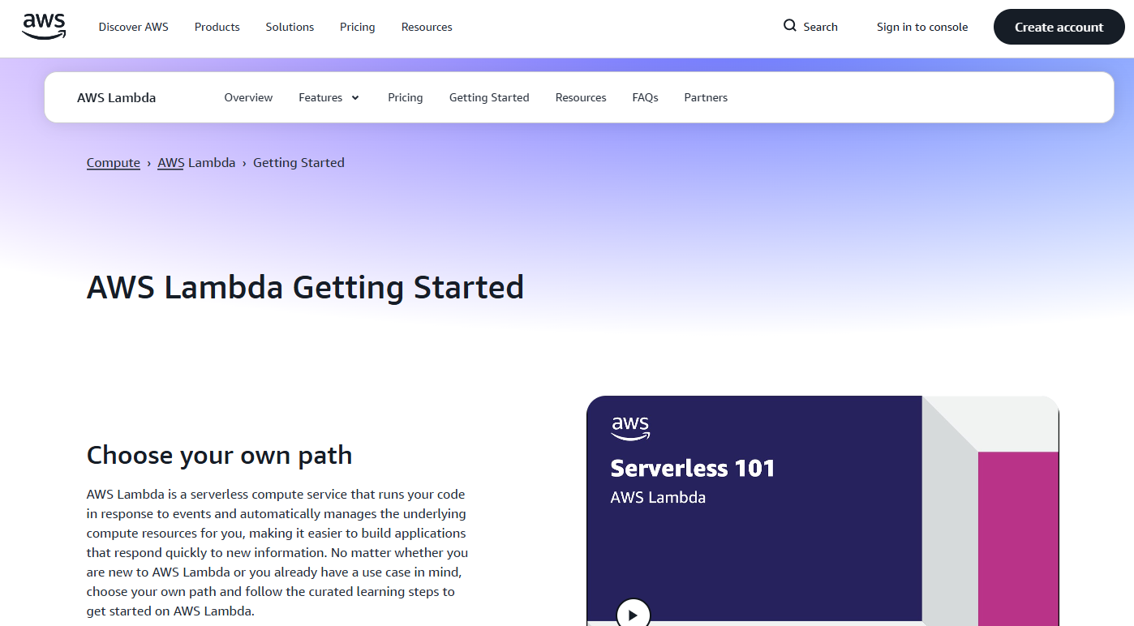
AWS Lambda:
AWS Lambda is a secure on-demand event-driven compute service that scales as needed and billed only for what is used

Slide 3
AWS Lambda:
You do NOT manage servers. You only upload code, and AWS runs it when needed.
Key Idea
Event → Lambda Function → Response
Examples of events:
HTTP request
File uploaded to S3
Database update
Scheduled job
So, Lambda is event-driven computing.

Slide 4
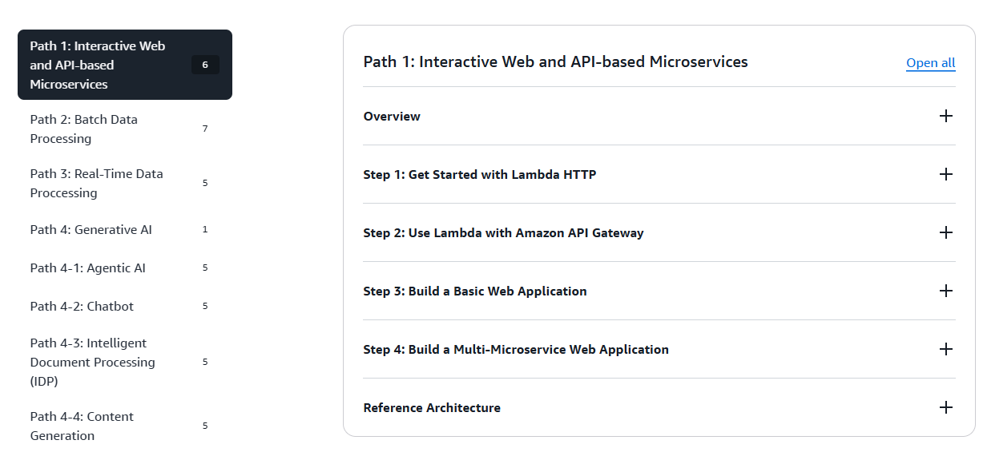
AWS Lambda

Slide 5
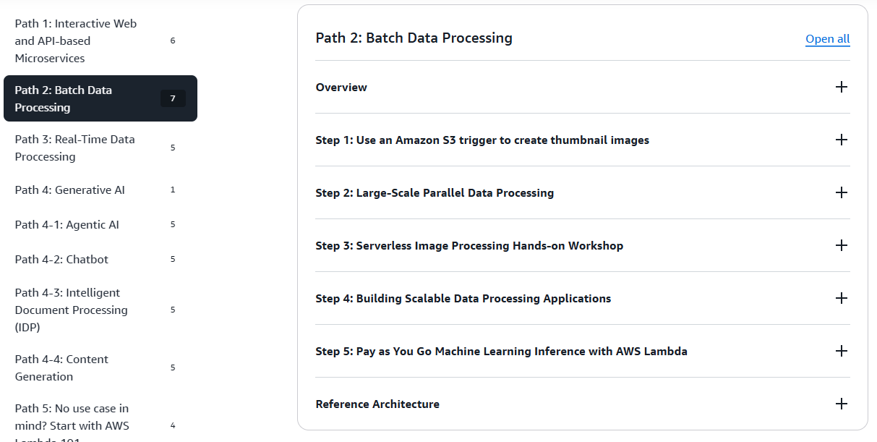
AWS Lambda

Slide 6
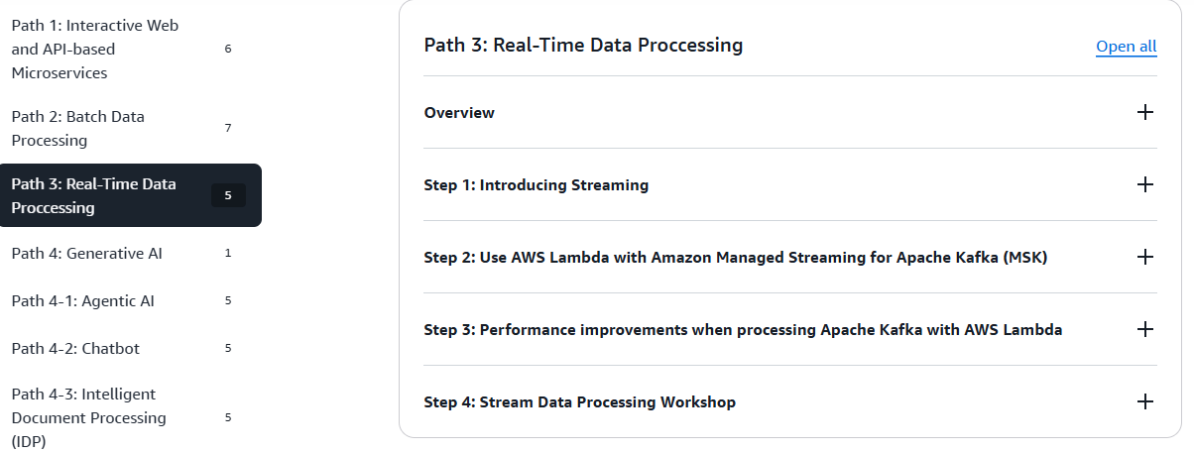
AWS Lambda

Slide 7
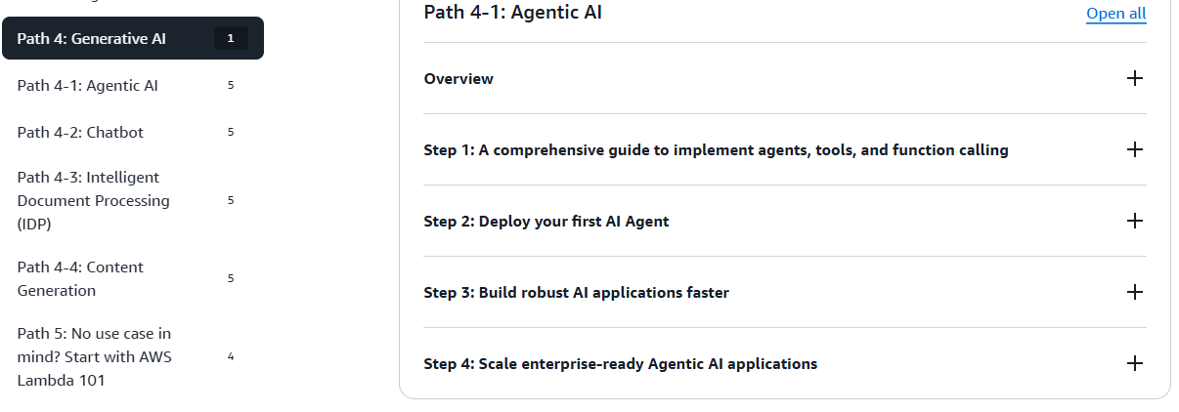
AWS Lambda

Slide 8
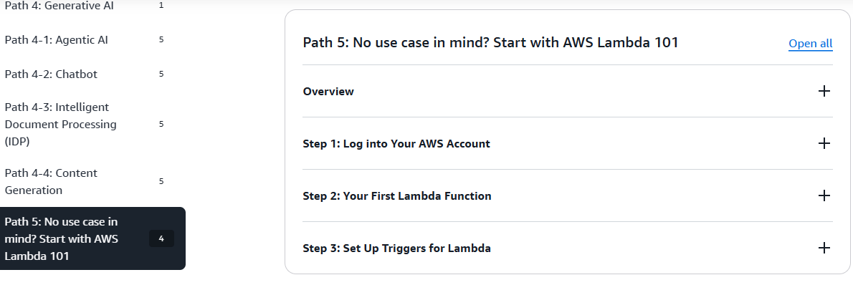
AWS Lambda

Slide 9
Heading Goes Here
Fhdsklf
Fjdsklf
Fjskldf

