Slide 1
AWS Lambda:
HTTP API Gateway

Slide 2
AWS Lambda
We’ll build a Serverless AI API using:
AWS Lambda → runs Python code
Amazon API Gateway → exposes HTTP endpoint
Test using
Python → simple AI logic (text processing)
POSTMAN
Online Tools

Slide 3
Demo Goal
We will call an API like: https://your-api-url/analyze
Input: { "text": "I love learning API. I like AWS Lambda because it is easy.“ }
Output: { "result": "Positive Sentiment“ }

Slide 4
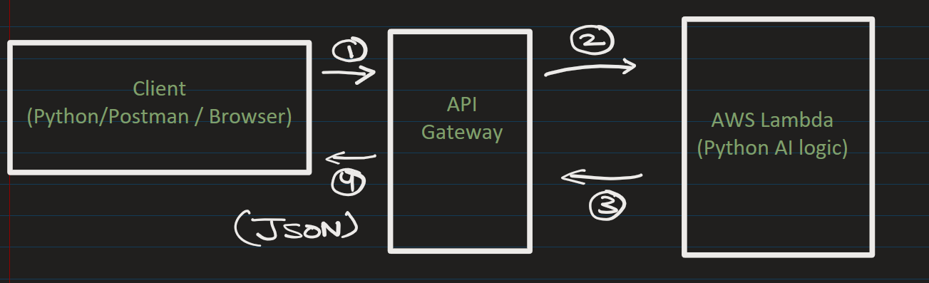
We’ll use a simple rule-based AI sentiment analyzer
(You can later replace it with real ML or OpenAI API)
Architecture

Slide 5
Create Lambda Function

Slide 6
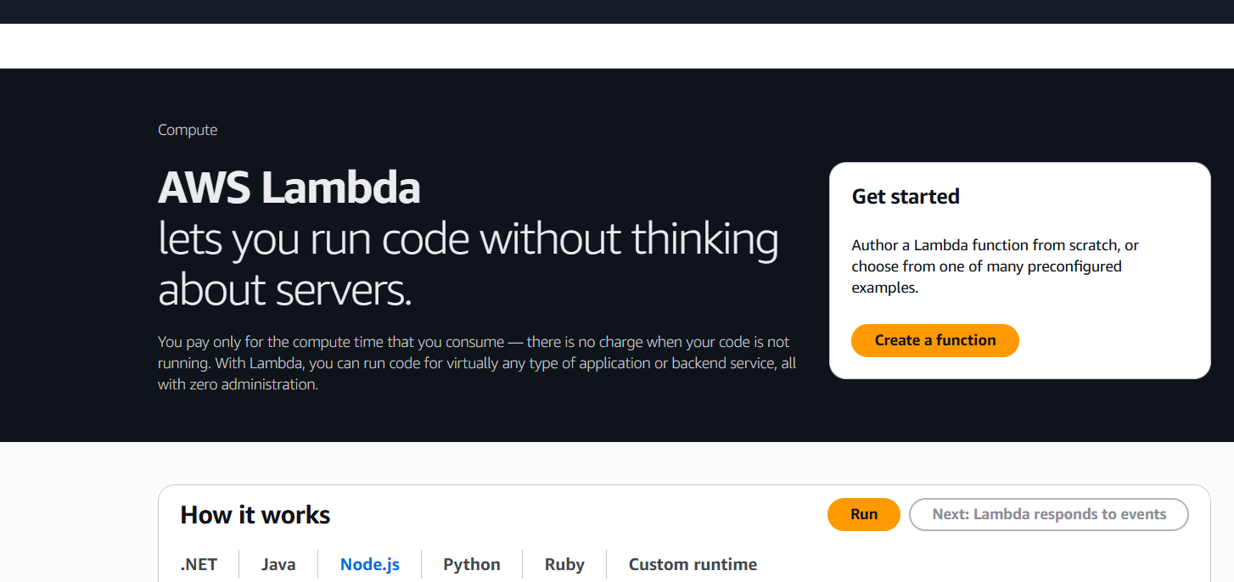

Step 1: Create Lambda Function
Go to AWS → Search Lambda
Click: Create Function
→ Author from Scratch
Fill:
Function name: ai-sentiment-api
Runtime: Python 3.x
Click Create

Slide 7
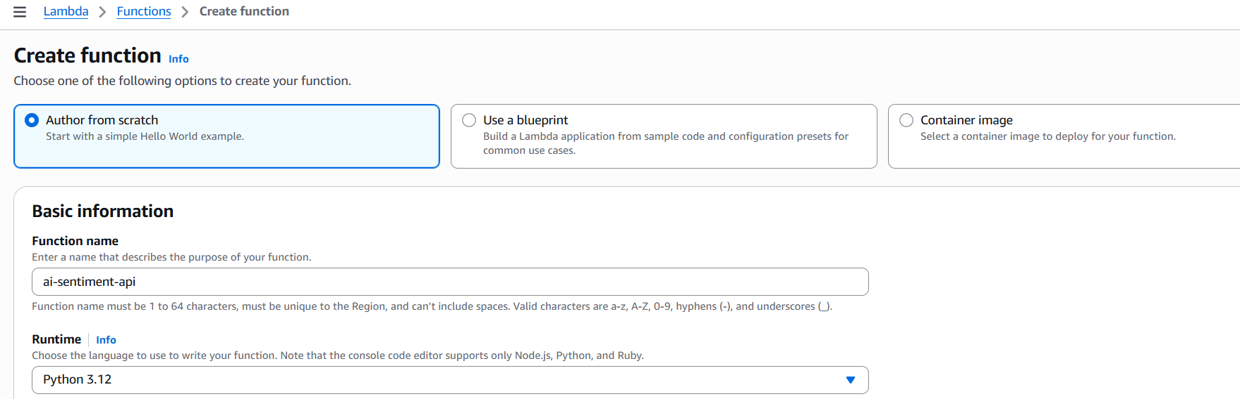



Step 1: Create Lambda Function
Go to AWS → Search Lambda
Click: Create Function
→ Author from Scratch
Fill:
Function name: ai-sentiment-api
Runtime: Python 3.x
Architecture: x86_64
Click Create

Slide 8
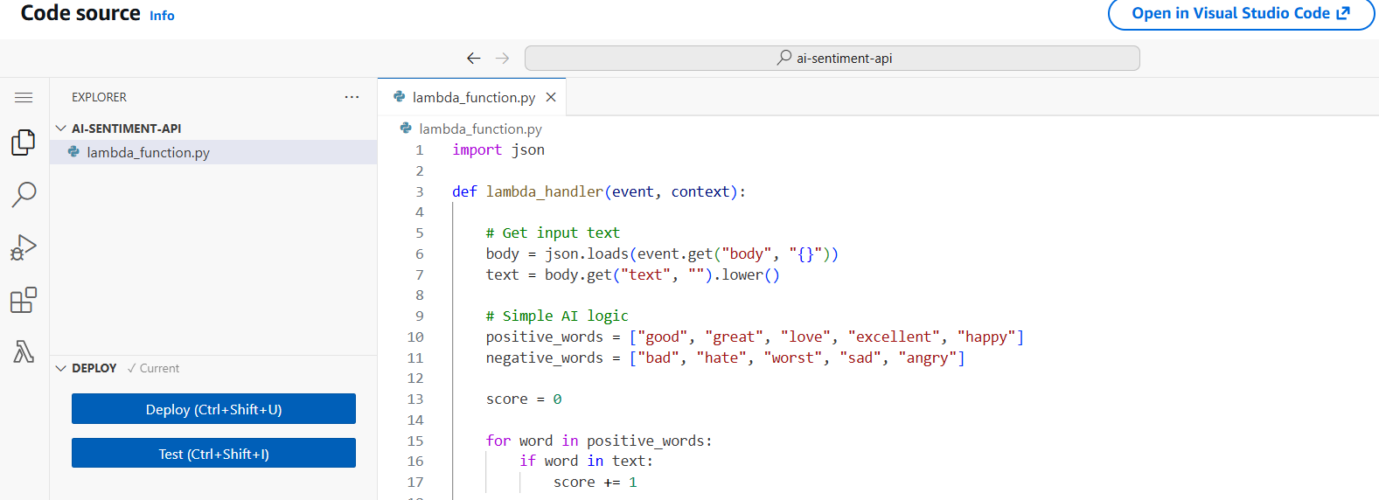

Step 2: Add AI Code
Replace with this: …. And click Deploy

Slide 9
import json
def lambda_handler(event, context):
# Get input text
body = json.loads(event.get("body", "{}"))
text = body.get("text", "").lower()
# Simple AI logic
positive_words = ["good", "great", "love", "excellent", "happy"]
negative_words = ["bad", "hate", "worst", "sad", "angry"]
score = 0
for word in positive_words:
if word in text:
score += 1
for word in negative_words:
if word in text:
score -= 1
if score > 0:
result = "Positive Sentiment "
elif score < 0:
result = "Negative Sentiment "
else:
result = "Neutral Sentiment "
return {
"statusCode": 200,
"headers": { "Content-Type": "application/json" },
"body": json.dumps({ "input": text, "result": result })
}

Slide 10
Create API Gateway

Slide 11
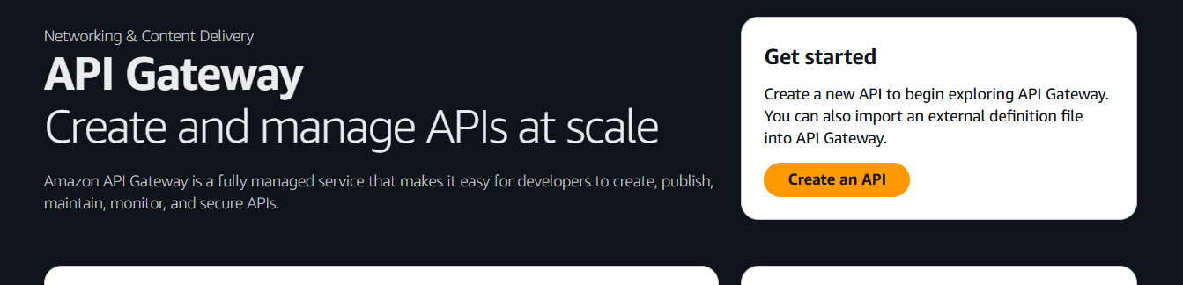
Step 3: Create API Gateway
Go to AWS → Search API Gateway
Choose HTTP API (simpler & faster) and click Build

Slide 12
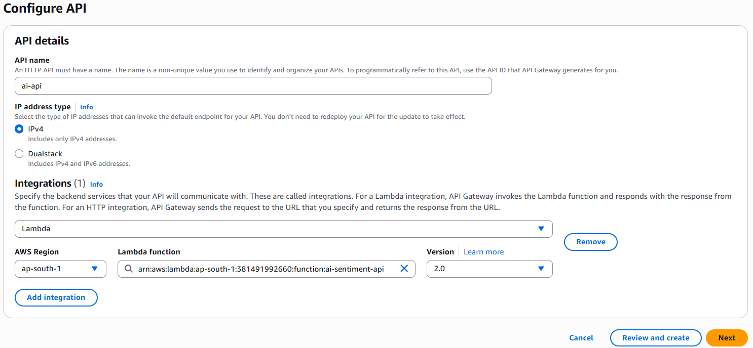
Step 4: Configure API
API-Name: ai-api
Add Integration
Select Lambda and Choose your function: ai-sentiment-api

Slide 13
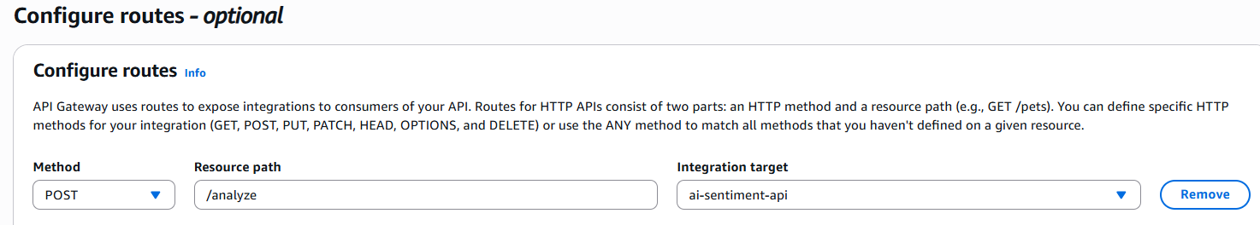

Add Route:
Method: POST
Resource path: /analyze
Integration target: ai-sentiment-api

Slide 14
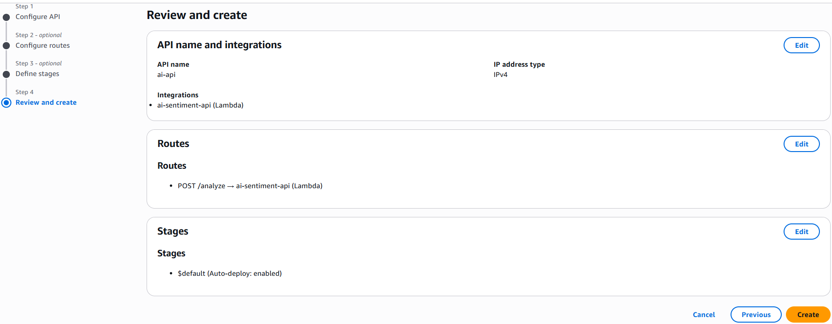
Click: Review and Create (Do Not press Deploy)

Slide 15
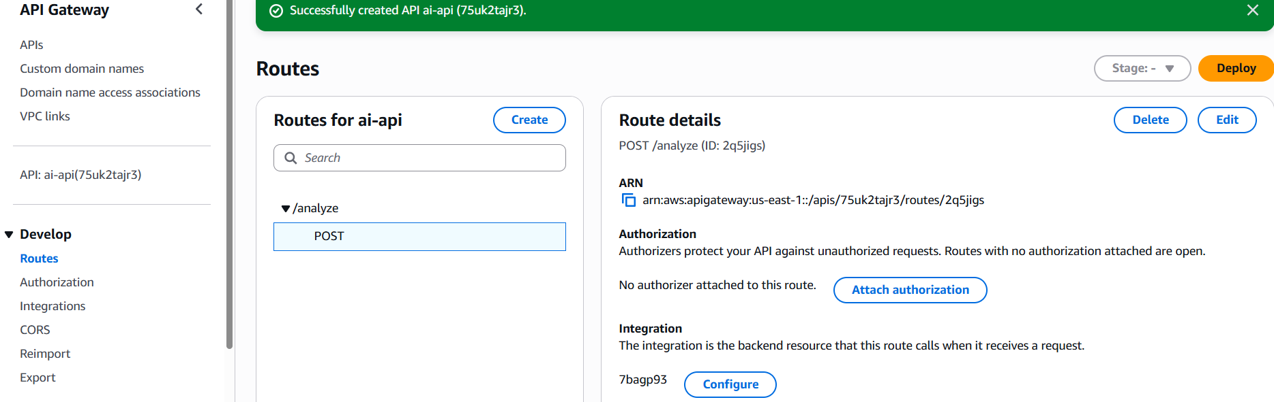


Slide 16
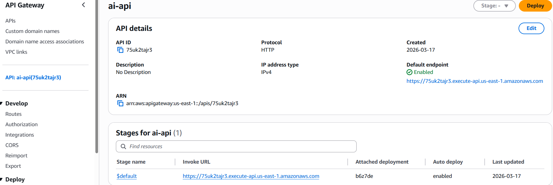


Click on the API (LHS)
You’ll get an API endpoint URL
Example: https://abc123.execute-api.region.amazonaws.com

Slide 17
Step 5: Test the API – Python Code
import requests
import json
# Replace with your actual API Gateway URL
url = "https://your-api-url/analyze"
payload = { "text": "I love learning API. I like AWS Lambda because it is easy."}
headers = { "Content-Type": "application/json" }
# Make POST request
response = requests.post(url, headers=headers, data=json.dumps(payload))
# Print response
print("Status Code:", response.status_code)
print("Response JSON:", response.json())

Slide 18
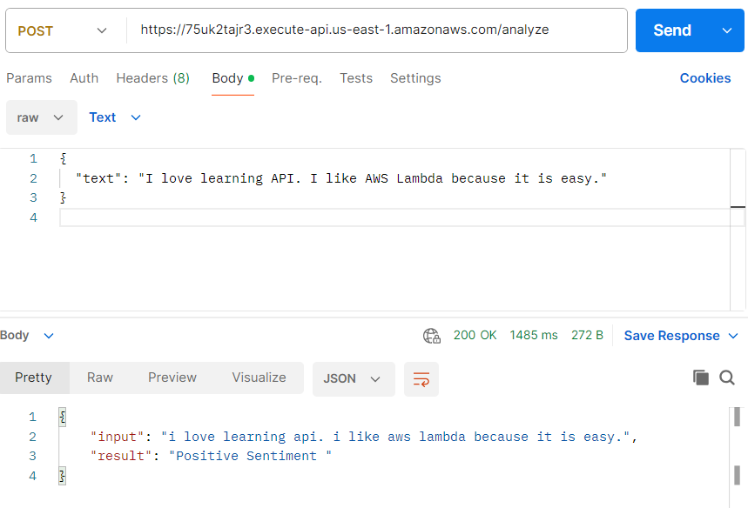
Step 5: Test the API – POSTMAN
POST request: https://your-api-url/analyze
Body:
{
"text": "I love learning API. I like AWS Lambda because it is easy."
}

Slide 19
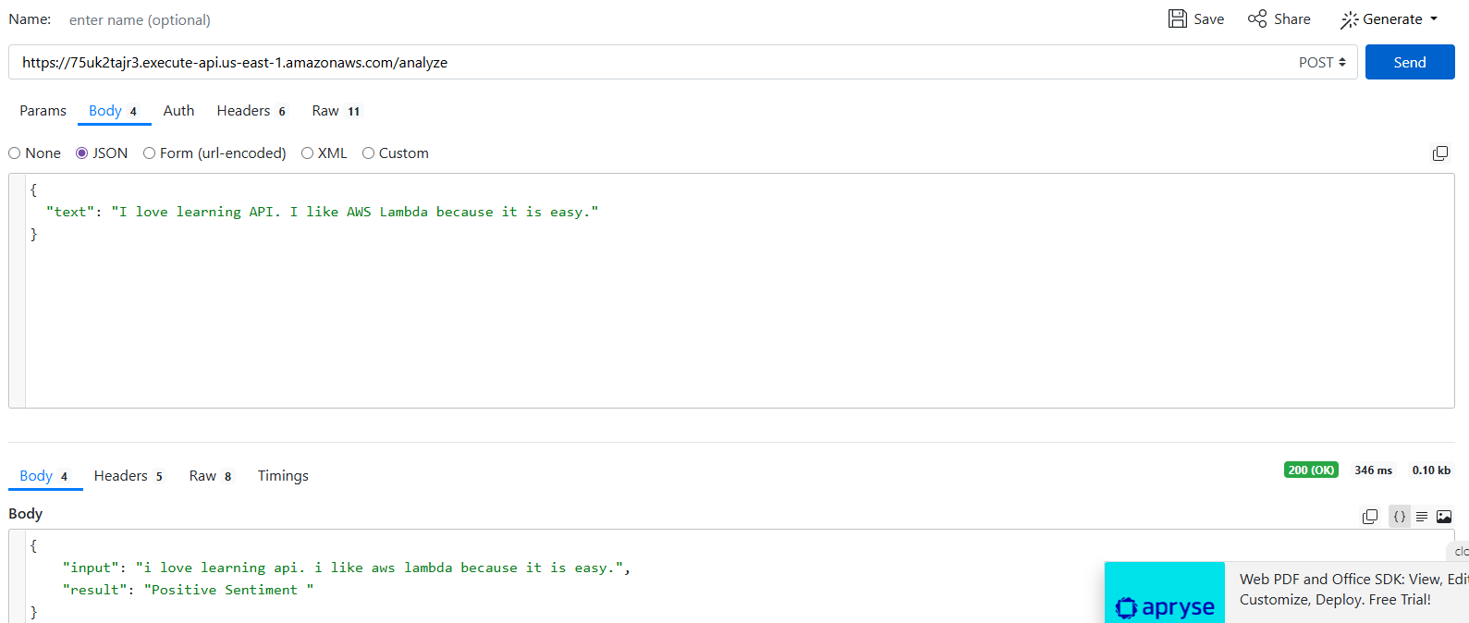



Step 5: Test the API – www.reqbin.com
POST request: https://your-api-url/analyze
Body:
{
"text": "I love learning API. I like AWS Lambda because it is easy."
}

Slide 20
Key Points
1. Event-driven execution
Lambda runs only when API is called.
2. Serverless architecture
No AWS EC2. No deployment headache.
3. API creation in minutes
Using API Gateway.
4. AI integration is easy
Even simple logic works.
This is exactly how frontend, mobile app, or ML system talks to a cloud AI service.

Slide 21
MAKE SURE TO DELETE
API GateWay
Lambda service
Otherwise, you may be charged

Slide 22
Heading Goes Here
Fhdsklf
Fjdsklf
Fjskldf

