Slide 1
SQL Database on Cloud:
AWS Relational Database Service (RDS)

Slide 2
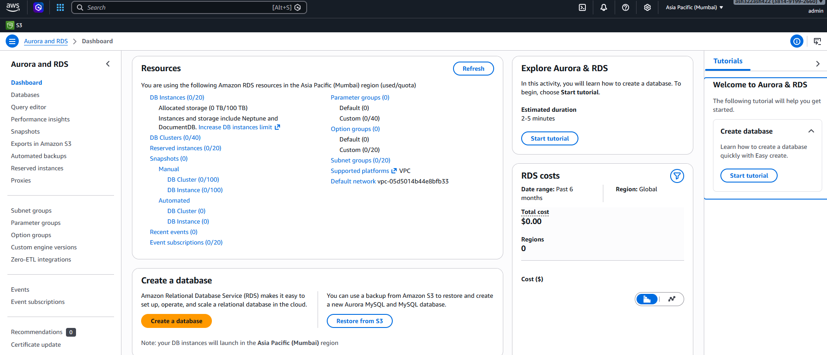

1. Create MySQL Database on AWS RDS
Go to: https://console.aws.amazon.com
Then navigate to: AWS Console → Services → RDS

Slide 3
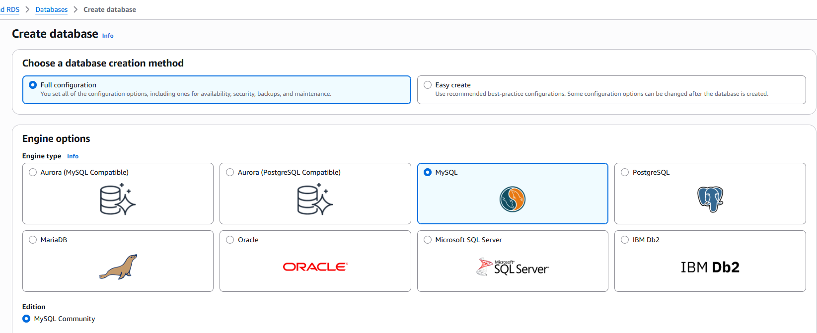


Step 1: Create Database
Click Create database.
Choose following
Setting | Value
DB creation method | Full config(default)
Engine type | MySQL
Version | Latest
Template | Free tier
DB instance identifier | my-first-db
Master username | admin
Master password | gh45mod7=78%()

Slide 4
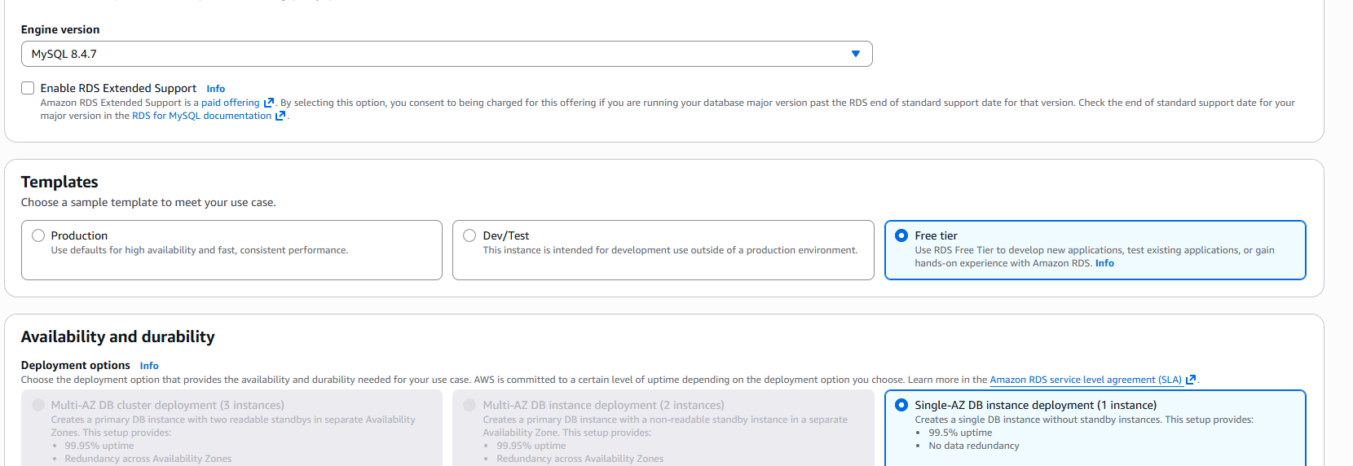


Step 1: Create Database
Click Create database.
Choose following
Setting | Value
DB creation method | Full config(default)
Engine type | MySQL
Version | Latest
Template | Free tier
DB instance identifier | my-first-db
Master username | admin
Master password | gh45mod7=78%()

Slide 5
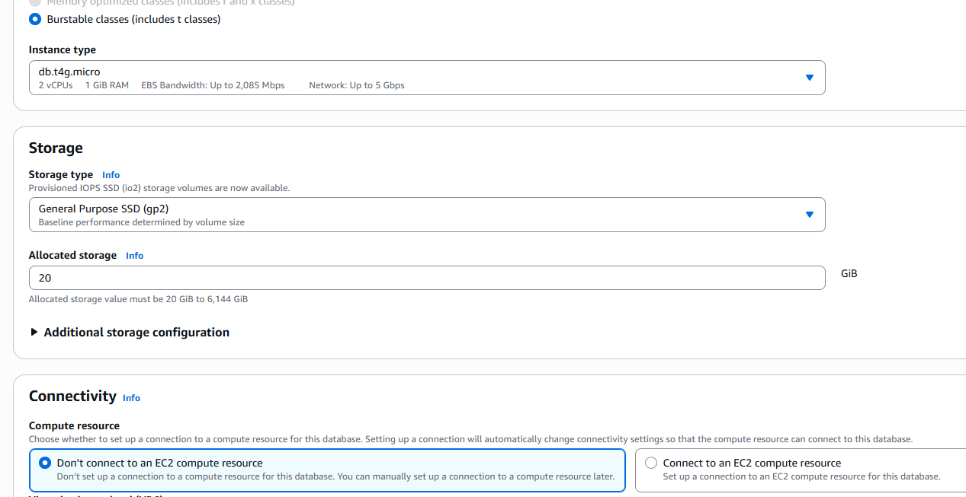


Step 2: Configure Instance
Recommended (Free tier):
Setting | Value
DB instance class | db.t3.micro
Storage | 20 GB
Storage type | gp2

Slide 6
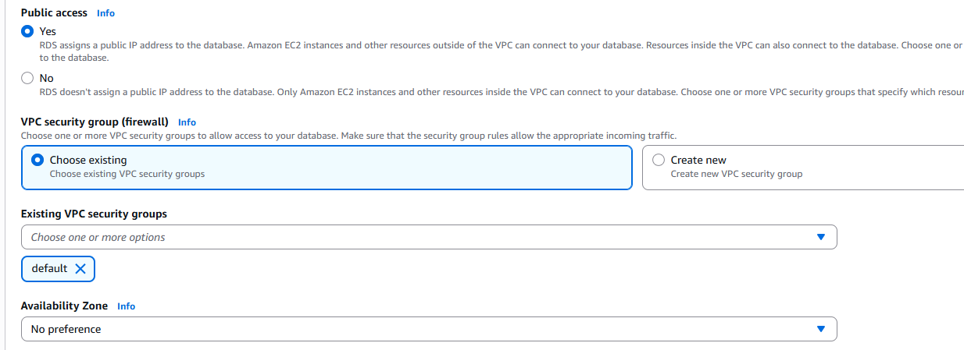

Step 3: Connectivity
Important settings:
Setting | Value
Public access | Yes
VPC security group | Default
Database port | 3306

Slide 7
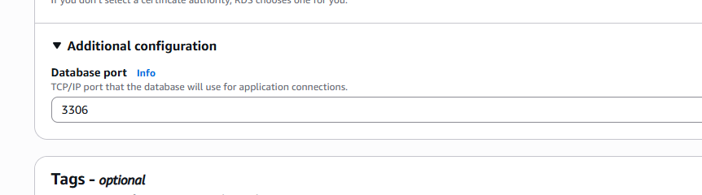

Step 3: Connectivity
Important settings:
Setting | Value
Public access | Yes
VPC security group | Default
Database port | 3306

Slide 8
Step 4: Create Database
Click Create database
It will take about 3–5 minutes.

Slide 9
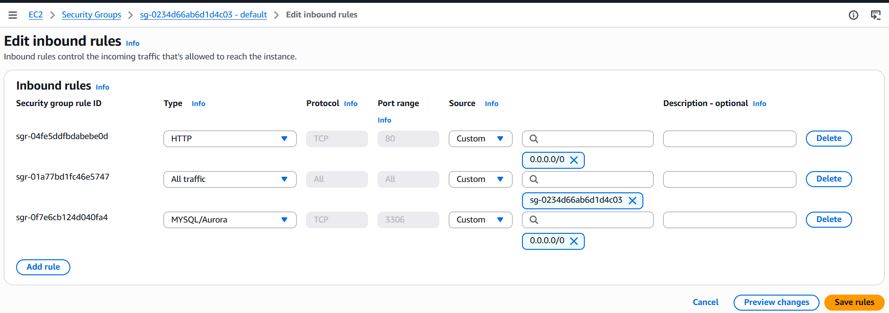
2. Allow Your IP to Connect
Go to RDS → Databases → my-first-db
Open Connectivity & Security -> Click Security Group
Add inbound rule:
Type | Port | Source
MySQL/Aurora | 3306 | Your IP: Or use 0.0.0.0/0

Slide 10
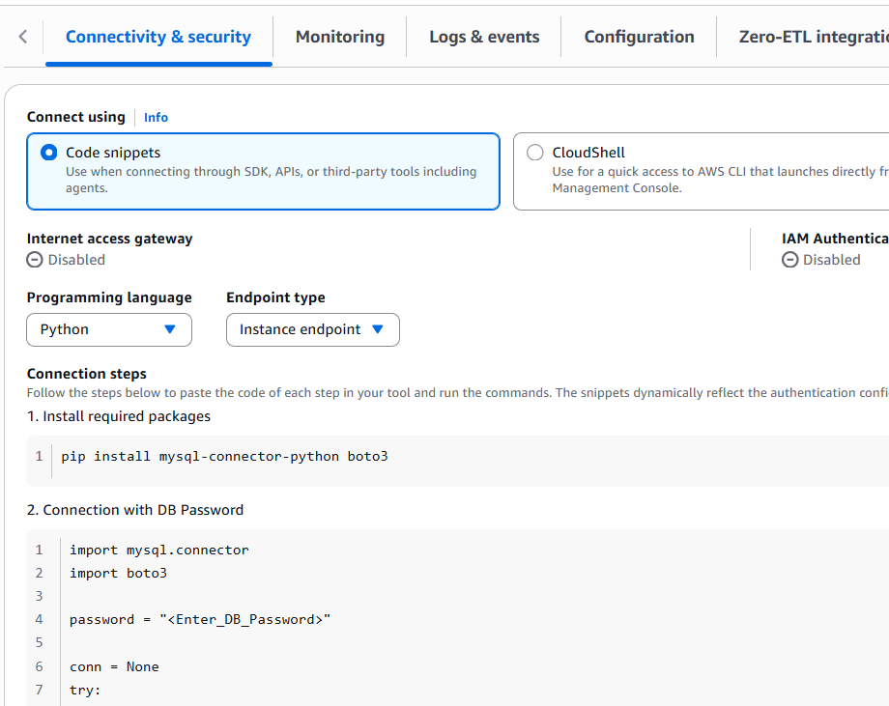




3. Get code to connect to DB
Click on DB and from
Connect Using -> Code snippet,
get python code and run it.
You will use this in Python code to create DB first.

Slide 11
4) On local Install Python MySQL Library
Use:
pip install mysql-connector-python boto3
pip install pymysql

Slide 12
5) The python code: Create table
import pymysql
connection = pymysql.connect(
host="my-first-db.xxxxxx.us-east-1.rds.amazonaws.com",
user="admin",
password="gh45mod7=78%()",
database=“student_db",
port=3306
)
cursor = connection.cursor()
Cont…

Slide 13
create_table_query = """
CREATE TABLE IF NOT EXISTS students (
id INT AUTO_INCREMENT PRIMARY KEY,
name VARCHAR(100),
course VARCHAR(100)
)
"""
cursor.execute(create_table_query)
connection.commit()
print("Table created successfully")
cursor.close()
connection.close()

Slide 14
6) The python code: Insert Data
import pymysql
connection = pymysql.connect(
host="my-first-db.xxxxxx.us-east-1.rds.amazonaws.com",
user="admin",
password="gh45mod7=78%()",
database="company_db"
)
cursor = connection.cursor()
query = """
INSERT INTO students (name, course)
VALUES (%s,%s)
"""
data = ("Alice", "Machine Learning")
cursor.execute(query, data)
connection.commit()
print("Data inserted")
cursor.close()
connection.close()
Cont…

Slide 15
6) The python code: Fetch Data
import pymysql
connection = pymysql.connect(
host="my-first-db.xxxxxx.us-east-1.rds.amazonaws.com",
user="admin",
password="gh45mod7=78%()",
database="company_db"
)
cursor = connection.cursor()
cursor.execute("SELECT * FROM students")
rows = cursor.fetchall()
for r in rows:
print(r)
cursor.close()
connection.close()
Cont…

Slide 16
MAKE SURE TO DELETE THIS after the demo.
Otherwise, you will be charged
Cont…

Slide 17
MAKE SURE TO DELETE THIS after the demo.
Otherwise, you will be charged
Cont…

Slide 18
Most ML pipelines use this pattern:
Python ETL
↓
AWS RDS (MySQL/Postgres)
↓
Data warehouse / analytics
Cont…

Slide 19
Tect box

