Slide 1
ReAct Agent (zero-shot-react-description)

Slide 2
ReAct Agent (zero-shot-react-description)
Test this code
Make it run in stream lit

Slide 3
ReAct Agent (zero-shot-react-description)
ReAct stands for Reasoning + Acting.
It's a prompting framework where the LLM interleaves thinking with tool use in a structured loop — rather than trying to answer all at once, it reasons step by step and acts on the world between each step.
Task given to the agent
A user provides a task.
The full prompt —
including the task,
available tool descriptions, and
any prior conversation history
is sent to the LLM.
The LLM has no memory between calls, so everything relevant must be in this prompt.

Slide 4
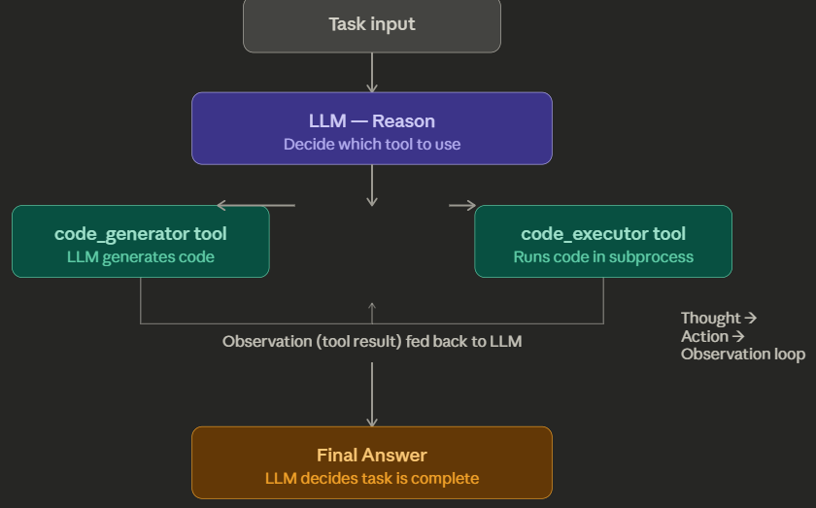
ReAct Agent (zero-shot-react-description)

Slide 5
ReAct Agent (zero-shot-react-description)
How it works:
The LLM follows a loop of Thought → Action → Observation. It reads the task, reasons about which tool to call, calls it, observes the result, and repeats until it's confident enough to give a Final Answer. No examples are given in the prompt (hence "zero-shot") — the LLM relies entirely on tool descriptions to figure out what to do.
Why it's NOT a reflection agent:
A reflection agent has a deliberate self-critique loop — it generates output, then a second pass (or a separate "critic" prompt) evaluates that output and suggests improvements, and the agent revises accordingly. This code has none of that. The LLM never looks back at its own output to judge or improve it.

Slide 6
Key things to understand about the ReAct architecture:
zero-shot means the agent gets no worked examples — it figures out which tool to use purely from the tool's description string. This is why writing good tool descriptions is critical.
The agent has no real memory. Each time the LLM is called, the entire conversation history — every Thought, Action, and Observation so far — is concatenated into a single prompt and sent again. This is why long agent runs get expensive fast.
The loop is bounded by max_iterations (default 15 in LangChain). If the agent hasn't reached a Final Answer by then, it stops forcibly. This prevents infinite loops but can also cut off complex tasks.
The two tools in our code have a natural chain:
code_generator → LLM writes code → code_executor → LLM sees output → decides if it's correct.
This is not reflection (no self-critique prompt), but it is multi-step tool chaining, which is a key ReAct strength.

Slide 7
EXTRA
Ffnbksdfd
Fdslj;f
Fl;ds

