Slide 1
Lang Chain
Installation
Set Up
Code Explanation

Slide 2
# STEPS
## Work with python3.10. Do not work with higher version.
### 1) Create virtual environment (Took 2 minutes):
> C:\Users\hi\AppData\Local\Programs\Python\Python310\python.exe -m venv .venv
### 2) Activate virtual envir
> .venv\Scripts\Activate.ps1

Slide 3
# STEPS
### 3) Install jupyter (Took 3 minutes):
> python -m pip install jupyter
### 4) Run jupyter:
> python -m jupyter notebook

Slide 4
# STEPS
### 5) Install following packages from jupyter (or use python virtual end):
#### From Jupyter (Took 5 minutes)
> !pip install langchain==0.2.14 langchain-community==0.2.12 langchain-openai==0.1.25
OR
#### From command line
> .\.venv\Scripts\python.exe pip install langchain==0.2.14 langchain-community==0.2.12 langchain-openai==0.1.25
Restart the Kernel (To be Safe)

Slide 5
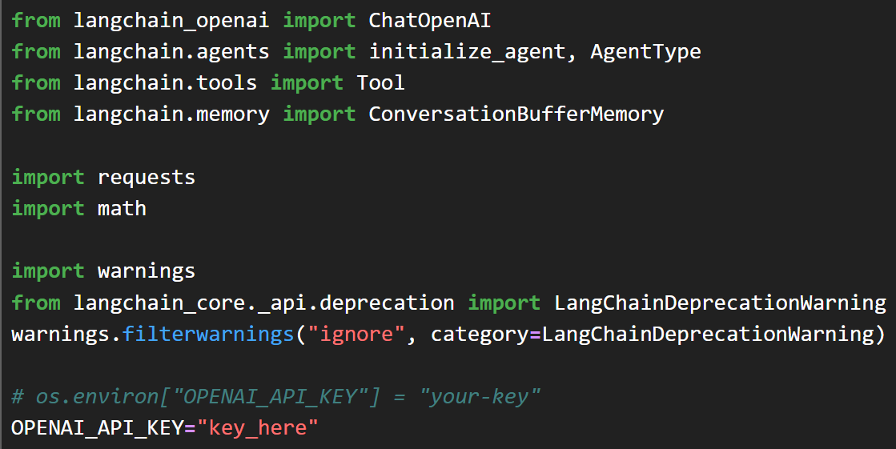
Code

Slide 6
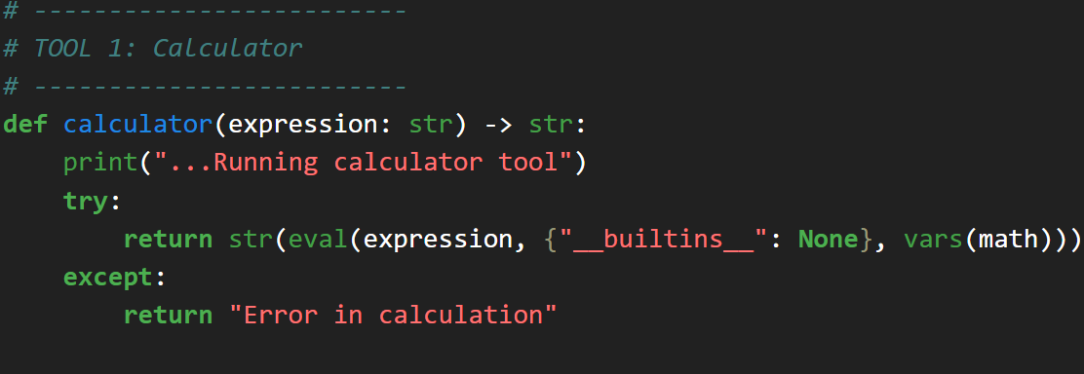
Code

Slide 7
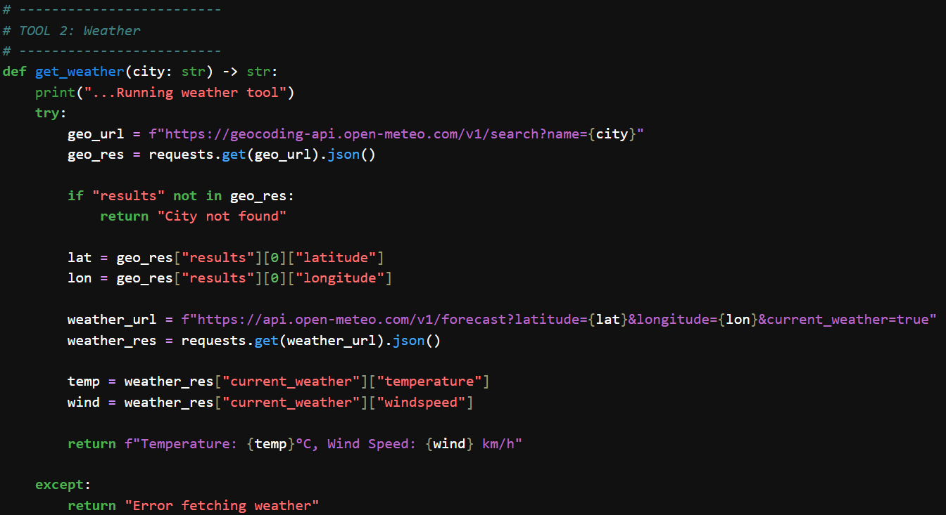
Code

Slide 8
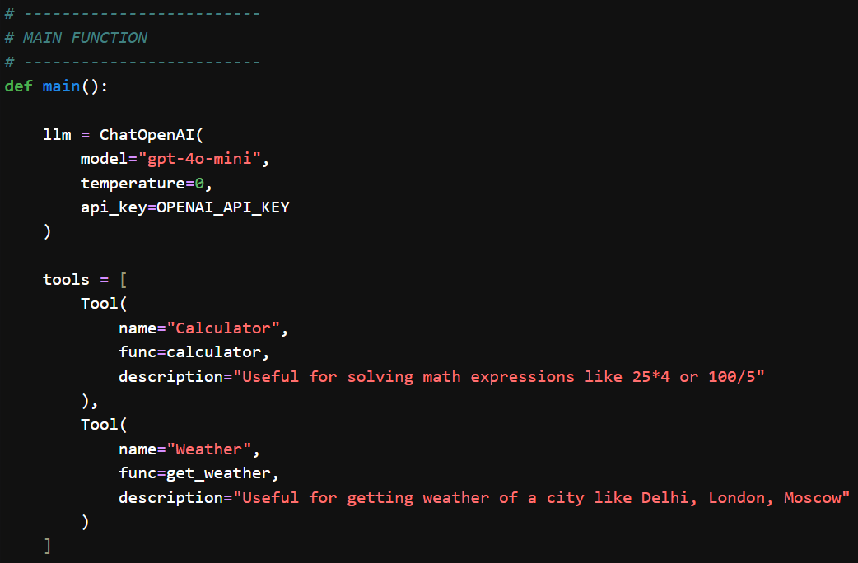
Code

Slide 9
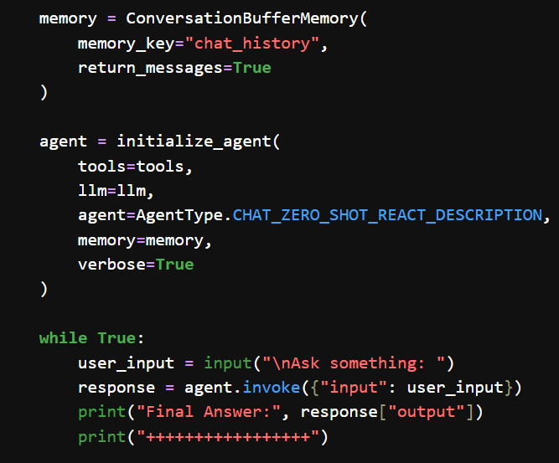

Code

Slide 10
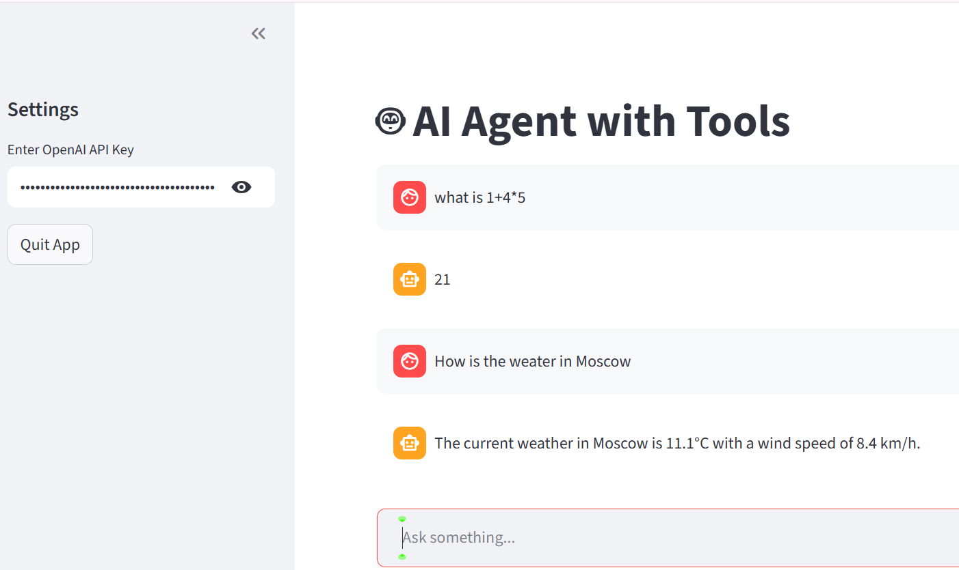
Now we put this in streamlit
Install streamlit: python -m pip install streamlit
2) Create file
step2_agent_logic.py
and put the code in there
3) Create app.py
4) Goto same dir that contains
app.py and Run
> python -m streamlit run app.py
(See the screenshot of the output)

Slide 11
EXTRA
Ffnbksdfd
Fdslj;f
Fl;ds

