Slide 1
GenAI Module7 – NLP- applications-challenges

Slide 2
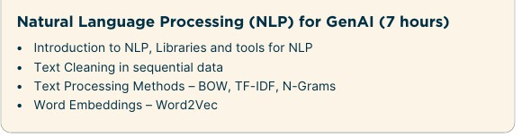
Good Source: https://www.deeplearning.ai/resources/natural-language-processing/

Slide 3
What is NLP ?
Natural language processing (NLP) is the discipline of building machines that can manipulate human language — or data that resembles human language — in the way that it is written, spoken, and organized. It evolved from computational linguistics, which uses computer science to understand the principles of language, but rather than developing theoretical frameworks, NLP is an engineering discipline that seeks to build technology to accomplish useful tasks.
NLP can be divided into two overlapping subfields: natural language understanding (NLU), which focuses on semantic analysis or determining the intended meaning of text, and natural language generation (NLG), which focuses on text generation by a machine.
NLP is separate from — but often used in conjunction with — speech recognition, which seeks to parse spoken language into words, turning sound into text and vice versa.

Slide 4
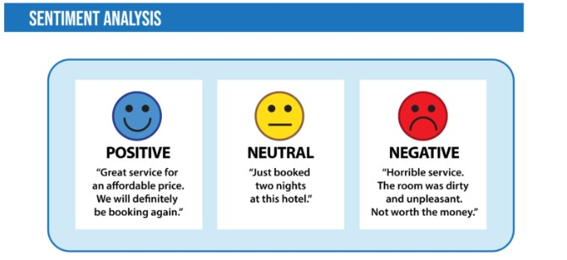
NLP : Applications(p1)
Sentiment analysis is the process of classifying the emotional intent of text. Generally, the input to a sentiment classification model is a piece of text, and the output is the probability that the sentiment expressed is positive, negative, or neutral. Typically, this probability is based on either hand-generated features, word n-grams, TF-IDF features, or using deep learning models to capture sequential long- and short-term dependencies. Sentiment analysis is used to classify customer reviews on various online platforms as well as for niche applications like identifying signs of mental illness in online comments.

Slide 5
NLP : Applications(p2)
Toxicity classification is a branch of sentiment analysis where the aim is not just to classify hostile intent but also to classify particular categories such as threats, insults, obscenities, and hatred towards certain identities. The input to such a model is text, and the output is generally the probability of each class of toxicity. Toxicity classification models can be used to moderate and improve online conversations by silencing offensive comments, detecting hate speech, or scanning documents for defamation.
Language Translator: Want to translate a text from English to Hindi but don’t know Hindi? Well, Google Translate is the tool for you! While it’s not exactly 100% accurate, it is still a great tool to convert text from one language to another. Google Translate and other translation tools as well as use Sequence to sequence modeling that is a technique in Natural Language Processing. Earlier, language translators used Statistical machine translation (SMT) which meant they analyzed millions of documents that were already translated from one language to another (English to Hindi in this case) and then looked for the common patterns and basic vocabulary of the language. However, this method was not that accurate as compared to Sequence to sequence modeling.

Slide 6
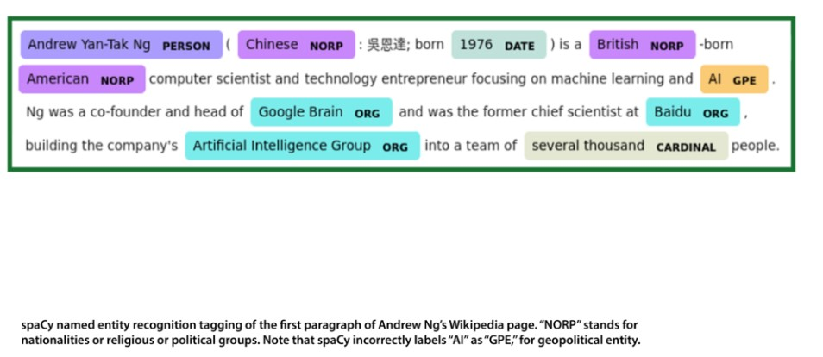
NLP : Applications(p3)
Named entity recognition aims to extract entities in a piece of text into predefined categories such as personal names, organizations, locations, and quantities. The input to such a model is generally text, and the output is the various named entities along with their start and end positions. Named entity recognition is useful in applications such as summarizing news articles and combating disinformation. For example, here is what a named entity recognition model could provide:

Slide 7
NLP : Applications(p4)
Grammatical error correction models encode grammatical rules to correct the grammar within text. This is viewed mainly as a sequence-to-sequence task, where a model is trained on an ungrammatical sentence as input and a correct sentence as output. Online grammar checkers like Grammarly and word-processing systems like Microsoft Word use such systems to provide a better writing experience to their customers. Schools also use them to grade student essays.
Topic modeling is an unsupervised text mining task that takes a corpus of documents and discovers abstract topics within that corpus. The input to a topic model is a collection of documents, and the output is a list of topics that defines words for each topic as well as assignment proportions of each topic in a document. Latent Semantic Analysis (LSA) and Latent Dirichlet Allocation (LDA) are 2 techniques used here. Latent Dirichlet Allocation (LDA), one of the most popular topic modeling techniques, tries to view a document as a collection of topics and a topic as a collection of words. Topic modeling is being used commercially to help lawyers find evidence in legal documents.

Slide 8
NLP : Applications(p5)
Text generation, more formally known as natural language generation (NLG), produces text that’s similar to human-written text. Such models can be fine-tuned to produce text in different genres and formats — including tweets, blogs, and even computer code. Text generation has been performed using Markov processes, LSTMs, BERT, GPT-2, LaMDA, and other approaches. It’s particularly useful for autocomplete and chatbots.
Information retrieval finds the documents that are most relevant to a query. This is a problem every search and recommendation system faces. The goal is not to answer a particular query but to retrieve, from a collection of documents that may be numbered in the millions, a set that is most relevant to the query.

Slide 9
NLP : Applications(p6)
Automatic MOM(Minutes of Meeting) Generation:
Transcription and Note-Taking:
NLP can be used to transcribe audio or video recordings of meetings into text, providing a real-time record of the discussion.
Summarization:
NLP algorithms can summarize the main points of the meeting, identify key speakers, and highlight important decisions and action items.

Slide 10
NLP : Applications(p6)
NLP in biomedicine, also known as Biomedical NLP (BNLP), utilizes natural language processing techniques to analyze and extract meaningful information from medical text, such as clinical notes, reports, and research papers. This field allows for automated understanding of complex medical language, enabling tasks like disease diagnosis, drug discovery, and patient care improvement.
1. Information Extraction and Knowledge Discovery:
Clinical Text Analysis: NLP algorithms can identify relevant details like patient symptoms, diagnoses, and treatments from electronic health records.
Drug Discovery: By analyzing research papers and databases, NLP can help identify potential drug candidates and their mechanisms of action.
Disease Diagnosis: NLP can assist in diagnosing diseases by extracting information from patient records and medical literature.
2. Text Classification and Categorization:
Medical Text Transcription Classification: NLP can categorize medical records, reports, or notes into predetermined categories or labels, simplifying information retrieval.
Sentiment Analysis: NLP can analyze the sentiment expressed in medical text, such as patient feedback or doctor's notes, to identify potential issues.
3. Translation and Accessibility:
Medical Terminology Translation: NLP can translate medical documents and information between different languages, improving patient access to care.
Patient Education: NLP can be used to create clear and concise medical information for patients in their native languages.

Slide 11
NLP : Applications(p7)
Summarization is the task of shortening text to highlight the most relevant information. Researchers at Salesforce developed a summarizer that also evaluates factual consistency to ensure that its output is accurate. Summarization is divided into two method classes:
Extractive summarization focuses on extracting the most important sentences from a long text and combining these to form a summary. Typically, extractive summarization scores each sentence in an input text and then selects several sentences to form the summary.
Abstractive summarization produces a summary by paraphrasing. This is similar to writing the abstract that includes words and sentences that are not present in the original text. Abstractive summarization is usually modeled as a sequence-to-sequence task, where the input is a long-form text and the output is a summary.
Question answering deals with answering questions posed by humans in a natural language. One of the most notable examples of question answering was Watson, which in 2011 played the television game-show Jeopardy against human champions and won by substantial margins. Generally, question-answering tasks come in two flavors:
Multiple choice: The multiple-choice question problem is composed of a question and a set of possible answers. The learning task is to pick the correct answer.
Open domain: In open-domain question answering, the model provides answers to questions in natural language without any options provided, often by querying a large number of texts.

Slide 12
NLP challenges(p1)
4. Punctuation ambiguity
She found inspiration in cooking, her family, and her dog (right meaning)
She found inspiration in cooking her family and her dog (weird meaning)
5. Slang
Sentence: "Dude your pants are on fire!"
Literal interpretation: pants are on fire.
Slang meaning: The pants was amazing or pants have design depicting fire
6. Sarcasm Ambiguity
"Oh great, another Monday. I’m so excited."
Literal meaning: The speaker is excited.
Actual (sarcastic) meaning: The speaker dreads it.
7. Spelling mistake:
"I cleaned the horse all morning.“….meant house
Solution: Developing models that can accurately discern context and resolve ambiguities.
1. Ambiguity and Polysemy:
Issue: Natural language is inherently ambiguous, with words and phrases having multiple meanings depending on context. NLP systems need to understand the intended meaning in different situations.
Example:
1. Lexical Ambiguity (Polysemy):
Ritesh went to the bank (Institution or beach???)
Ritesh swung the bat in an attempt to hit the flying bat.
2. Syntactic Ambiguity
Sentence: "I saw the man with the telescope."
Interpretation 1: I used a telescope to see the man.
Interpretation 2: I saw a man who was holding a telescope.
3. Pragmatic Ambiguity
Sentence: "Can you pass the salt?"
Literally, it's a yes/no question about ability.
Pragmatically, it's a polite request to pass the salt.

Slide 13
NLP challenges(p2)
2. Data Quality and Availability:
Issue: NLP models rely on large amounts of training data, and the quality of this data significantly impacts performance. Noisy, incomplete, or biased data can lead to inaccurate results.
Example: Training data with gendered stereotypes can result in NLP models perpetuating biases.
Training Data Example (Biased)
Suppose a language model is trained on large-scale web data (like Common Crawl) that includes sentences like:
"Women are nurses. Men are doctors."
"He is a brilliant scientist." / "She is a beautiful actress."
"The secretary scheduled his meeting." / "The boss signed the contract."
These examples reinforce stereotypical gender roles (e.g., associating women with appearance or support roles, and men with intelligence or leadership).
You ask a model: "The doctor went to the hospital because __ was needed."
It may respond: "he" — even if gender wasn’t specified in the question.
Solution: Carefully selecting and cleaning training data, and developing techniques to mitigate biases.

Slide 14
NLP challenges(p4)
3. Evolving Language:
Issue: Languages are constantly evolving, with new words, idioms, and slang emerging. NLP systems need to adapt to these changes.
Example: New slang terms and internet memes need to be understood by NLP systems.
“Flex”:
Old meaning: To "flex" meant to bend a muscle.
New meaning: "Flex" in modern slang refers to showing off or boasting (e.g., "He’s flexing his new car.").
Solution: Developing NLP techniques that can adapt to evolving language and incorporating knowledge from online resources. For example regularly update models with new language data, particularly from social media, forums, and new books.

Slide 15
NLP challenges(p3)
4. Language Complexity and Diversity:
Issue: Languages have varying structures, grammars, and vocabularies. NLP systems need to be able to handle diverse languages and dialects.
Example: Languages with complex grammatical structures can be challenging to model.
Solution: Developing models that can generalize across different languages and dialects, and utilizing cross-lingual transfer learning.

