Slide 1
Evaluating your LLM Apps

Slide 2
🤔 Why LLM Evaluation is Different
Traditional ML:
Clear labels → accuracy, precision, recall
LLMs:
Open-ended outputs
Multiple correct answers
Subjective quality (tone, helpfulness, safety)
👉 Example: Question: "Explain AI to a 10-year-old"
There is no single correct answer → evaluation becomes nuanced.

Slide 3
Types of LLM Evaluation
Automatic Evaluation
String-based metrics
Semantic similarity
LLM-as-a-Judge ( Important )
B. Human Evaluation (Gold Standard)
C. Task-Based Evaluation (Best for Applications)

Slide 4
Types of LLM Evaluation
A. Automatic Evaluation (Fast but Limited)
1. String-based metrics
BLEU
ROUGE
Used in
Machine translation
Summarization
⚠️ Problem: They measure text overlap, not meaning.

Slide 5
2. Semantic similarity
Cosine similarity using embeddings
👉 Example:
"AI is machine intelligence"
"Artificial intelligence is intelligence shown by machines“
Different words → same meaning → good score

Slide 6
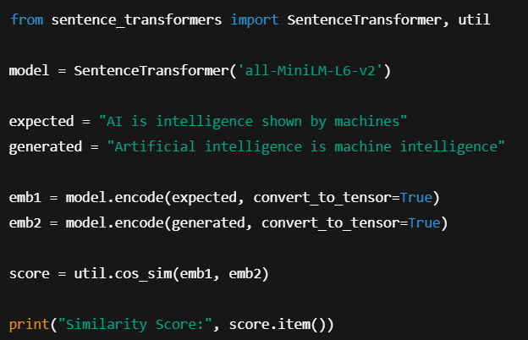
2. Semantic similarity
Example of Cosine similarity using embeddings

Slide 7
3. LLM-as-a-Judge (Very Important Concept)
Use one LLM to evaluate another.
Example prompt:
Score the answer from 1–10 based on:
- correctness
- clarity
- completeness

Slide 8
B. Human Evaluation (Gold Standard)
Humans rate outputs on:
Correctness
Helpfulness
Tone
Safety
👉 Scale example:
1 = Bad
5 = Excellent
⚠️ Downsides:
Expensive
Slow
Subjective – Person A and Person B may have different evaluation

Slide 9
C. Task-Based Evaluation (Best for Applications)
Evaluate based on real task success
👉 Example:
Application | Metric
Chatbot | % of correct answers
RAG system | Retrieval relevance
Code generator | Code runs successfully

Slide 10
4. 📊 Key Metrics in Evaluation
1. Accuracy
Correct vs incorrect answers
2. Hallucination Rate
% of answers that are factually wrong
3. Relevance
Does the answer match the question?
4. Faithfulness (Important for RAG)
Does the answer stick to provided context?
5. Latency
How fast is the response?
6. Cost
API usage cost per request

Slide 11
EXTRA
Ffnbksdfd
Fdslj;f
Fl;ds

