Slide 1
RAG (Retrieval-Augmented Generation)

Slide 2
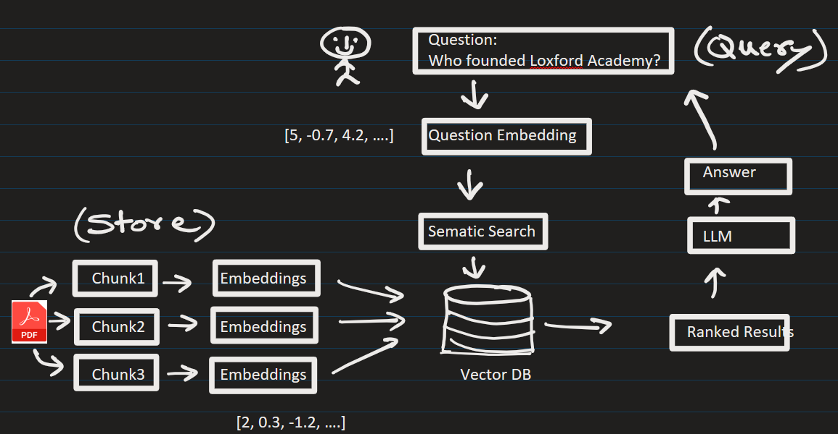











RAG (Retrieval-Augmented Generation):
Phase 1) Populate the vector DB
Phase 2) User asks questions.

Slide 3
Steps:
1) Get an OpenAI API key from their website
2) I am using python3.12. Install following packages:
> python –m pip install streamlit openai faiss-cpu pypdf numpy python-dotenv
It installed following version
streamlit==1.54.0
openai==2.29.0
faiss-cpu==1.13.2
pypdf==6.9.1
numpy== 2.4.3
You can manually install above version:
> python –m pip install streamlit==1.54.0 openai==2.29.0 faiss-cpu==1.13.2 pypdf==6.9.1 numpy== 2.4.3 python-dotenv

Slide 4
3) Go to directory that contains app.py and run the program:
> python -m streamlit run .\app.py
4) Goto browser and load a PDF document-Loxford-company:
Ask question related with the PDF doc:
Q1) Who is the current CTO of Loxford Company ?
Answers correctly
Q2) Tell me the range of industries it serves
Answers correctly
Q3) How many professional it employs ?
Change wording -> How many people are currently working here?
Answers correctly

Slide 5
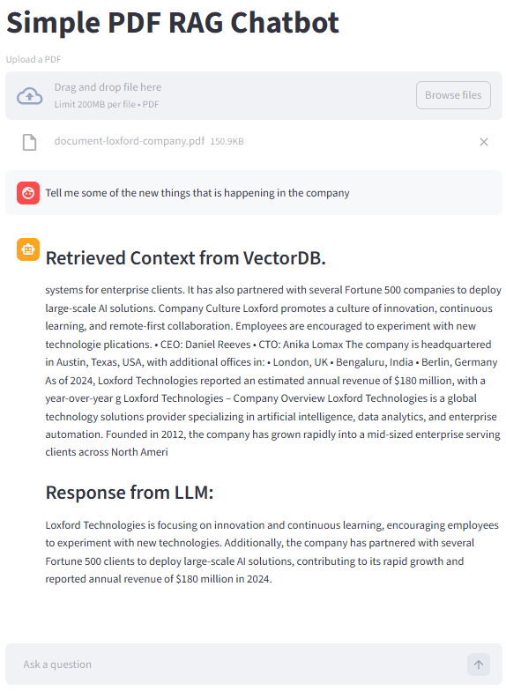
Q4) Tell me some of the new things that is happening in the company
Answer is not perfect. Missing the context somewhat.
There is some room for improvement here:
Increase the chunks size
Use overlapping in the chunks
Use semantic splitting
Use paragraph/header splitting, etc.

Slide 6
EXTRA
Ffnbksdfd
Fdslj;f
Fl;ds

