Slide 1
RAG (Retrieval-Augmented Generation)

Slide 2
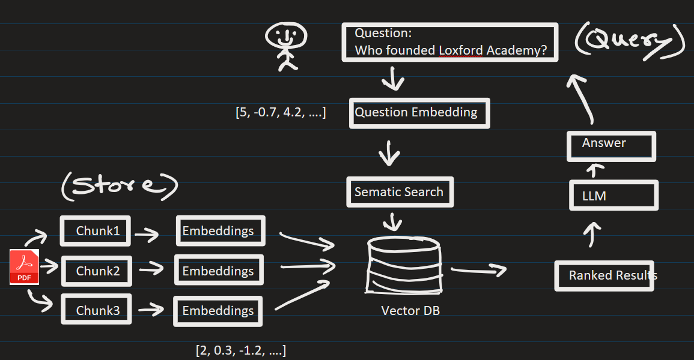











RAG (Retrieval-Augmented Generation):
Phase 1) Populate the vector DB
Phase 2) User asks questions.

Slide 3
Step 1: Prepare Your Project
Your folder should look like:
rag-app/
│
|── app.py
|── rag_core.py
|── requirements.txt
└── .env (optional locally only)
Create requirements.txt
streamlit==1.54.0
openai==2.29.0
faiss-cpu==1.13.2
pypdf==6.9.1
numpy==2.4.3
python-dotenv

Slide 4
Step 2: Push to GitHub
Go to GitHub
Enter Commands:
git init
git add .
git commit -m "initial commit"
git branch -M main
git remote add origin https://github.com/your-username/rag-app.git
git push -u origin main

Slide 5
Step 3: Deploy on Streamlit Cloud
Go to https://share.streamlit.io/
Click "New app"
Select:
Repository → your GitHub repo
Branch → main
File → app.py
Click Deploy

Slide 6
Step 4: Add API Key (IMPORTANT)
After deployment:
Go to App Settings
Click Secrets
Add:
OPENAI_API_KEY = "your_api_key_here"
Done!
You’ll get a live URL like:
https://your-app-name.streamlit.app

Slide 7
Steps:
1) Get an OpenAI API key from their website
2) I am using python3.12. Install following packages:
> python –m pip install streamlit openai faiss-cpu pypdf numpy python-dotenv
It installed following version
streamlit==1.54.0
openai==2.29.0
faiss-cpu==1.13.2
pypdf==6.9.1
numpy== 2.4.3
You can manually install above version:
> python –m pip install streamlit==1.54.0 openai==2.29.0 faiss-cpu==1.13.2 pypdf==6.9.1 numpy== 2.4.3 python-dotenv

Slide 8
3) Go to directory that contains app.py and run the program:
> python -m streamlit run .\app.py
4) Goto browser and load a PDF document-Loxford-company:
Ask question related with the PDF doc:
Q1) Who is the current CTO of Loxford Company ?
Answers correctly
Q2) Tell me the range of industries it serves
Answers correctly
Q3) How many professional it employs ?
Change wording -> How many people are currently working here?
Answers correctly

Slide 9
Q4) Tell me some of the new things that is happening in the company
Answer is not perfect. Missing the context somewhat.
There is some room for improvement here:
Increase the chunks size
Use overlapping in the chunks
Use semantic splitting
Use paragraph/header splitting, etc.

Slide 10
EXTRA
Ffnbksdfd
Fdslj;f
Fl;ds

