Slide 1
A Short Introduction
To Git SetUp

Slide 2
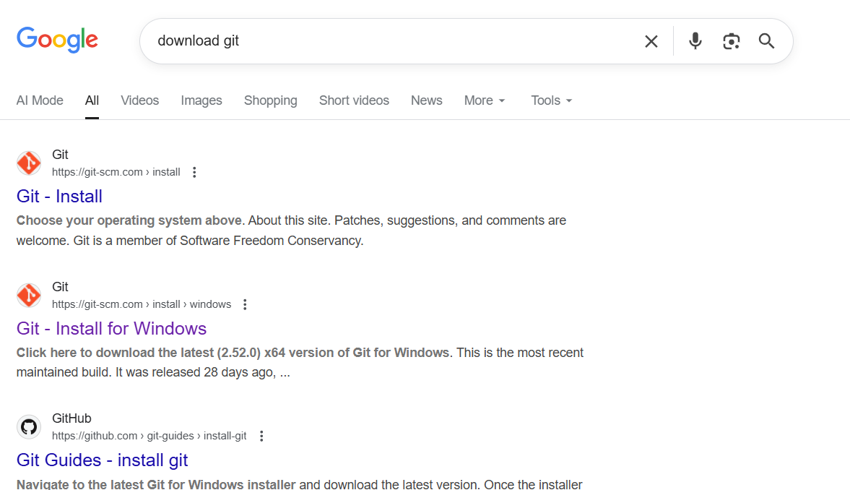

Step1: Download git and setup an account

Slide 3
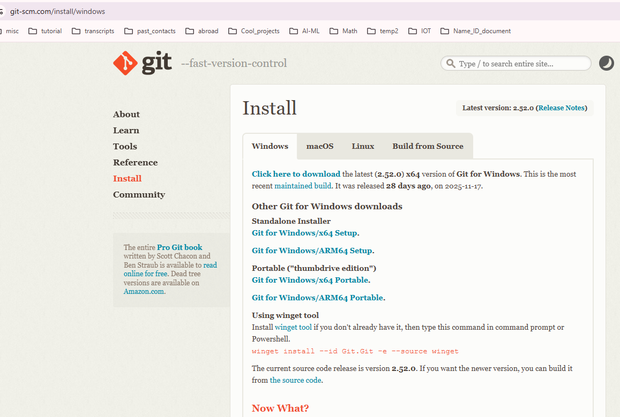

Step1: Download git and setup an account

Slide 4
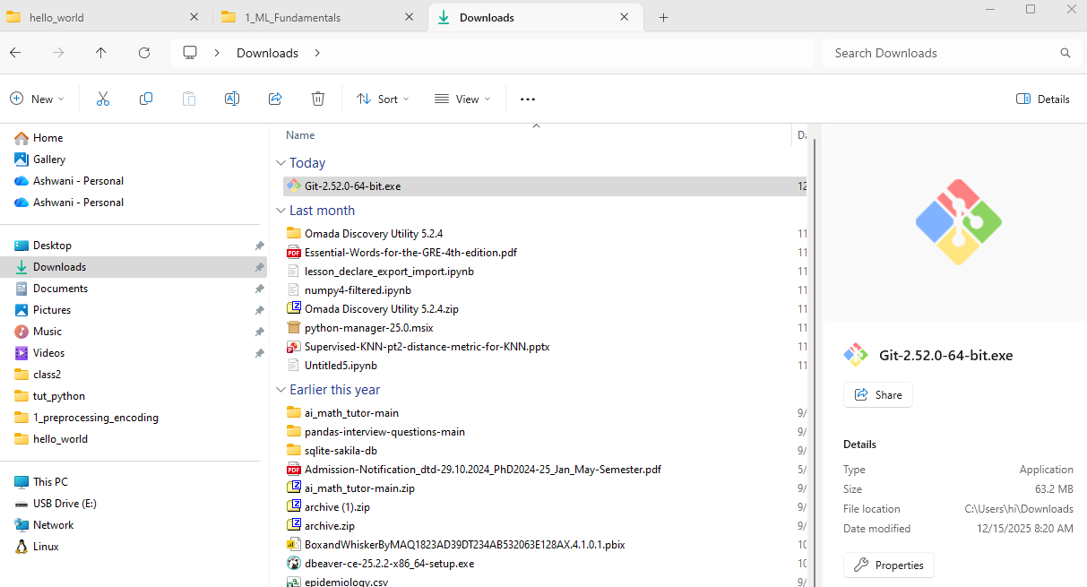
Step1: Download git and setup an account

Slide 5
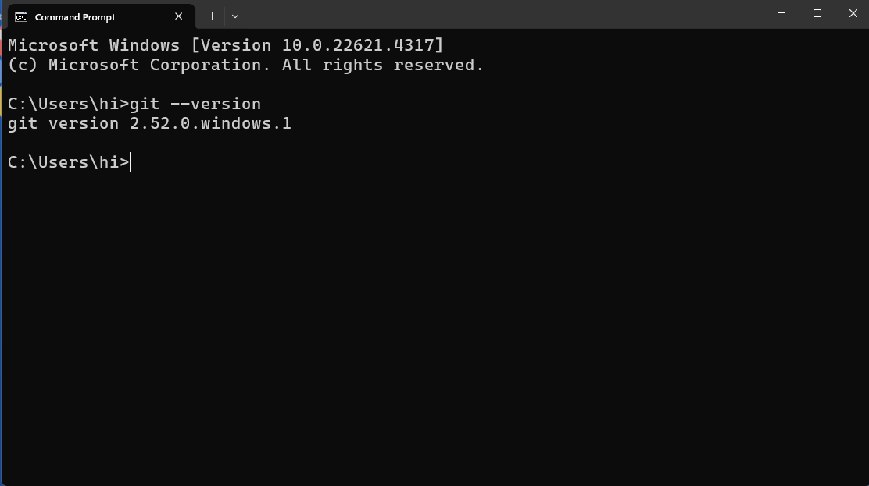
Step1: Download git and setup an account

Slide 6
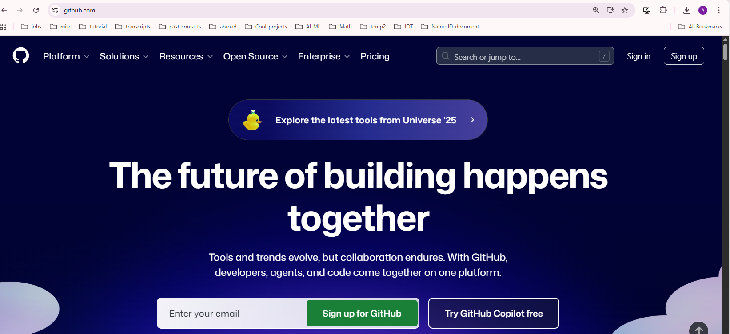


Step1: Download git and setup an account

Slide 7
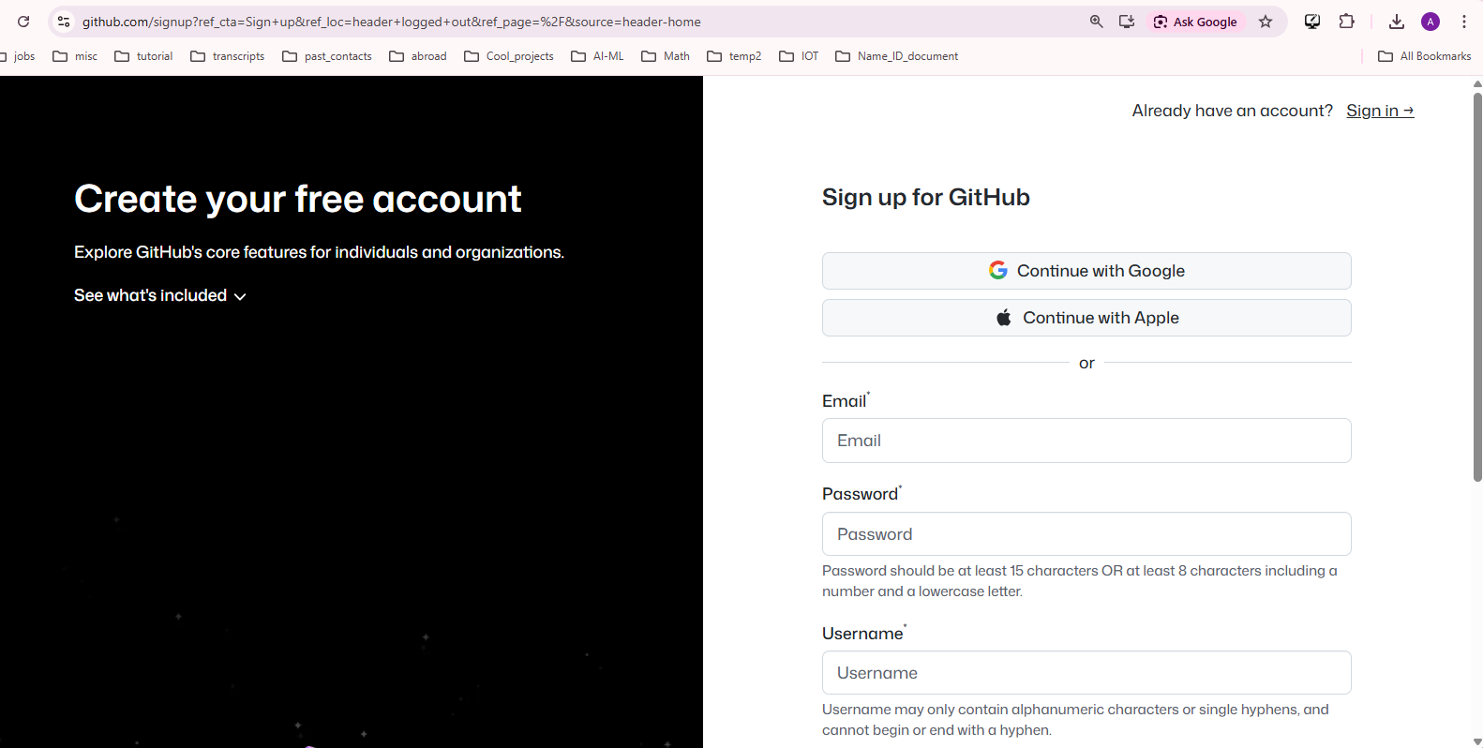

Step1: Download git and setup an account

