Slide 1
Deployment of ML on AWS

Slide 2


STEPS
ML Model
Create a ML Model
Create an API – FastAPI
Containerize – Docker
4) Push the Docker image to Docker hub
5) Create an AWS EC2 instance
6) Pull the Docker image from Docker hub to AWS EC2
7) Start the Docker and access the API endpoint
Request
Response
FastAPI

Slide 3
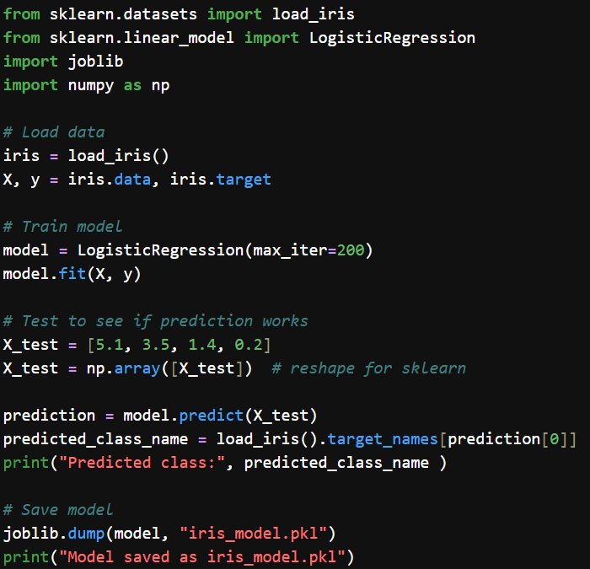
Create a ML Model
pip install scikit-learn pandas joblib

Slide 4
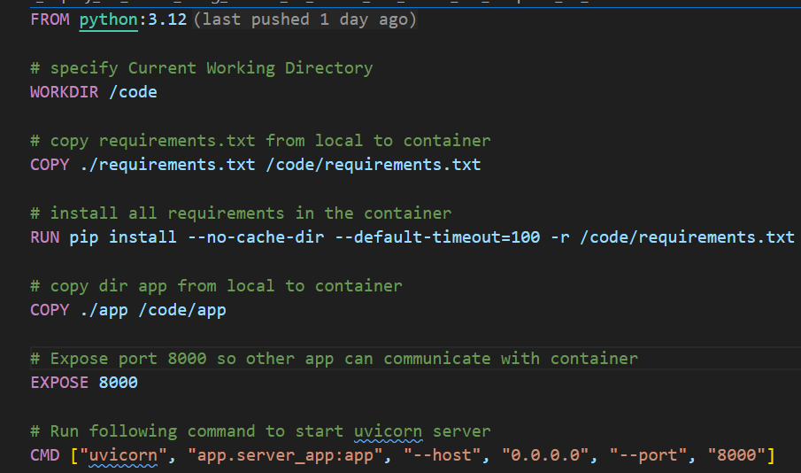
Create a FastAPI and dockerize it
Create docker file:

Slide 5
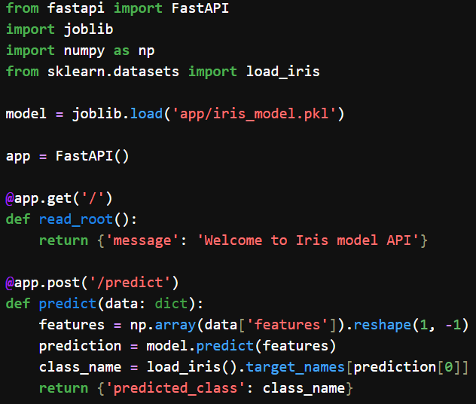
Create a FastAPI and dockerize it
1) Create fastAPI server
See the code server_app.py

Slide 6
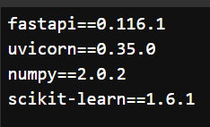
Create a FastAPI and dockerize it
2) Create requirements.txt file
See the file requirements.txt

Slide 7
Create a FastAPI and dockerize it
3) Create Docker file
See the Docker file
step a: Start docker engine
Start the docker engine by simply running the Docker Desktop: Start -> Docker Desktop
step b: Build docker image
Run following command in same directory which contains Dockerfile:
> docker build -t image_ml_model .
This would pull the image from docker hub. This could take 4 - 10 minutes.
step c: Run container
> docker run --name container_ml_model -p 8000:8000 image_ml_model
NOTE: If you make a mistake, then delete the container_ml_model
> docker rm -f <container_id_name>
and redo above steps

Slide 8
Create a FastAPI and dockerize it
4) Goto URL http://127.0.0.1:8000/docs
Or
http://127.0.0.1:8000/
You should see a simple Welcome message
5) Access the API endpoint via python program
Run the file client_to_access_API_endpoint.py in a dedicated terminal
Or
Run the jupyter notebook client_to_access_API_endpoint.ipynb
This docker is running locally

Slide 9
Push the Docker Image to Docker Hub

Slide 10
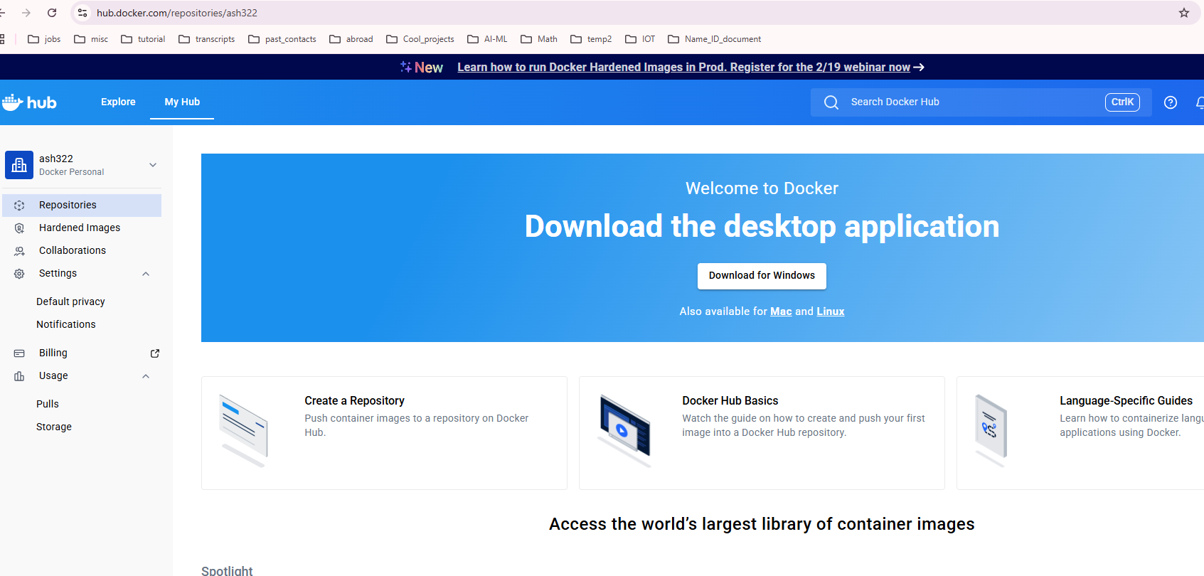
Push the Image to Docker Hub
Goto docker hub and create an account. Also note down user name

Slide 11
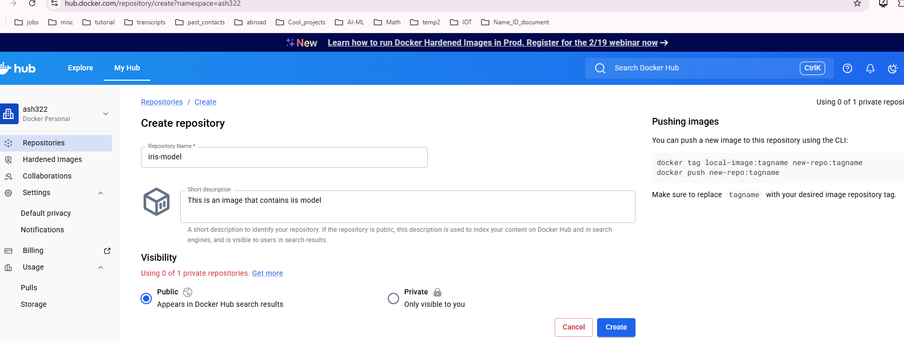
Push the Image to Docker Hub
Create a repository: image_ml_model

Slide 12
Push the Image to Docker Hub
Now let’s look at the docker images on local machine:
> docker image ls
2) Now we tag the image:
> docker tag image_ml_model ash322/image_ml_model
Here ash322 is my username
3) Now login: > docker login
(Follow instructions)
3) Now push the image to docker hub (This could take few minutes):
> docker push ash322/image_ml_model

Slide 13
NOW CREATE AN AWS EC2 INSTANCE
AND PULL THE DOCKER IMAGE

Slide 14
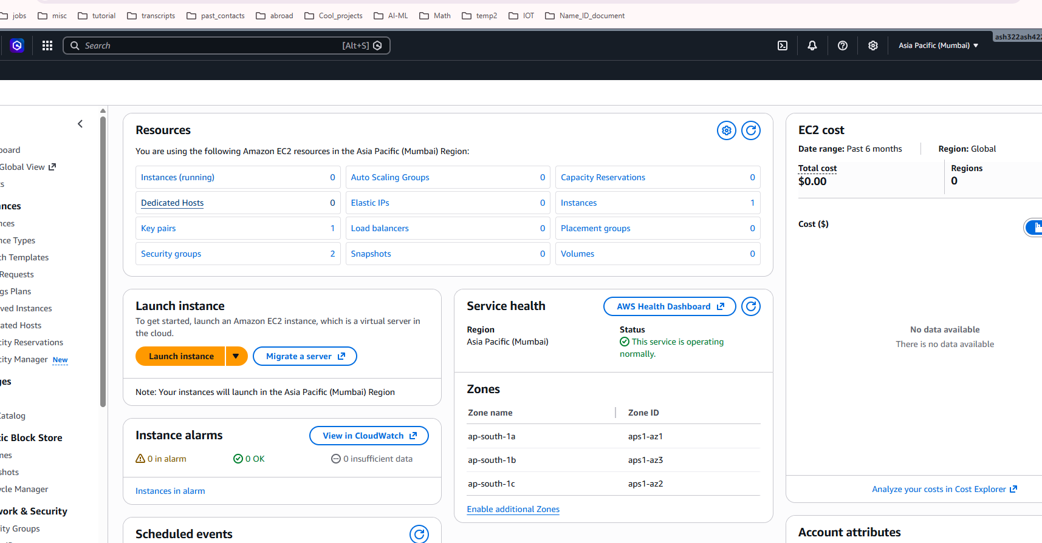
Here we launch the EC2 instance.
Name = iris-model-instance
OS image=Ubuntu
Do not need to create key-pair. Proceed without key-pair

Slide 15
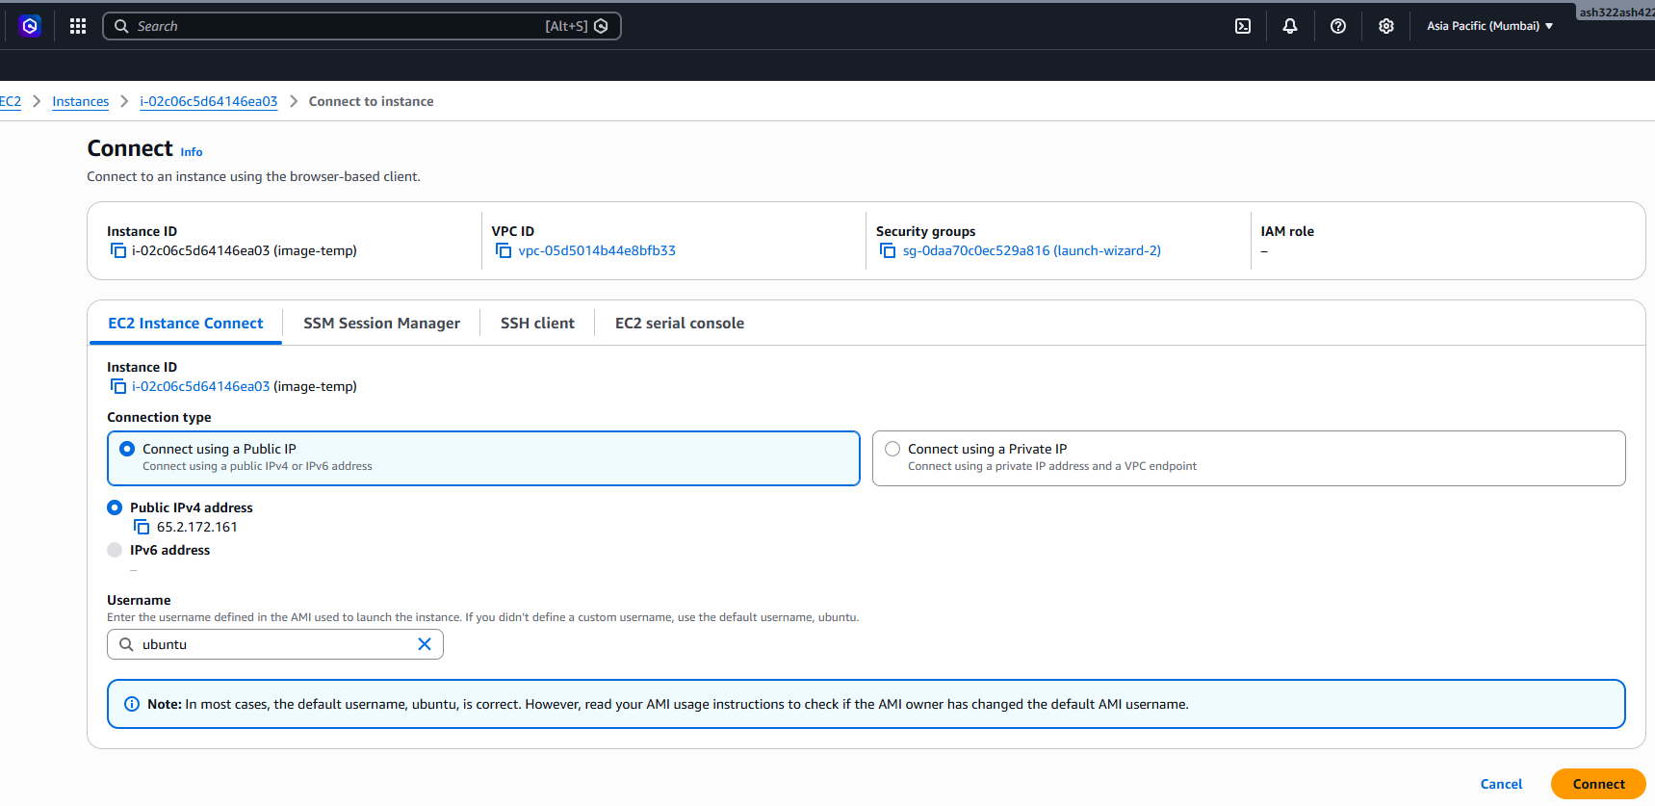
Now we connect to our EC2 instance: Connect using a Public IP

Slide 16
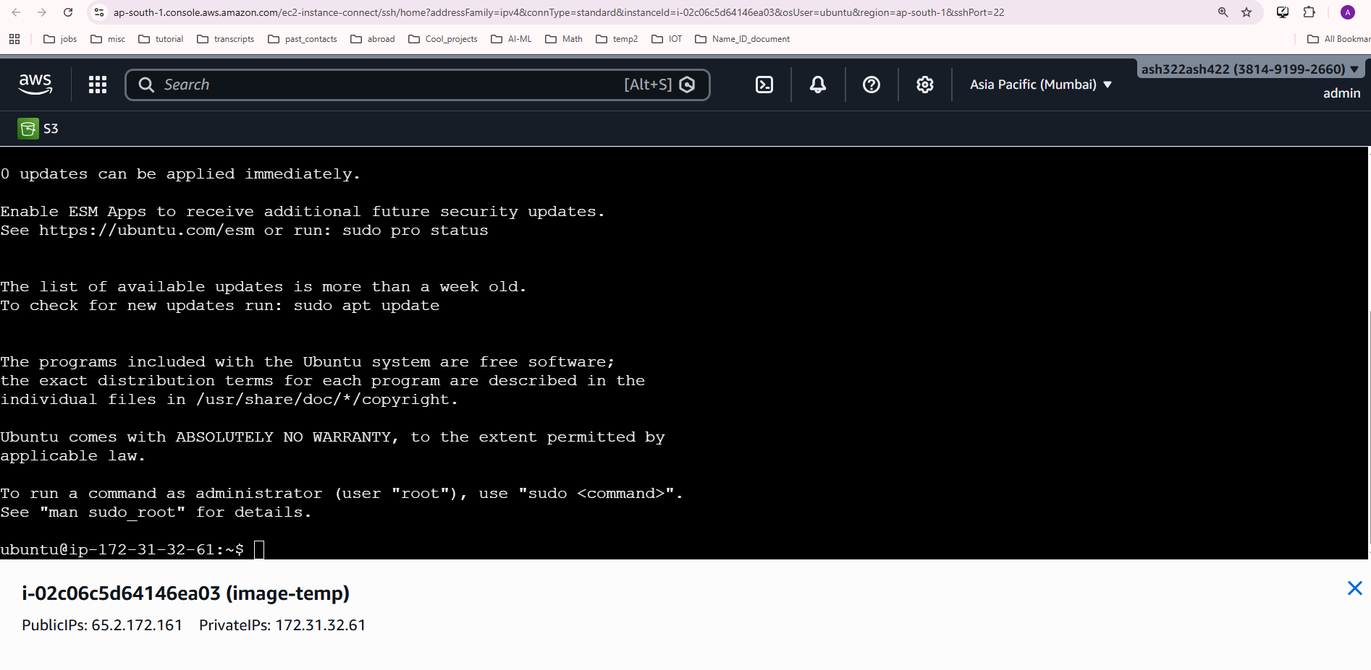
You should see following EC2 console

Slide 17
Run following commands on EC2 console:
Install Docker on EC2
> sudo apt update
> sudo apt install docker.io -y
> sudo systemctl start docker
Check if docker is running:
> ps –aux | grep dock
Login to docker:
> docker login
Go to url specified and paste the code
(Now we give permission)
> sudo usermod -aG docker $USER
> newgrp docker
Pull Image on Ubuntu OS:
> docker pull ash322/image_ml_model
Run Container
> docker run -d -p 8000:8000 ash322/image_ml_model

Slide 18
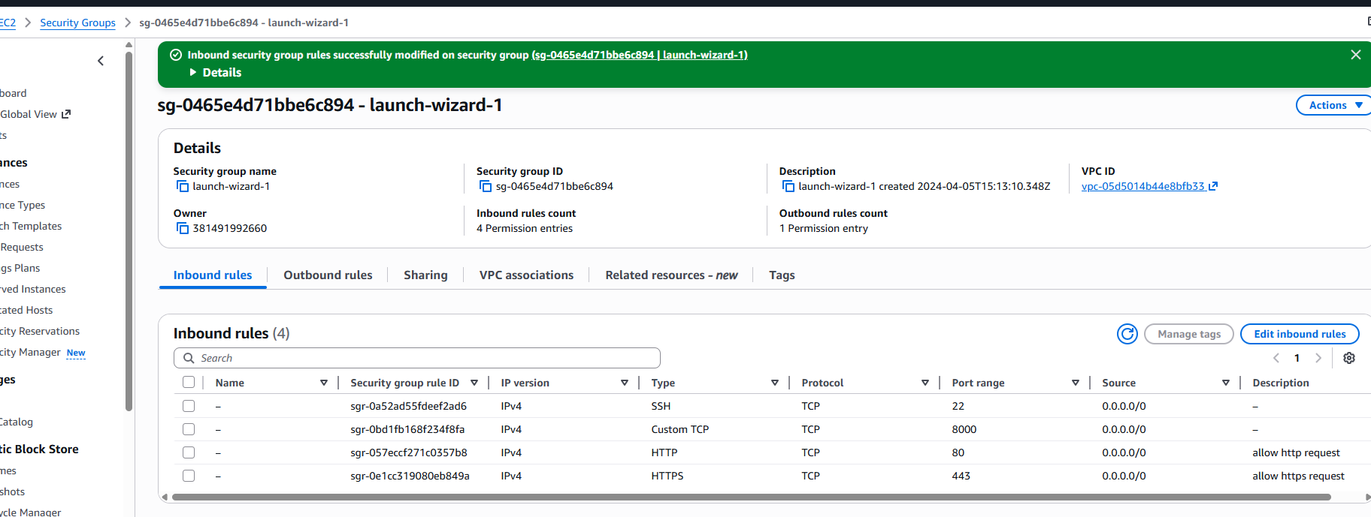
Open Security Group:
Make sure you have following
Custom TCP → Port 8000 → Anywhere

Slide 19
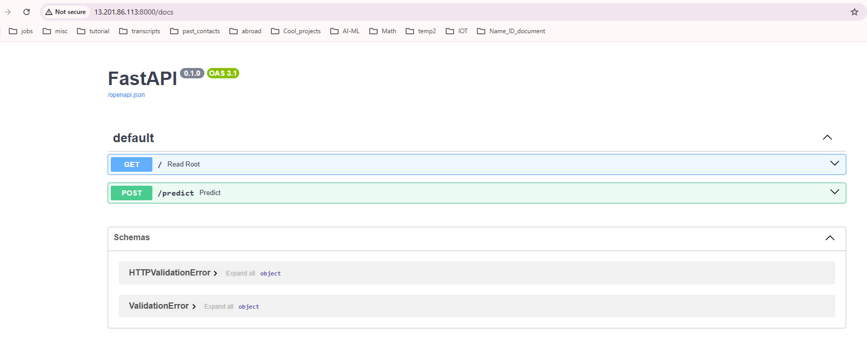
Access Model:
http://EC2-PUBLIC-IP:8000/docs

Slide 20
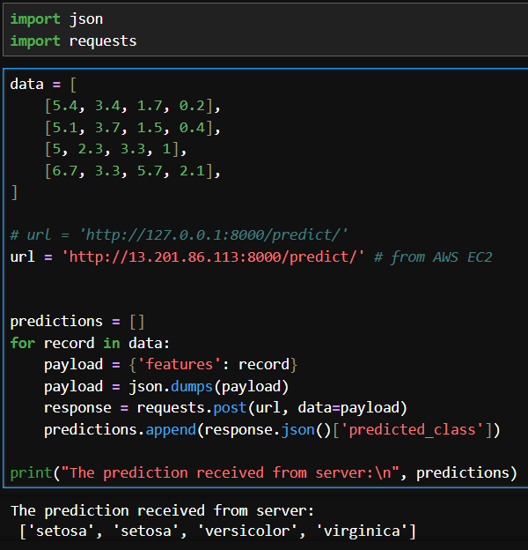
Now run following:

