Slide 1
SQL Database on Cloud:
AWS Relational Database Service (RDS)

Slide 2
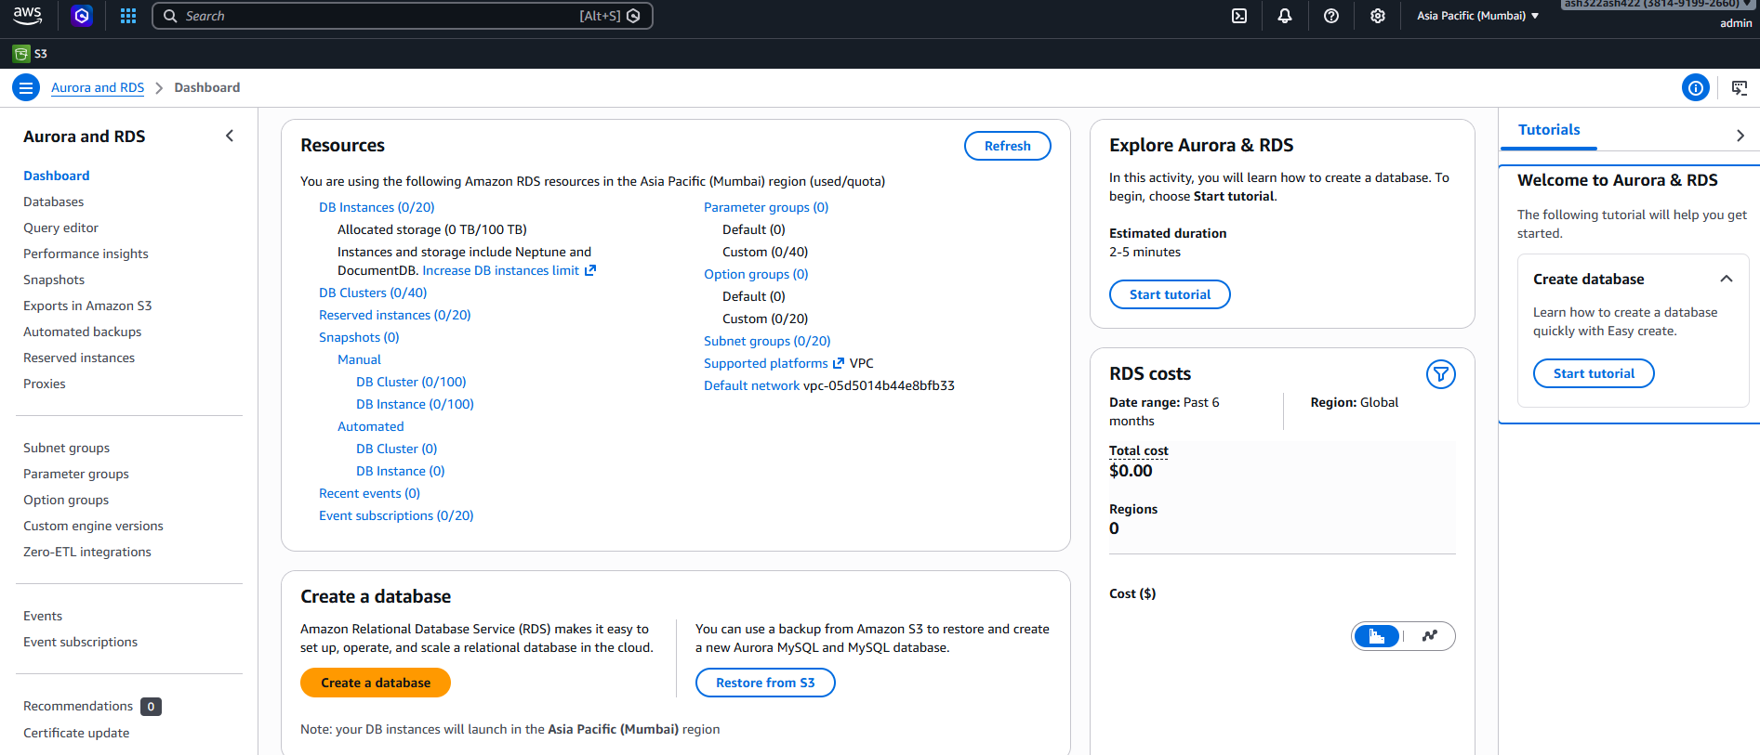

1. Create MySQL Database on AWS RDS
Go to: https://console.aws.amazon.com
Then navigate to: AWS Console → Services → RDS

Slide 3
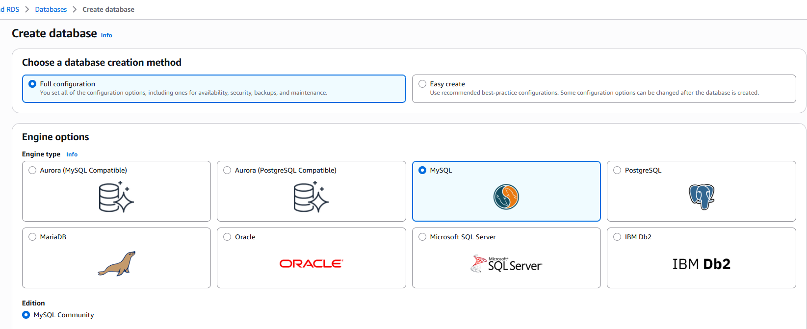


Step 1: Create Database
Click Create database.
Choose following
Setting | Value
DB creation method | Full config(default)
Engine type | MySQL
Version | Latest
Template | Free tier
DB instance identifier | my-first-db
Master username | admin
Master password | gh45mod7=78%()

Slide 4
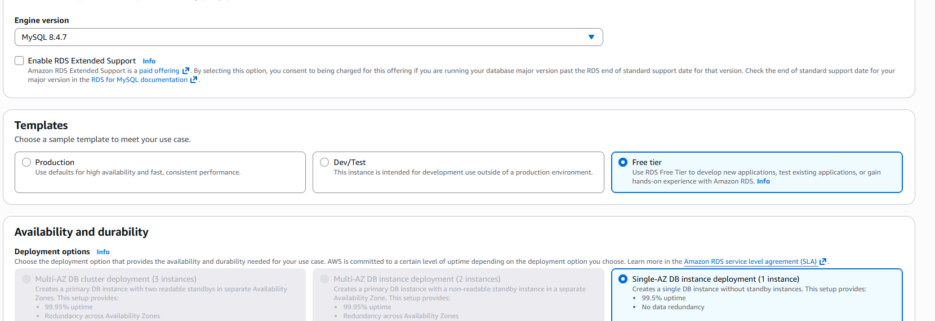


Step 1: Create Database
Click Create database.
Choose following
Setting | Value
DB creation method | Full config(default)
Engine type | MySQL
Version | Latest
Template | Free tier
DB instance identifier | my-first-db
Master username | admin
Master password | gh45mod7=78%()

Slide 5
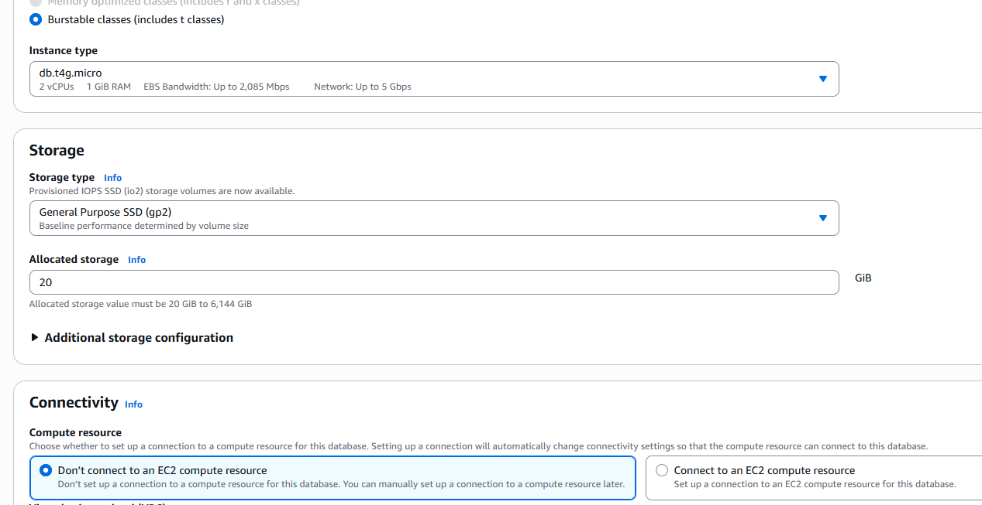


Step 2: Configure Instance
Recommended (Free tier):
Setting | Value
DB instance class | db.t3.micro
Storage | 20 GB
Storage type | gp2

Slide 6
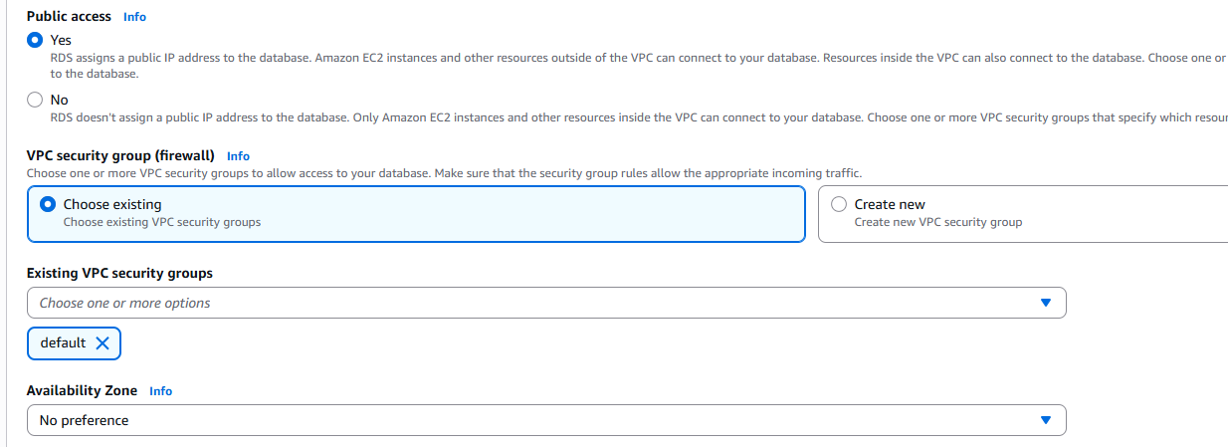

Step 3: Connectivity
Important settings:
Setting | Value
Public access | Yes
VPC security group | Default
Database port | 3306

Slide 7
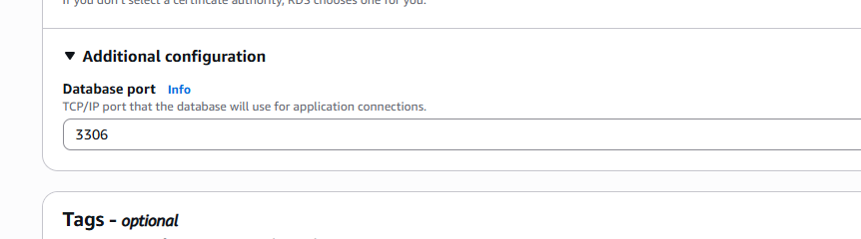

Step 3: Connectivity
Important settings:
Setting | Value
Public access | Yes
VPC security group | Default
Database port | 3306

Slide 8
Step 4: Create Database
Click Create database
It will take about 3–5 minutes.

Slide 9
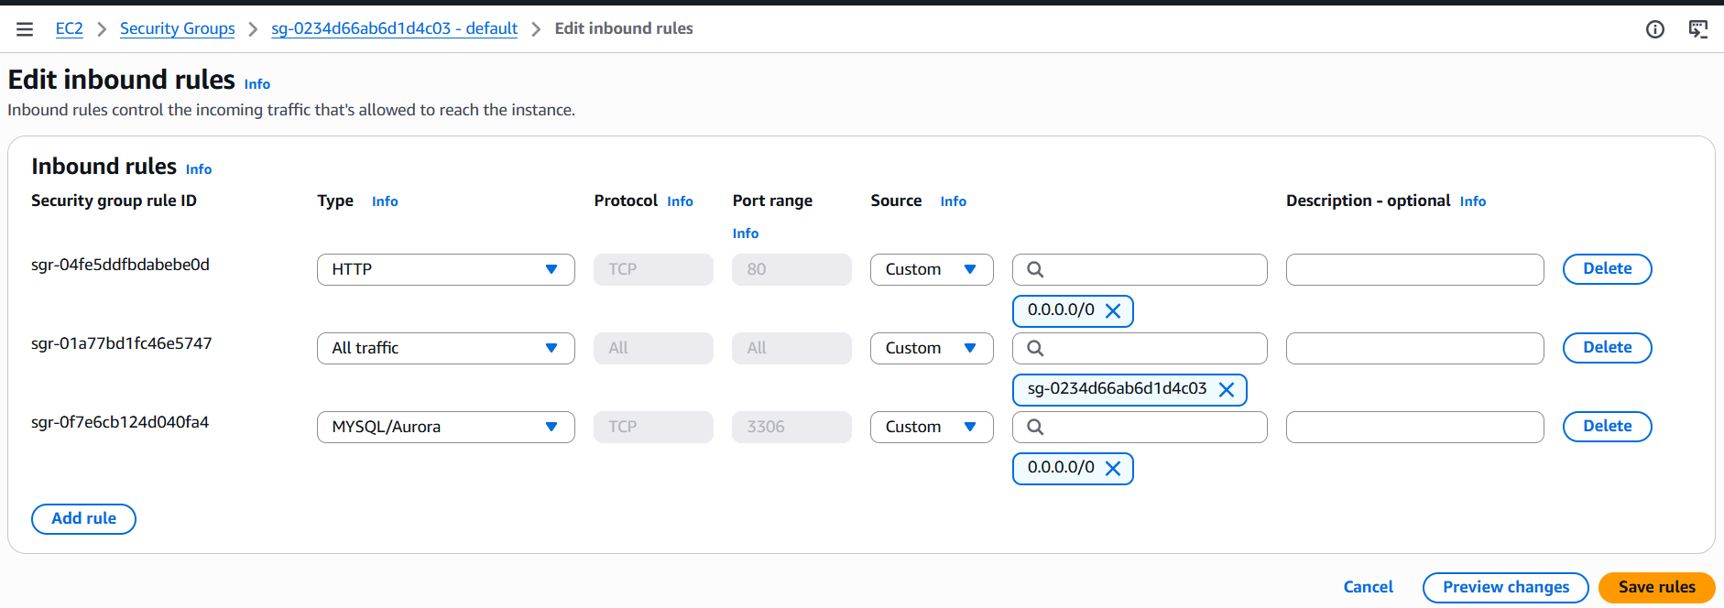
2. Allow Your IP to Connect
Go to RDS → Databases → my-first-db
Open Connectivity & Security -> Click Security Group
Add inbound rule:
Type | Port | Source
MySQL/Aurora | 3306 | Your IP: Or use 0.0.0.0/0

Slide 10
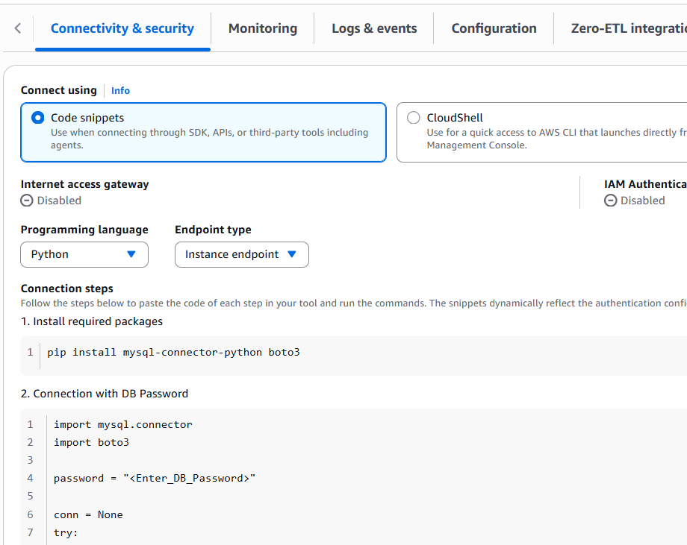




3. Get code to connect to DB
Click on DB and from
Connect Using -> Code snippet,
get python code and run it.
You will use this in Python code to create DB first.

Slide 11
4) On local Install Python MySQL Library
Use:
pip install mysql-connector-python boto3
pip install pymysql

Slide 12
5) The python code: Create table
import pymysql
connection = pymysql.connect(
host="my-first-db.xxxxxx.us-east-1.rds.amazonaws.com",
user="admin",
password="gh45mod7=78%()",
database=“student_db",
port=3306
)
cursor = connection.cursor()
Cont…

Slide 13
create_table_query = """
CREATE TABLE IF NOT EXISTS students (
id INT AUTO_INCREMENT PRIMARY KEY,
name VARCHAR(100),
course VARCHAR(100)
)
"""
cursor.execute(create_table_query)
connection.commit()
print("Table created successfully")
cursor.close()
connection.close()

Slide 14
6) The python code: Insert Data
import pymysql
connection = pymysql.connect(
host="my-first-db.xxxxxx.us-east-1.rds.amazonaws.com",
user="admin",
password="gh45mod7=78%()",
database="company_db"
)
cursor = connection.cursor()
query = """
INSERT INTO students (name, course)
VALUES (%s,%s)
"""
data = ("Alice", "Machine Learning")
cursor.execute(query, data)
connection.commit()
print("Data inserted")
cursor.close()
connection.close()
Cont…

Slide 15
6) The python code: Fetch Data
import pymysql
connection = pymysql.connect(
host="my-first-db.xxxxxx.us-east-1.rds.amazonaws.com",
user="admin",
password="gh45mod7=78%()",
database="company_db"
)
cursor = connection.cursor()
cursor.execute("SELECT * FROM students")
rows = cursor.fetchall()
for r in rows:
print(r)
cursor.close()
connection.close()
Cont…

Slide 16
Most ML pipelines use this pattern:
Python ETL
↓
AWS RDS (MySQL/Postgres)
↓
Data warehouse / analytics
Cont…

Slide 17
Tect box

