Slide 1
Training and classification using a discrete perceptron with a step-by-step example.

Slide 2
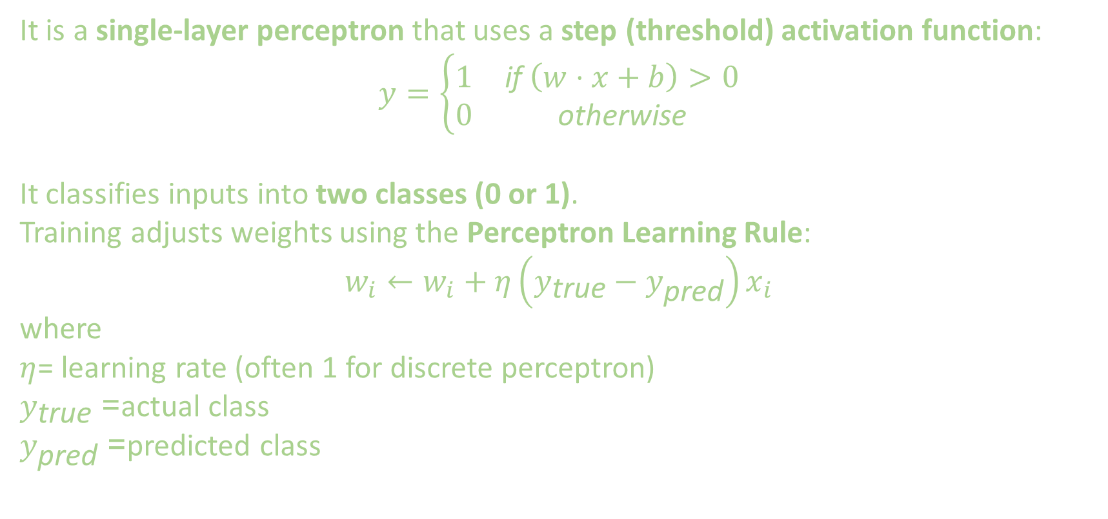
1.Quick Recap: Discrete Perceptron
It is a single-layer perceptron that uses a step (threshold) activation function:
$$y=\left\{\begin{matrix}1 & \text{if} \left(w⋅x+b\right)>0 \\ 0 & \text{otherwise}\end{matrix}\right.$$
It classifies inputs into two classes (0 or 1).
Training adjusts weights using the Perceptron Learning Rule:
$$w_{i}←w_{i}+η\left(y_{\text{true}}−y_{\text{pred}}\right)x_{i}$$
where
$η$= learning rate (often 1 for discrete perceptron)
$y_{\text{true}}$= actual class
$y_{\text{pred}}$= predicted class

Slide 3
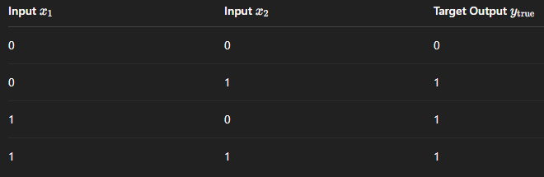
2. Example Problem
Let’s use a simple OR gate as our classification problem. Let's construct a perceptron that can classify output as 0 or 1 depending on the input.

Slide 4
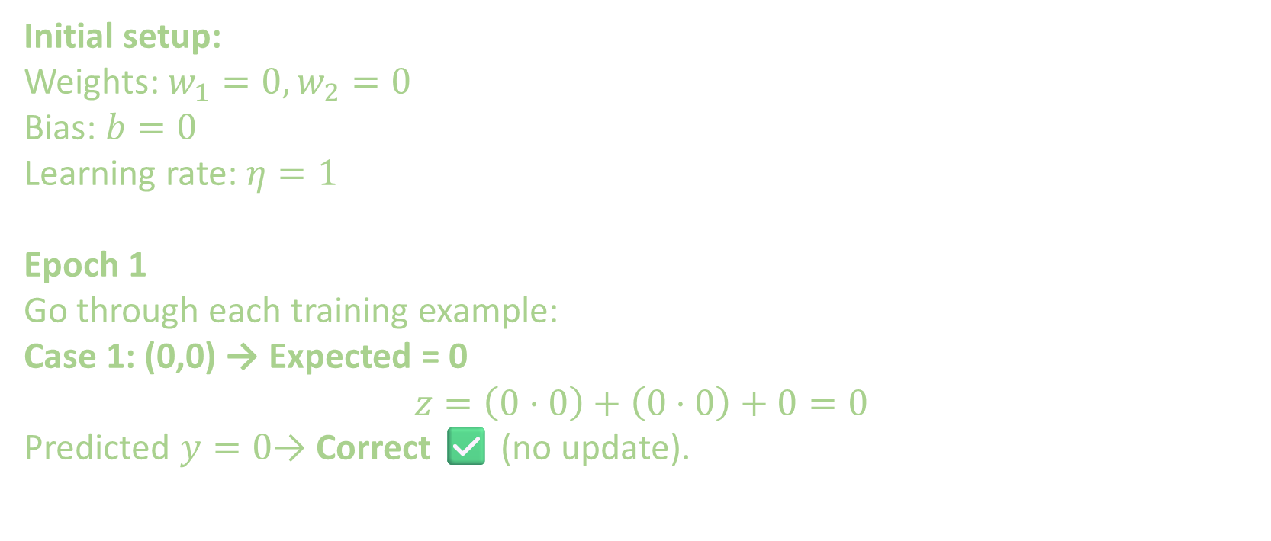
3. Step-by-Step Training
Initial setup:
Weights: $w_{1}=0,w_{2}=0$
Bias: $b=0$
Learning rate: $η=1$
Epoch 1
Go through each training example:
Case 1: (0,0) → Expected = 0
$$z=\left(0⋅0\right)+\left(0⋅0\right)+0=0$$
Predicted $y=0$→ Correct ✅ (no update).

Slide 5
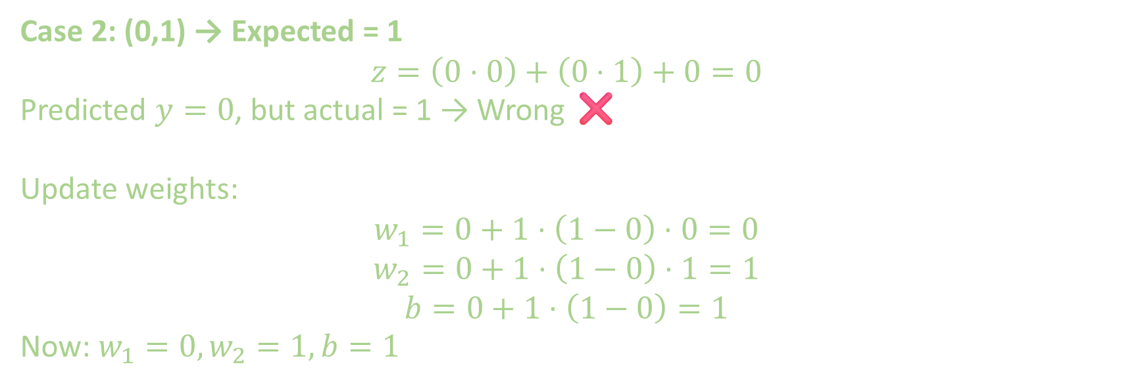
3. Step-by-Step Training
Case 2: (0,1) → Expected = 1
$$z=\left(0⋅0\right)+\left(0⋅1\right)+0=0$$
Predicted $y=0$, but actual = 1 → Wrong ❌
Update weights:
$$w_{1}=0+1⋅\left(1−0\right)⋅0=0$$
$$w_{2}=0+1⋅\left(1−0\right)⋅1=1$$
$$b=0+1⋅\left(1−0\right)=1$$
Now: $w_{1}=0,w_{2}=1,b=1$

Slide 6
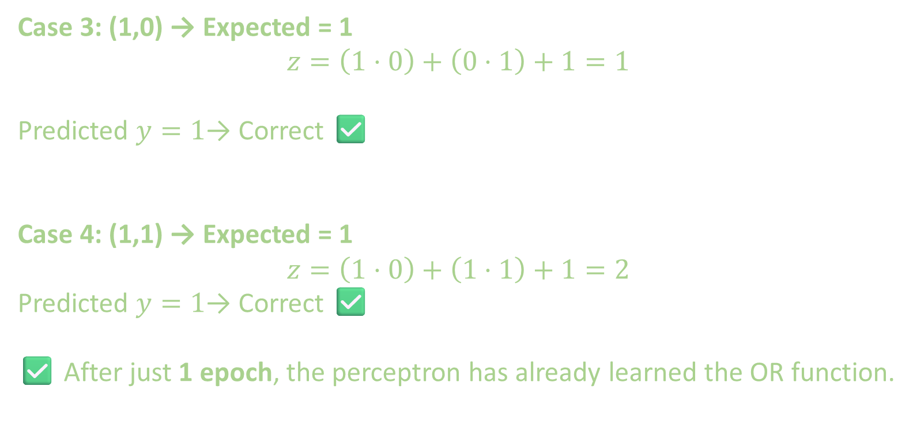
3. Step-by-Step Training
Case 3: (1,0) → Expected = 1
$$z=\left(1⋅0\right)+\left(0⋅1\right)+1=1$$
Predicted $y=1$→ Correct ✅
Case 4: (1,1) → Expected = 1
$$z=\left(1⋅0\right)+\left(1⋅1\right)+1=2$$
Predicted $y=1$→ Correct ✅
✅ After just 1 epoch, the perceptron has already learned the OR function.

Slide 7
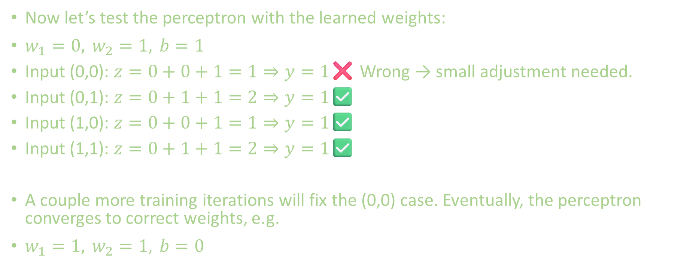
4. Classification
Now let’s test the perceptron with the learned weights:
$w_{1}=0, w_{2}=1, b=1$
Input (0,0): $z=0+0+1=1⇒y=1$❌ Wrong → small adjustment needed.
Input (0,1): $z=0+1+1=2⇒y=1$✅
Input (1,0): $z=0+0+1=1⇒y=1$✅
Input (1,1): $z=0+1+1=2⇒y=1$✅
A couple more training iterations will fix the (0,0) case. Eventually, the perceptron converges to correct weights, e.g.
$w_{1}=1, w_{2}=1, b=0$

Slide 8
5. Key Takeaways
Training = adjust weights using perceptron rule until all training samples are classified correctly.
Classification = compute weighted sum, apply step function, output 0 or 1.
Works only for linearly separable problems (like AND, OR).
Does not work for XOR (non-linear).

Slide 10
EXTRA
Xxxxxxxxxxx
xxxxxxxxxxxx

