Slide 1
Why GPUs for Deep Learning ?

Slide 2
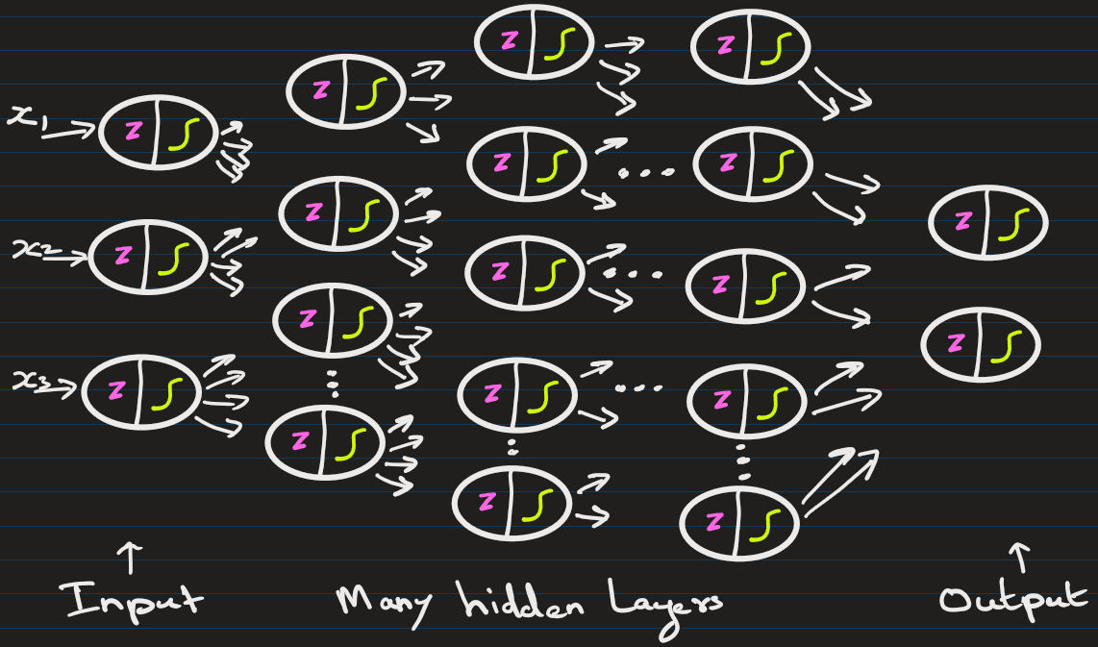
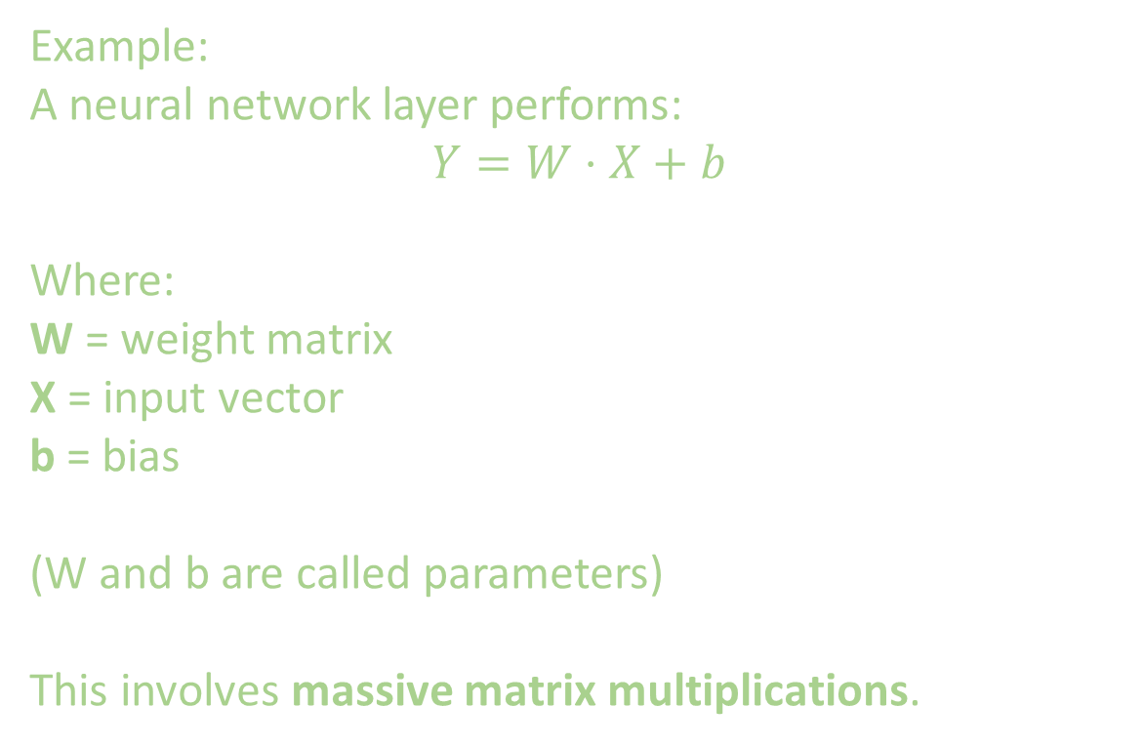
Example: A neural network layer performs:
$$Y=W⋅X+b$$
Where:
W = weight matrix
X = input vector
b = bias
(W and b are called parameters)
This involves massive matrix multiplications.

Slide 3
Model | Parameters
Small neural network | 1 million
ResNet | 25 million
GPT models | billions
Training requires repeating these operations thousands of times.

Slide 4
CPU (Central Processing Unit)
CPU is designed for general-purpose tasks.
Few cores (4 – 32). Each core can run in parallel
Good for sequential tasks
GPU (Graphics Processing Unit)
Originally designed for graphics rendering: processing millions of pixels simultaneously
Therefore, GPUs have:
Few cores (1000 – 16000). Each core can run in parallel
Massive parallelism

Slide 5
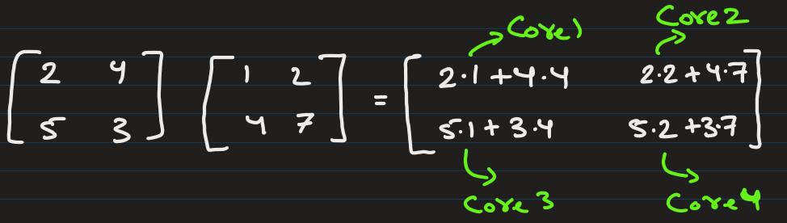
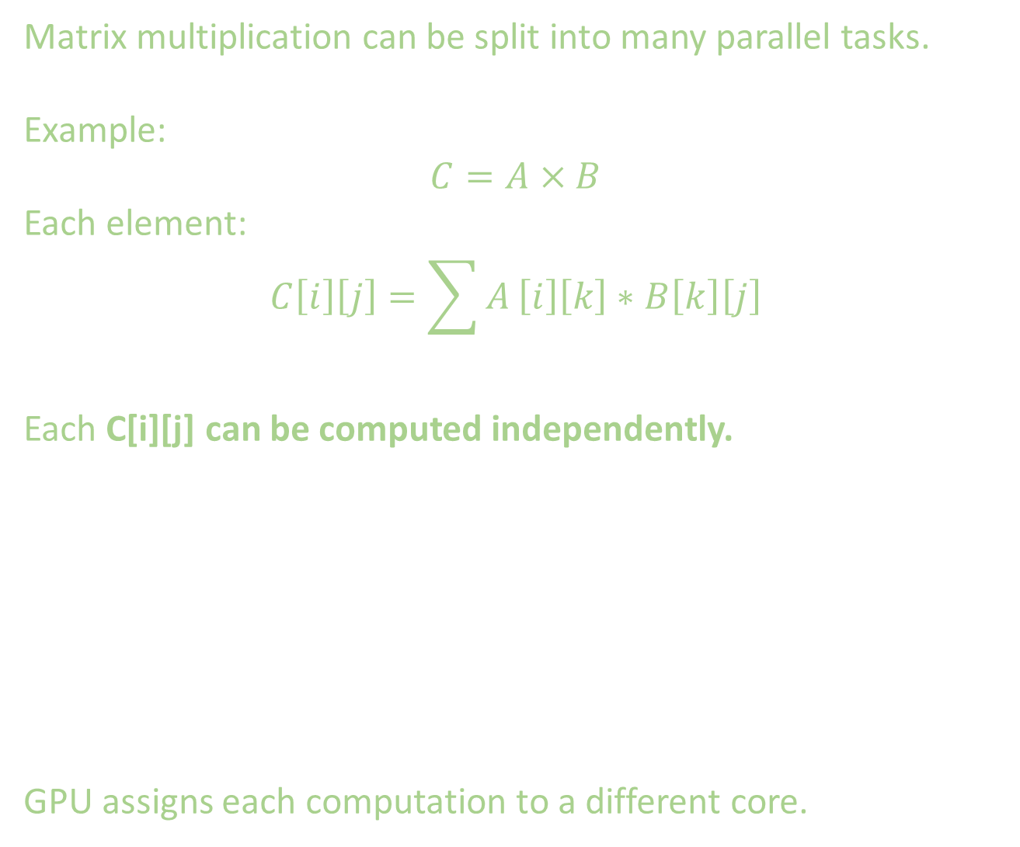
Matrix multiplication can be split into many parallel tasks.
Example:
$$C=A×B$$
Each element:
$$C\left[i\right]\left[j\right]=\sum{A}\left[i\right]\left[k\right]∗B\left[k\right]\left[j\right]$$
Each C[i][j] can be computed independently.
GPU assigns each computation to a different core.

Slide 6
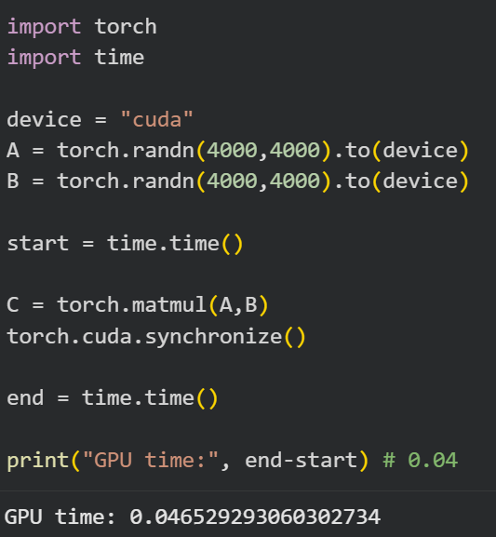
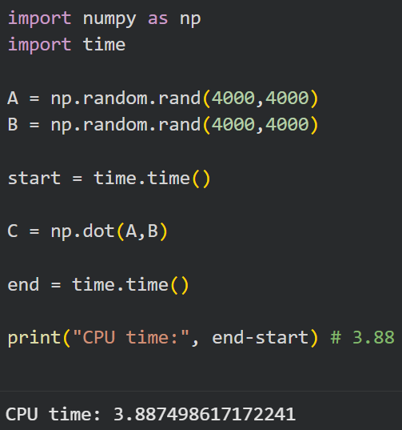
I ran following on Google Colab. I took 2 matrix A and B, each of shape 4000 x 4000 and multiplied them on CPU / GPU.

Slide 7
Deep Neural Network has many hidden layers

Slide 8
EXTRA
Xxxxxxxxxxx
xxxxxxxxxxxx

