Slide 1
ANN Key Terms: BatchSize-Iterations-Epoch
(On Dev) Artificial Neural Network

Slide 2
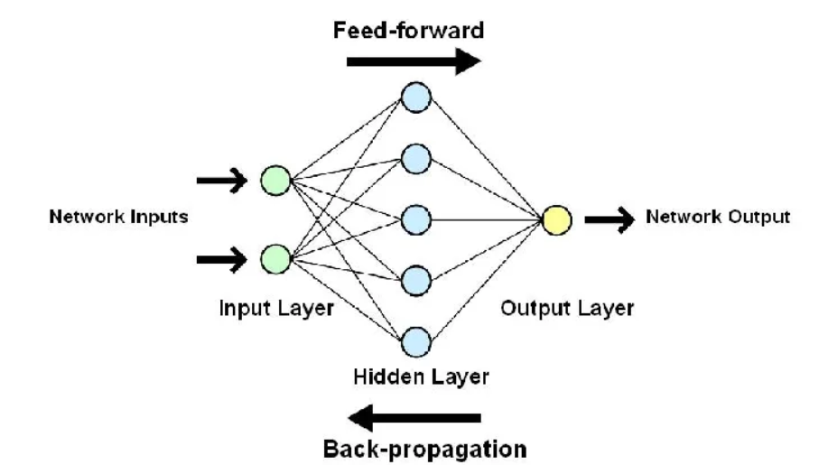
Some key terms: Batch size(p1)
Batch size refers to the number of training examples used in a single iteration of model training, meaning how many data points the model processes before updating its internal parameters like weights and biases.
Each batch of samples goes through one full forward and one full backward propagation.
Idea:
Suppose you have 500 training samples and set the batch size to 100. The algorithm trains the network using the first 100 samples from the training dataset. The network is then trained again using the second 100 samples. It will repeat this process(5 times) until all samples have been propagated across the network.
The batch is passed forward and backward via the neural network.

Slide 3
Some key terms: Batch size(p2)
Importance of batch size: It has a direct impact on the accuracy and computational efficiency of the training process. The batch size can be understood as a trade-off between accuracy and speed. Large batch sizes can lead to faster training times but may result in lower accuracy and overfitting, while smaller batch sizes can provide better accuracy, but can be computationally expensive and time-consuming.
The batch size can also affect the convergence of the model, meaning that it can influence the optimization process and the speed at which the model learns. Small batch sizes can be more susceptible to random fluctuations in the training data, while larger batch sizes are more resistant to these fluctuations but may converge more slowly.

Slide 4
Some key terms: Batch size(p2)
How to choose right batch size: There is no one-size-fits-all answer when it comes to choosing a batch size, as the ideal size will depend on several factors, including the size of the training dataset, the complexity of the model, and the computational resources available. It is generally good practice to increase the batch size until you saturate your GPU consumption. However, like everything, the batch size is merely a hyperparameter.
For the most part, a batch size of 32 is a decent starting point, but you can also experiment with 64, 128, and 256. Other values (lower or higher) may be appropriate for specific data sets. Again, it depends entirely on the problem, but picking something from this range is usually the best to begin experimenting.

Slide 5
Some key terms: Iterations(p3)
Iterations are the number of steps through batches of the whole training data. It is Total_Number_Of_Samples/Batch_Size.
Iterations determine the number of updates made to the model weights. More iterations, means that weight would get updated a greater number of times.
Example on next page

Slide 6
Some key terms: Iterations(p3)
Example: Suppose you are given total training set of 500 images and batch size of 100. How many iterations you this set will go through?
From the above values, 100 samples will be taken each time through the neural network forward and backward. This constitutes one iteration.
Therefore, if you are loading 100 images at a time (in one batch), to go through all 500 images, you will need 500 / 100 = about 5 iterations. So, when an entire training dataset passes through the NN, model weights would get updated 5 times.
In above example, 5 iterations makes 1 epoch.
100
100
100
100
100

Slide 7
Some key terms: Epoch(p4)
Epoch is a complete cycle of training a machine learning model on an entire dataset
How does an epoch work?
The model passes through the entire training dataset once.
The model adjusts its internal parameters based on errors made in the previous pass.
The model repeats this process multiple times, adjusting its parameters to best fit the training data.
In one epoch, the entire training dataset is passed forward and backward via the neural network.
100
100
100
100
100

Slide 8
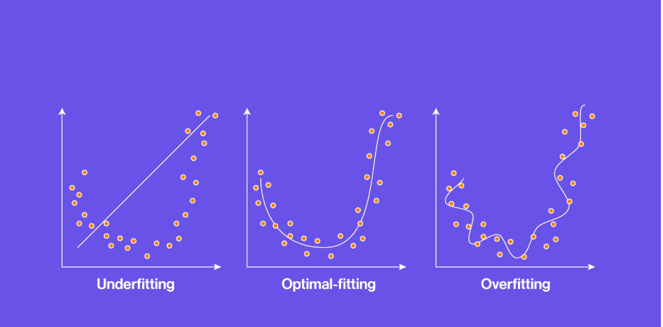
Some key terms: Epoch(p5)
Why are epochs important?
The number of epochs determines how many times the model will see the entire training data before completing training. The number of epochs is an important hyperparameter to set correctly, as it can affect both the accuracy and computational efficiency of the training process.
If the number of epochs is too small, the model may not learn the underlying patterns in the data, resulting in underfitting.
If the number of epochs is too large, the model may overfit the training data, leading to poor generalization performance on new, unseen data.
How do I determine the right number of epochs?
The ideal number of epochs for a given training process can be determined through experimentation and monitoring the performance of the model on a validation set. Once the model stops improving on the validation set, it is a good indication that the number of epochs has been reached.

