Slide 1
ANN Key Terms: Optimizer
(On Dev) Artificial Neural Network

Slide 2
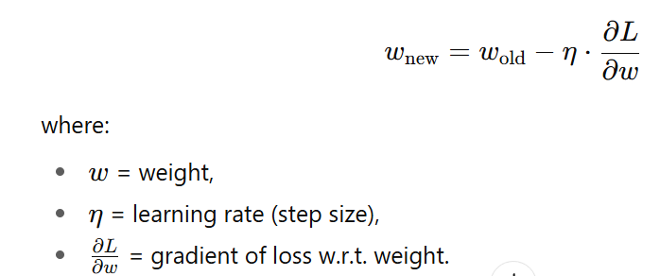
Most optimizers are variations of Gradient Descent. They
Compute the gradient (slope of loss function with respect to weights).
Update weights in the opposite direction of the gradient (because we want to minimize loss).
Formula:

Slide 3
Types of Optimizers
a) Batch Gradient Descent
Uses the entire dataset to compute gradient before updating weights.
Accurate but very slow for large datasets.
(b) Stochastic Gradient Descent (SGD)
Uses one sample at a time to update weights.
Much faster but updates are noisy (loss jumps around).
Analogy: Batch = careful slow walk, SGD = fast but shaky run downhill.

Slide 4
(c) Mini-Batch Gradient Descent
Middle ground: Uses a small batch of samples (like 32, 64).
Most common in practice.
Balances speed + stability.
Example: Keras model.fit(..., batch_size=32).
d) Momentum
Idea: Don’t just look at current gradient → also keep some memory of the past direction.
Helps smooth out noisy updates and speeds up downhill movement.
Analogy: Like a ball rolling down a hill — momentum carries it forward.

Slide 5
(e) AdaGrad
Adjusts the learning rate for each parameter individually.
Parameters with frequent updates get smaller steps; rare ones get bigger steps.
Downside: Learning rate shrinks too much over time.
(f) RMSProp
Fixes AdaGrad by keeping learning rate steady.
Works well for recurrent networks.

Slide 6
(g) Adam (Adaptive Moment Estimation)
Most popular today.
Combines Momentum + RMSProp.
Maintains a running average of past gradients (momentum) and squared gradients (adaptive learning rate).
Fast, efficient, works well in many cases.

Slide 7
Applications
Deep learning is used in computer vision, natural language processing (NLP), speech recognition, autonomous vehicles, and many more AI applications.

