Slide 1
ANN Key Terms: LearningRate-LossFunction
(On Dev) Artificial Neural Network

Slide 2
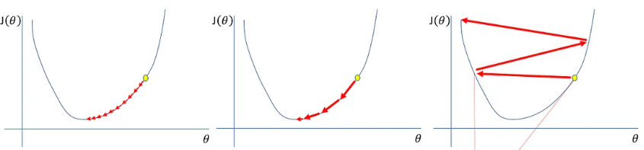
Some key terms: Learning rate(p6)
Learning rate, α, is a hyperparameter that controls how much a model adjusts its parameters, weights and biases, during each training iteration
It controls how much parameter should change in response to the estimated error each time the model weights are updated. It determines the size of the steps taken towards a minimum of the loss function during optimization.
If α is too low, the model converges slowly, requiring many epochs and leading to inefficient resource use.
If α is too high, it can cause the model to overshoot optimal weights, resulting in instability and divergence of the loss function.
An optimal α should be low enough for accurate convergence while high enough for reasonable training time. Smaller rates require more epochs, potentially yielding better final weights, whereas larger rates can cause fluctuations around the optimal solution.
In general, a good starting point is to use a learning rate of 0.01.
Too Low
Just Right
Too High

Slide 3
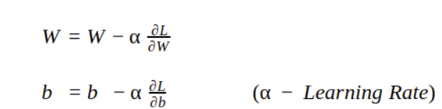
Some key terms: Learning rate(p6)
Simple definition:
Another definition common in literature:
Learning rate for updating model weights in Stochastic Gradient Descent (SGD):
new_weight <- old_weight — (learning_rate * gradient)
w <- w – α * ∇J(θ)
Learning rate α : A hyperparameter that controls the size of steps taken to update model weights,w.
Gradient ∇J(θ) : The derivative of the loss function with respect to the model's weights
Too Low
Just Right
Too High

Slide 4
Techniques for Adjusting the Learning Rate in Neural Networks(p1)
Fixed Learning Rate (α): It is a common optimization approach where a constant learning rate is selected and maintained throughout the training process. Initially, parameters are assigned random values, and a cost function is generated based on these initial values. The algorithm then iteratively improves the parameter estimations to minimize the cost function.
- Used in small datasets or linear models with straightforward optimization goals.

Slide 5
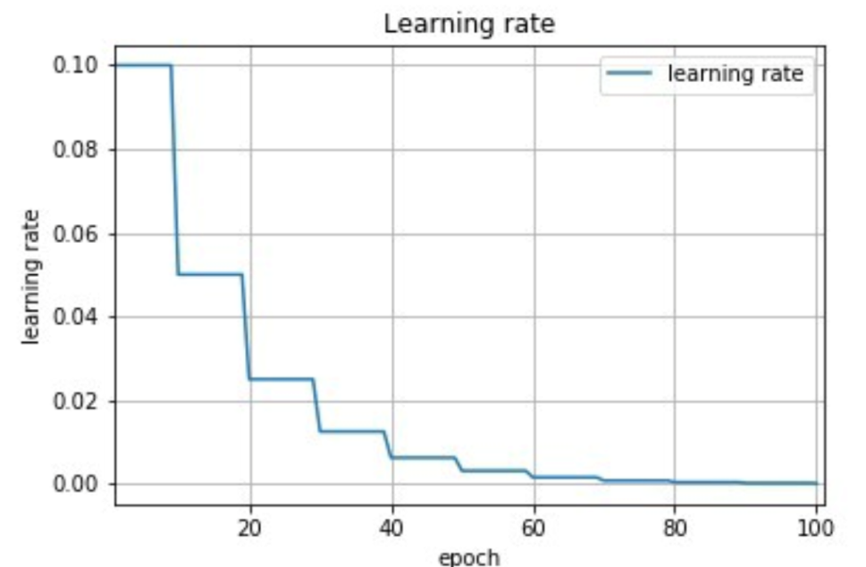
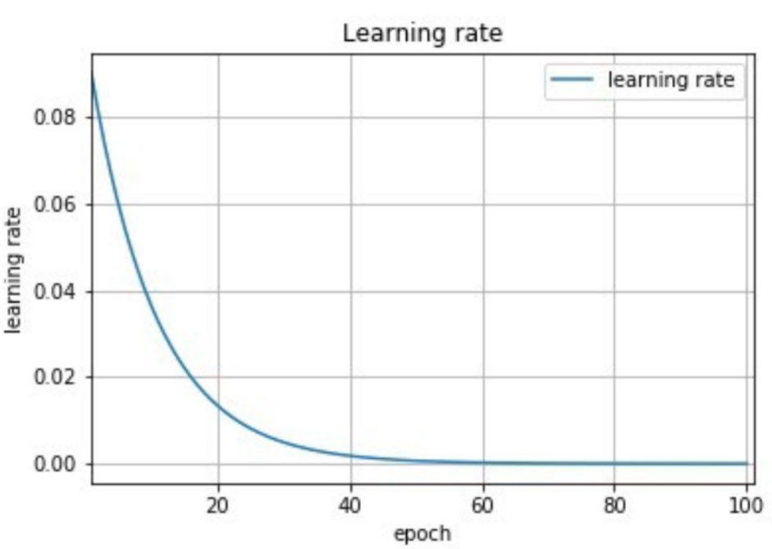
Techniques for Adjusting the Learning Rate in Neural Networks(p1)
2. Learning Rate Schedules: It adjust the learning rate based on predefined rules or functions, enhancing convergence and performance. Some common methods include:
a) Step Decay: The learning rate decreases by a specific factor at designated epochs or after a fixed number of iterations.
b) Exponential Decay: The learning rate is reduced exponentially over time, allowing for a rapid decrease in the initial phases of training.
c) Polynomial Decay: The learning rate decreases polynomially over time, providing a smoother reduction.
Step decay
Exponential decay

Slide 6
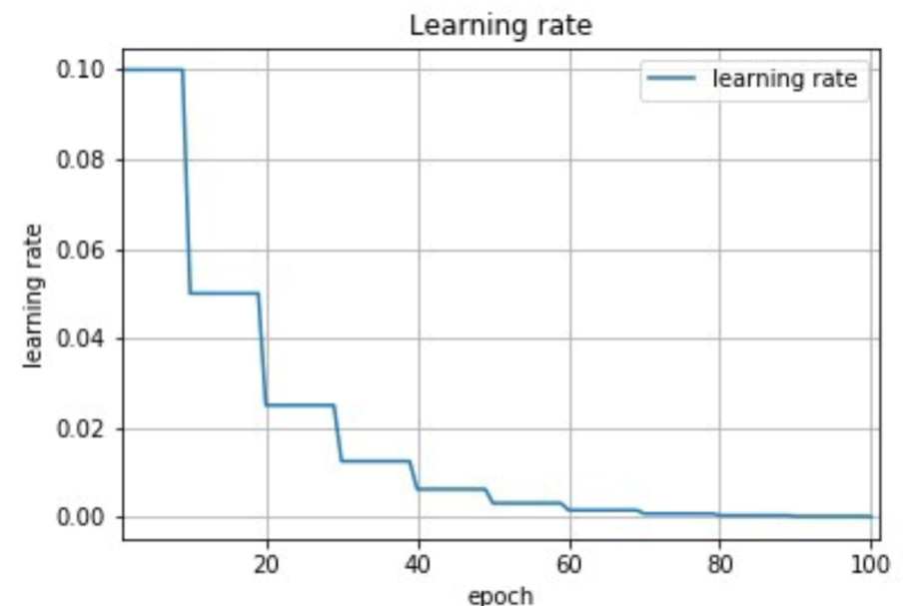

Techniques for Adjusting the Learning Rate in Neural Networks(p1)
a) Step Decay:
STEP DECAY
new_lr = initial_lr * (decay_factor) ^ (floor(epoch / step_size))
initial_lr: is the starting learning rate
decay_factor: amount by which the learning rate is reduced at each step
step_size: number of epochs after which the learning rate is reduced by the decay factor.

Slide 7
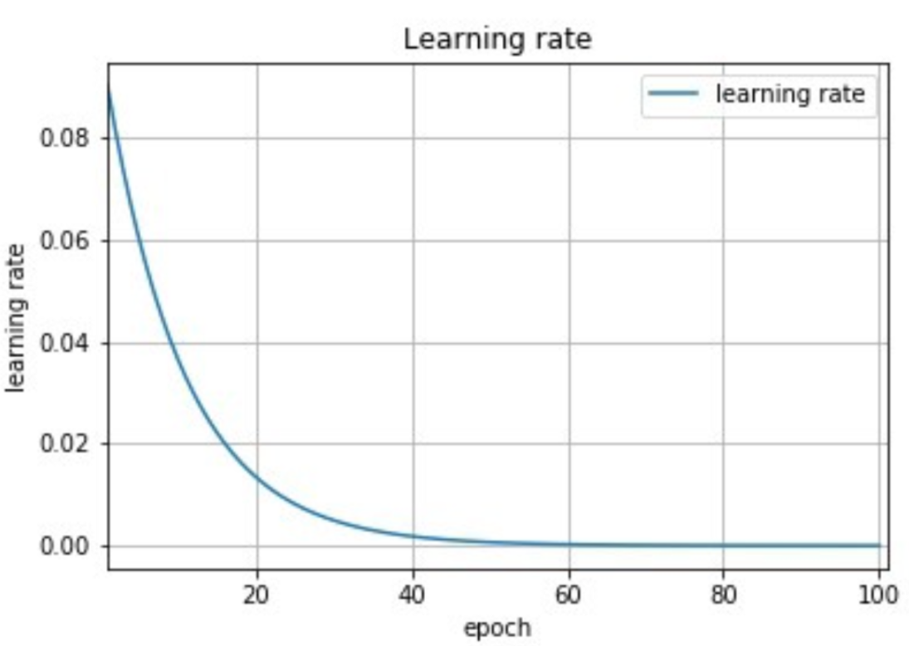

Techniques for Adjusting the Learning Rate in Neural Networks(p1)
b) Exponential Decay:

Slide 8

Techniques for Adjusting the Learning Rate in Neural Networks(p1)
c) Polynomial Decay:

Slide 9
Techniques for Adjusting the Learning Rate in Neural Networks(p2)
3. Adaptive Learning Rate: It dynamically adjust the learning rate based on the model’s performance and the gradient of the cost function. This approach can lead to optimal results by adapting the learning rate depending on the steepness of the cost function curve:
3.1) AdaGrad: Adaptive Gradient method adjusts the learning rate for each parameter individually based on historical gradient information, reducing the learning rate for frequently updated parameters.
3.2) RMSprop: A variation of AdaGrad, RMSprop addresses overly aggressive learning rate decay by maintaining a moving average of squared gradients to adapt the learning rate effectively.
3.3) Adam: Combining concepts from both AdaGrad and RMSprop, Adam incorporates adaptive learning rates and momentum to accelerate convergence.

Slide 10
Techniques for Adjusting the Learning Rate in Neural Networks(p2)
4. Scheduled Drop Learning Rate: Learning rate is decreased by a specified proportion at set intervals, contrasting with decay techniques where the learning rate continuously diminishes. This allows for more controlled adjustments during training.

Slide 11
Techniques for Adjusting the Learning Rate in Neural Networks(p3)
5. Cycling Learning Rate: It involve cyclically varying the learning rate within a predefined range throughout the training process. The learning rate fluctuates in a triangular shape between minimum and maximum values, maintaining a constant frequency. One popular strategy is the triangular learning rate policy, where the learning rate is linearly increased and then decreased within a cycle. This method aims to explore various learning rates during training, helping the model escape poor local minima and speeding up convergence.
6. Decaying Learning Rate: Learning rate decreases as the number of epochs or iterations increases. This gradual reduction helps stabilize the training process as the model converges to a minimum.

