Slide 1
Batch Normalization
Normalization:
Here you scale your data such it has mean=0 and standard deviation=1
So, the age and income values would be on same scale. This way no one feature would dominate other.
After Normalization
age | Income
39 | 60000
42 | 94000
27 | 120000
33 | 90000
… | ….
age | Income
-1.2 | 1.4
1.4 | 0.7
0.4 | 2.3
0.9 | 1.8
… | …

Slide 2



Internal Covariate Shift
Suppose you feed your normalized data to 1st input layer of deep neural networks.
When training DNN:
Each layer’s output becomes the next layer’s input.
As weights update in each layer, the distribution of inputs to deeper layers keeps changing.
This makes training slow and unstable. This problem is called Internal Covariate Shift

Slide 3
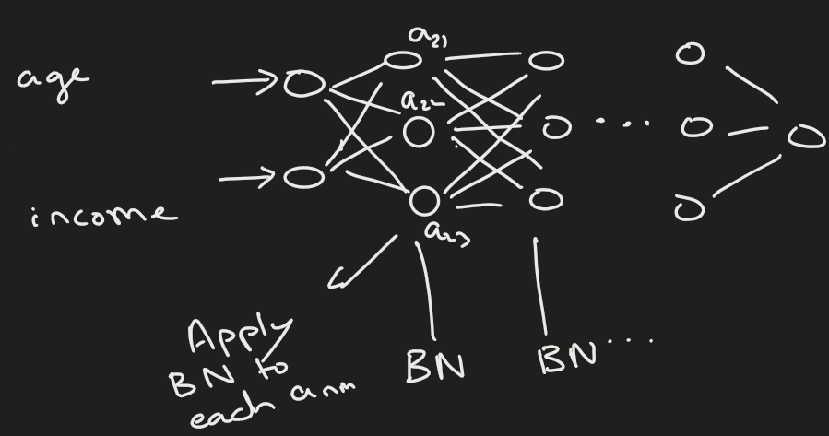
Batch Normalization
Batch Normalization is a technique used in neural networks to - normalize the activations of a layer so that they have a stable distribution during training.
So, each activation that becomes input to next layer is also normalized.

Slide 4
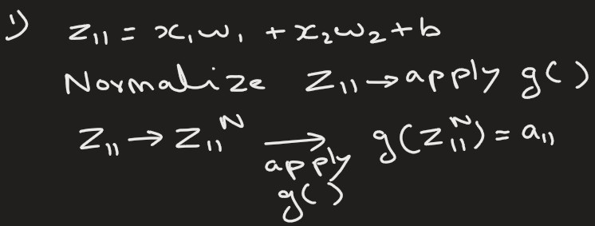
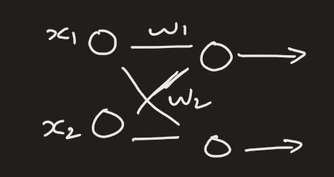
2 ways to do batch normalization
1) Calculate z first for each neuron, then normalize the z value, and then calculate the activation a for this normalized z

Slide 5
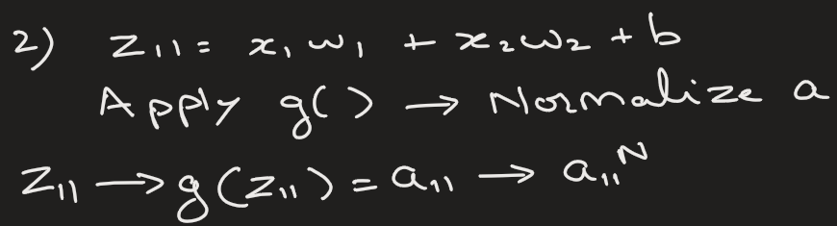
2 ways to do batch normalization
2) Calculate z first for each neuron, then calculate the activation a for this z , and then normalize the activation a.

Slide 6
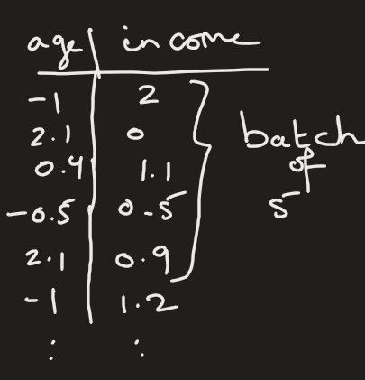
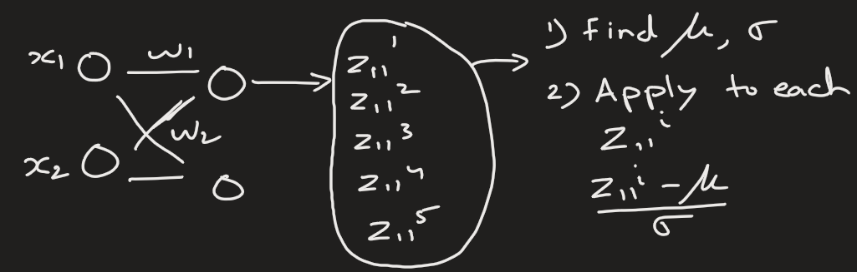

Question: How do you normalize z ?
Let’s focus on first top neuron.
Step 1)
Since we are working with batches (i.e. batch normalization), so we feed a batch of, say 5, input values and calculate the z for all 5 values.
Then we normalize these 5 values like we do any dataset.

Slide 7
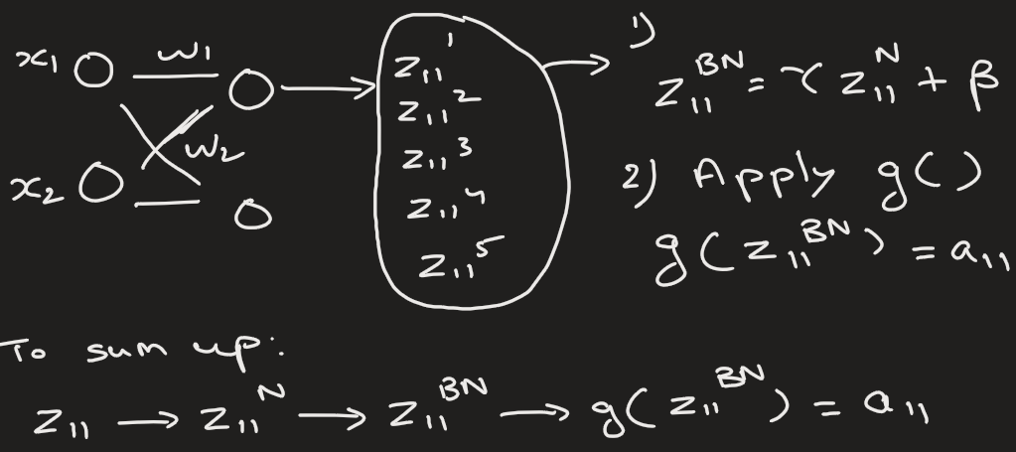
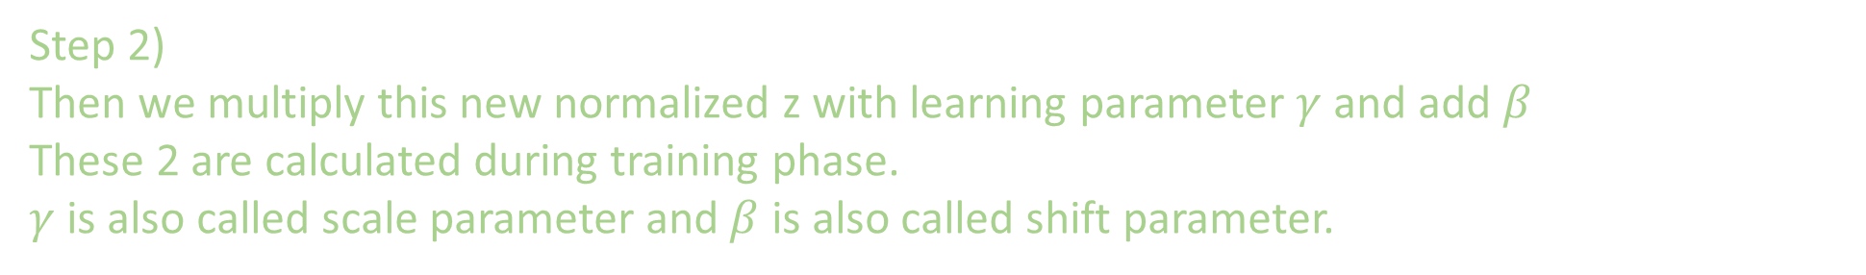
Step 2)
Then we multiply this new normalized z with learning parameter $γ$ and add $β$
These 2 are calculated during training phase.
$γ$ is also called scale parameter and $β$ is also called shift parameter.

Slide 8

Batch Normalization
Note:
We do these steps for all neurons.
Each neuron has its own learning parameter, $γ$ and $β$.

Slide 9
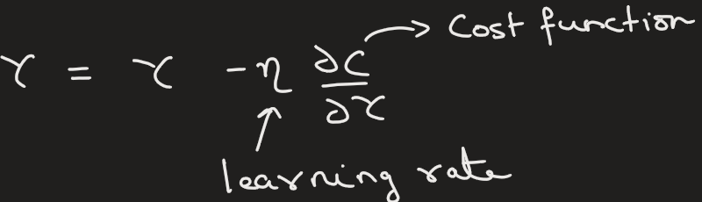
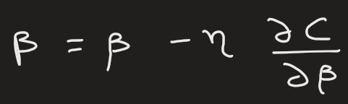
Question: How do you update parameter $γ$ and $β$?
We use gradient descent.

Slide 10


BN advantage
BN does not necessarily increase accuracy, but it helps in following:
1) Faster Training: Allows higher learning rates and converges faster.
2) Reduces Internal Covariate Shift: Prevents input distributions to deeper layers from changing drastically as previous layers' weights update.
3) Less Sensitive to Initialization: Reduces dependency on careful initial weight settings.
4) Helps avoid vanishing or exploding gradients.

Slide 11
Limitations of BN
Small Batches: Performance can degrade with very small mini-batches because batch statistics become less reliable. For example, mean is more reliable when samples are large.
RNNs: Difficult to apply directly to Recurrent Neural Networks (RNNs) due to variable sequence lengths, though variants exist.

Slide 12
“Batch Normalization is not magic. On easy problems with modern optimizers, you may not see dramatic improvements.”
“But on deep or poorly conditioned networks, BatchNorm becomes essential.”
“If you don’t see BatchNorm helping, your problem is probably too easy.”

Slide 13
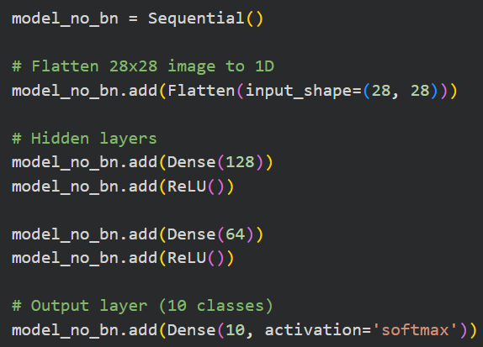
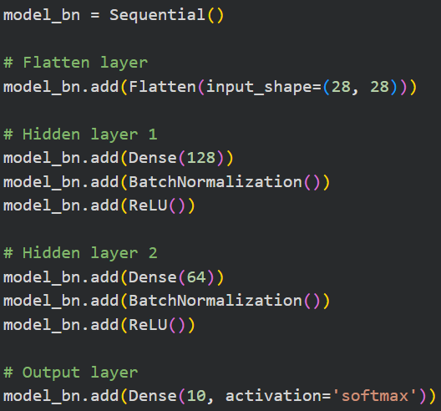



Slide 14
Heading Goes Here
Fhdsklf
Fjdsklf
Fjskldf

