Slide 1
Scalar + Vector

Slide 2
A scalar is a quantity that has only magnitude (value) and NO direction.
Examples:
10 kilograms
25°C temperature
5 seconds
₹ 1000
$342
All have size/value only — no direction.

Slide 3



A vector is a quantity that has both:
Magnitude → how much (size or length)
Direction → where it is going
If a car moves:
60 km/h → magnitude
East → direction
This is a vector because direction matters.
Example: 3 vectors shown below

Slide 4
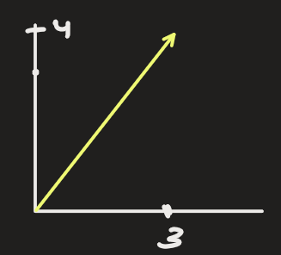
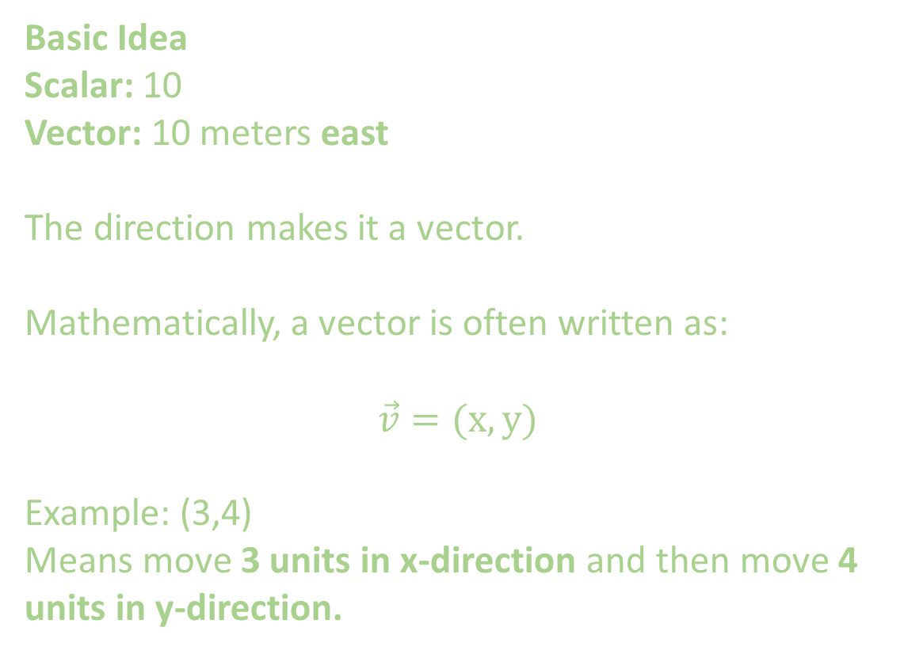
Basic Idea
Scalar: 10
Vector: 10 meters east
The direction makes it a vector.
Mathematically, a vector is often written as:
$$\vec{v}=(x, y)$$
Example: (3,4)
Means move 3 units in x-direction and then move 4 units in y-direction.

Slide 5
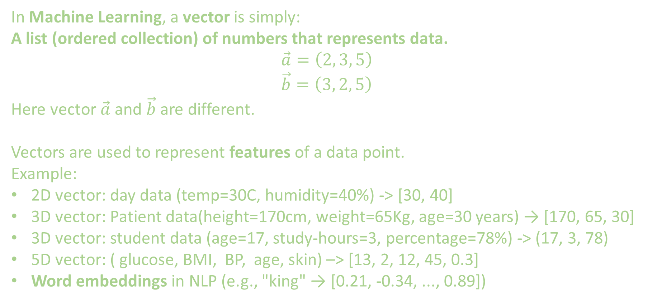
In Machine Learning, a vector is simply:
A list (ordered collection) of numbers that represents data.
$$\vec{a}=\left(2, 3, 5\right)$$
$$\vec{b}=\left(3, 2, 5\right)$$
Here vector $\vec{a}$ and $\vec{b}$ are different.
Vectors are used to represent features of a data point.
Example:
2D vector: day data (temp=30C, humidity=40%) -> [30, 40]
3D vector: Patient data(height=170cm, weight=65Kg, age=30 years) → [170, 65, 30]
3D vector: student data (age=17, study-hours=3, percentage=78%) -> (17, 3, 78)
5D vector: ( glucose, BMI, BP, age, skin) –> [13, 2, 12, 45, 0.3]
Word embeddings in NLP (e.g., "king" → [0.21, -0.34, ..., 0.89])

Slide 6
3D vector: student data (age=17, study-hours=3, percentage=78%) -> (17, 3, 78)
This vector describes one student.
Each value = a feature.
Here features are age, study-hours, percentage.
So: Vector = Feature Representation

Slide 7
Example: Text → Vector (Very Important in ML)
Machines cannot read words like humans.
Sentence: I understand data science.
Converted into vector: [0.2, 0.8, 0.6, 0.1, ...]
This process is called:
Feature encoding
Embedding
Vectorization

Slide 8
Example: Dataset = Collection of Vectors
Dataset looks like:
Vector representation is
[22, 30000, 1]
[35, 70000, 10]
[52, 56000, 9]
Each row = feature vector.
Age | Salary | Experience
22 | 30000 | 1
35 | 70000 | 10
52 | 56000 | 9

Slide 9
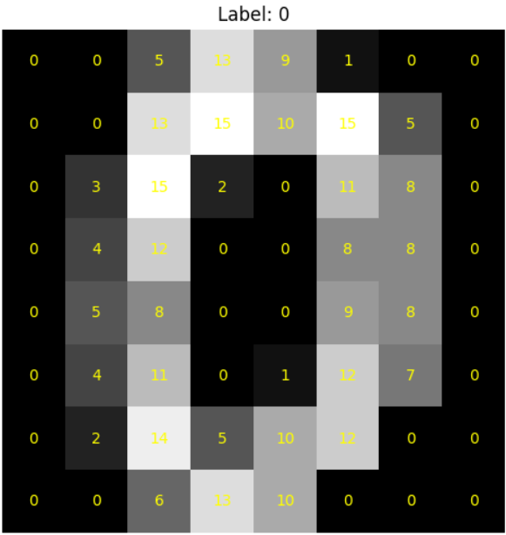
Example: Image as a Vector
An image is just pixels.
Size of each image is 8x8 pixels
Each image is represented by 8x8= 64 pixels
The values of pixel range from 0 – 16.
Digit 0 would contain following pixel values:
[ 0, 0, 5, 13, 9, 1, 0, 0, 0, 0, 13, 15, 10, 15, 5, 0, 0, 3, 15, 2, 0, 11, 8, 0, 0, 4, 12, 0, 0, 8, 8, 0, 0, 5, 8, 0, 0, 9, 8, 0, 0, 4, 11, 0, 1, 12, 7, 0, 0, 2, 14, 5, 10, 12, 0, 0, 0, 0, 6, 13, 10, 0, 0, 0,]

Slide 10
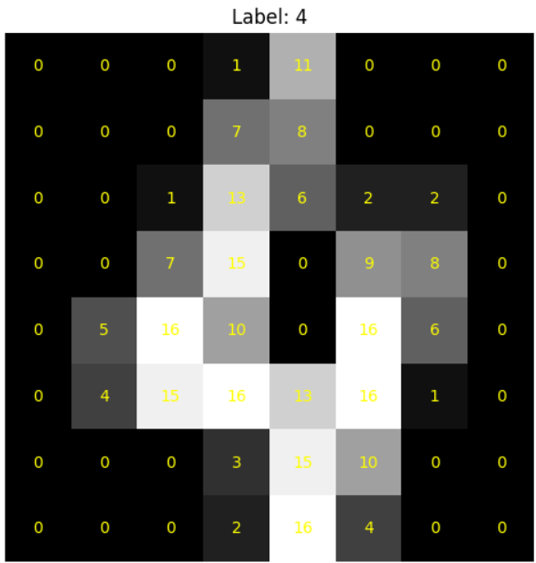
Digit 4 would contain following pixel values:
[ 0, 0, 0, 1, 11, 0, 0, 0, 0, 0, 0, 7, 8, 0, 0, 0, 0, 0, 1, 13, 6, 2, 2, 0, 0, 0, 7, 15, 0, 9, 8, 0, 0, 5, 16, 10, 0, 16, 6, 0, 0, 4, 15, 16, 13, 16, 1, 0, 0, 0, 0, 3, 15, 10, 0, 0, 0, 0, 0, 2, 16, 4, 0, 0,]

Slide 11
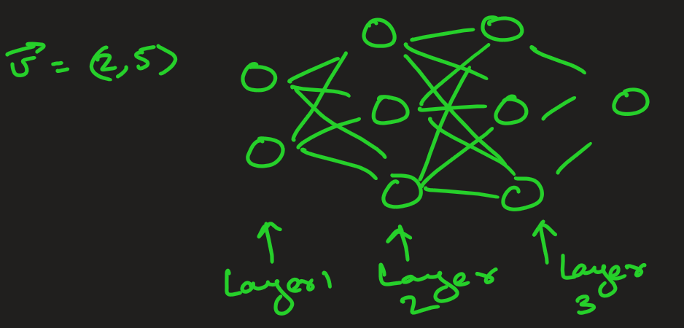
In neural networks, each layer transforms an input vector into another vector using weights and activation functions.

Slide 12
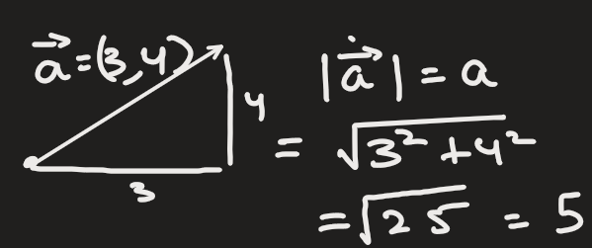
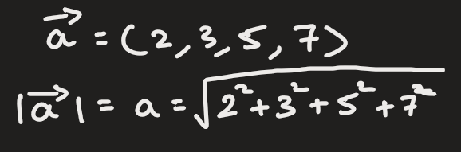
Magnitude of vector:
In 2D ->
This idea can be extended to higher dimension n-D

Slide 13
Scalar
A number that scales up or down the vector or any measurable quantity
For example:
2 * [170, 65, 30] = [340, 130, 60] …..this scales up by factor of 2
0.5 * [170, 65, 30] = [85, 32.5, 15] ….. This scales down the values by half

Slide 14
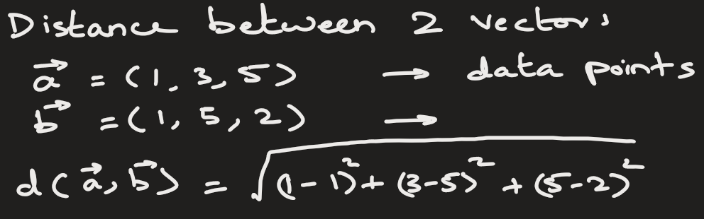
Why Vectors Are Important in ML
Machine learning works by comparing vectors.
Models compute:
Distance between vectors
Angle between vectors
Similarity between vectors
Example:
Recommendation systems
Face recognition
ChatGPT embeddings
Search engines

Slide 17
Explain vectors and matrix are general form of numbers. Then explain dot product of vectors, matrix addition/subtraction, scalar multiplication (c*M),
Explain how 2 matrix gets multiplied.
A = [[1, 2, 3],
[4, 5, 6]]
A is 2×3
B = [[7, 8],
[9, 10],
[11, 12]]
B is 3×2
A @ B
= [ (1×7+2×9+3×11) (1×8+2×10+3×12)
(4×7+5×9+6×11) (4×8+5×10+6×12)
]
= [ 58 64
139 154
]

Slide 18
Vector Space
Matrices satisfy following few important properties which have similar counterpart in Q :
There is an element of V, denoted by 0, such that
u + O = O + u = u
for all elements u of V.
2) Given an element u of V, there exists an element -u in V such that
u+(-u)=O.
3) For all elements u of V, there exists an element 1 in V such that
1· u = u
4) There exist u_inv of u s.t.
u * u_inv = 1

