Slide 1
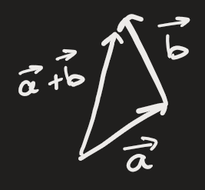
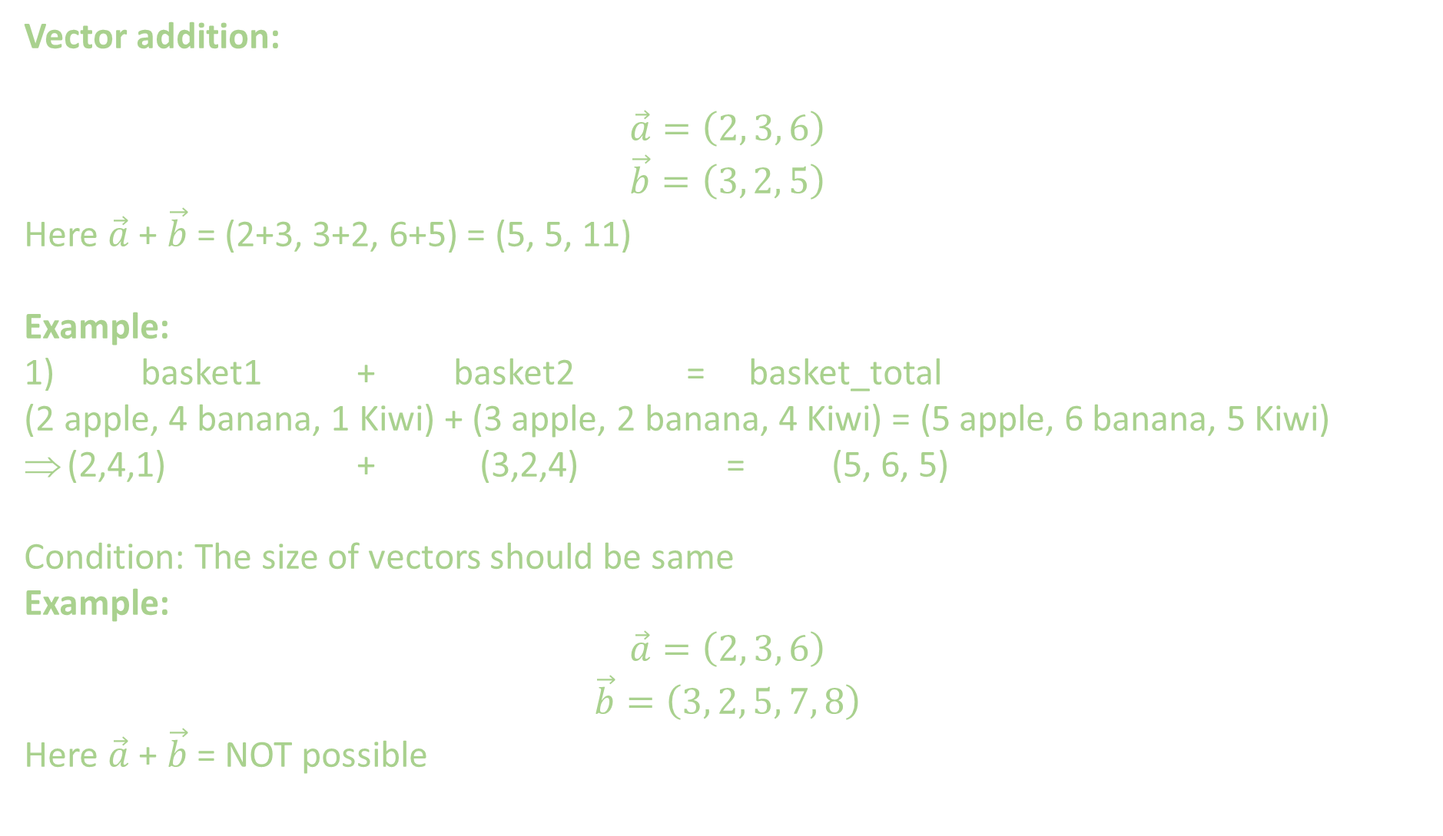
Vector addition:
$$\vec{a}=\left(2, 3, 6\right)$$
$$\vec{b}=\left(3, 2, 5\right)$$
Here $\vec{a}$ + $\vec{b}$ = (2+3, 3+2, 6+5) = (5, 5, 11)
Example:
1) basket1 + basket2 = basket_total
(2 apple, 4 banana, 1 Kiwi) + (3 apple, 2 banana, 4 Kiwi) = (5 apple, 6 banana, 5 Kiwi)
(2,4,1) + (3,2,4) = (5, 6, 5)
Condition: The size of vectors should be same
Example:
$$\vec{a}=\left(2, 3, 6\right)$$
$$\vec{b}=\left(3, 2, 5, 7, 8\right)$$
Here $\vec{a}$ + $\vec{b}$ = NOT possible

Slide 2
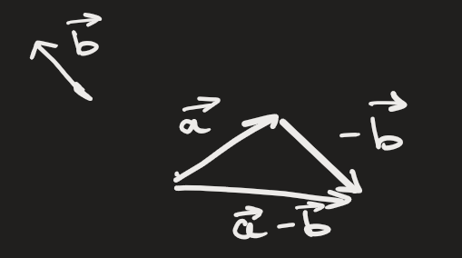
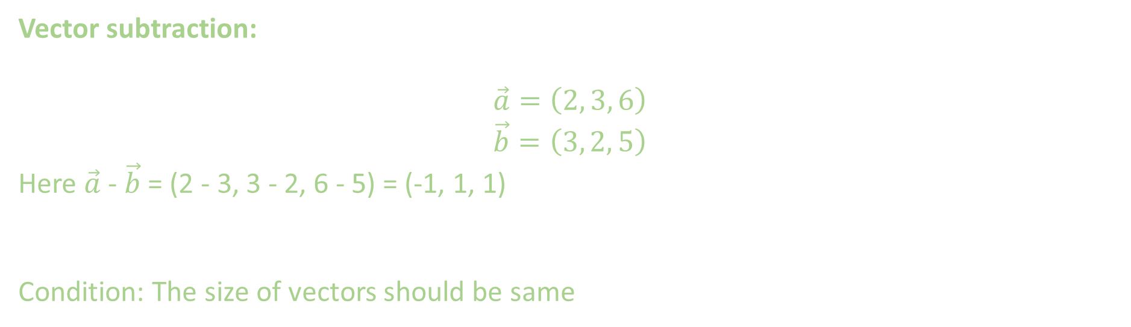
Vector subtraction:
$$\vec{a}=\left(2, 3, 6\right)$$
$$\vec{b}=\left(3, 2, 5\right)$$
Here $\vec{a}$ - $\vec{b}$ = (2 - 3, 3 - 2, 6 - 5) = (-1, 1, 1)
Condition: The size of vectors should be same

Slide 3
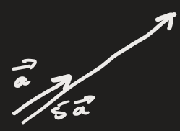
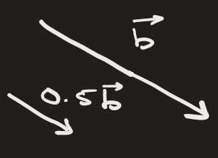
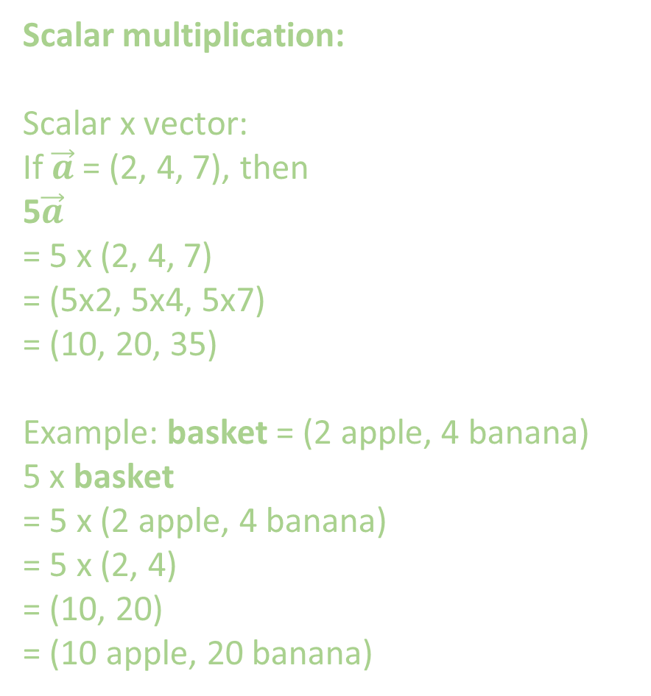
Scalar multiplication:
Scalar x vector:
If $\vec{a}$ = (2, 4, 7), then
5$\vec{a}$
= 5 x (2, 4, 7)
= (5x2, 5x4, 5x7)
= (10, 20, 35)
Example: basket = (2 apple, 4 banana)
5 x basket
= 5 x (2 apple, 4 banana)
= 5 x (2, 4)
= (10, 20)
= (10 apple, 20 banana)

Slide 4


Dot product of vectors:
For 2 vector a and b:
The dot product is
Condition for dot product: The size of 2 vectors should be same

Slide 5
Example 1:
a = (3, 5, 1)
b = (2, 4, -7)
Then,
a.b
= ( 3, 5, 1 ) . ( 2, 4, -7 )
= 3x2 + 5x4 + 1x-7
= 6 + 20 -7 = 19
Example2:
a = (3, 5, 1)
b = (2, 4, -7, 6)
Dot product not possible.

Slide 6
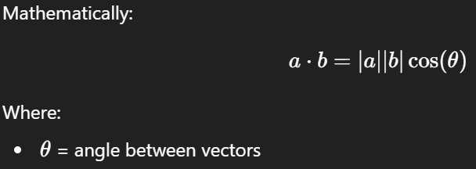
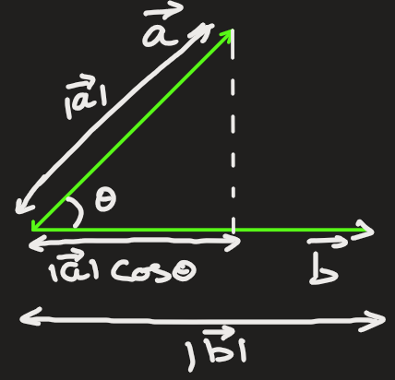
Geometric Meaning (Deep Intuition)
The dot product measures how aligned two vectors are

Slide 7
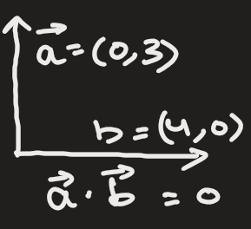
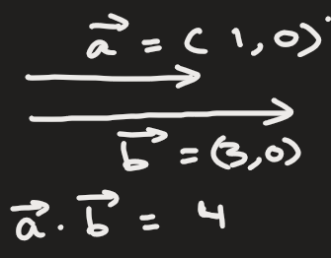
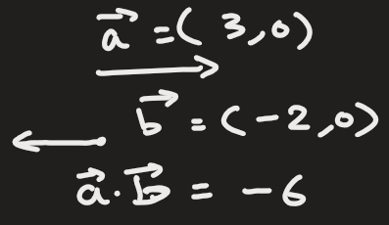
Angle Between Vectors | Dot Product Meaning
0° | Very similar direction (large positive)
90° | Unrelated (0)
180° | Opposite meaning (negative)

Slide 8
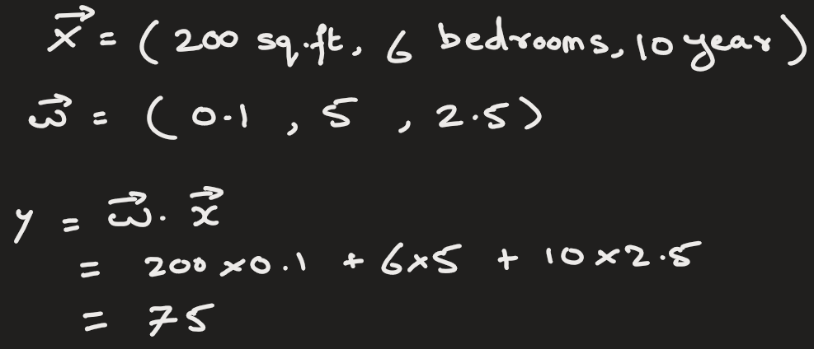
Dot Product in Machine Learning (Core Idea)
In ML:
One vector = data (features)
Another vector = model parameters (weights)
Dot product = model decision score
For example:
x = [size of rooms, number of bedrooms, age of house]
w = [size_weight, bedroom_weight, age_weight]
Prediction on price = w⋅x

Slide 9
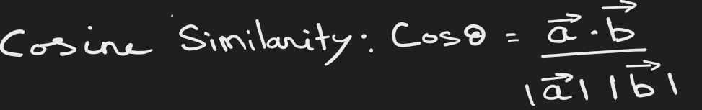
Dot Product to find similarity between 2 vectors

Slide 10
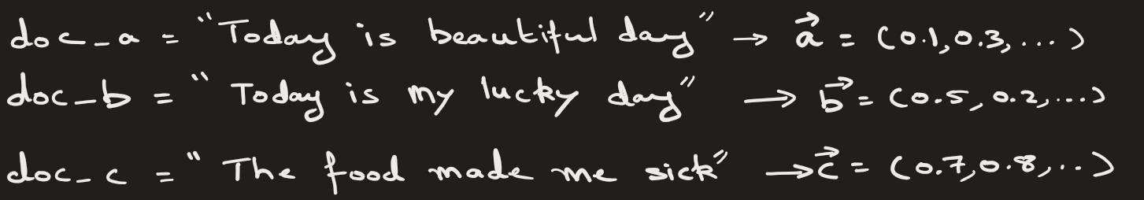
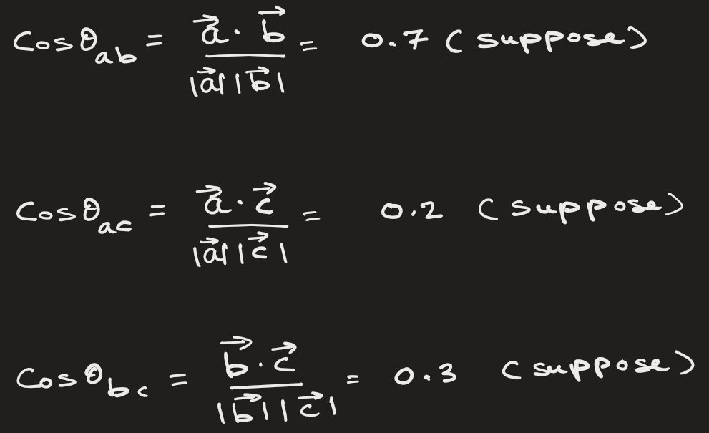
Conclusion:
doc_a and doc_b are similar.
doc_a and doc_c are not similar

