Slide 1
Matrix Addition Subtraction Multiplication

Slide 2
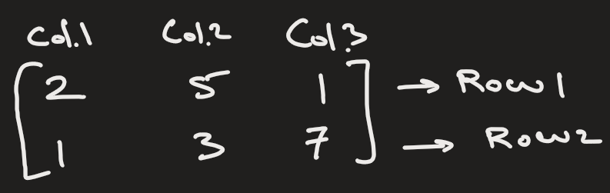
What is a matrix ?
It is a grid of numbers
In a 2D matrix, you have rows and columns
The shape of matrix is rows x columns
Example: 2 x 3

Slide 3
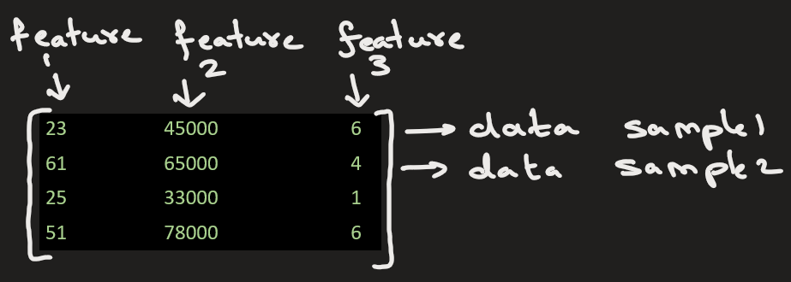
Matrices are used to:
Represent data (e.g., a dataset where rows = samples, columns = features).
age | income | experience
23 | 45000 | 6
61 | 65000 | 4
25 | 33000 | 1
51 | 78000 | 6

Slide 4
Matrices are used to images:
0 -> black
255 -> white
203 | 0 | 0 | 200
0 | 0 | 30 | 0
0 | 32 | 0 | 0
205 | 0 | 0 | 49
Input 4X4 image
Pixel representation in 2D (not normalized), Size = 4X4

Slide 5
matrix addition + multiplication

Slide 6
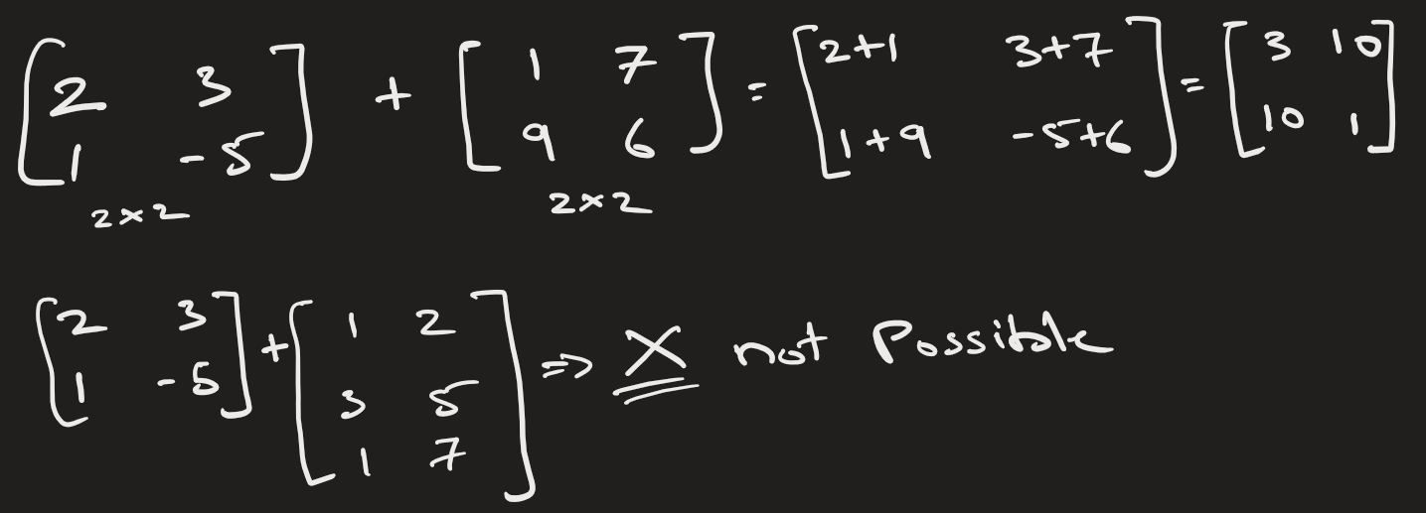
Matrix addition / subtraction:
The shape of 2 matrix should be same for addition or subtraction.

Slide 7
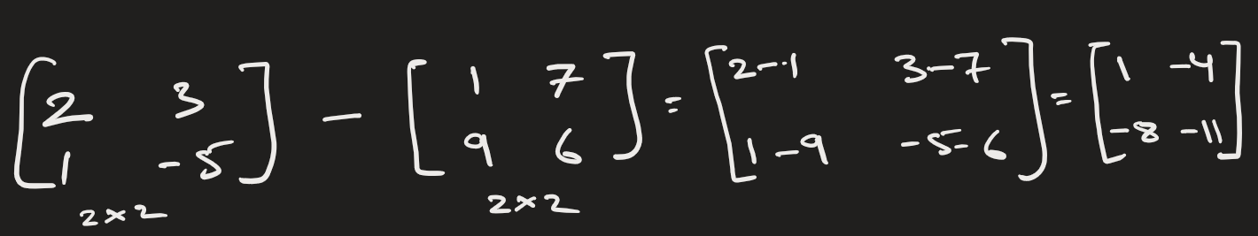
Matrix subtraction:

Slide 8
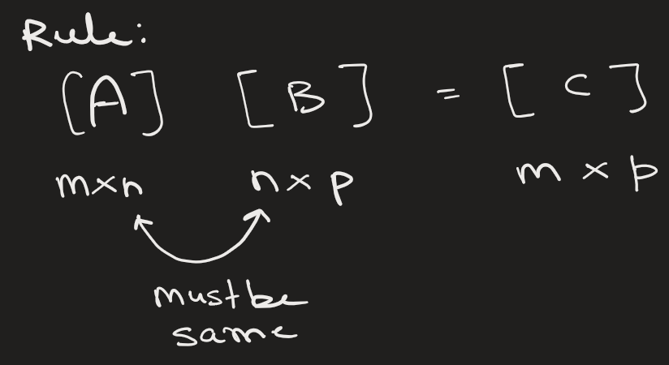
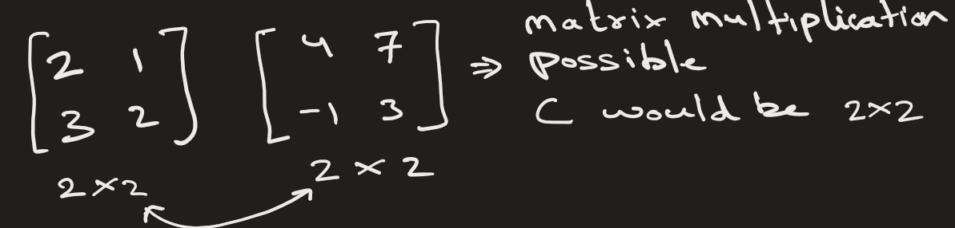
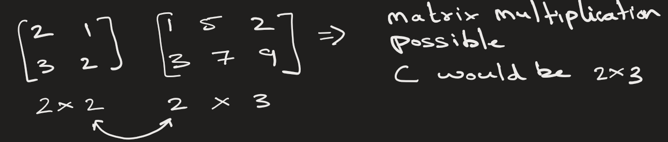
Matrix multiplication:

Slide 9
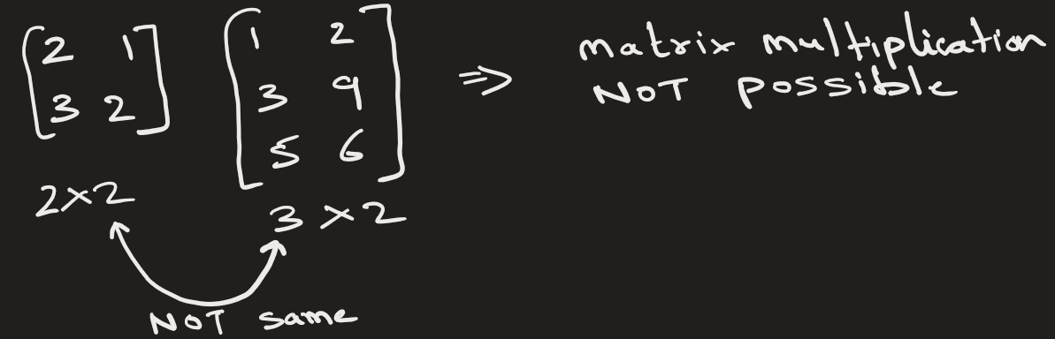
Matrix multiplication:

Slide 10
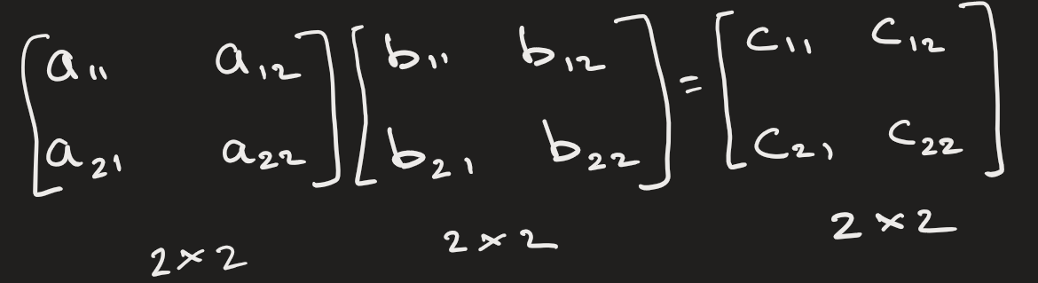
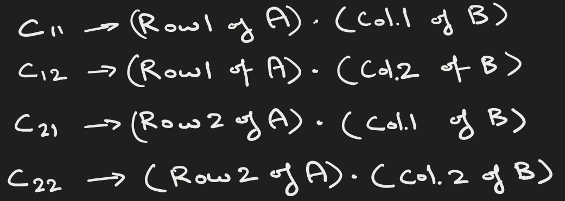
Matrix multiplication:

Slide 11


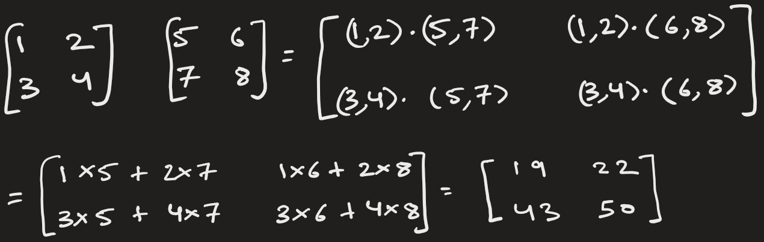
Matrix multiplication:
Suppose we have matrix A and B.
We want C = AB

Slide 12

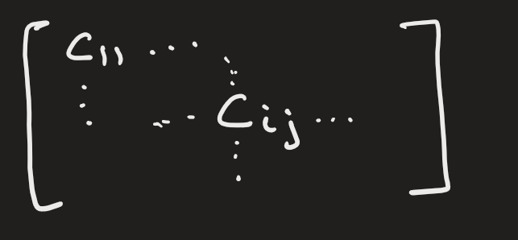
Matrix multiplication:
The general formula for C:
Meaning:
take row i from A
take column j from B
multiply matching elements(i.e. dot product)
add them

Slide 13
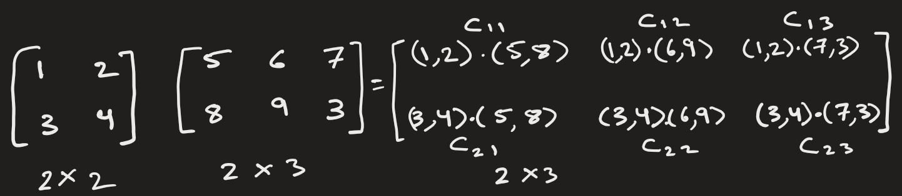
Matrix multiplication:

Slide 14
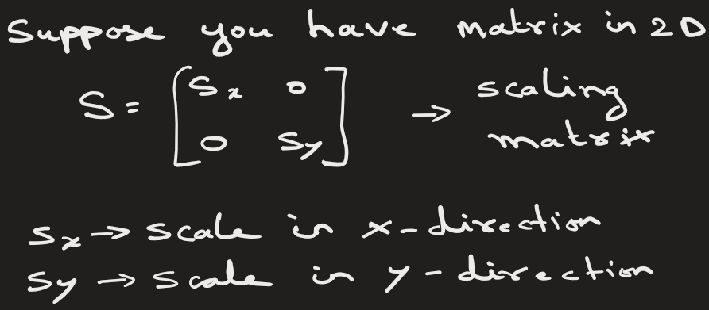
Matrix multiplication are used to perform linear transformations: Scaling, rotation of images
Scaling Matrix:

Slide 15
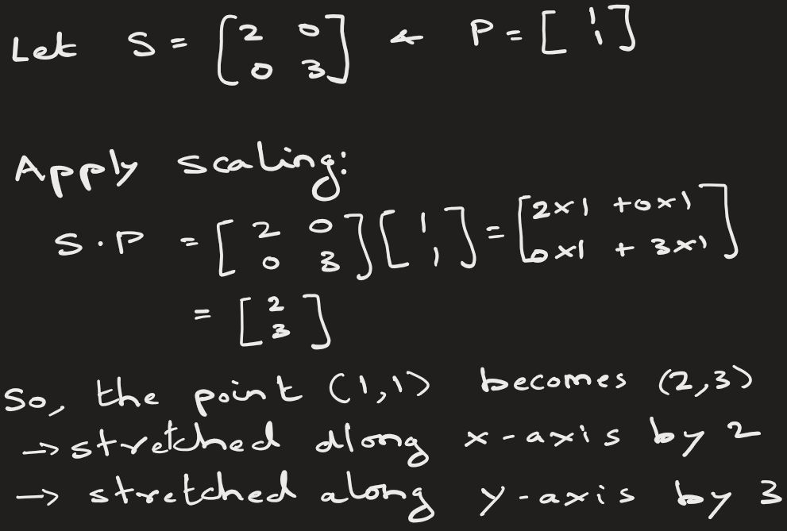
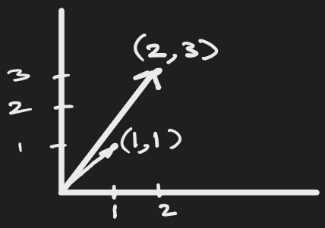
Matrices are used to Perform linear transformations: Scaling, rotation of images

Slide 16
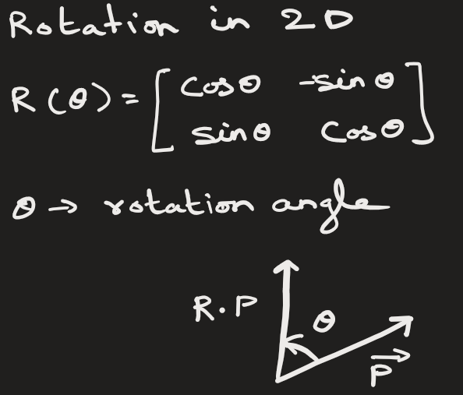
Rotation Matrix:
It rotates the vector.
It does not change the magnitude of the vector.

Slide 17
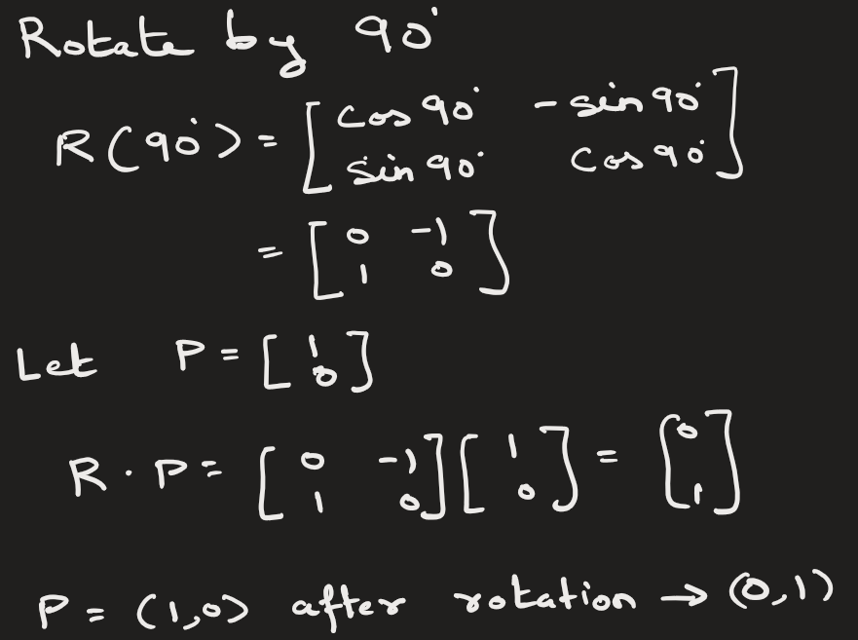
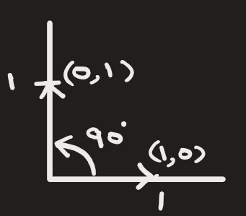
Rotation Matrix:

Slide 18
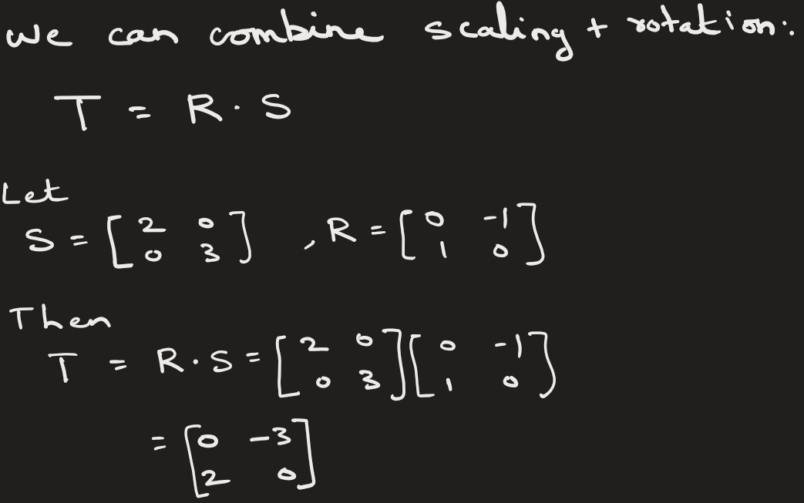
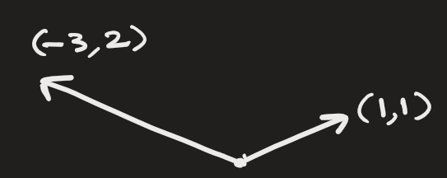
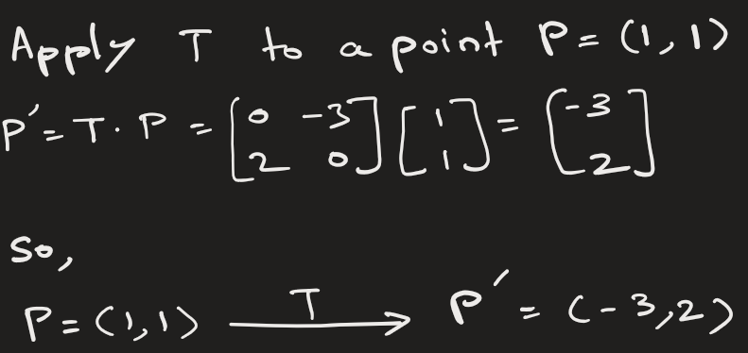
Combine
Scaling + Rotation:

Slide 19
Uses of matrix multiplication:
Matrices transform coordinates of points in images.
In graphics or robotics, when you perform scaling, rotating, or transforming an image, you are doing matrix multiplication.
In ML when you perform scaling or transforming data , you are doing matrix multiplication.
When you rotate or zoom an image → matrix multiplication is happening!

Slide 20
Representing an image as a matrix and then blurring it:
Suppose we have a grayscale image of size 3x3 pixels:
255, 0, 0
0, 255, 0
0, 0, 255
Each value represents brightness of a pixel (0=black, 255=white).
Applying a matrix operation — Blurring
Let’s apply a simple average blur filter (kernel):
1/9, 1/9, 1/9
1/9, 1/9, 1/9
1/9, 1/9, 1/9

Slide 21
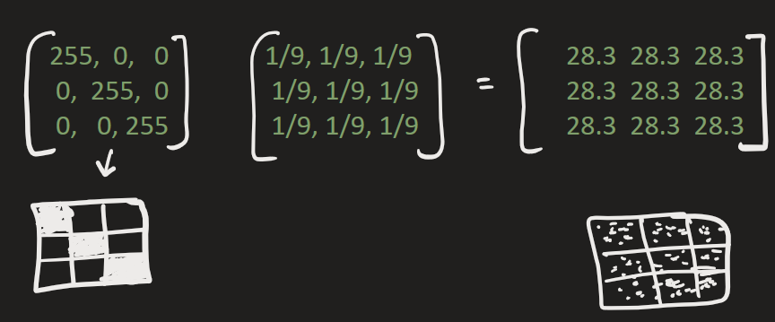
This is just matrix multiplication

Slide 22
STOP

Slide 23
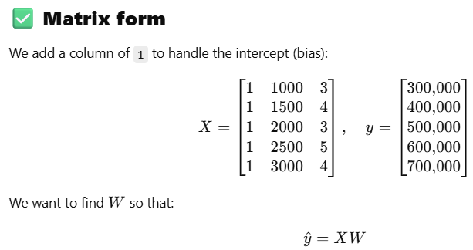
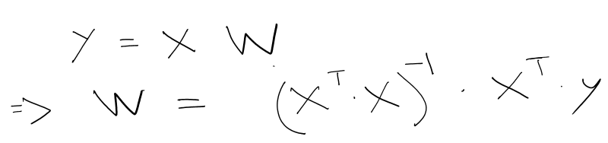
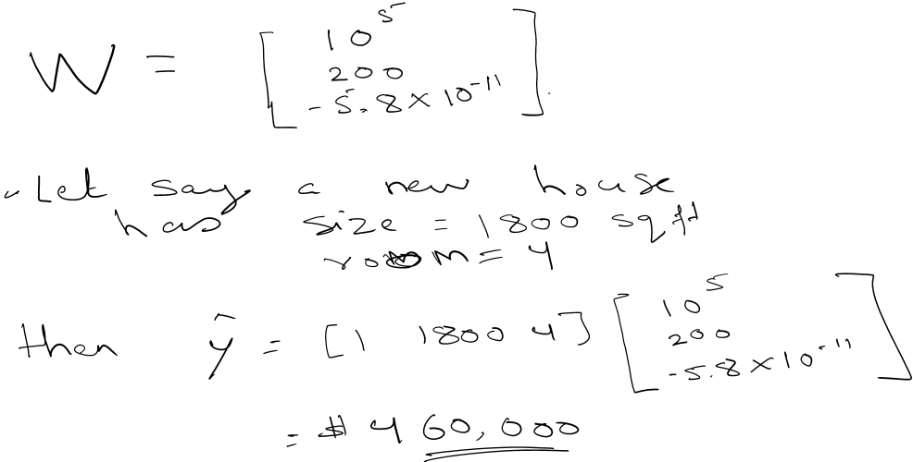
1) Predicting house prices using matrix operations for linear regression ( see jupyter n/b ) :
Predict house prices using:
​y_hat = W*X
where,
X = feature matrix (house size, number of rooms,etc)
W = weight matrix (parameters to learn)
Y_hat = predicted price
W is determined using following mathematical formula:
Size (sqft) | Rooms | Price (target)
1000 | 3 | 300,000
1500 | 4 | 400,000
2000 | 3 | 500,000
2500 | 5 | 600,000
3000 | 4 | 700,000

Slide 25
Explain how to find determinant
A = np.array([[2, 1],
[3, 5]])
det_A = 2*5 - 1*3 = 7
A = np.array([[2, 1, 0],
[0, 1, -1],
[0, 2, 4]])
det_A = 12

