Slide 1
Matrix identity transpose determinant inverse

Slide 2

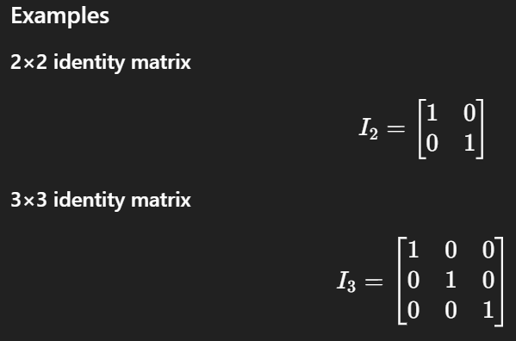

Slide 3
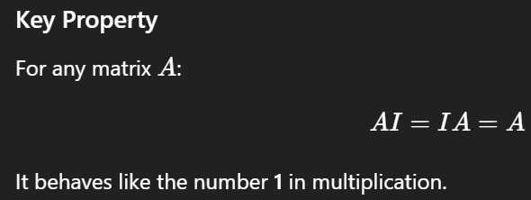



Slide 4
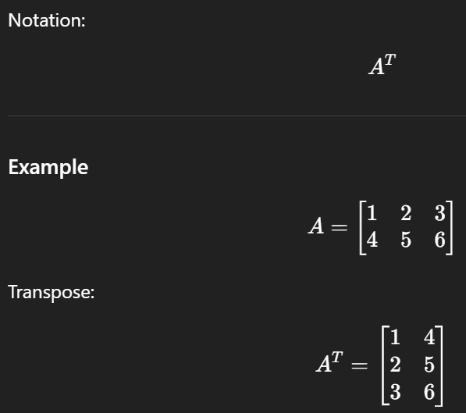
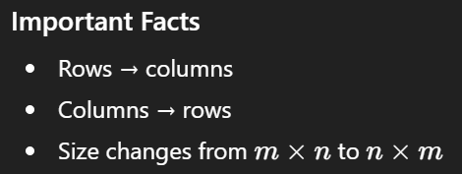
The transpose of a matrix swaps rows and columns.

Slide 5
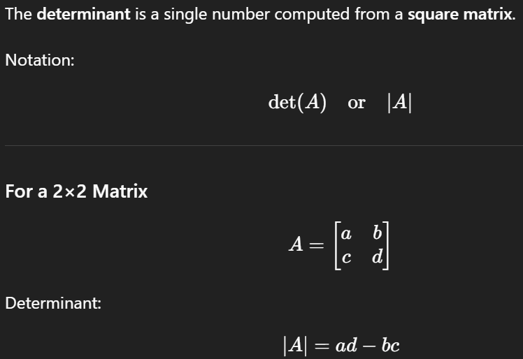

Slide 6


Slide 7



The inverse of a matrix A:

Slide 8
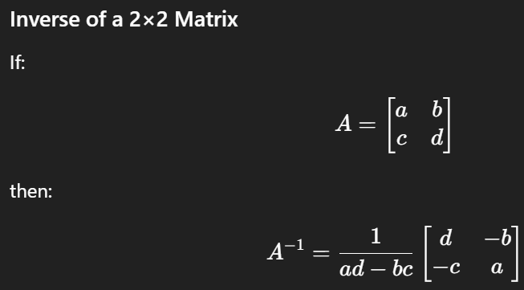

Slide 9
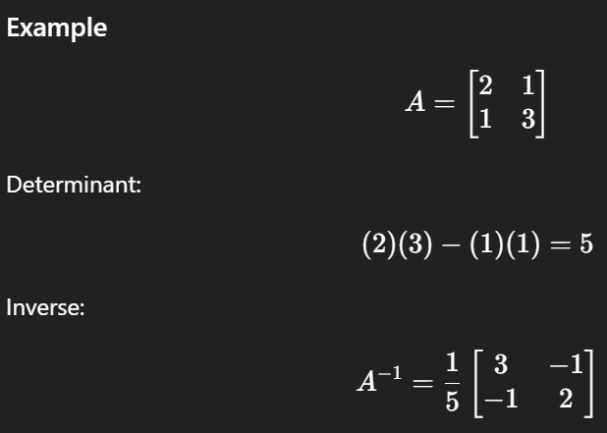
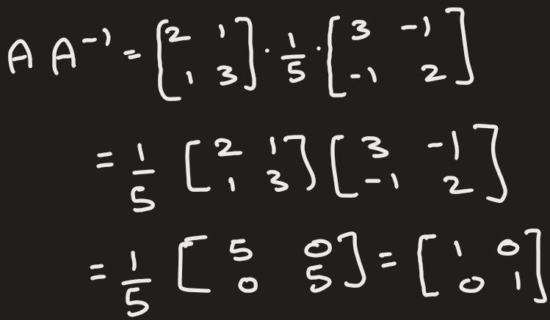
Verify

Slide 10


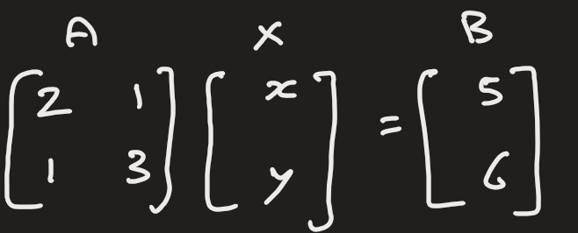
Application

Slide 11


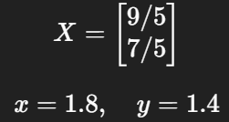
Application
After find inverse of A

Slide 12
A = np.array([[2, 1],
[3, 5]])
det_A = 2*5 - 1*3 = 7
A = np.array([[2, 1, 0],
[0, 1, -1],
[0, 2, 4]])
det_A = 12

