Slide 1
Orthogonal vectors, orthonormal vectors, normalizing vectors

Slide 2
Orthogonal, orthonormal, and normalization are fundamental in ML, especially in
PCA
Embeddings
Neural networks
Cosine similarity
Optimization

Slide 3
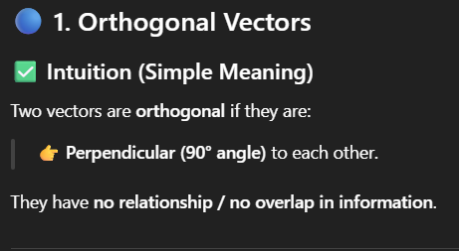
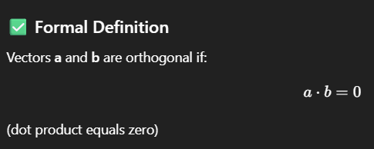

Slide 4
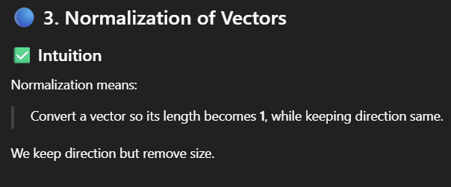
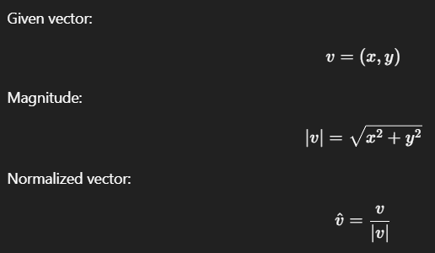

Slide 5
ML Intuition
Normalization removes scale bias.
Example:
[Age=25, Salary=100000]
Salary dominates learning.
After normalization → fair comparison.

