Slide 1
Eigen Vector And Eigen value

Slide 2
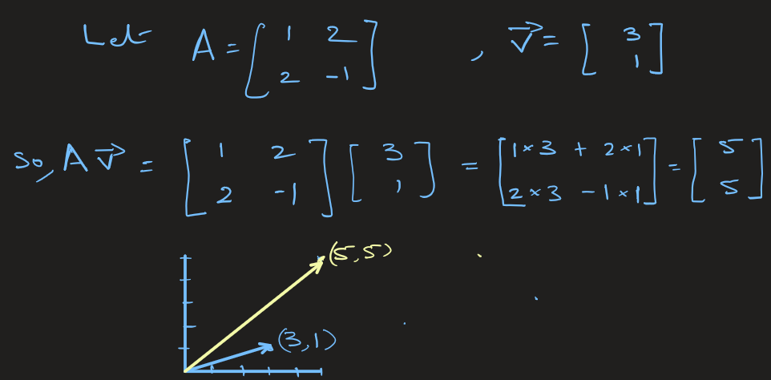
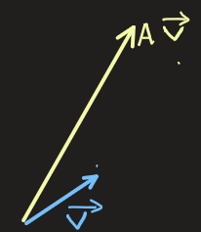
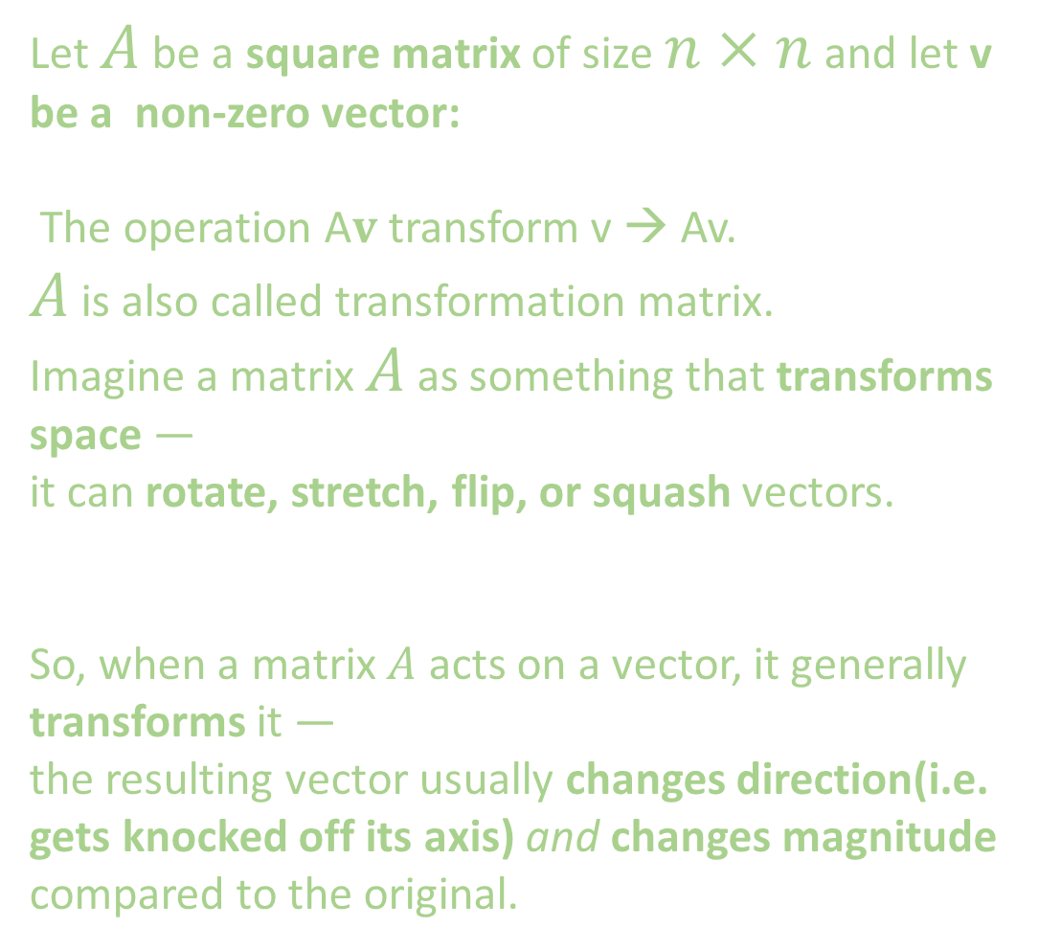
Eigen vector and Eigen value
Let $A$ be a square matrix of size $n×n$ and let v be a non-zero vector:
The operation A$v$transform v → Av.
$A$ is also called transformation matrix.
Imagine a matrix $A$ as something that transforms space —
it can rotate, stretch, flip, or squash vectors.
So, when a matrix $A$ acts on a vector, it generally transforms it —
the resulting vector usually changes direction(i.e. gets knocked off its axis) and changes magnitude compared to the original.

Slide 3

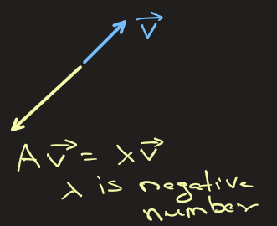
Some special vectors do not change their direction when a matrix transforms them. These are called eigenvectors. Although their direction stays the same, their length (magnitude) may change — they can be stretched or compressed. The amount of stretching or shrinking is given by a number called the eigenvalue (λ)
Side Note: The word “direction” above means the line or axis through the origin.
Eigen vectors stays on the same line through the origin, but may get reversed. In that sense, reversing does not change direction — it’s still along the same axis

Slide 4
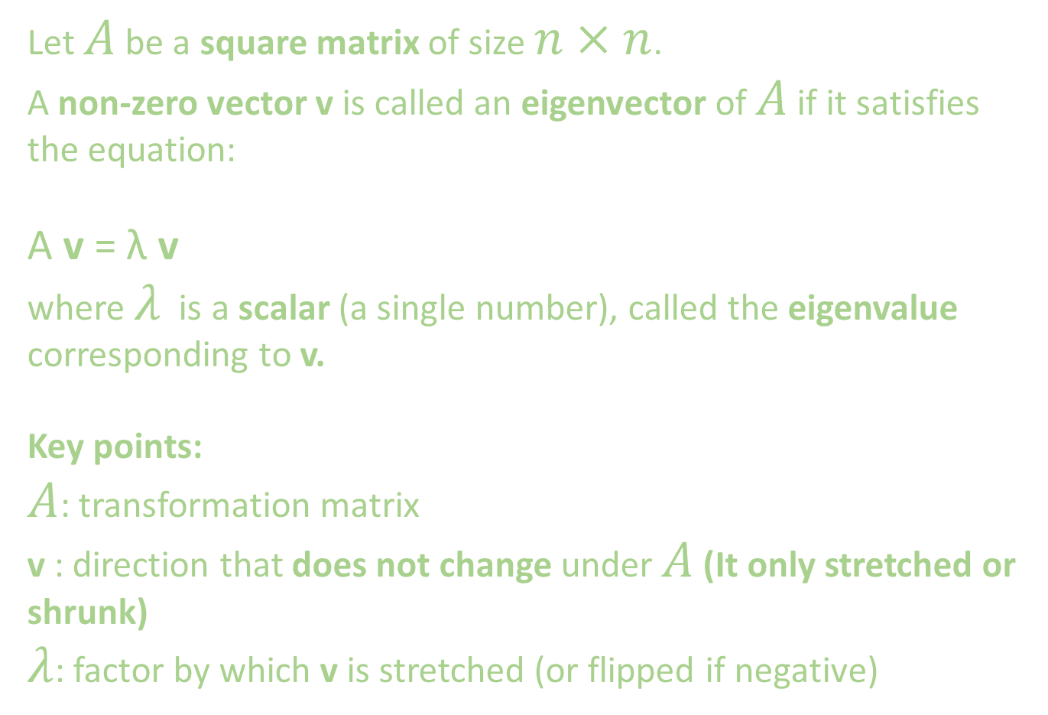
Eigen Vector And Eigen Value: Definition
Let $A$ be a square matrix of size $n×n$.
A non-zero vector v is called an eigenvector of $A$ if it satisfies the equation:
A v = λ v
where $λ$ is a scalar (a single number), called the eigenvalue corresponding to v.
Key points:
$A$: transformation matrix
v : direction that does not change under $A$ (It only stretched or shrunk)
$λ$: factor by which v is stretched (or flipped if negative)

Slide 5
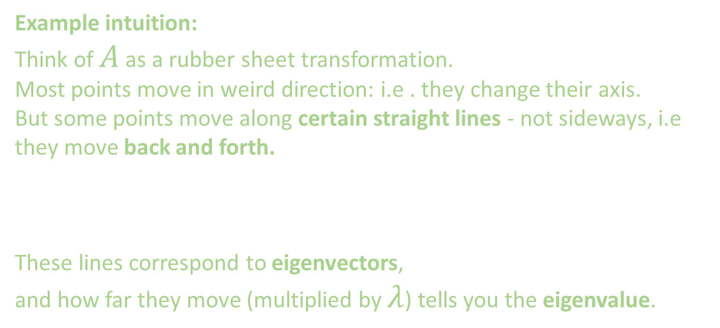
Eigen Vector And Eigen Value: Definition
Example intuition:
Think of $A$ as a rubber sheet transformation. Most points move in weird direction: i.e . they change their axis. But some points move along certain straight lines - not sideways, i.e they move back and forth.
These lines correspond to eigenvectors, and how far they move (multiplied by $λ$) tells you the eigenvalue.

Slide 6
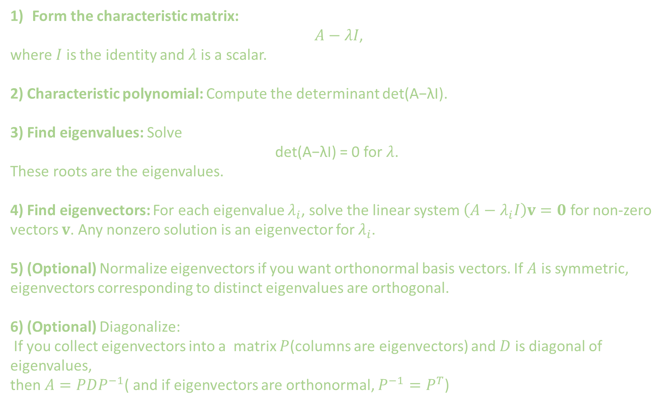
How do You find Eigen Vectors and Eigen Values
Form the characteristic matrix:
$A−λI$,
where $I$ is the identity and $λ$ is a scalar.
2) Characteristic polynomial: Compute the determinant det(A−λI).
3) Find eigenvalues: Solve
det(A−λI) = 0 for $λ$.
These roots are the eigenvalues.
4) Find eigenvectors: For each eigenvalue $λ_{i}$, solve the linear system $\left(A−λ_{i}I\right)v=0$ for non-zero vectors $v$. Any nonzero solution is an eigenvector for $λ_{i}$.
5) (Optional) Normalize eigenvectors if you want orthonormal basis vectors. If $A$ is symmetric, eigenvectors corresponding to distinct eigenvalues are orthogonal.
6) (Optional) Diagonalize:
If you collect eigenvectors into a matrix $P$(columns are eigenvectors) and $D$ is diagonal of eigenvalues,
then $A=PDP^{−1}$( and if eigenvectors are orthonormal, $P^{−1}=P^{T}$)

Slide 7
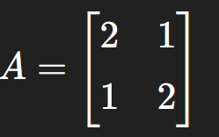
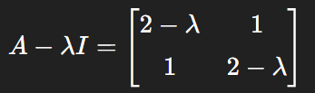
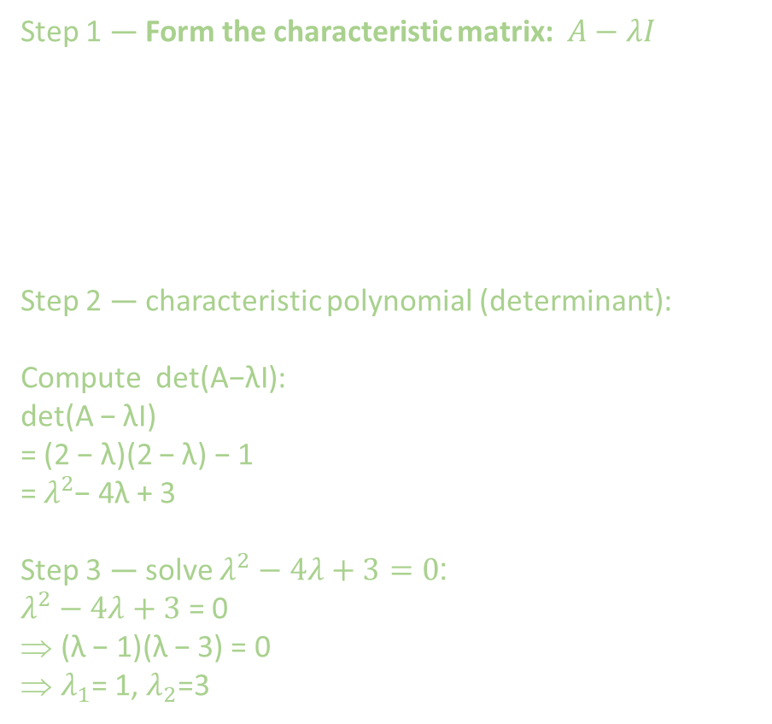
How do You find Eigen Vectors and Eigen Values: Example
Step 1 — Form the characteristic matrix: $A−λI$
Step 2 — characteristic polynomial (determinant):
Compute det(A−λI):
det(A − λI)
= (2 − λ)(2 − λ) − 1
= $λ^{2}$− 4λ + 3
Step 3 — solve $λ^{2}−4λ+3=0$:
$λ^{2}−4λ+3$ = 0
(λ − 1)(λ − 3) = 0
$λ_{1}$= 1, $λ_{2}$=3

Slide 8
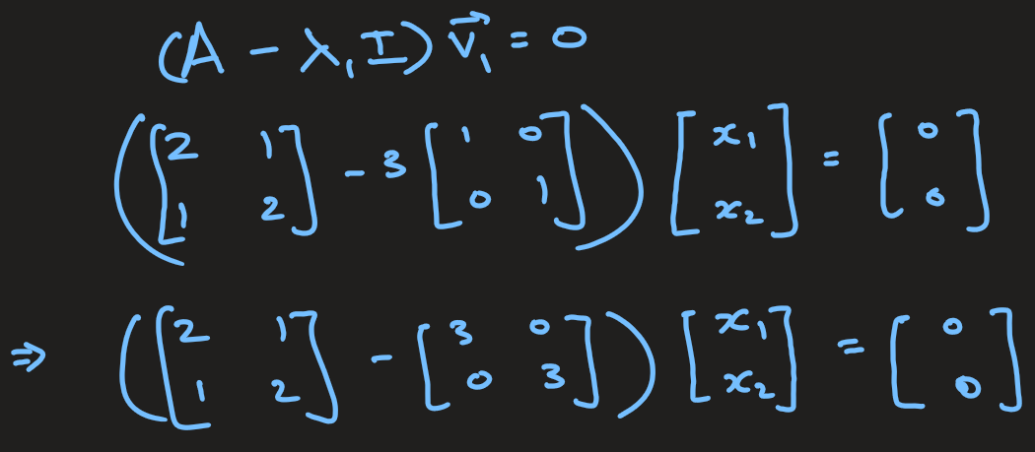
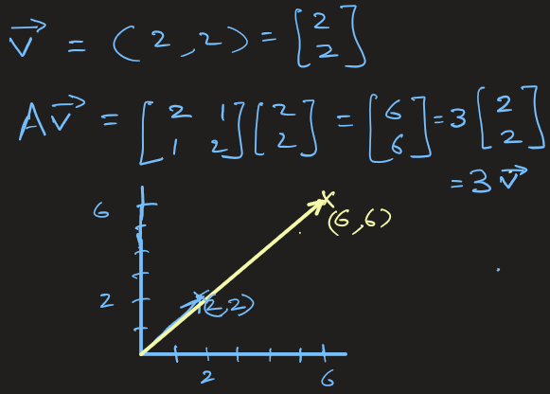



How do You find Eigen Vectors and Eigen Values: Example
Step 4 — find eigenvectors
For $λ_{1}=3$, solve $\left(A−λ_{1}I\right)v=0$:
Here all vectors that span along (1,1) gets scaled by Matrix A by factor of 3. These scaled vectors do not change direction.
For example, if v = (2,2) → Av = 3v (see fig.)

Slide 9
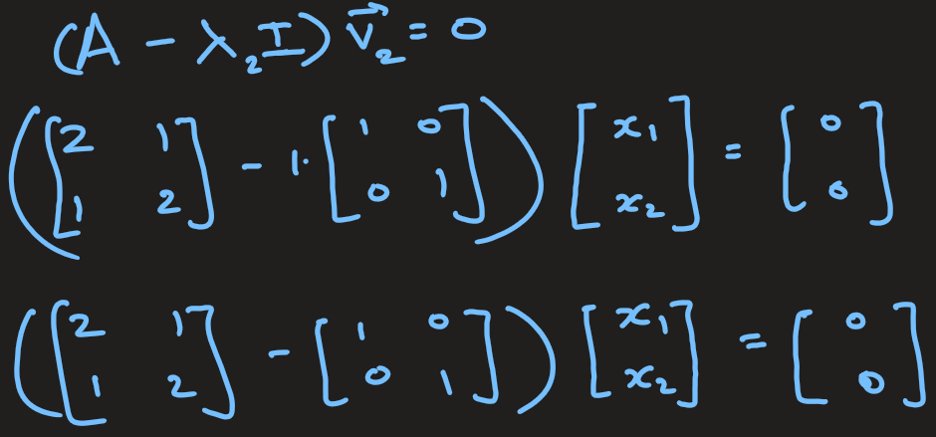
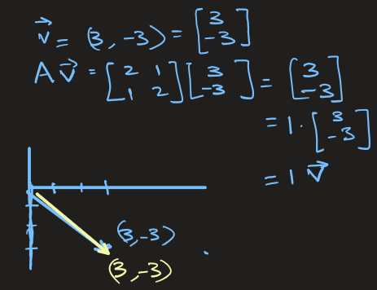



How do You find Eigen Vectors and Eigen Values: Example
For $λ_{2}=1$, solve $\left(A−1I\right)v=0$:
Here all vectors span along (1,-1) gets scaled by Matrix A by factor of 1. These scaled vectors do not change direction.
For example, if v = (3,-3) → Av = 1v (see fig.)

Slide 10
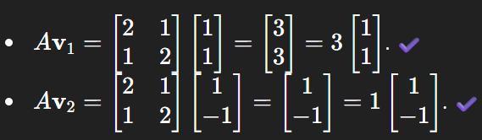

How do You find Eigen Vectors and Eigen Values: Example
Verify: Av = λv
$$Av_{1}=λ_{1}v_{1}$$
$$Av_{2}=λ_{2}v_{2}$$

Slide 11
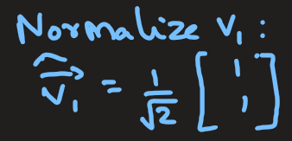
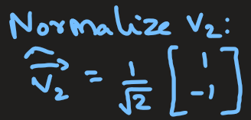
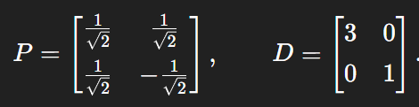
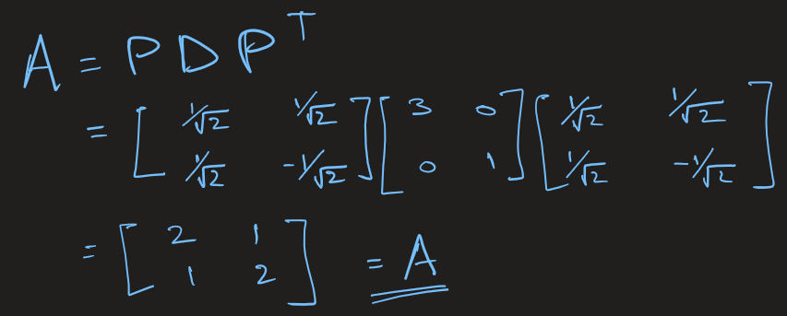
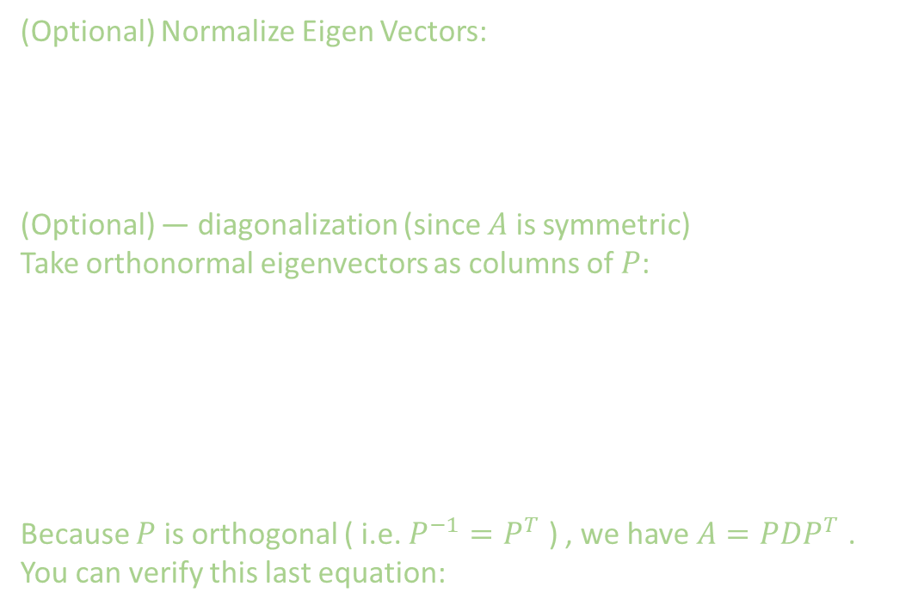
How do You find Eigen Vectors and Eigen Values: Example
(Optional) Normalize Eigen Vectors:
(Optional) — diagonalization (since $A$ is symmetric)
Take orthonormal eigenvectors as columns of $P$:
Because $P$ is orthogonal ( i.e. $P^{−1}=P^{T}$ ) , we have $A=PDP^{T}$ . You can verify this last equation:

Slide 12
EXTRA

Slide 13
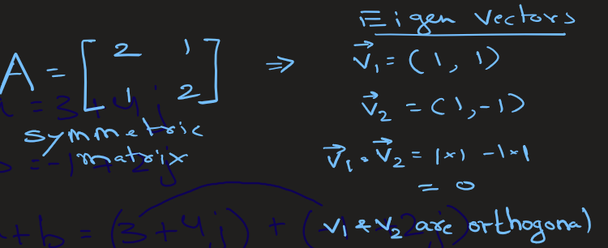
Key Properties of Eigen Vectors
Eigen Vectors are not generally orthogonal, but they are orthogonal for a particular type of matrix such as a symmetric matrix.

Slide 14
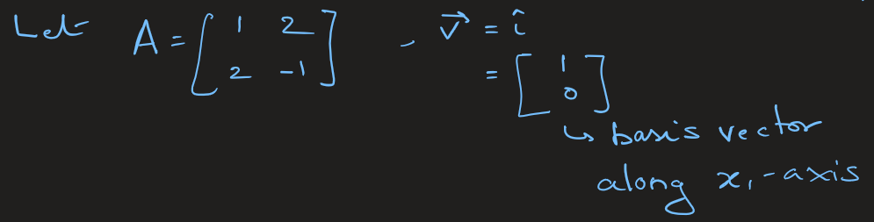
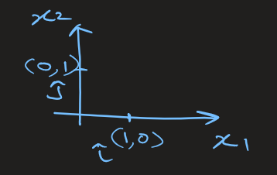
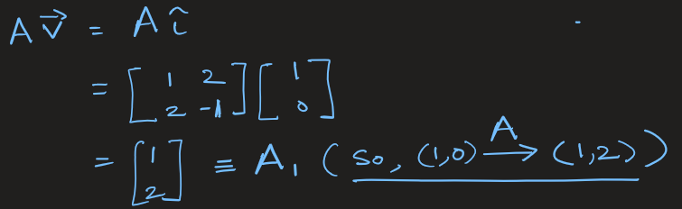
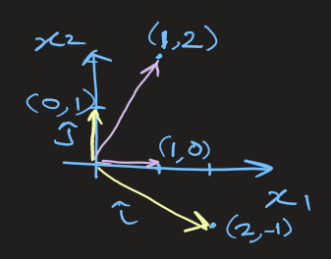
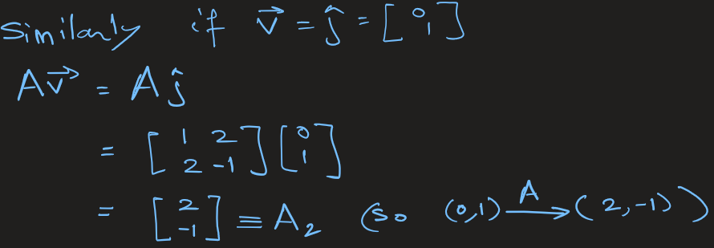
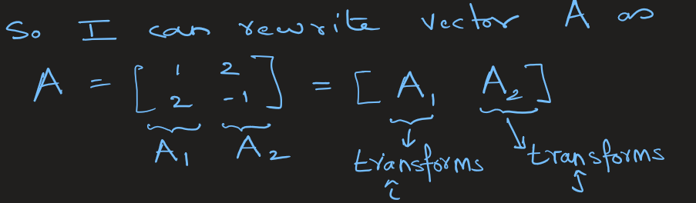
Let’s see the effect of A on the basis vectors:
Conclusion: The columns of a matrix A tell you how the basis vectors transform under that matrix.

Slide 15
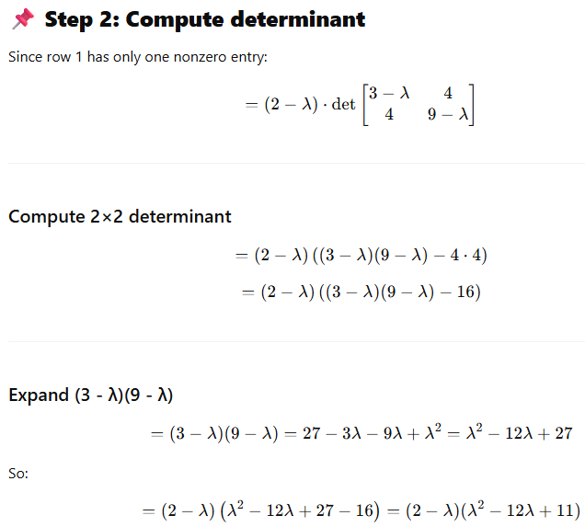
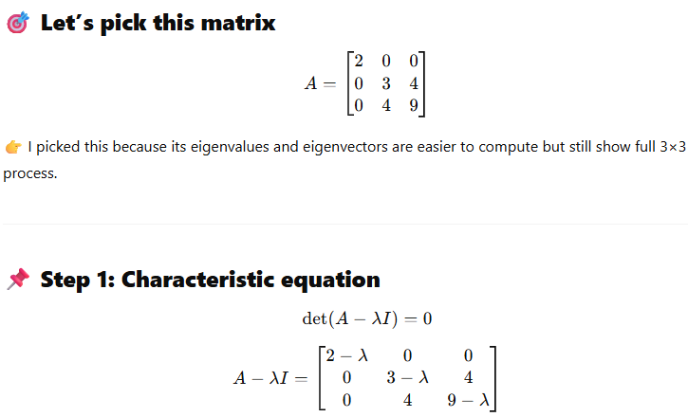
Example of 3X3 matrix: (p1)

Slide 16
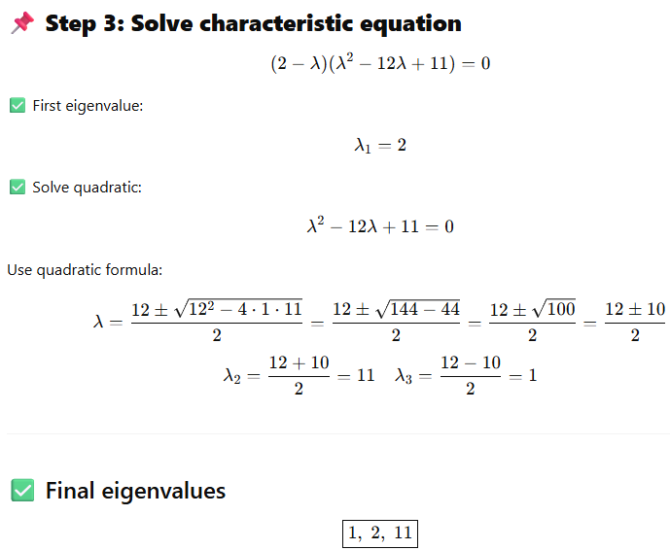
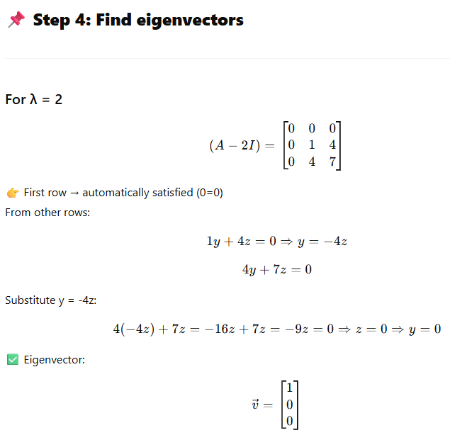
Example of 3X3 matrix: (p2)

Slide 17
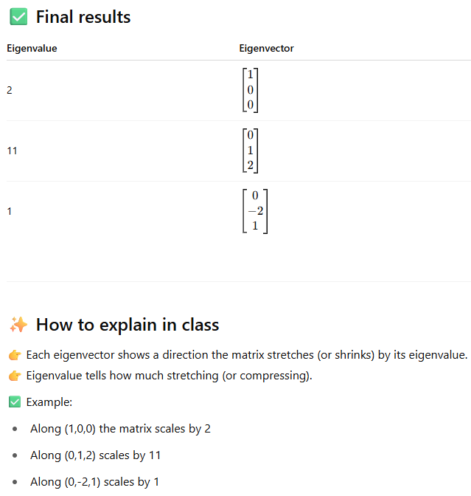
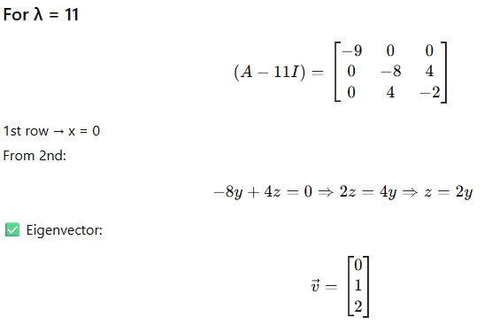
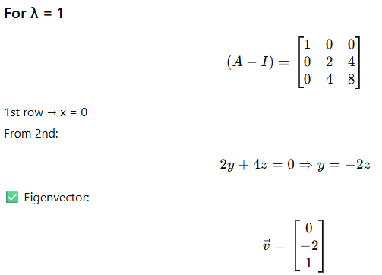
Example of 3X3 matrix: (p3)

