Slide 1
ML Math-eigenvalue

Slide 2
DEFINITION

Slide 3
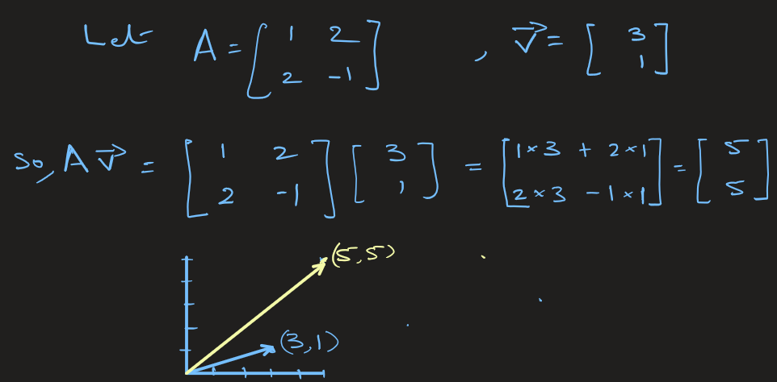
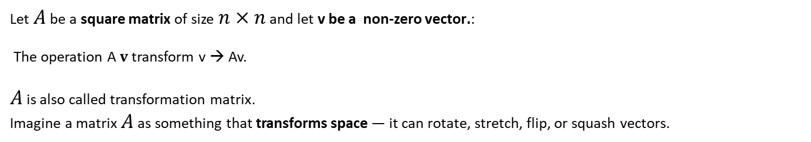
Eigen value and E. vector(See Jupyter n/b)
Let $A$ be a square matrix of size $n×n$ and let v be a non-zero vector$.$:
The operation A $v$transform v → Av.
$A$ is also called transformation matrix.
Imagine a matrix $A$ as something that transforms space — it can rotate, stretch, flip, or squash vectors.

Slide 4


Eigen value and E. vector(See Jupyter n/b)

Slide 5
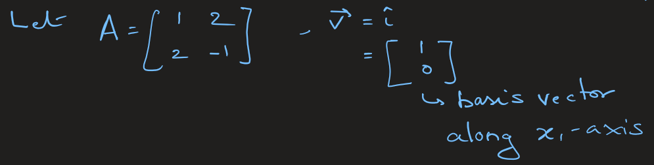
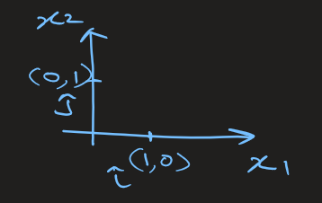
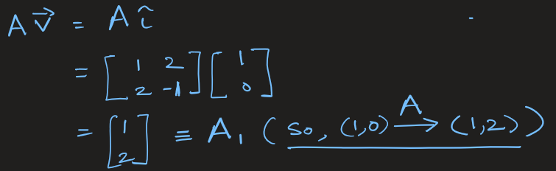
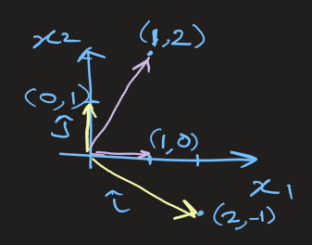
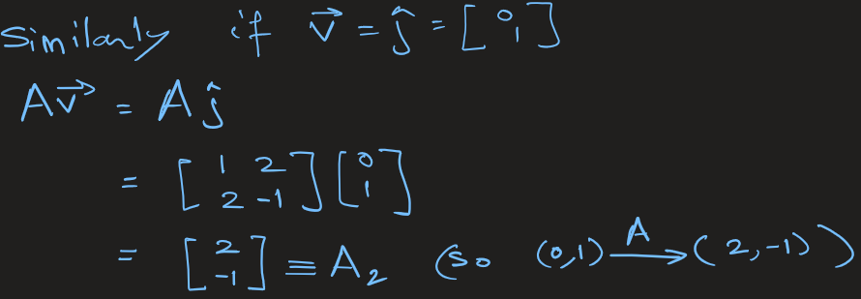
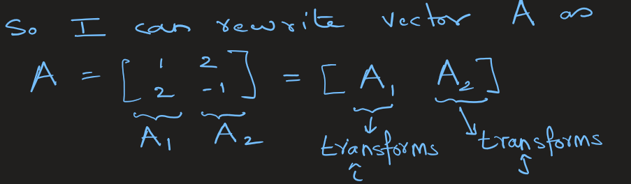

Slide 6
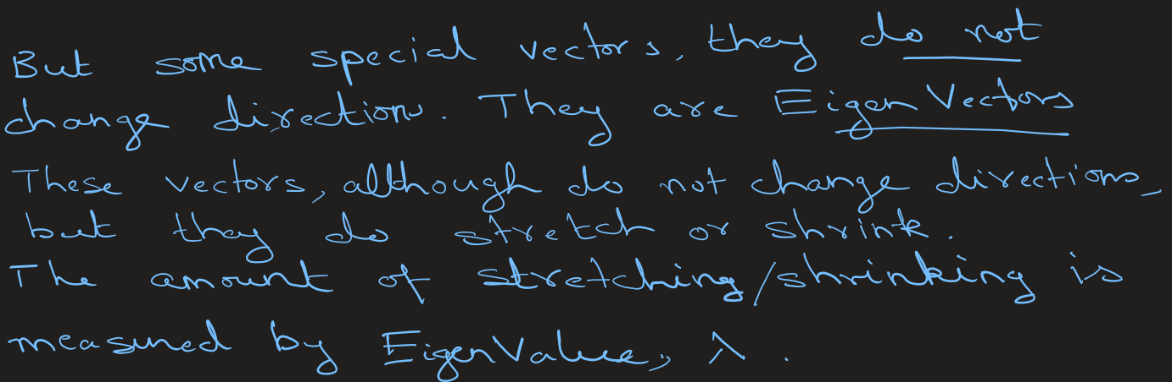


Slide 7

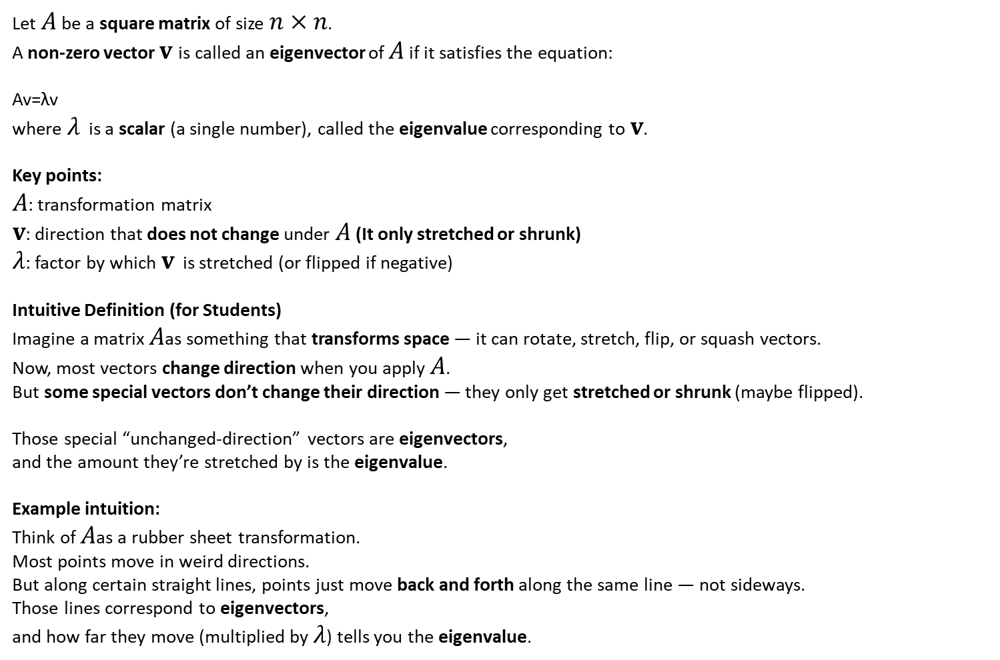
Eigen value and E. vector: Definition(See Jupyter n/b)
Let $A$ be a square matrix of size $n×n$.
A non-zero vector $v$is called an eigenvector of $A$ if it satisfies the equation:
Av=λv
where $λ$ is a scalar (a single number), called the eigenvalue corresponding to $v$.
Key points:
$A$: transformation matrix
$v$: direction that does not change under $A$ (It only stretched or shrunk)
$λ$: factor by which $v$ is stretched (or flipped if negative)
Intuitive Definition (for Students)
Imagine a matrix $A$as something that transforms space — it can rotate, stretch, flip, or squash vectors.
Now, most vectors change direction when you apply $A$. But some special vectors don’t change their direction — they only get stretched or shrunk (maybe flipped).
Those special “unchanged-direction” vectors are eigenvectors, and the amount they’re stretched by is the eigenvalue.
Example intuition:
Think of $A$as a rubber sheet transformation. Most points move in weird directions. But along certain straight lines, points just move back and forth along the same line — not sideways.
Those lines correspond to eigenvectors, and how far they move (multiplied by $λ$) tells you the eigenvalue.

Slide 8
How do You find Eigen Vectors and Eigen Values

Slide 9
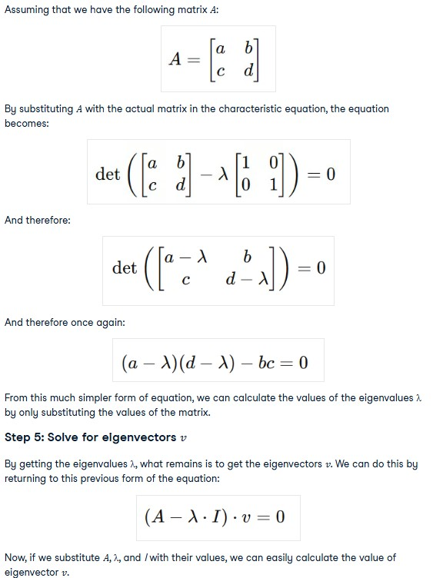




Eigen value and E. vector(See Jupyter n/b)
Example:
Given: Matrix A
NOTE: In PCA, A is covariance matrix of 2D data; in CV, A could be transformation applied to an image
Step 1: Start with the matrix transformation equation
For a matrix 𝐴 and a vector 𝑣, the basic equation for eigenvectors and eigenvalues is:
𝐴 is a matrix (a square grid of numbers).
𝑣 is the eigenvector
λ (lambda) is the eigenvalue.
The goal is to find both λ (the eigenvalue) and 𝑣 (the eigenvector).
Step 2: Rearrange and solve:

Slide 10
Eigen value and E. vector(See Jupyter n/b)
Example:
Given: Matrix A
NOTE: In PCA, A is covariance matrix of 2D data; in CV, A could be transformation applied to an image
Step 1: Start with the matrix transformation equation
For a matrix 𝐴 and a vector 𝑣, the basic equation for eigenvectors and eigenvalues is:
𝐴 is a matrix (a square grid of numbers).
𝑣 is the eigenvector
λ (lambda) is the eigenvalue.
The goal is to find both λ (the eigenvalue) and 𝑣 (the eigenvector).
Step 2: Rearrange and solve:

Slide 11
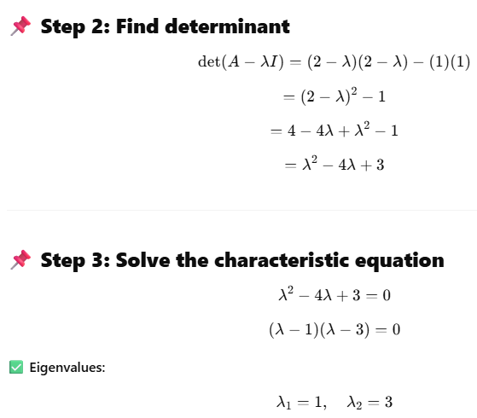
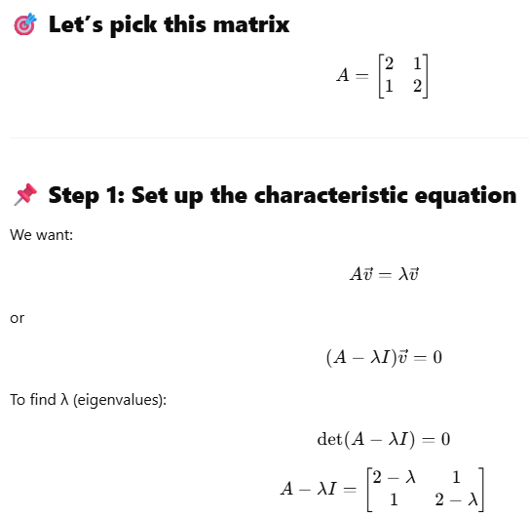
Example of 2X2 matrix: (p1)

Slide 12
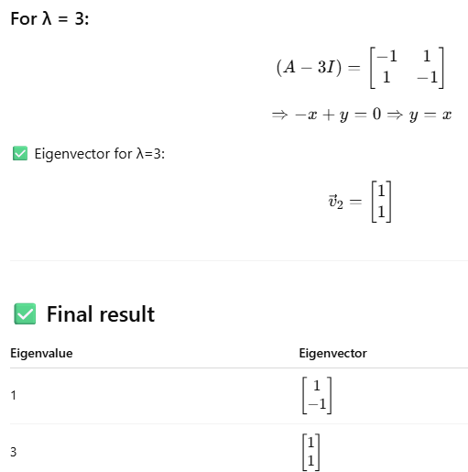
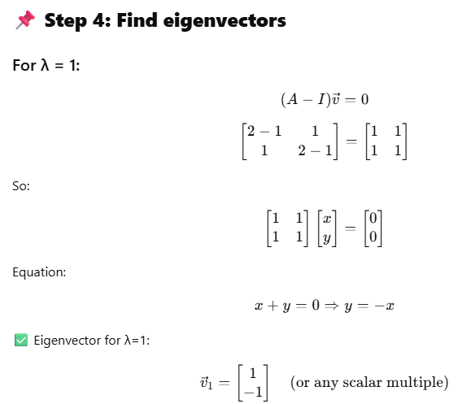
Example of 2X2 matrix: (p2)
How to explain in class:
➡ Eigenvalue = factor by which the matrix stretches/shrinks vectors along a special direction.
➡ Eigenvector = direction that doesn’t change except for scaling.
In this example:
Along (1,1) → matrix scales by 3
Along (1,-1) → matrix scales by 1

Slide 13
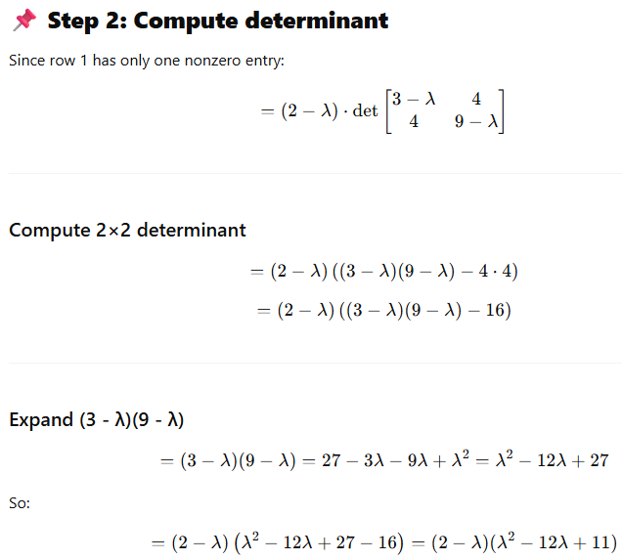
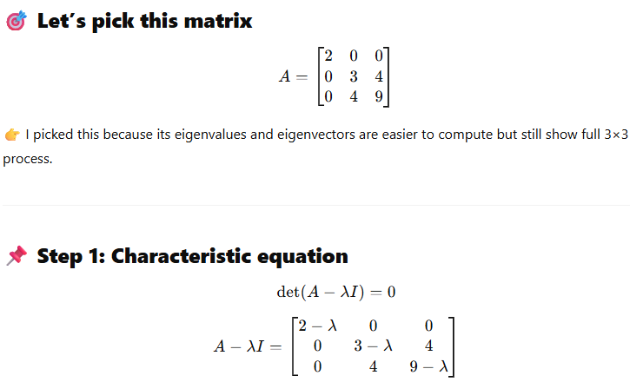
Example of 3X3 matrix: (p1)

Slide 14
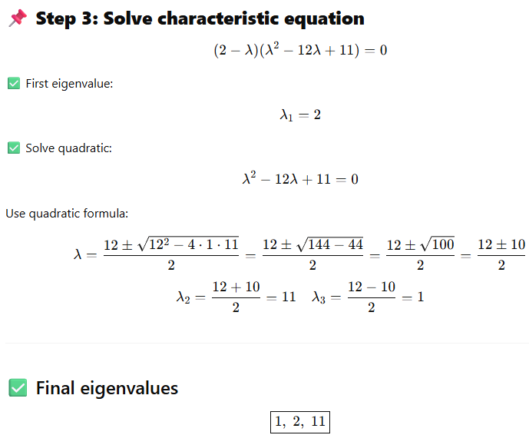
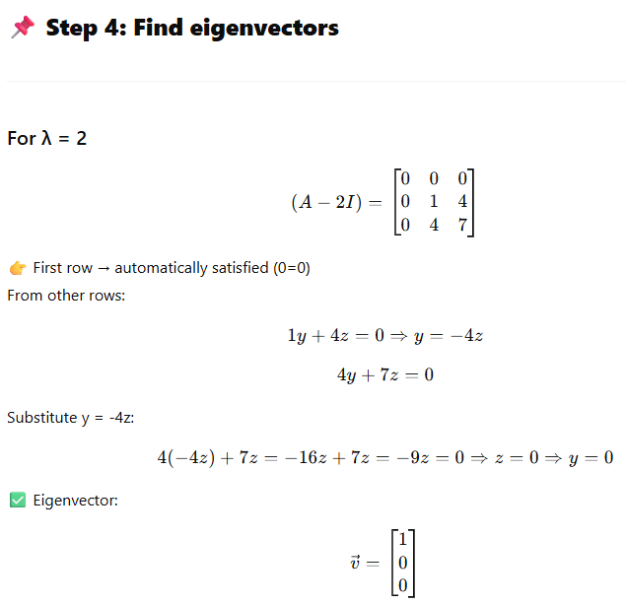
Example of 3X3 matrix: (p2)

Slide 15
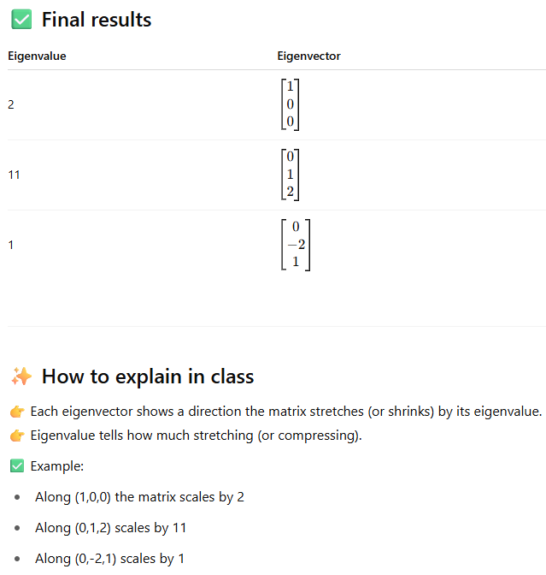
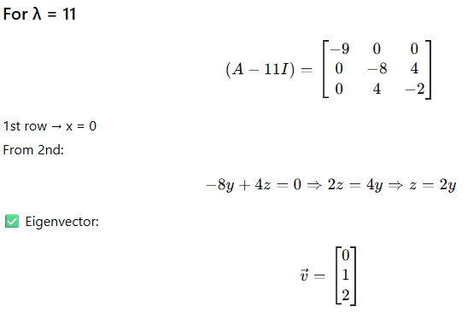
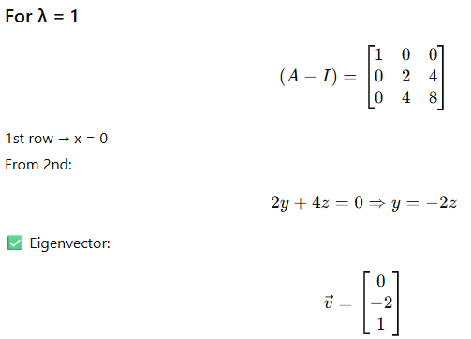
Example of 3X3 matrix: (p3)

Slide 16
Application in PCA

Slide 17
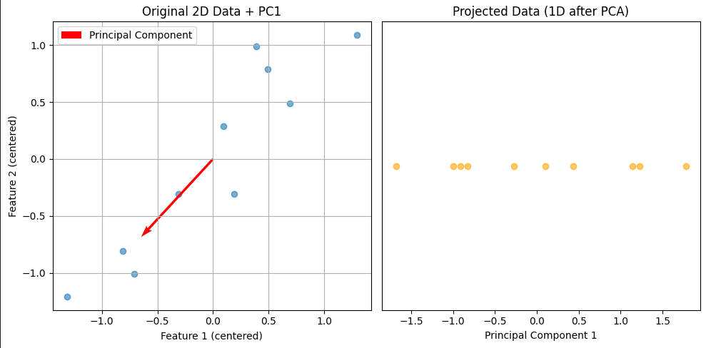








Eigen value and E. vector(See Jupyter n/b)
The eigenvectors are the principal directions — directions along which the data varies the most.
The eigenvalues tell how much variance ( spread ) there is along those directions.
- Largest eigenvalue → direction with most variance → 1st principal component
- Second eigenvalue → orthogonal direction → 2nd principal component
Eigenvalues + eigenvectors = tools to find patterns and reduce dimensions while preserving structure of data.
In PCA:
Eigenvectors → directions of maximum spread
Eigenvalues → how much spread in those directions

Slide 18
Eigen value and E. vector (Application in PCA) (p1) (see jupyter n/b)
Principal components are new variables that are constructed as linear combinations or mixtures of the initial variables. PC represent the directions of the data that explain a maximal amount of variance, that is to say, the lines that capture most information of the data.
Follow 5 steps to create PCA:
Step 1: Standardization:
Why do we do this ?
If your features are on different scales (e.g., one feature ranges 0–1, another 0–1000), PCA will give more importance to features with larger magnitudes or variances.
Step 2: Covariance Matrix Computation:
The covariance matrix tells us how features vary together. It capture relationships (variances + covariances) between features to identify directions of maximum variance.

Slide 19

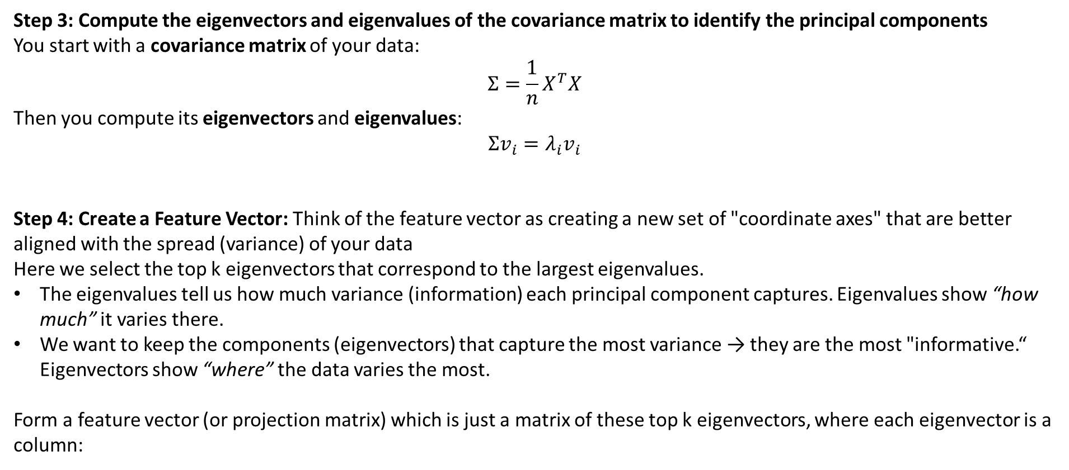
Eigen value and E. vector (Application in PCA) (p2)
Step 3: Compute the eigenvectors and eigenvalues of the covariance matrix to identify the principal components
You start with a covariance matrix of your data:
$$Σ=\frac{1}{n}X^{T}X$$
Then you compute its eigenvectors and eigenvalues:
$$Σv_{i}=λ_{i}v_{i}$$
Step 4: Create a Feature Vector: Think of the feature vector as creating a new set of "coordinate axes" that are better aligned with the spread (variance) of your data
Here we select the top k eigenvectors that correspond to the largest eigenvalues.
The eigenvalues tell us how much variance (information) each principal component captures. Eigenvalues show “how much” it varies there.
We want to keep the components (eigenvectors) that capture the most variance → they are the most "informative.“ Eigenvectors show “where” the data varies the most.
Form a feature vector (or projection matrix) which is just a matrix of these top k eigenvectors, where each eigenvector is a column:
,where each PC_i is a principal component (an eigenvector).

Slide 20
Eigen value and E. vector (Application in PCA) (p3)
Step 5: Recast the Data Along the Principal Components Axes

Slide 21
Eigen value and E. vector (Application)
Eigenvectors and eigenvalues are essential in many applications, including the following:
Covariance and Correlation Analysis
When studying relationships among variables (like in feature selection or clustering), eigenvectors of the covariance matrix show the uncorrelated directions (orthogonal features).
Image Processing:
They are used in facial recognition and image classification.
Natural Language Processing (NLP):
Eigenvectors and eigenvalues are used in topic modeling and word embeddings.
In word embeddings (like Word2Vec, GloVe):
Eigenvalue decomposition appears when factorizing co-occurrence matrices or SVD of the word-context matrix.
The top eigenvectors represent semantic directions in embedding space — e.g., gender, tense, country/capital relationships.
Recommendation Systems:
As in collaborative and content-based filtering, where dimensionality reduction can improve the accuracy of the recommendation systems.

Slide 22
Eigen value and E. vector (Application)
Spectral Clustering:
Eigenvectors and eigenvalues are also a founding component of spectral clustering, which is a method that groups data points by looking at their connections in a graph, using information from the structure of the data instead of just distance that has several practical applications, such as in image processing.
In unsupervised learning:
You create a similarity graph between data points.
Compute the graph Laplacian matrix.
Find its eigenvectors — they reveal the underlying cluster structure of the data.
The smallest eigenvectors (of the Laplacian) help embed the data into a low-dimensional space where clusters are easier to separate.
Markov Chains & PageRank:
In Google’s PageRank algorithm, the steady-state probabilities (importance of web pages) come from the dominant eigenvector of a transition matrix.
Eigenvalue = 1 corresponds to the stationary distribution.

Slide 23
Eigen value and E. vector (Application)
Neural Networks & Optimization:
Hessian matrix (second derivative of loss function) has eigenvalues/eigenvectors that tell you:
Eigenvectors → directions in parameter space
Eigenvalues → curvature (how steep/flat the loss surface is)
Used in understanding:
Convergence speed
Stability of gradient descent
Flat minima vs sharp minima

