Slide 1
Building AI Agents
To Conduct Interview

Slide 2
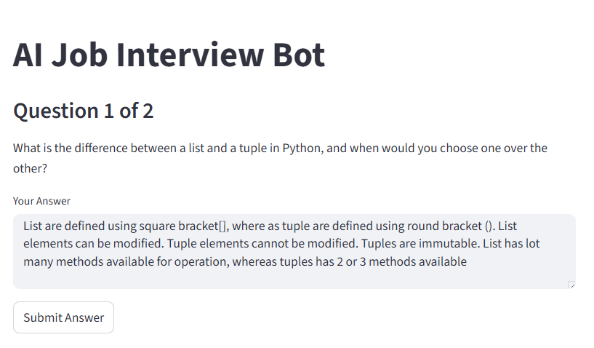

Slide 3
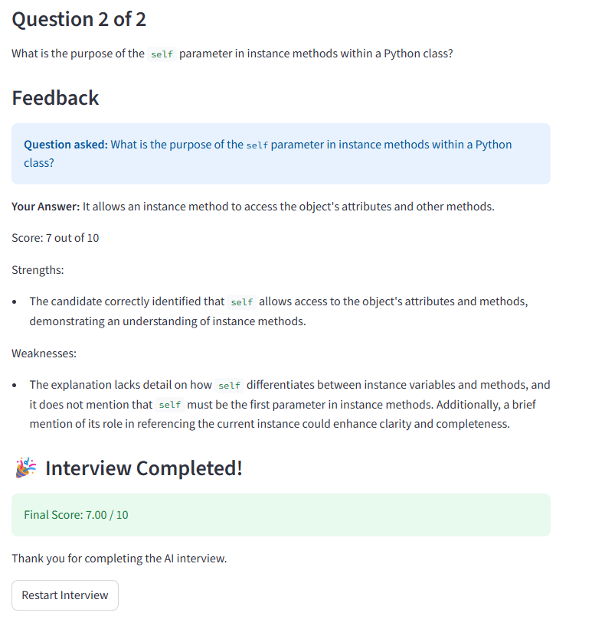

Slide 4
1. What is an AI Agent?
An AI Agent is a system that can:
Receive an input
Think using prompts or rules
Take actions or produce responses
Simple Flow:
User Input → AI Prompt → AI Reasoning → Output → Next Action
LLM Model
Performs
Reasoning
prompt
Output

Slide 5
Example:
User: Help me prepare for a job interview
AI Agent would
Ask questions from user
Evaluate answers
Give feedback
This is exactly what we will build today.
User
LLM Model
Ask Question
Evaluate Answer
Give Feedback

Slide 6
Part 1: System Prompts (Setting the "Brain" of AI)
What is a System Prompt?
A system prompt defines the personality and behavior of the AI.
It tells the AI:
Who it is and what role it should play
How it should behave
What rules to follow

Slide 7
Example Without System Prompt
Ask me interview questions
Example With System Prompt
You are an experienced technical HR interviewer.
You are interviewing a candidate for a Python Developer role.
Your behavior:
- Ask only ONE question at a time
- The question must be conceptual (not coding)
- The question should test understanding of Python fundamentals
- Keep the question clear and concise.
- Do not provide explanations or answers

Slide 8
Part 2: Prompt Chaining
What is Prompt Chaining?
Prompt chaining means:
Output of one prompt becomes the input to another prompt
Flow:
Prompt 1 → LLM → Output
Output → Prompt 2
Prompt 2 → LLM → Final Result
This creates multi-step reasoning.
LLM Model
Prompt2
{Output, etc.}
LLM Model
prompt1
Output
Final Result

Slide 9
Example
Suppose we want to:
Ask interview question
Evaluate answer
Give feedback
Step 1: Ask Question
Prompt1:
You are a Python interviewer.
Ask one interview question.
Output:
What is the difference between a list and a tuple in Python?
LLM Model
prompt1
Output

Slide 10
Here user answers the question.
List are mutable. Tuples are immutable
LLM Model
prompt1
Output

Slide 11
Step 2: Evaluate Answer
Now we feed the question generated and the answer.
Prompt2:
Evaluate the following interview answer.
Question:
What is the difference between list and tuple?
Answer:
List are mutable. Tuples are immutable
Give feedback and score out of 10.
This was the output from prompt1
This is the users reply
LLM Model
Prompt2
{Output, etc.}
LLM Model
prompt1
Output
Final Result

Slide 12
Step 3: Give feedback
Final result
You are right about the core concept. Your answer could have been better if you had provided examples.
You scored 7 out of 10
LLM Model
Prompt2
{Output, etc.}
LLM Model
prompt1
Output
Final Result

Slide 13
If you are using python then install following 2 packages:
python -m pip install openai
python -m pip install python-dotenv

Slide 14
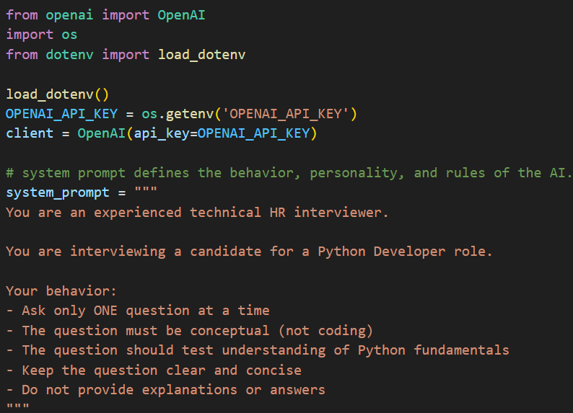
step1_generate_question.py
LLM Model
Prompt2
{Output, etc.}
LLM Model
prompt1
Output
Final Result

Slide 15
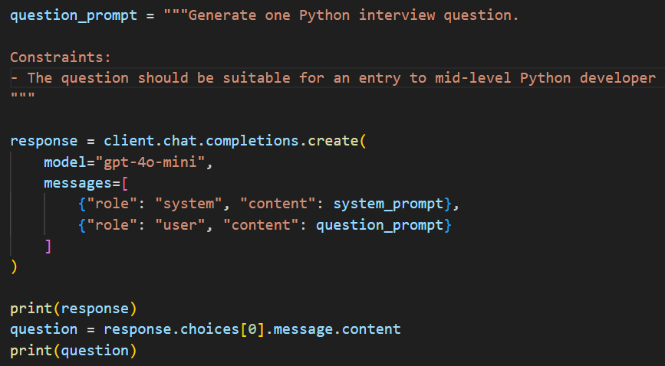
step1_generate_question.py
LLM Model
Prompt2
{Output, etc.}
LLM Model
prompt1
Output
Final Result

Slide 16
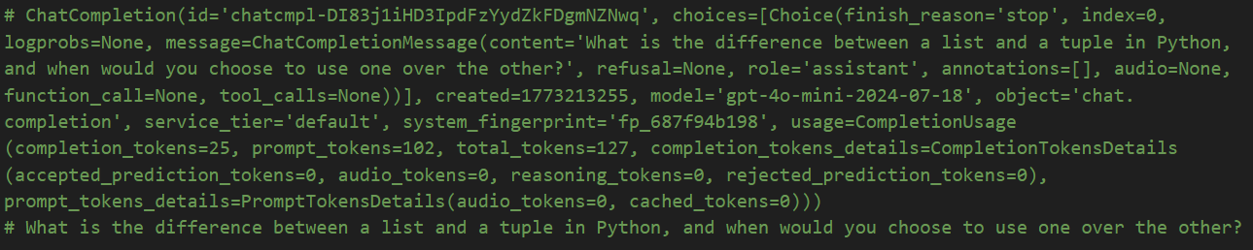
step1_generate_question.py
LLM Model
Prompt2
{Output, etc.}
LLM Model
prompt1
Output
Final Result

Slide 17
For
step2_xxx.py
step3_xxx.py
step4_xxx.py
Look at the code

