Slide 1
Prompt Engineering
Today we will understand how AI actually processes language and how to design better prompts.
Prompt engineering and optimization involve designing, testing, and refining input text (prompts) to guide AI models like LLMs to produce accurate, relevant, and high-quality output

Slide 2
Prompt Engineering
Tokenization – Why AI Sees Numbers, Not Words
AI models do not understand language like humans. They convert text into tokens, which are basically numbers representing pieces of words.
Humans see: I love machine learning
AI sees: [101, 1045, 2293, 3698, 4083, 102]

Slide 3
What is Tokenization?
Tokenization = Breaking text into smaller units (tokens).
Tokens can be:
Words
Parts of words
Characters
Symbols
Punctuation
Example
Sentence: Unbelievable performance!
Possible tokens: ["Un", "believ", "able", "performance", "!"]

Slide 4
Why Tokenization Matters in Prompt Engineering
1) Token Limit
Every AI model has a maximum token capacity.
Example:
GPT models have input + output token limits
If prompt is too long → information gets cut
2) Cost Calculation
Most APIs charge per token used.
More tokens = More cost

Slide 5
3) Prompt Clarity
Bad tokenization can change meaning.
Example:
Let’s eat grandma
Let’s eat, grandma
Comma changes tokens → meaning changes

Slide 6
Hallucinations – Why AI Lies & How to Stop It
What is Hallucination?
Real Example
Prompt: Who won FIFA World Cup 2050?
AI may confidently give wrong answer.
Hallucination happens when AI:
Generates false information
Sounds confident, but information is incorrect or invented
AI is predicting text, NOT verifying facts.

Slide 7
Hallucinations – Why AI Lies & How to Stop It
Why Hallucination Happens
1. Prediction Based Model
AI predicts most probable next word, not truth.
2. Missing Information
If prompt lacks details → AI guesses.
3. Ambiguous Prompts
Vague instructions lead to creative (but wrong) answers.

Slide 8
Hallucinations – Why AI Lies & How to Stop It
How to Reduce Hallucinations
Provide Context
Bad Prompt: Explain diabetes.
Better Prompt: Explain Type 2 diabetes for class 10 students in 100 words.

Slide 9
Hallucinations – Why AI Lies & How to Stop It
How to Reduce Hallucinations
Ask AI to Admit Uncertainty
Example: What is the cure for Type 2 diabetes. If unsure, say "I don’t know".
Use Source Requirement
Example: What is the cure for Type 2 diabetes. If unsure, say "I don’t know". Provide answer with references.

Slide 10
Hallucinations – Why AI Lies & How to Stop It
How to Reduce Hallucinations
Break Tasks into Steps
Instead of:
Write research paper
Use:
Step 1: Create outline
Step 2: Expand sections

Slide 11
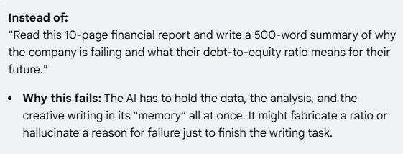
Hallucinations – Why AI Lies & How to Stop It
How to Reduce Hallucinations
Break Tasks into Steps

Slide 12
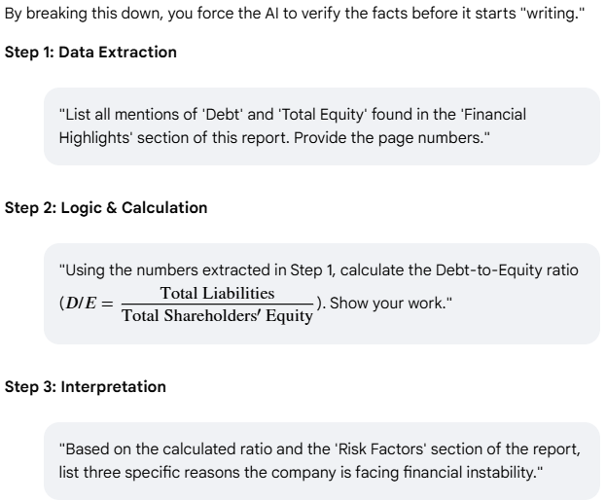
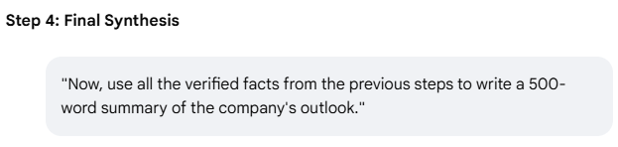
How to Reduce Hallucinations
Break Tasks into Steps

Slide 13
Hallucinations – Why AI Lies & How to Stop It
How to Reduce Hallucinations
Use Role Prompting
You are a certified medical professional...

Slide 14
Hallucinations – Why AI Lies & How to Stop It
How to Reduce Hallucinations
Use Role Prompting
The "Generic" Prompt (High Hallucination Risk)
Bad Prompt: "What should I do if my heart is racing?“
Risk: The AI might give overly cautious, irrelevant, or dangerously vague advice because it's pulling from its entire training set—which includes forums, blog posts, and fiction.

Slide 15
How to Reduce Hallucinations
Use Role Prompting
The "Role-Prompted" Example (Lower Hallucination Risk)
Better Prompt: "You are a board-certified cardiologist with 20 years of experience. Based on clinical emergency protocols, what is the step-by-step procedure for a patient experiencing a sudden resting heart rate over 120 BPM? If you are unsure of specific diagnostic criteria, state that you cannot provide medical advice for that detail."
Why this works:
Domain Alignment: By assuming the role, the model weights "medical journal" data more heavily than "internet forum" data.
Tone Shift: It shifts from a conversational buddy to a professional authority, which often suppresses the AI's tendency to "people please" with made-up answers.
Specific Constraints: You’ve combined the role with an "uncertainty" clause, which is proven to reduce hallucinations by up to 30–50%.

Slide 16
The Golden Prompt Formula
Prompt = Context + Task + Constraint + Output Format
1. Context (Background Information)
Gives AI situation or environment.
Without context → AI guesses
The "No Context" Prompt (The Guessing Game)
Bad Prompt: "Write a plan to improve customer retention.“
The Problem: The AI doesn't know if you are a local coffee shop, a billion-dollar SaaS company, or a non-profit. It will likely give you a "generic list" (loyalty cards, email newsletters) that might be totally irrelevant to your business model.

Slide 17
The Golden Prompt Formula
Prompt = Context + Task + Constraint + Output Format
The "High Context" Example (The Grounded Response)
Better Prompt :
"[Background]: We are a mid-sized B2B software company that sells a project management tool to construction firms. Our subscription is $500/month.
[The Situation]: We’ve noticed that customers usually leave (churn) after the 3rd month because the software feels too complex for their field workers.
[Goal]: Create a 30-day retention plan specifically focused on simplifying the 'onboarding' phase for non-technical users."

Slide 18
The Golden Prompt Formula
Prompt = Context + Task + Constraint + Output Format
2. Task (What AI Should Do)
Clear action instruction.
Example: Analyze the dataset and find trends in sales from the column monthly_sales.

Slide 19
The Golden Prompt Formula
Prompt = Context + Task + Constraint + Output Format
3. Constraint (Rules & Limitations)
Controls AI output.
Examples:
Word limit
Tone
Audience level
Style
Technology restriction
Example: Explain in simple language under 150 words the concept of calculus. My audience is high school students with weak math background. Do not use complex math formulas.

Slide 20
The Golden Prompt Formula
Prompt = Context + Task + Constraint + Output Format
4. Output Format (Structure)
This dramatically improves results.
Examples:
Table
Bullet points
JSON
Code
Step-by-step guide
Example: Provide output in table format.

Slide 21
The Golden Prompt Formula
Prompt = Context + Task + Constraint + Output Format
Weak Prompt:
Explain neural networks
Strong Prompt Using Formula
Context: You are teaching beginners in AI.
Task: Explain neural networks.
Constraint: Use simple language and include real-life analogy.
Output Format: Provide explanation in bullet points.

Slide 22
(Add On) Prompt Template
[ROLE]
You are a ___
[TASK]
Your task is to ___
[CONTEXT]
Here is the context: ___
[CONSTRAINTS]
Follow these rules:
- ___
- ___
[OUTPUT FORMAT]
Return answer as: ___

Slide 24
Practical Demo Idea
Ask students:
Count tokens in:
"Machine learning is powerful.“
Then show them using tokenizer tools like:
OpenAI tokenizer
HuggingFace tokenizer

