Slide 1
Visuals

Slide 2
1. The Image Prompt Formula
Subject + Style + Lighting + Vibe + Parameters
What is the Image Prompt Formula?
The Image Prompt Formula is a structured way of writing prompts to generate high-quality and controlled AI-generated images.
Instead of writing vague prompts, this formula helps create precise and visually appealing outputs.

Slide 3
Subject + Style + Lighting + Vibe + Parameters
1. Subject – What Should Appear in the Image
The subject defines the main object or scene in the image.
Examples of subjects include:
A futuristic city
A portrait of a warrior
A mountain landscape
A cyberpunk robot
A fantasy castle

Slide 4
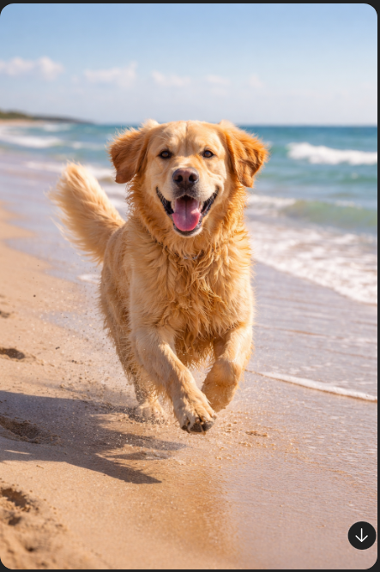
Subject + Style + Lighting + Vibe + Parameters
Example
A golden retriever running on a beach
The subject here is the dog and beach environment.

Slide 5
Subject + Style + Lighting + Vibe + Parameters
2. Style – How the Image Should Look
Style controls the artistic or visual appearance.
Common styles include:
Realistic
Cartoon
Anime
Oil Painting
Watercolor
Cinematic
3D Render
Pixel Art

Slide 6
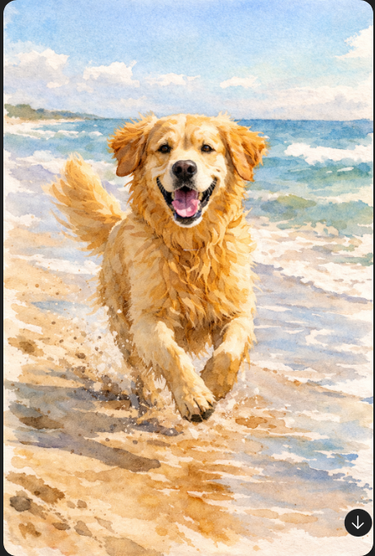
Subject + Style + Lighting + Vibe + Parameters
Example
A golden retriever running on a beach, watercolor painting style

Slide 7
Subject + Style + Lighting + Vibe + Parameters
3. Lighting – How Light Appears in the Image
Lighting dramatically affects mood and realism.
Common lighting types include:
Soft lighting
Neon lighting
Golden hour lighting
Studio lighting
Dramatic lighting
Natural sunlight
Backlighting

Slide 8
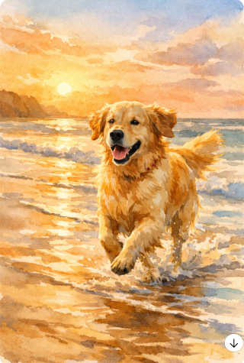
Subject + Style + Lighting + Vibe + Parameters
Example
Golden retriever running on a beach,
watercolor style,
golden hour lighting

Slide 9
Subject + Style + Lighting + Vibe + Parameters
4. Vibe – Emotional or Atmospheric Feel
Vibe controls the emotional tone or atmosphere.
Examples include:
Calm and peaceful
Dark and mysterious
Energetic and vibrant
Futuristic and sci-fi
Dreamlike and fantasy

Slide 10
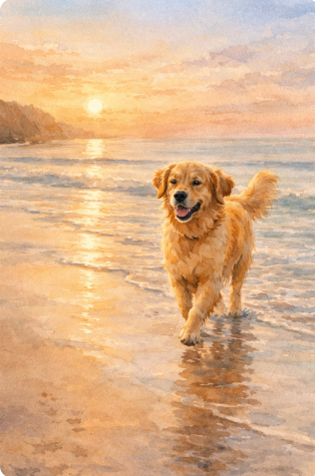
Subject + Style + Lighting + Vibe + Parameters
Example
Golden retriever running on a beach,
watercolor style,
golden hour lighting,
calm and peaceful vibe

Slide 11
Subject + Style + Lighting + Vibe + Parameters
5. Parameters – Technical Settings
Parameters control technical image settings such as:
Aspect ratio (--ar)
Aspect ratio controls image shape.
Examples:
--ar 1:1 → Square image
--ar 16:9 → Wide landscape image
--ar 9:16 → Vertical image
Stylization level (--s)
Stylization controls how artistic or creative the output becomes.
Lower value → More realistic
Higher value → More artistic or stylized

Slide 12
Subject + Style + Lighting + Vibe + Parameters
5. Parameters – Technical Settings
Rendering quality
Image variation
Resolution control

Slide 13
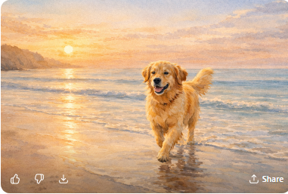
Subject + Style + Lighting + Vibe + Parameters
Example Full Prompt
Golden retriever running on a beach, watercolor style,
golden hour lighting, calm and peaceful vibe --ar 16:9 --s 750
Why This Formula is Important
Improve visual control
Reduce randomness
Generate professional results

Slide 14
2. Negative Prompts – Controlling What Should NOT Appear
What are Negative Prompts?
Negative prompts are instructions that tell the AI what elements to remove or avoid in generated images.
They help refine and clean up the output.

Slide 15
Why Negative Prompts are Important
AI sometimes generates:
Extra limbs
Blurry images
Distorted faces
Unwanted objects
Poor quality textures
Negative prompts help eliminate these issues.

Slide 16
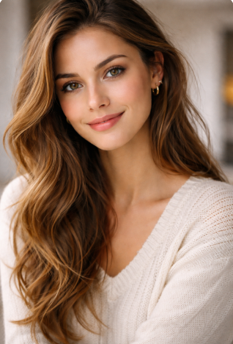
Example With Negative Prompt
Prompt:
Portrait of a woman, realistic style
Negative Prompt:
blurry, distorted face, extra fingers, low quality, black hair

Slide 17
Example Without Negative Prompt
Prompt:
Portrait of a woman, realistic style
AI might generate unwanted distortions.

Slide 18
Common Negative Prompt Keywords
Blurry
Low resolution
Extra limbs
Deformed face
Cropped image
Watermark
Noise
Text artifacts

