Slide 1
Decision Tree
Problem:
Suppose you are given following data that determines whether a person goes out and play based on following weather conditions:
Outlook, Humidity and Wind
Using this data, construct a decision tree that would decide based on features (Outlook, Humidity and Wind) whether a person would play or not.
ID | Outlook | Humidity | Wind | Play
1 | Sunny | High | Weak | No
2 | Sunny | High | Strong | No
3 | Overcast | High | Weak | Yes
4 | Rain | High | Weak | Yes
5 | Rain | Normal | Weak | Yes
6 | Rain | Normal | Strong | No
7 | Overcast | Normal | Strong | Yes
8 | Sunny | Normal | Weak | Yes

Slide 2
Decision Tree
A Decision Tree is a supervised machine learning algorithm used for classification and regression.

Slide 3
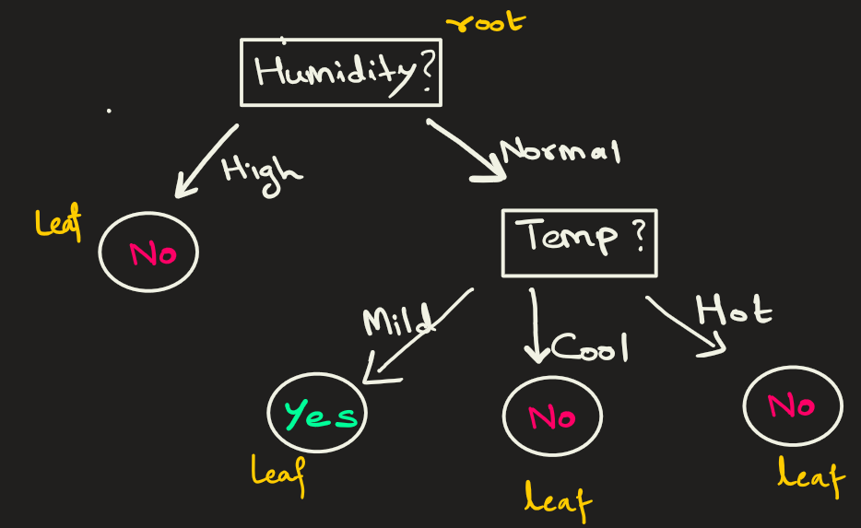
Decision Tree: Idea
Suppose you have to decide if you are going to play outside.
You make your decision based on 2 features only: Humidity and Temperature
Humidity can be high or normal.
Temperature can be cool, mild or hot

Slide 4
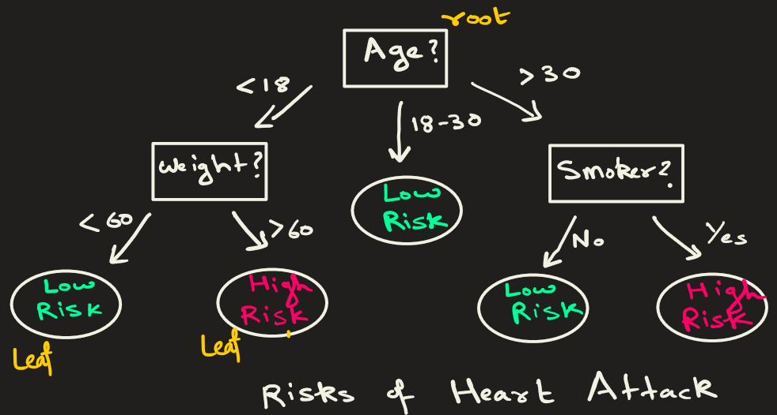
Decision Tree
Following is another example of decision :
Features are age, weight and smoker.
Root node starts with age, then in left node it decides based on wt.
Right node decides based on smoker.
The response variable is High/Low risk of heart attack

Slide 5
Decision Tree: Algorithm
How is a decision tree constructed ? It is constructed from training data.
1) Choose the Best Attribute: The algorithm evaluates all features using a metric such as Gini impurity, entropy, or information gain. The feature that best separates the classes becomes the root node (the first decision).
2) Split the Dataset:
The dataset is divided into groups based on the selected feature.
For numerical features → a threshold is used (e.g., in Iris dataset, petal_length <= 2.5 )
For categorical features → the data is split by categories (e.g., Temperature = Hot, Mild, Cool)
3) Repeat the Process:
For each new subset of data, the same steps are applied again:
Choose the best feature → Split the data → Create new branches
This continues until a stopping rule is reached, such as:
All samples in a node belong to the same class
No features left to split
Maximum depth reached
Minimum samples per node reached

Slide 6
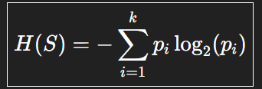
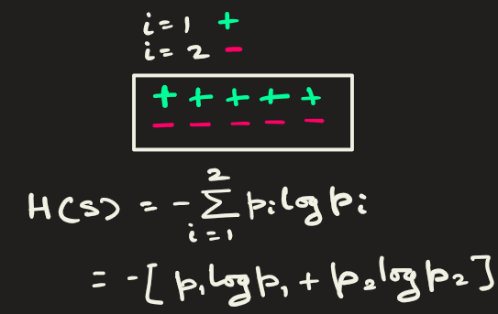
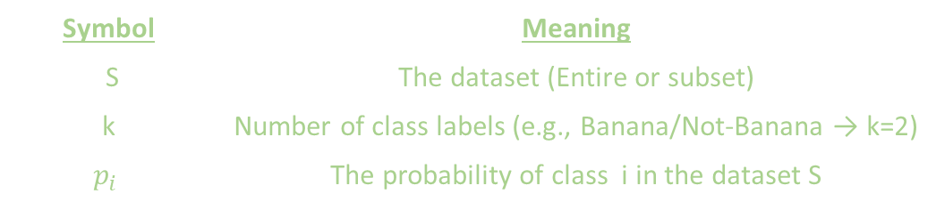
Entropy: It measures the randomness in data
Symbol | Meaning
S | The dataset (Entire or subset)
k | Number of class labels (e.g., Banana/Not-Banana → k=2)
$$p_{i}$$ | The probability of class i in the dataset S
Example: Suppose we have 2 class: + and -. Then the formula becomes,

Slide 7
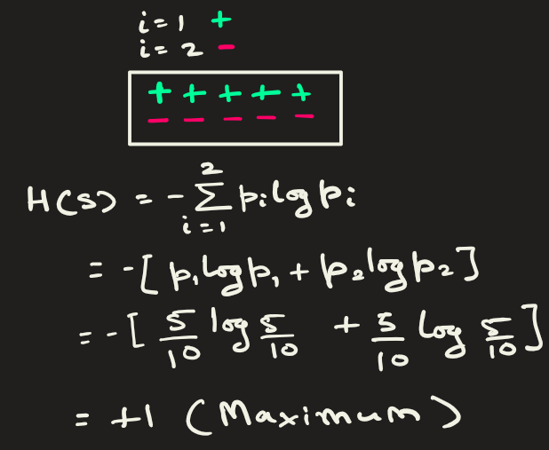
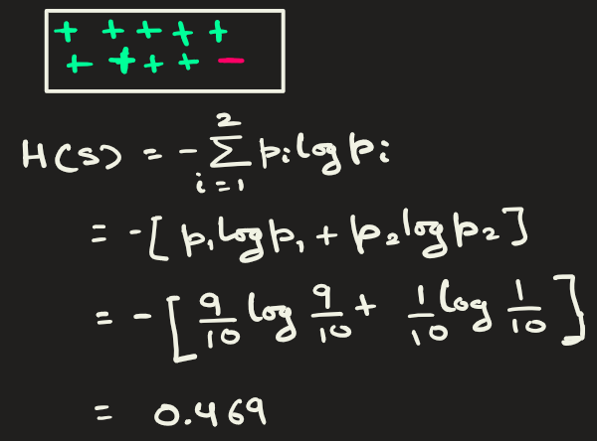
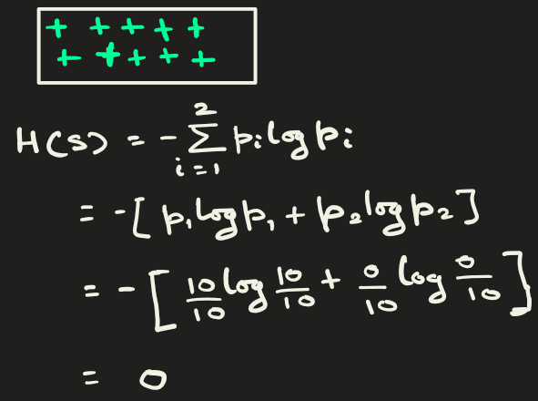
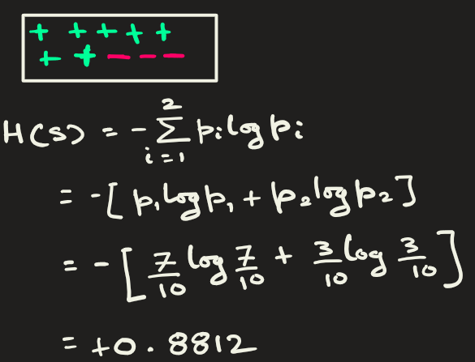
Below we see that as randomness is lowering, entropy H(S) is getting lower.
For Binary class, the entropy ranges from 0 to +1.

Slide 8
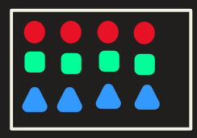
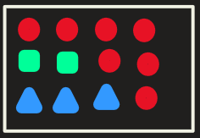
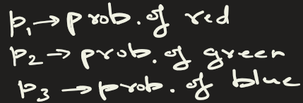
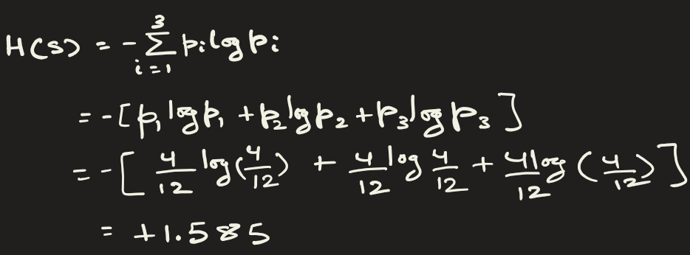
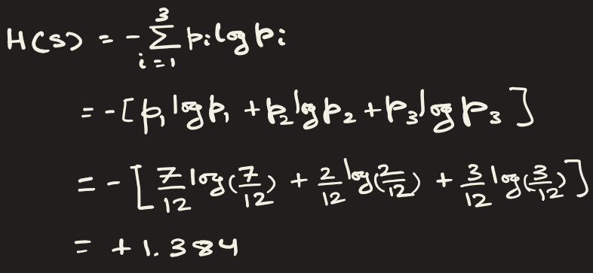
Example: Below we have 3 classes
For tertiary class, the entropy ranges from 0 to +1.585

Slide 9

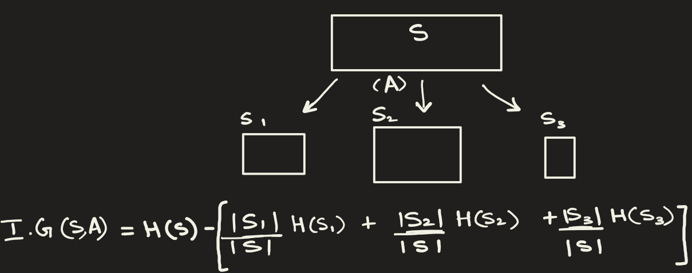
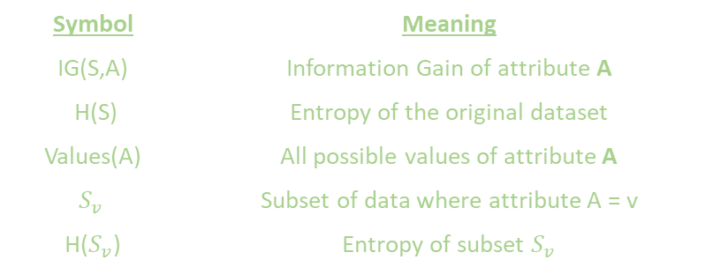
Information gain
Information Gain = Entropy before split – Entropy after split
= Entropy of Parent – Weighted entropy of child nodes
Symbol | Meaning
IG(S,A) | Information Gain of attribute A
H(S) | Entropy of the original dataset
Values(A) | All possible values of attribute A
$$S_{v}$$ | Subset of data where attribute A = v
H($S_{v}$) | Entropy of subset $S_{v}$
Example: Suppose that S is split into 3 child nodes. Then formula for IG is

Slide 10
Information gain
Suppose you are given following training data. Here the features are weight, shape and sweetness. Using this data, construct a decision tree that would decide based on features whether a fruit is a banana or not.
At any node, how do you determine which feature to use when splitting?
weight | shape | sweet | is_banana
0.1 | round | y | Not banana
0.2 | round | y | Not banana
0.2 | round | n | Not banana
0.2 | round | y | Not banana
0.4 | elongated | y | Banana
0.6 | elongated | n | Banana
0.1 | elongated | y | Banana
0.6 | round | n | Not banana
0.4 | elongated | n | Banana
0.5 | elongated | n | Banana
Here target variable(aka, response or label) is is_banana
The shape is best feature that determines the type of fruit. So, this feature has most information gain among all. So, start by asking if the fruit shape is elongated or round, we can quickly determine the type of fruit.
This would be good candidate for splitting.
Feature sweet provides no useful information on the type of fruit.

Slide 11
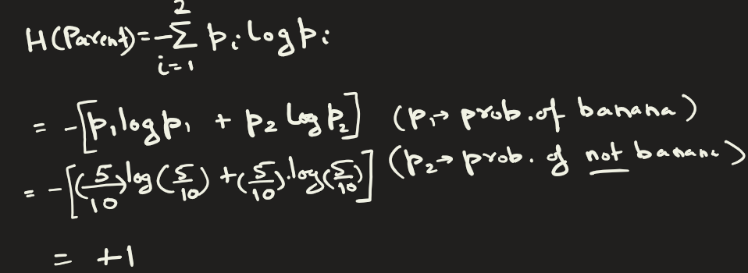
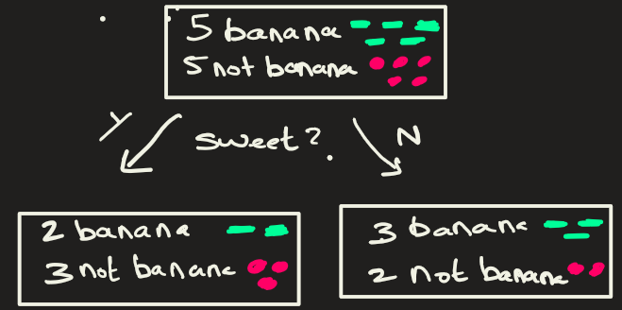
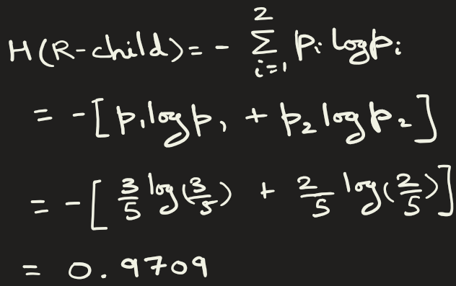
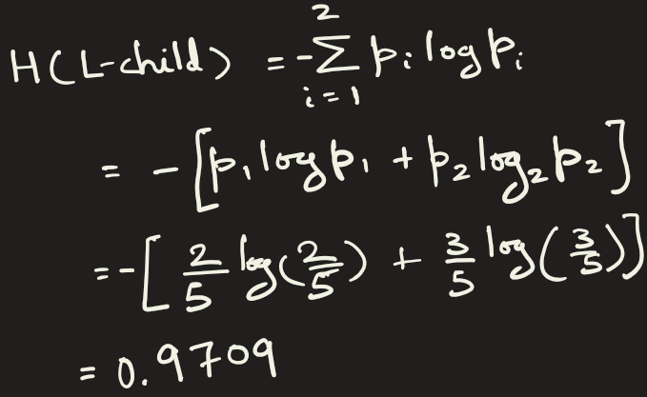
Information gain
weight | shape | sweet | is_banana
0.1 | round | y | Not banana
0.2 | round | y | Not banana
0.2 | round | n | Not banana
0.2 | round | y | Not banana
0.4 | elongated | y | Banana
0.6 | elongated | n | Banana
0.1 | elongated | y | Banana
0.6 | round | n | Not banana
0.4 | elongated | n | Banana
0.5 | elongated | n | Banana
Less Information Gain from feature sweet
Final split is more impure.

Slide 12
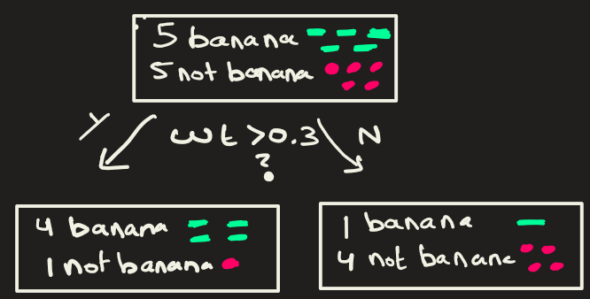
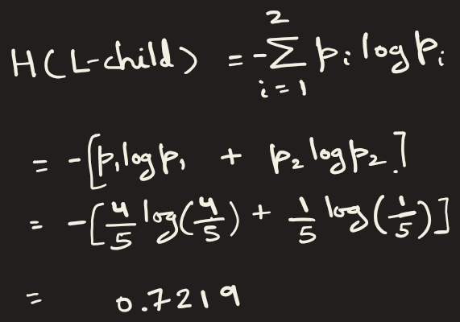
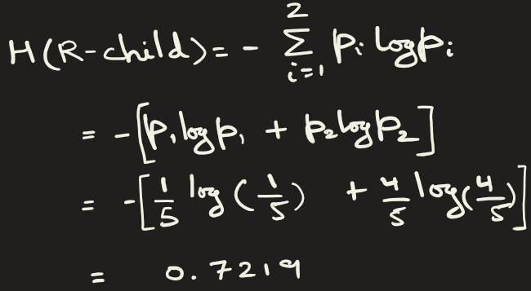
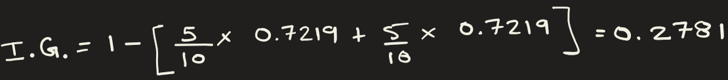
Information gain
weight | shape | sweet | is_banana
0.1 | round | y | Not banana
0.2 | round | y | Not banana
0.2 | round | n | Not banana
0.2 | round | y | Not banana
0.4 | elongated | y | Banana
0.6 | elongated | n | Banana
0.1 | elongated | y | Banana
0.6 | round | n | Not banana
0.4 | elongated | n | Banana
0.5 | elongated | n | Banana
Information Gain increases from feature weight.
Final split is less Impure

Slide 13
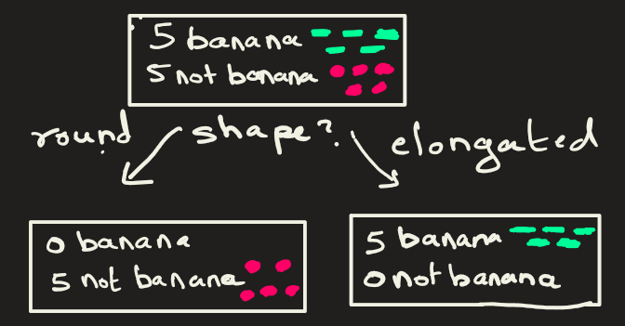
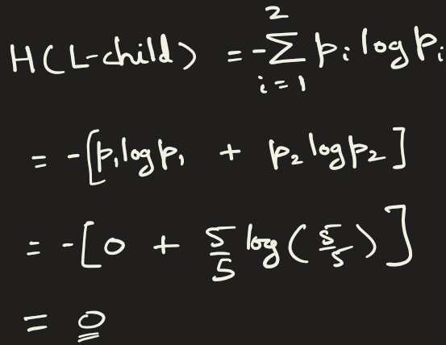
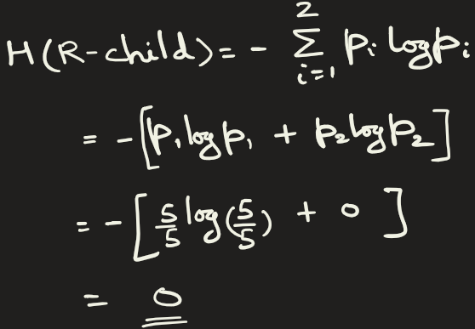

Information gain
weight | shape | sweet | is_banana
0.1 | round | y | Not banana
0.2 | round | y | Not banana
0.2 | round | n | Not banana
0.2 | round | y | Not banana
0.4 | elongated | y | Banana
0.6 | elongated | n | Banana
0.1 | elongated | y | Banana
0.6 | round | n | Not banana
0.4 | elongated | n | Banana
0.5 | elongated | n | Banana
Maximum information gain from shape
Final split is pure.

Slide 14
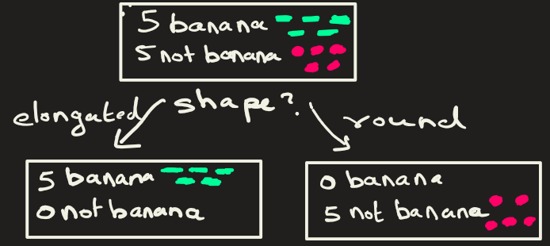
Information gain
IG(Parent, ‘sweet’) = 0.029
IG(Parent, ‘weight’) = 0.2781
IG(Parent, ‘shape’) = 1
So, we choose shape as the attribute to split the parent as it gives maximum IG.
The split is pure.

Slide 15
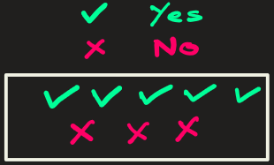
Decision Tree
Example: Create a decision tree from following data
ID | Outlook | Humidity | Wind | Play
1 | Sunny | High | Weak | No
2 | Sunny | High | Strong | No
3 | Overcast | High | Weak | Yes
4 | Rain | High | Weak | Yes
5 | Rain | Normal | Weak | Yes
6 | Rain | Normal | Strong | No
7 | Overcast | Normal | Strong | Yes
8 | Sunny | Normal | Weak | Yes

Slide 16


Decision Tree
ID | Outlook | Humidity | Wind | Play
1 | Sunny | High | Weak | No
2 | Sunny | High | Strong | No
3 | Overcast | High | Weak | Yes
4 | Rain | High | Weak | Yes
5 | Rain | Normal | Weak | Yes
6 | Rain | Normal | Strong | No
7 | Overcast | Normal | Strong | Yes
8 | Sunny | Normal | Weak | Yes
STEP 1 — Calculate Entropy of the Full Dataset
Total entropy of parent = 0.954

Slide 17
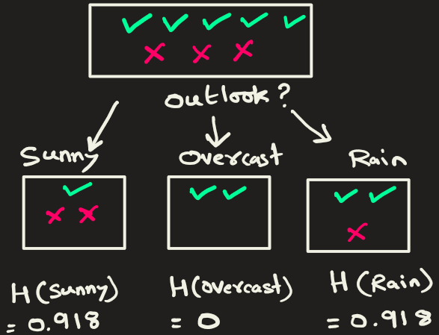
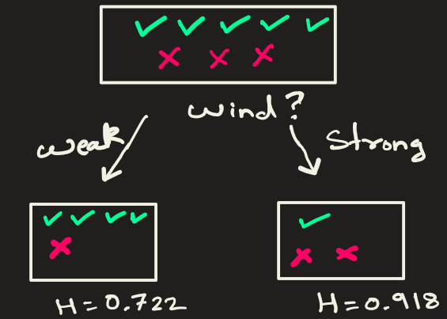

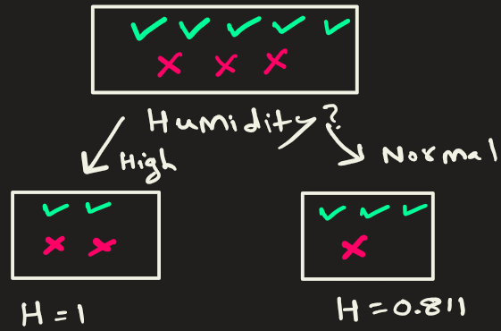
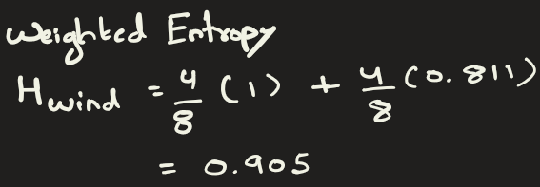
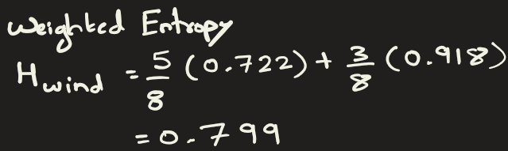
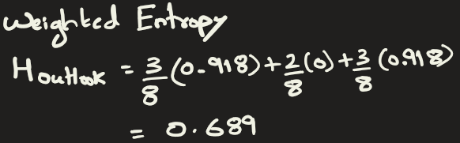



Decision Tree
STEP 2 — Compute Information Gain for each feature: outlook, humidity and wind

Slide 18
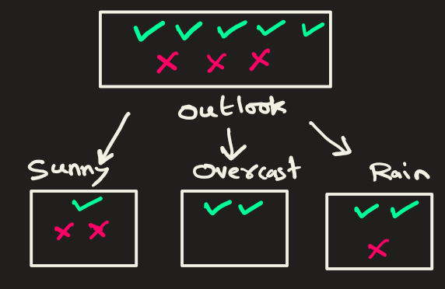
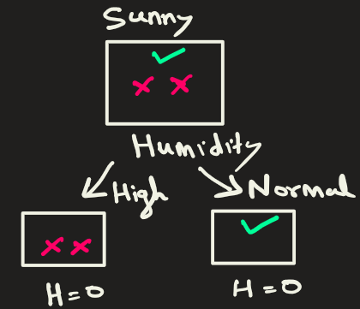
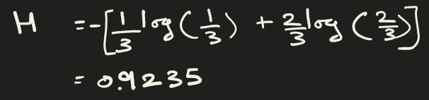
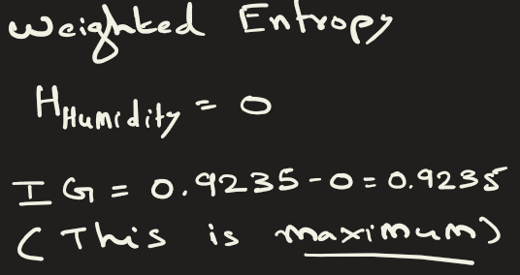
Decision Tree
STEP 3 — a) Split the dataset on branch Outlook → Sunny

Slide 19
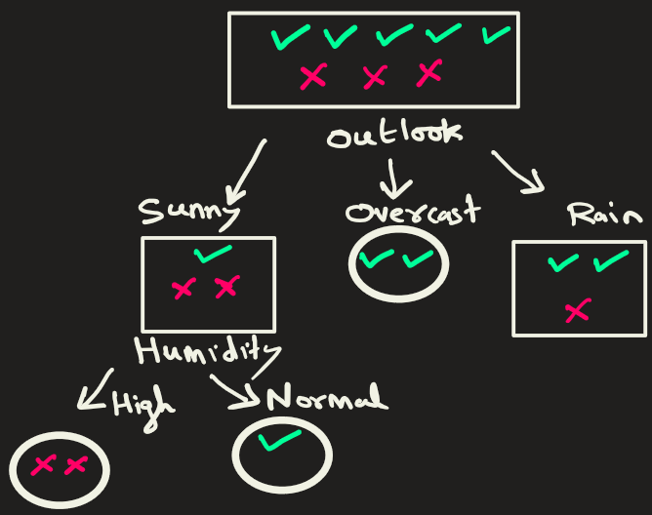
Decision Tree
STEP 3 — b) Split the dataset on branch Outlook → Overcast:
Overcast is pure. No split needed here.

Slide 20
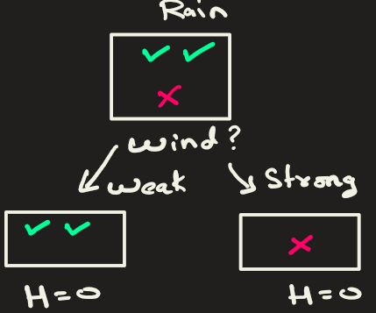
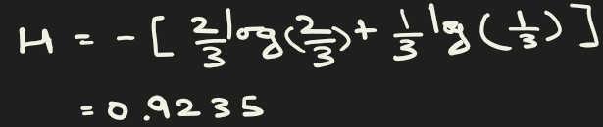
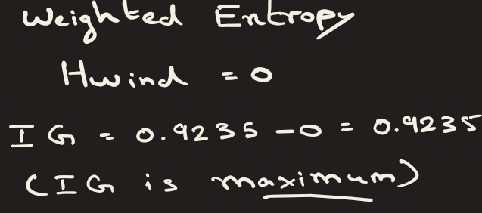
Decision Tree
STEP 3 — c) Split the dataset on branch Outlook → Rain:

Slide 21
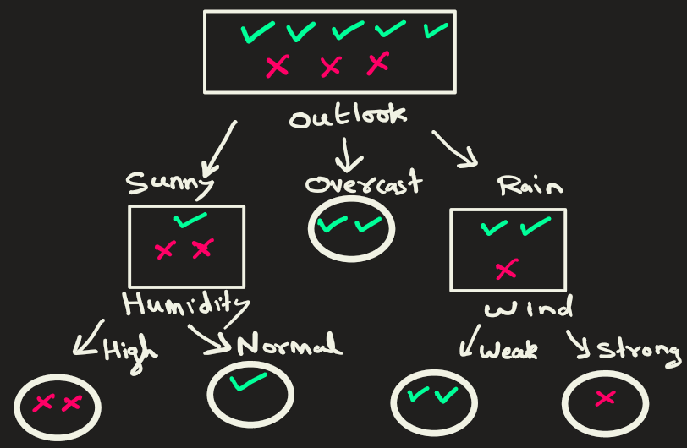
Decision Tree
STEP 4 — All splits are pure. No further split required.

Slide 22
Decision Tree: Advantages
Easy to understand, visualize, and explain: They use if-else logic
No need for feature scaling
Handles numerical & categorical data
Works well even with missing values and even if outliers exist
Fast training and prediction

Slide 23
Extra

Slide 24
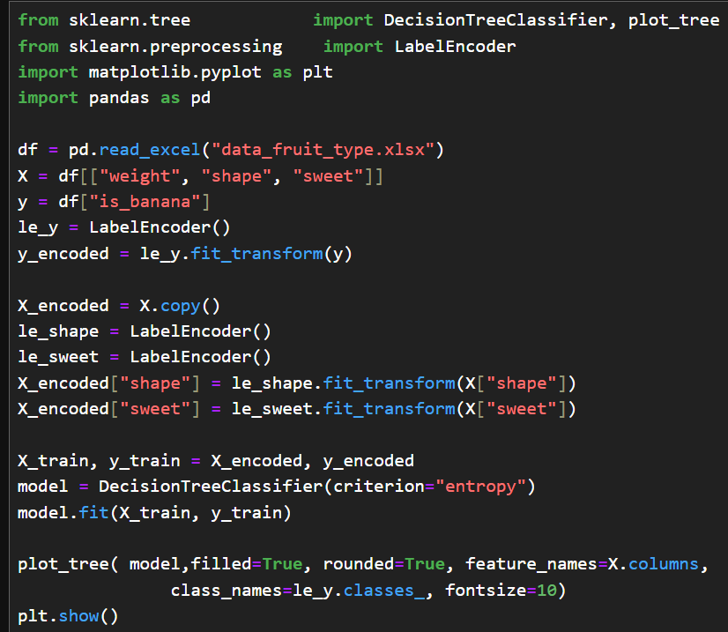
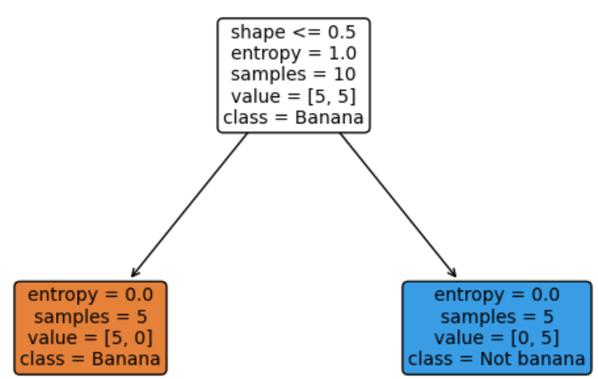
Decision Tree: Code

Slide 25
Steps to calculate IG on Heart disease:
ID | Age Group | Smoking Status | Exercise Habit | Heart Disease (Label)
1 | Younger (<40) | Smoker | Regular | Positive
2 | Younger (<40) | Smoker | Regular | Positive
3 | Younger (<40) | Smoker | Regular | Positive
4 | Younger (<40) | Smoker | No Exercise | Positive
5 | Younger (<40) | Smoker | No Exercise | Positive
6 | Younger (<40) | Non-Smoker | Regular | Positive
7 | Younger (<40) | Non-Smoker | Regular | Positive
8 | Younger (<40) | Non-Smoker | Regular | Positive
9 | Younger (<40) | Non-Smoker | No Exercise | Positive
10 | Younger (<40) | Non-Smoker | No Exercise | Positive
11 | Younger (<40) | Smoker | No Exercise | Negative
12 | Younger (<40) | Smoker | No Exercise | Negative
13 | Younger (<40) | Non-Smoker | No Exercise | Negative
14 | Younger (<40) | Non-Smoker | No Exercise | Negative
15 | Younger (<40) | Non-Smoker | No Exercise | Negative
16 | Older (≥40) | Smoker | No Exercise | Positive
17 | Older (≥40) | Smoker | No Exercise | Positive
18 | Older (≥40) | Non-Smoker | Regular | Positive
19 | Older (≥40) | Non-Smoker | Regular | Positive
20 | Older (≥40) | Smoker | No Exercise | Negative
21 | Older (≥40) | Smoker | No Exercise | Negative
22 | Older (≥40) | Smoker | No Exercise | Negative
23 | Older (≥40) | Smoker | No Exercise | Negative
24 | Older (≥40) | Smoker | No Exercise | Negative
25 | Older (≥40) | Smoker | No Exercise | Negative
26 | Older (≥40) | Smoker | No Exercise | Negative
27 | Older (≥40) | Non-Smoker | No Exercise | Negative
28 | Older (≥40) | Non-Smoker | No Exercise | Negative
29 | Older (≥40) | Non-Smoker | No Exercise | Negative
30 | Older (≥40) | Non-Smoker | No Exercise | Negative
This is an example related to predicting heart disease in patients. At this node, there are 3 features where split could be made:
1) Age Group Split: Older individuals are more prone to heart disease.
2) Smoking Status Split: Smokers have a higher risk.
3) Exercise Habit Split: Lack of exercise increases risk significantly.
Let’s determine on which feature the split should be made.

Slide 26
Steps to calculate IG(p2):
Step 1: Calculate Entropy of the Parent Node
positive cases(Has heart disease) = 14
negative cases(Has no heart disease) = 16
Total case = 30
Entropy of parent
= Entropy before split
= −[ (14/30 * ​log​(14/30)​ + 16/30*​log(16/30​) ]
= −(0.466×−1.099+0.533×−0.912) = 0.999
This is almost 1…so high entropy.

Slide 27
Steps to calculate IG(p3):
Step 2: Perform 3 Different Splits & Calculate Information Gain
Split 1: Based on Age Group (Younger vs. Older)
We split the data based on whether a person is younger (<40 years) or older (≥40 years).
Age Group | Positive Cases | Negative Cases | Total
Younger (<40) | 10 | 5 | 15
Older (≥40) | 4 | 11 | 15
Entropy of younger Node
= −[10/15 * ​log​(10/15)​+5/15*​log(5/15​) ]
= −(0.666×−0.585+0.333×−1.585) = 0.918
Entropy of older Node
= −[4/15 * ​log​(4/15)​+11/15*​log(11/15​) ]
= −(0.266×−1.907+0.733×−0.448) = 0.836
Entropy after split on Age group
= (15/30​×0.918)+(15/30​×0.836) = 0.877
Info gain = Entropy before split - Entropy after split
= Entropy of parent - Entropy after split
= 0.999−0.877= 0.122

Slide 28
Steps to calculate IG(p4):
Split 2: Based on Smoking Status (Smoker vs. Non-Smoker)
We split the data based on whether a person is smoker or not
Smoking Status | Positive Cases | Negative Cases | Total
Smoker | 6 | 12 | 18
Non-Smoker | 8 | 4 | 12
Entropy of smoker Node
= −[6/18 * ​log​(6/18)​+12/18*​log(12/18​) ]
= −(0.333×−1.585+0.666×−0.585) = 0.918
Entropy of non smoker Node
= −[8/12 * ​log​(8/12)​+4/12*​log(4/12​) ] = 0.918
Entropy after split on smoking status
= (18/30​ × 0.918) + (12/30​ × 0.918)=0.918
Info gain = Entropy before split - Entropy after split
= Entropy of parent - Entropy after split
= 0.999 − 0.918 = 0.081

Slide 29
Steps to calculate IG(p5):
Split 3: Based on Exercise Habit (Regular vs. No Exercise)
We split the data based on exercise habit
Exercise Habit | Positive Cases | Negative Cases | Total
Regular | 9 | 3 | 12
No Exercise | 5 | 13 | 18
Entropy of regular-exercise Node
= −[9/12 * ​log​(9/12)​+3/12*​log(3/12​) ] = 0.811
Entropy of no-exercise Node
= −[5/18 * ​log​(5/18)​+13/18*​log(13/18​) ] = 0.850
Entropy after split on exercise habit status
= (12/30​×0.811) + (18/30​×0.850) = 0.835
Info gain = Entropy before split - Entropy after split
= Entropy of parent - Entropy after split
= 0.999 − 0.835 = 0.164
Split Criterion | Information Gain (IG)
Age Group (Young vs. Old) | 0.122
Smoking Status (Smoker vs. Non-Smoker) | 0.081
Exercise Habit (Regular vs. No Exercise) | 0.164
Conclusion: The best attribute for the split is Exercise Habit (IG = 0.164) as it gives the highest Information Gain.

Slide 30
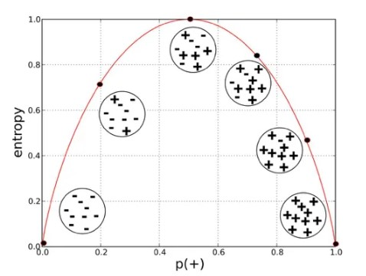
How is entropy related to probability of positive class for binary classification?

Slide 31
Heading Goes Here
Fhdsklf
Fjdsklf
Fjskldf

