Slide 1
Decision Tree Regressor
A Decision Tree is a supervised machine learning algorithm used for classification and regression.

Slide 2
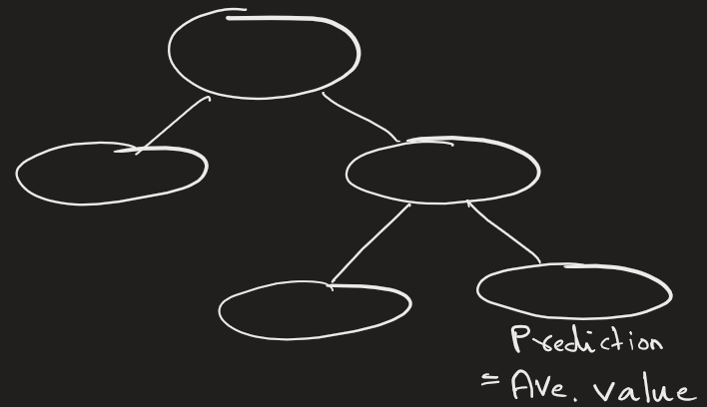
Decision Tree Regression
Idea: Splits data into regions and predicts average value per region.

Slide 3
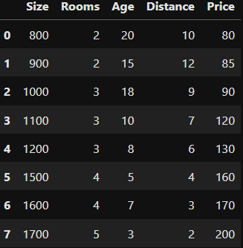
Problem Statement
We want to predict house price based on:
Size (sqft)
Number of rooms
Age of house
Distance from city center
We want output: House Price (continuous value)
Therefore, this is Regression Problem

Slide 4
Here it should be noted that
Larger size → higher price
Less distance → higher price
Newer houses → costly

Slide 5
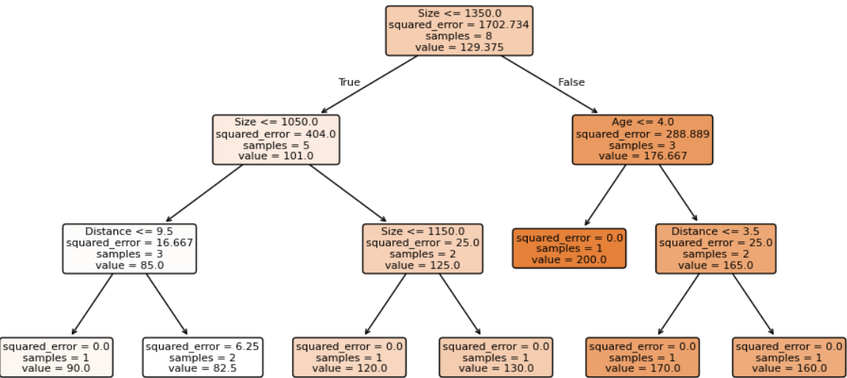
Here you make series of decision splits based on features and their values that gives you maximum information gain.
This is discussed in detail in DT classifier.
At the end you get final DT shown below.

Slide 6
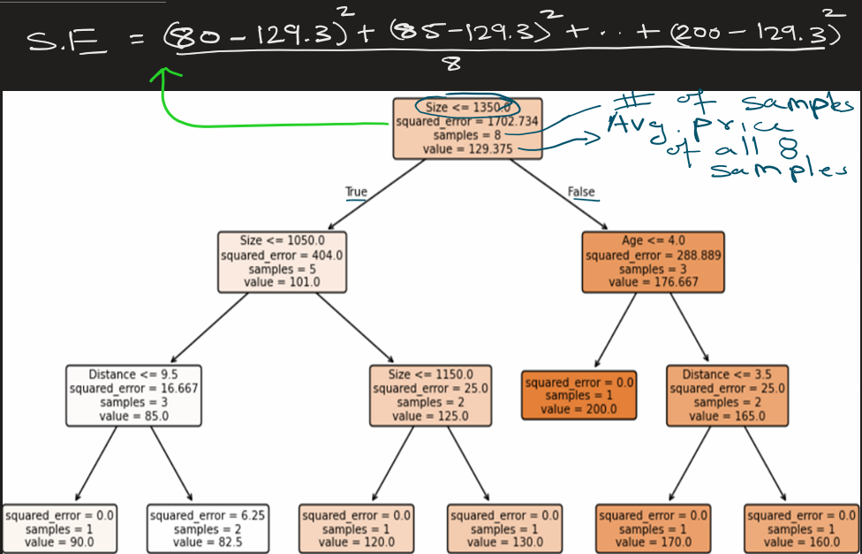
What does each value mean ?
Let’s look at root node

Slide 7
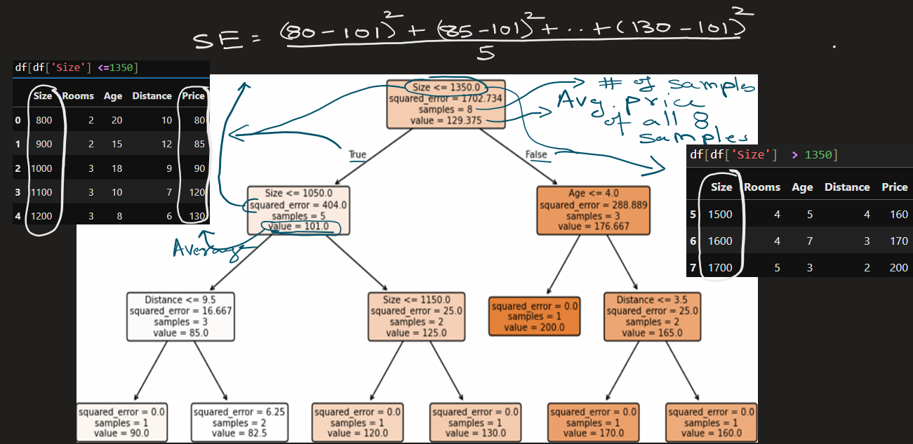
Data split at root node Size <= 1350

Slide 8
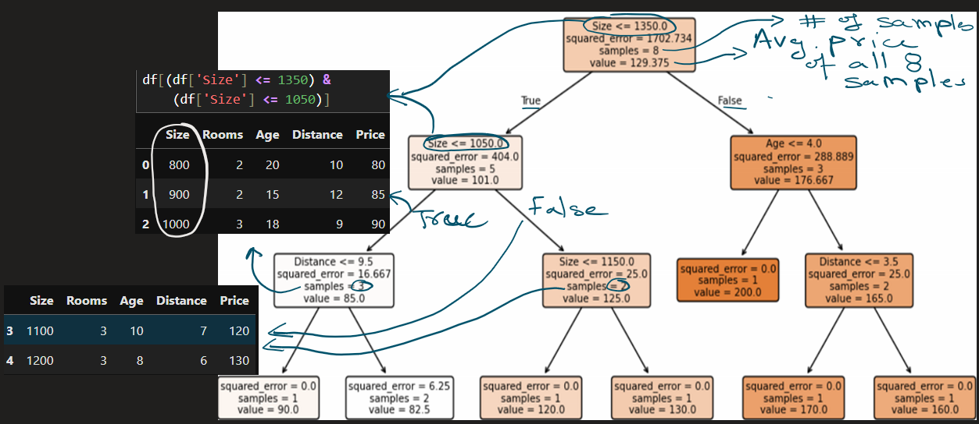
Data split at node Size<=1050

Slide 9
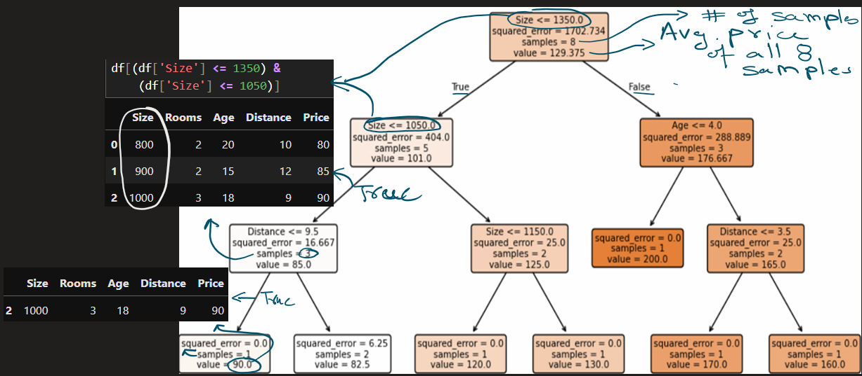
Data split at node Distance <= 9.5

Slide 10
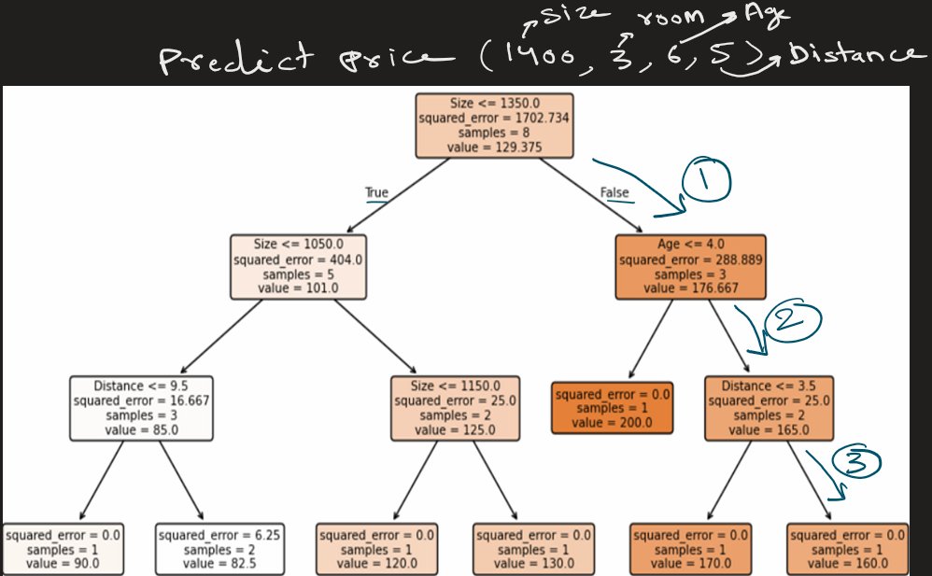
Predict house price
(1400, 3, 6, 5):
Is size <= 1350 -> No
Is Age <=4 -> No
Is Distance <=3.5 -> No
Now you have reached leaf
node
Calculate the average of
samples in leaf node: 160

Slide 11
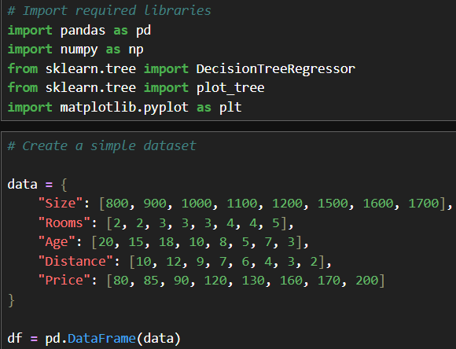
The python code:

Slide 12
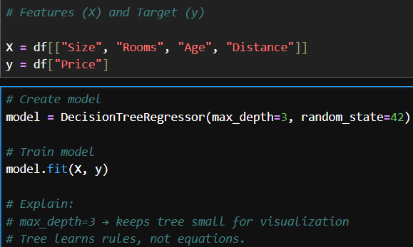
The python code:

Slide 13
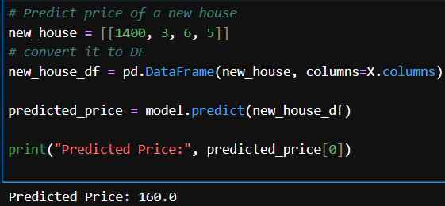
The python code:

Slide 14
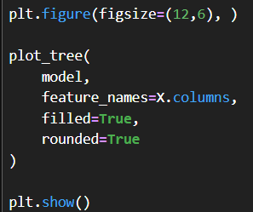
The python code:

Slide 15

The python code:

Slide 16
Advantage | Explanation
No scaling needed | Works on raw data. No need to scale
Nonlinear learning | Captures complex patterns
Easy interpretation | Rule-based are easy to understand
Handles mixed features | Numeric + categorical

Slide 17
Use Cases
Real estate pricing
Risk modeling

Slide 18
EXTRA
See jupyter notebook for code

