Slide 1
Decision Tree
A Decision Tree is a supervised machine learning algorithm used for classification and regression.

Slide 2
Decision Tree Regression
Idea: Splits data into regions and predicts average value per region.

Slide 3
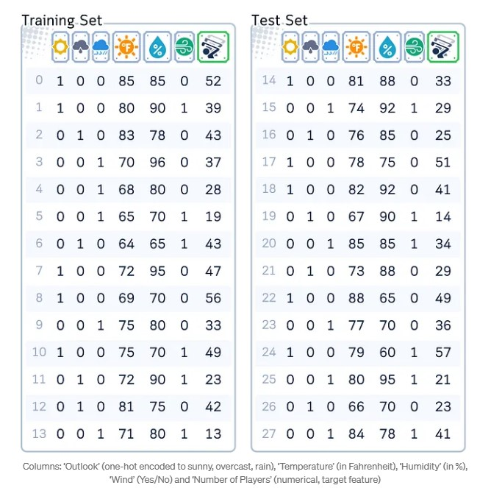
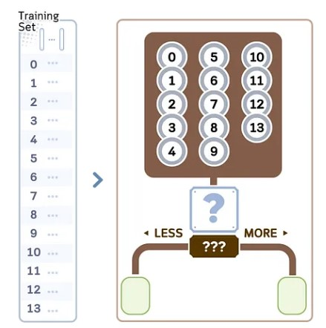
Decision Tree Regressor(p1)
Source:
https://medium.com/data-science/decision-tree-regressor-explained-a-visual-guide-with-code-examples-fbd2836c3bef
A Decision Tree for regression is a model that predicts numerical values using a tree-like structure (See jupyter notebook for the code)
Training Steps
We will explore the regression part in the decision tree algorithm CART (Classification and Regression Trees). We would use the data shown in right.
It builds binary trees and typically follows these steps:
1.Begin with all training samples in the root node.
See jupyter notebook for code

Slide 4
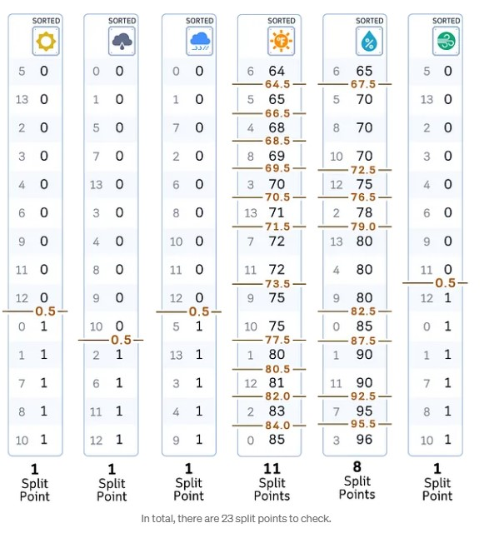
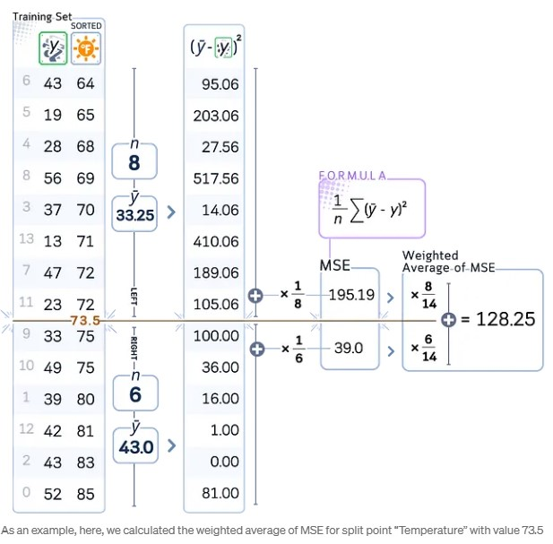
Decision Tree Regressor(p2)
2.For each feature in the dataset: a. Sort the feature values in ascending order. b. Consider all midpoints between adjacent values as potential split points.
3. For each potential split point: a. Calculate the mean squared error (MSE) of the current node. b. Compute the weighted average of errors for the resulting split.
(43 – 33.25)^2 = 95.06
(19 – 33.25)^2 = 203.06

Slide 5
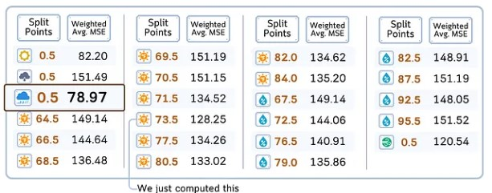
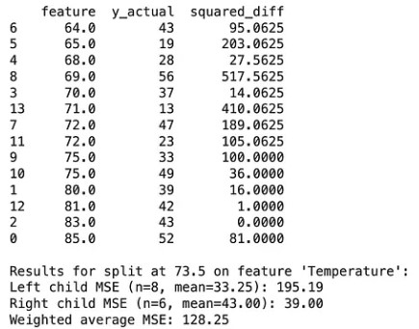
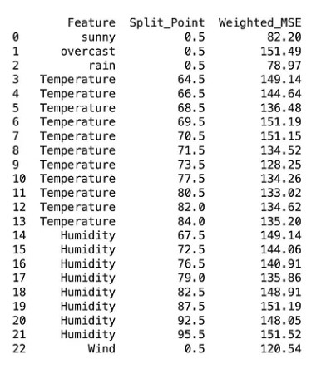
Decision Tree Regressor(p3)
4. After evaluating all features and split points, select the one with lowest weighted average of MSE.
See jupyter notebook for code
See jupyter notebook for code

Slide 6
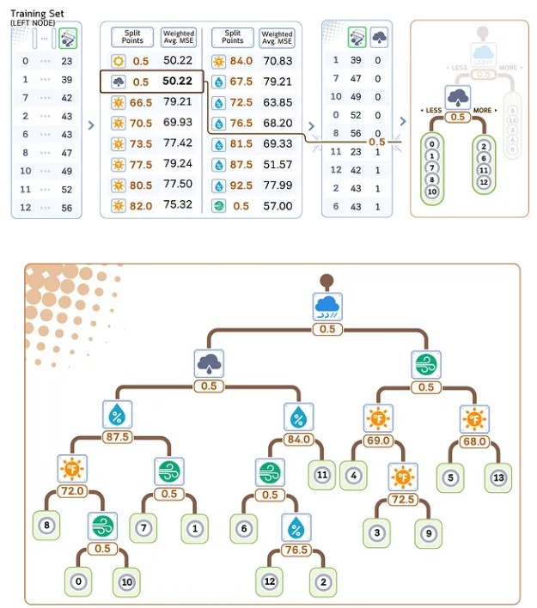
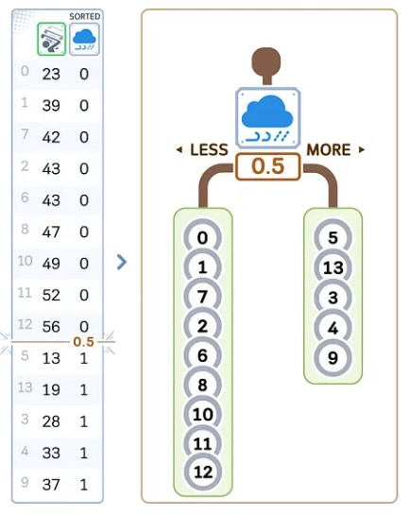
Decision Tree Regressor(p4)
5. Create two child nodes based on the chosen feature and split point: - Left child: samples with feature value <= split point - Right child: samples with feature value > split point
6. Recursively repeat steps 2–5 for each child node. (Continue until a stopping criterion is met.)

Slide 7
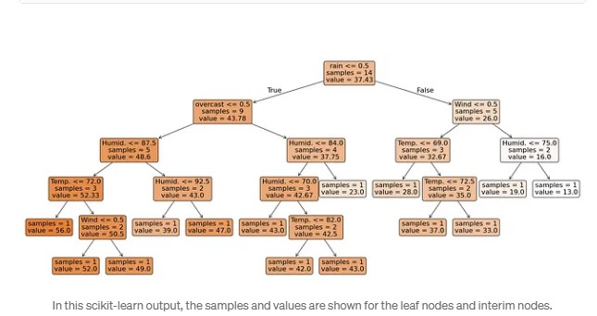
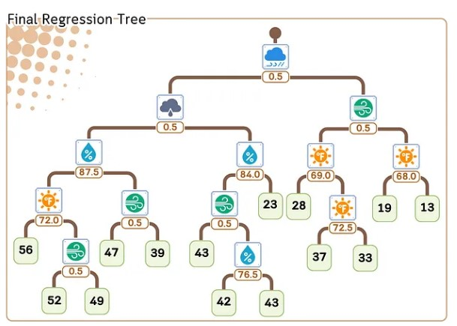
Decision Tree Regressor(p5)
7. At each leaf node, assign the average target value of the samples in that node as the prediction.
See jupyter notebook for code

Slide 8
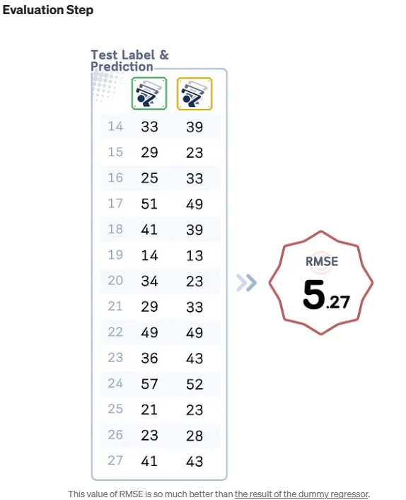
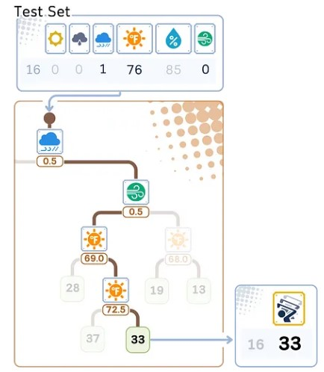
Decision Tree Regressor(p6)
Regression/Prediction Step
Here’s how a regression tree makes predictions for new data: 1. Start at the top (root) of the tree. 2. At each decision point (node): - Look at the feature and split value. - If the data point’s feature value is smaller or equal, go left. - If it’s larger, go right. 3. Keep moving down the tree until you reach the end (a leaf). 4. The prediction is the average value stored in that leaf.
See jupyter notebook for code

Slide 9
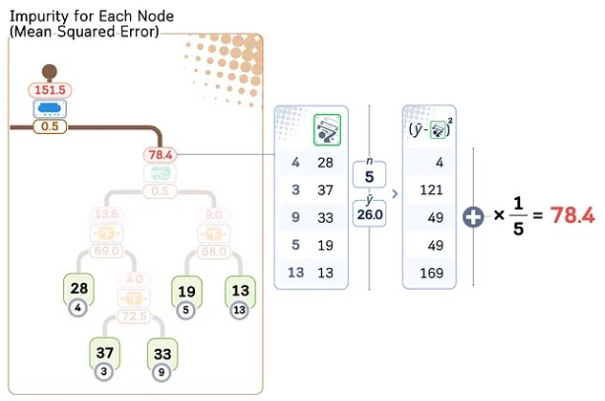
Decision Tree Regressor(p7)
Pre-pruning vs Post-pruning
After building the tree, the only thing we need to worry about is the method to make the tree smaller to prevent overfitting. In general, the method of pruning can be categorized as:
Pre-pruning
Pre-pruning, also known as early stopping, involves halting the growth of a decision tree during the training process based on certain predefined criteria. This approach aims to prevent the tree from becoming too complex and overfitting the training data. Common pre-pruning techniques include:
Maximum depth: Limiting how deep the tree can grow.
Minimum samples for split: Requiring a minimum number of samples to justify splitting a node.
Minimum samples per leaf: Ensuring each leaf node has at least a certain number of samples.
Maximum number of leaf nodes: Restricting the total number of leaf nodes in the tree.
Minimum impurity decrease: Only allowing splits that decrease impurity by a specified amount.
These methods stop the tree’s growth when the specified conditions are met, effectively “pruning” the tree during its construction phase.
Post-pruning
Post-pruning, on the other hand, allows the decision tree to grow to its full extent and then prunes it back to reduce complexity. This approach first builds a complete tree and then removes or collapses branches that don’t significantly contribute to the model’s performance. One common post-pruning technique is called Cost-Complexity Pruning.
Cost Complexity Pruning
Step 1: Calculate the Impurity for Each Node
For each interim node, calculate the impurity (MSE for regression case). We then sorted this value from the lowest to highest.

Slide 10
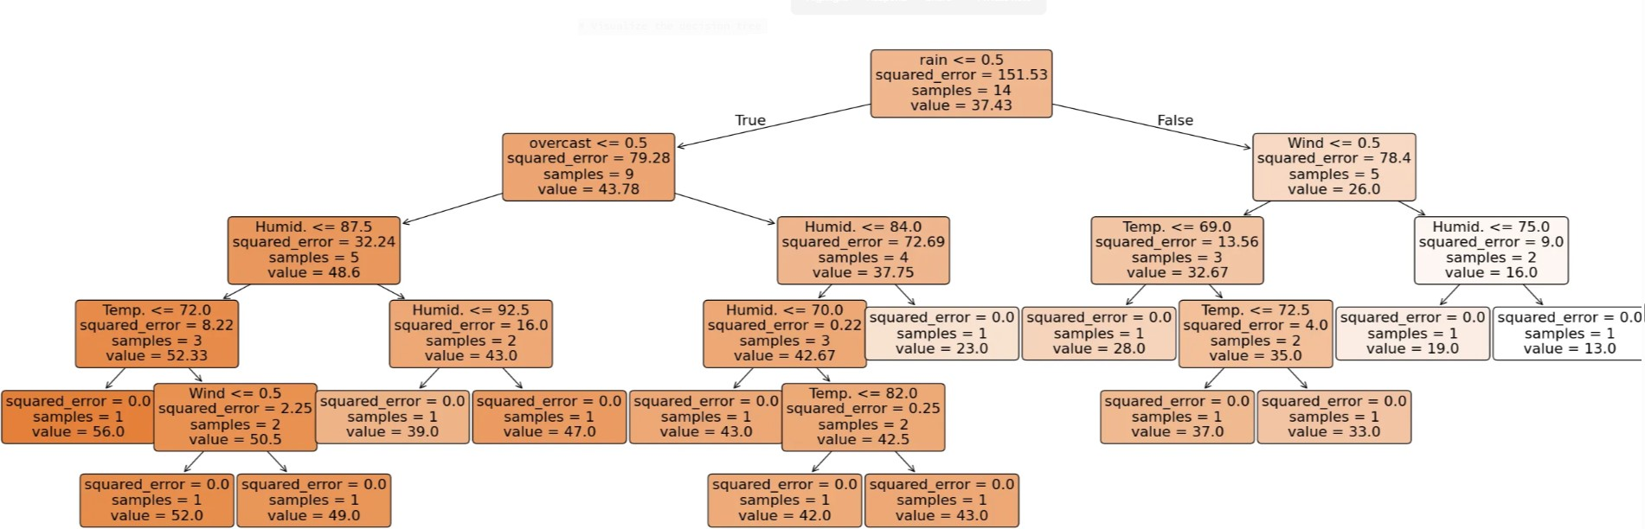
Decision Tree Regressor(p8)
In this scikit learn output, the impurity are shown as “squared_error” for each nodes.
See jupyter notebook for code

Slide 11
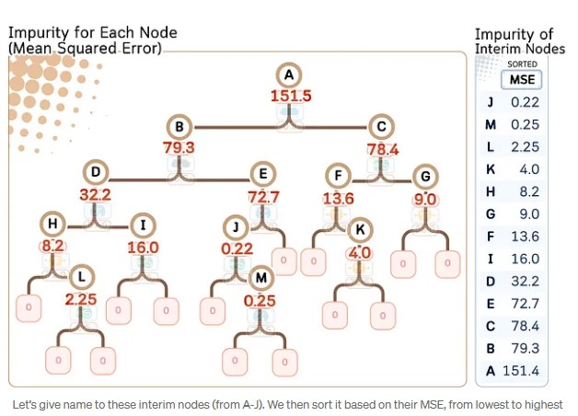
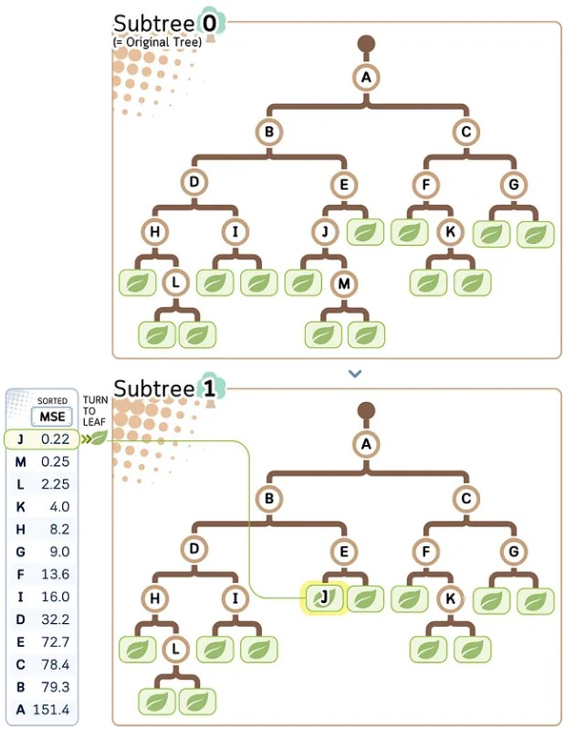
Decision Tree Regressor(p9)
Step 2: Create Subtrees by Trimming The Weakest Link
The goal is to gradually turn the interim nodes into leaves starting from the node with the lowest MSE (= weakest link). We can create a path of pruning based on that.

Slide 12
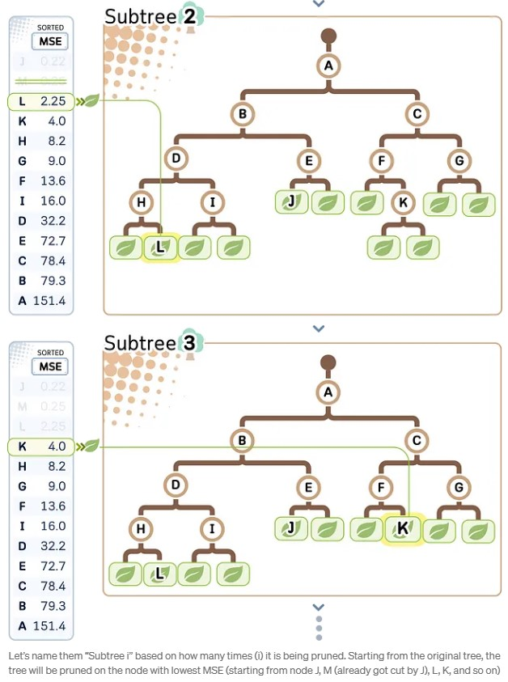
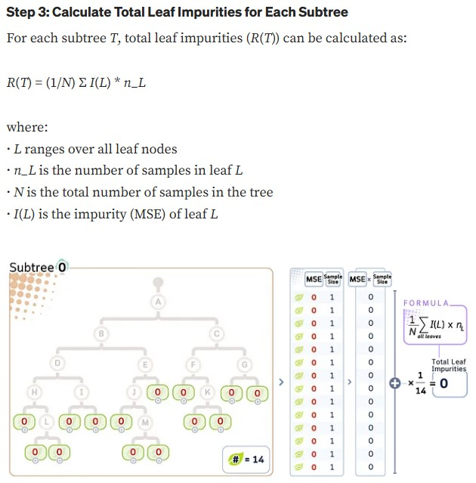
Decision Tree Regressor(p10)

Slide 13
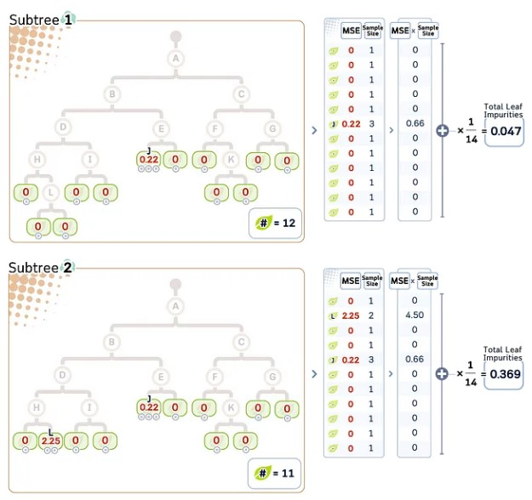
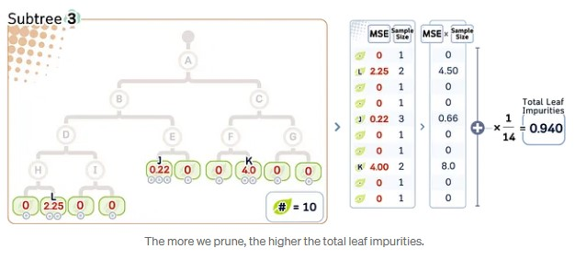
Decision Tree Regressor(p11)

Slide 14
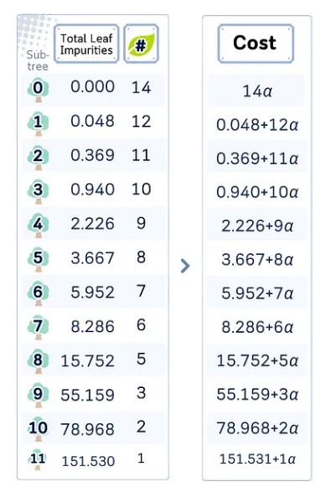
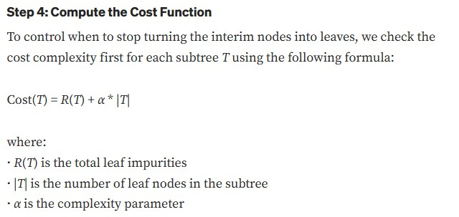
Decision Tree Regressor(p12)

Slide 15
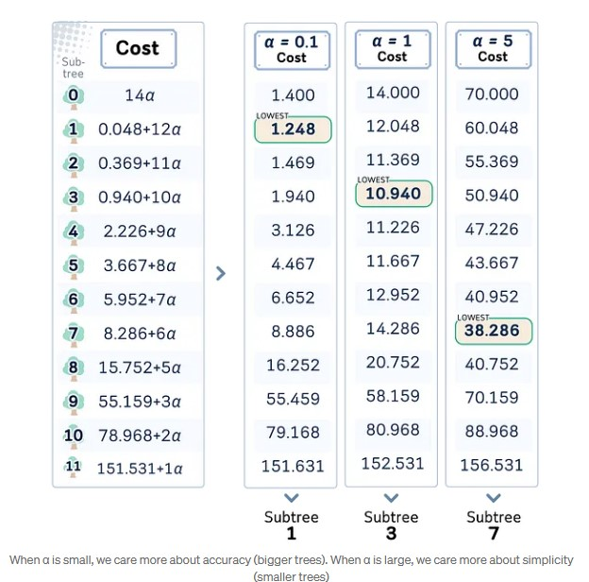
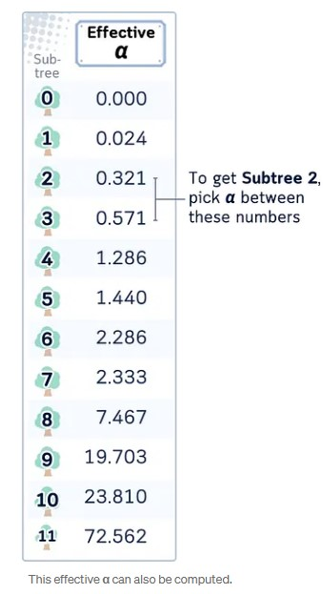
Decision Tree Regressor(p13)
Step 5: Select the Alpha
The value of alpha control which subtree we will end up with. The subtree with the lowest cost will be the final tree.
While we can freely set the α, in scikit-learn, you can also get the smallest value of α to obtain a particular subtree. This is called effective α.

Slide 16
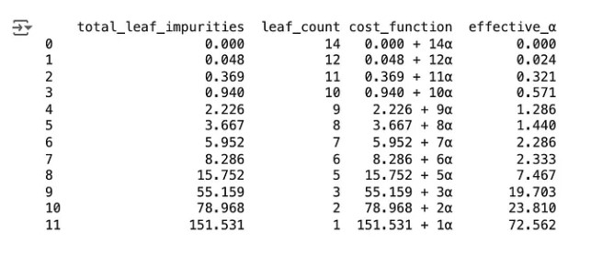
Decision Tree Regressor(p14)
Final Remarks
Pre-pruning methods are generally faster and more memory-efficient, as they prevent the tree from growing too large in the first place.
Post-pruning can potentially create more optimal trees, as it considers the entire tree structure before making pruning decisions. However, it can be more computationally expensive.
Both approaches aim to find a balance between model complexity and performance, with the goal of creating a model that generalizes well to unseen data. The choice between pre-pruning and post-pruning (or a combination of both) often depends on the specific dataset, the problem at hand, and of course, computational resources available.
In practice, it’s common to use a combination of these methods, like applying some pre-pruning criteria to prevent excessively large trees, and then using post-pruning for fine-tuning the model’s complexity.
See jupyter notebook for code

Slide 17
EXTRA
See jupyter notebook for code

