Slide 1
MSE – Mean Squared Error
RMSE – Root Mean Squared Error
MAE – Mean Absolute Error
MAPE – Mean Absolute Percentage Error

Slide 2
Baseline Model:
A baseline model is a simple model used as a reference to determine whether a more complex model is an improvement.
Example: A model that predicts the mean of the target variable for all observations
Any model should give results better than baseline model
Hours Studied (x) | Score (y) | Baseline Predicted | Some Model
1 | 5 | 31 | 7
2 | 30 | 31 | 37
3 | 20 | 31 | 24
4 | 40 | 31 | 35
5 | 60 | 31 | 53
 | Mean = 31

Slide 3
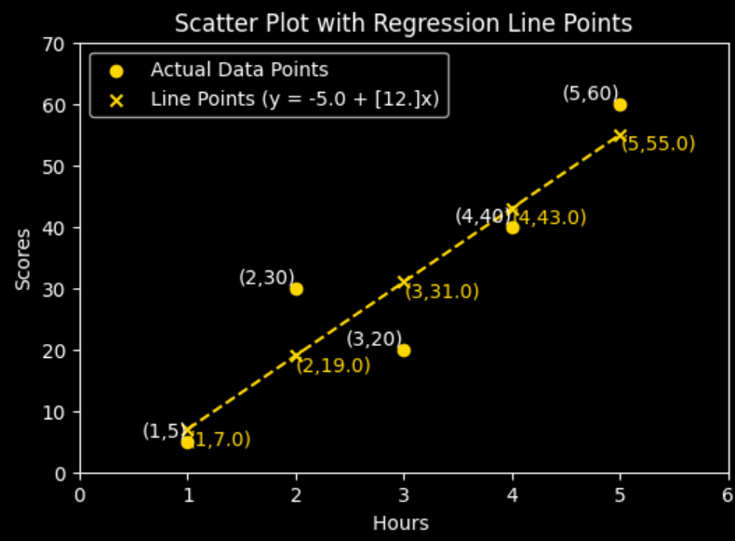

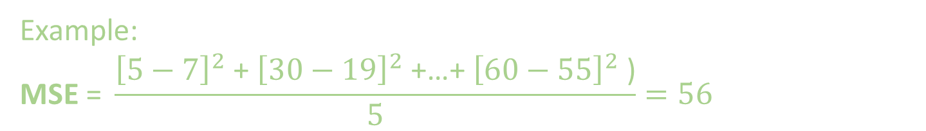
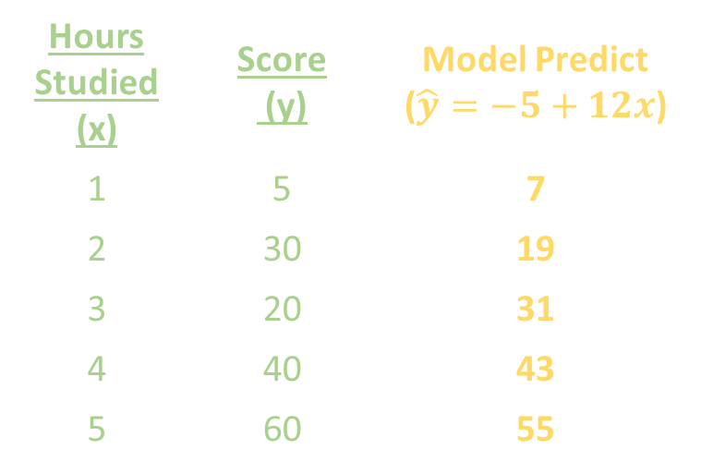
Mean Squared Error:
Hours Studied (x) | Score (y) | Model Predict ($\hat{y}=−5+12x$)
1 | 5 | 7
2 | 30 | 19
3 | 20 | 31
4 | 40 | 43
5 | 60 | 55
Example:
$$\text{M}\text{S}\text{E}\text{ = }\frac{{\left[5−7\right]}^{2}\text{ + }{\left[30−19\right]}^{2}\text{ +…+ }{\left[60−55\right]}^{2}\text{ )}}{5}=56$$

Slide 4
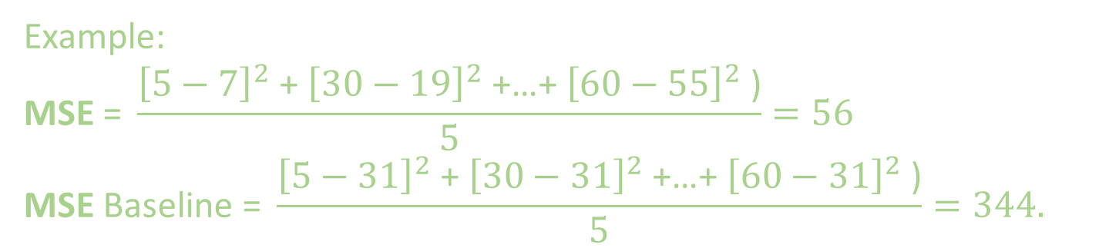
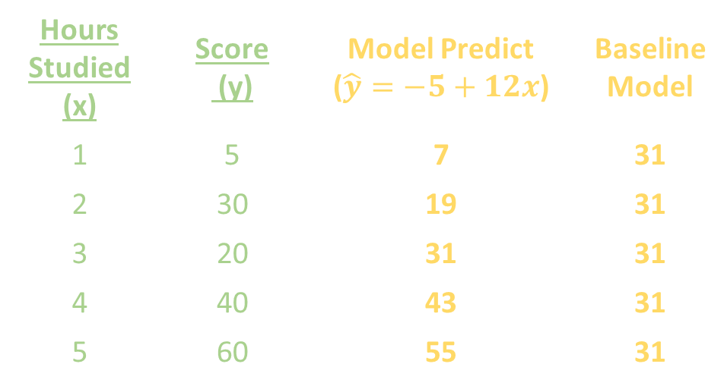
Now let’s compare MSE with baseline model:
Hours Studied (x) | Score (y) | Model Predict ($\hat{y}=−5+12x$) | Baseline Model
1 | 5 | 7 | 31
2 | 30 | 19 | 31
3 | 20 | 31 | 31
4 | 40 | 43 | 31
5 | 60 | 55 | 31
Example:
$$\text{M}\text{S}\text{E}\text{ = }\frac{{\left[5−7\right]}^{2}\text{ + }{\left[30−19\right]}^{2}\text{ +…+ }{\left[60−55\right]}^{2}\text{ )}}{5}=56$$
$$\text{MSE} \text{Baseline}\text{ = }\frac{{\left[5−31\right]}^{2}\text{ + }{\left[30−31\right]}^{2}\text{ +…+ }{\left[60−31\right]}^{2}\text{ )}}{5}=344.$$
Model is better than baseline

Slide 5
Mean Squared Error:
Note:
The unit is squared, so it’s harder to interpret directly.
Sensitive to large errors, since errors are squared. Outliers influences its value — a single big error can dominate the loss.
Penalizes larger errors more strongly (because of squaring). If you want your model to care a lot about outliers or big mistakes, MSE is better.
Mathematically convenient — differentiable and smooth everywhere, which makes it easier for gradient-based optimization.

Slide 6

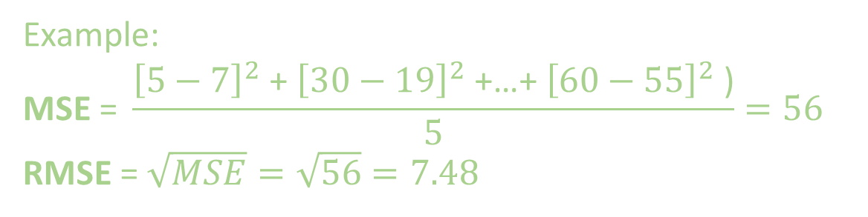

Root Mean Squared Error:
Hours Studied (x) | Score (y) | Model Predict ($\hat{y}=−5+12x$)
1 | 5 | 7
2 | 30 | 19
3 | 20 | 31
4 | 40 | 43
5 | 60 | 55
Example:
$$\text{MSE}\text{ = }\frac{{\left[5−7\right]}^{2}\text{ + }{\left[30−19\right]}^{2}\text{ +…+ }{\left[60−55\right]}^{2}\text{ )}}{5}=56$$
RMSE = $\sqrt{MSE}=\sqrt{56}=7.48$

Slide 7
Root Mean Squared Error:
Note:
It is in same units as the target variable. So easy to interpret.
Robust to outliers — treats all errors linearly, so a few extreme values don’t overly affect the model.

Slide 8

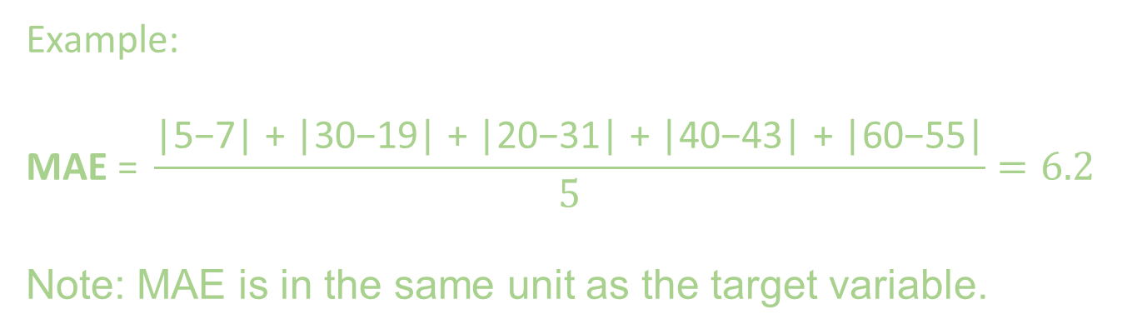
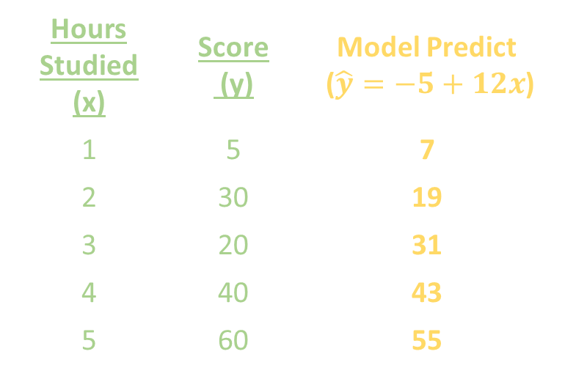
Mean Absolute Error:
Hours Studied (x) | Score (y) | Model Predict ($\hat{y}=−5+12x$)
1 | 5 | 7
2 | 30 | 19
3 | 20 | 31
4 | 40 | 43
5 | 60 | 55
Example:
$$\text{MAE}\text{ =} \frac{\text{|}\text{5−7}\text{| + |30−}\text{19}\text{| + |20−31| + |40−43| + |60−}\text{55}\text{|}}{5}=6.2$$
Note: MAE is in the same unit as the target variable.

Slide 9
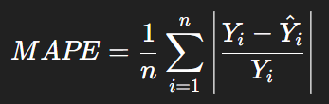
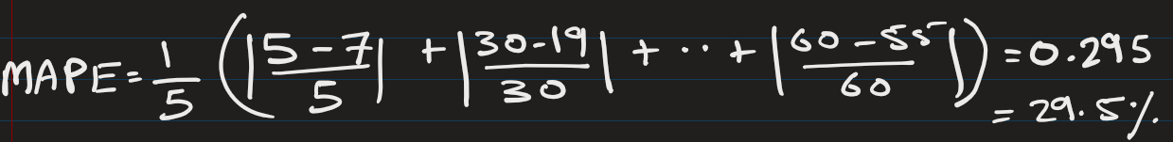
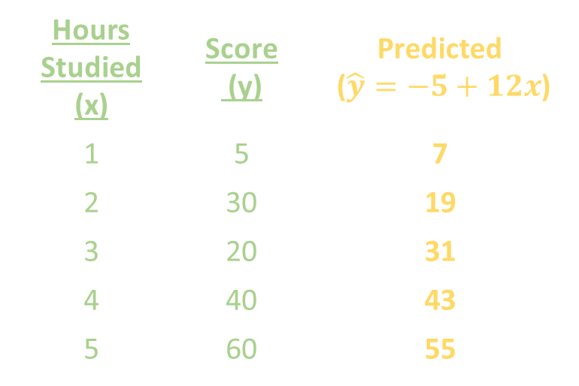
Mean Absolute Percentage Error (MAPE) :
Hours Studied (x) | Score (y) | Predicted ($\hat{y}=−5+12x$)
1 | 5 | 7
2 | 30 | 19
3 | 20 | 31
4 | 40 | 43
5 | 60 | 55
The model’s predictions are off by about 29.5% on average.

Slide 10
Mean Absolute Percentage Error (MAPE) :
2 things to consider when using MAPE:
Data should not contain zeros (Division by 0 gives error)
All values should be reasonably large, otherwise it inflate percentage error (division by small number -> big number).

Slide 11
Mean Absolute Percentage Error (MAPE) :
MAPE (%) | Interpretation | Meaning in Plain English
< 10% | Excellent | Predictions are very close to actual values
10% – 20% | Good | Model is accurate and reliable
20% – 50% | Reasonable / Moderate | Model has noticeable error but may still be usable
50% – 100% or > 100% | Poor | Predictions are highly inaccurate

Slide 12
EXTRA

Slide 13
When to Use Which?
Mean Squared Error (MSE)
Use when:
You want to penalize large errors more heavily (squaring effect).
The error distribution is expected to be Gaussian (normal noise).
You want mathematical convenience (e.g., closed-form solution in linear regression).
Best for: Training models where you want sensitivity to outliers.

Slide 14
When to Use Which?
Mean Absolute Error (MAE)
Use when:
Data has outliers or heavy-tailed distributions, and you don’t want them to dominate.
You want the typical/median error rather than being skewed by large mistakes.
Robustness is more important than punishing big deviations.
Best for: Noisy or messy datasets where outliers are common.

Slide 15
When to Use Which?
Root Mean Square Error (RMSE)
Use when:
You want the error in the same units as the target variable (interpretable).
You care about both sensitivity to large errors (like MSE) and readability.
You need a metric that’s easier to communicate (e.g., "average prediction is off by 3 units").
Best for: Reporting model performance in real-world units.

