Slide 1
R-Square

Slide 2


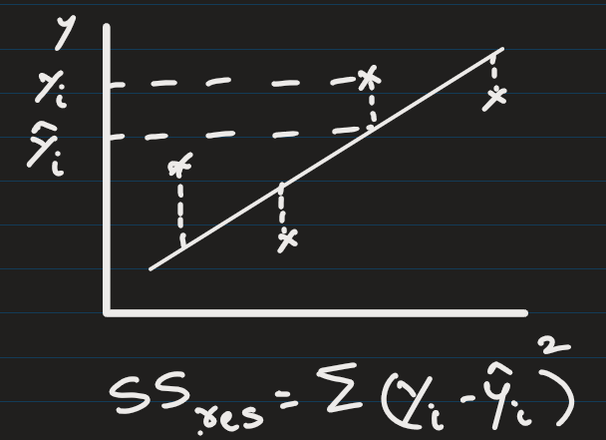
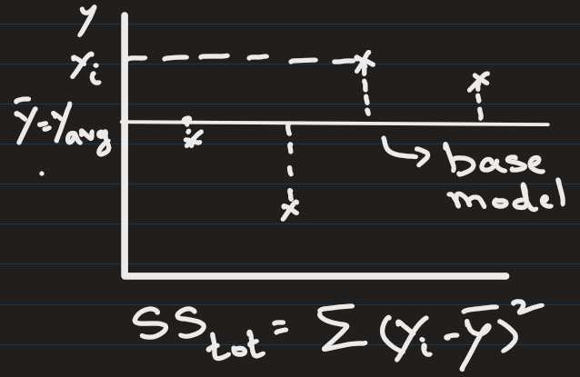
Coefficient of Determination (R² Score):
R-square measures how much of the variance in Y is explained by the model.

Slide 3
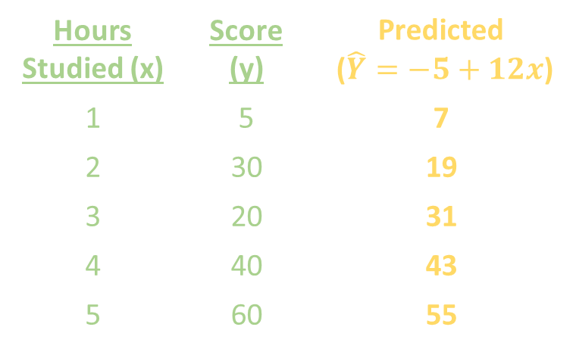
Hours Studied (x) | Score (y) | Predicted ($\hat{Y}=−5+12x$)
1 | 5 | 7
2 | 30 | 19
3 | 20 | 31
4 | 40 | 43
5 | 60 | 55
What is the R-square value ?

Slide 4
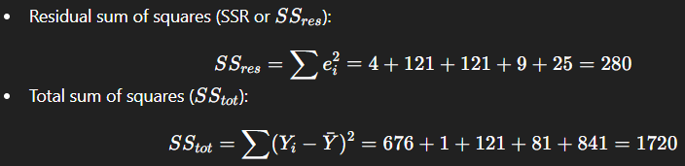

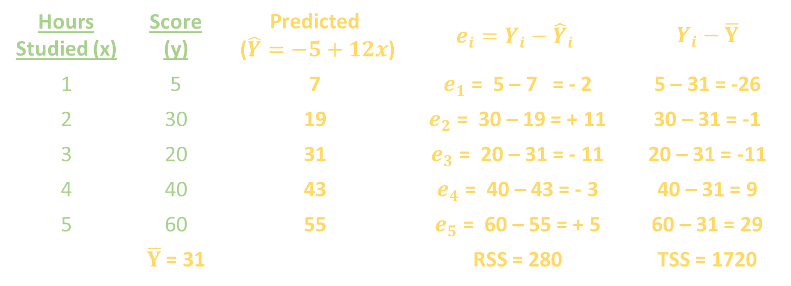
Hours Studied (x) | Score (y) | Predicted ($\hat{Y}=−5+12x$) | $$e_{i}=Y_{i}−{\hat{Y}}_{i}$$ | $Y_{i}−$ $\overline{Y}$
1 | 5 | 7 | $e_{1}$ = 5 – 7 = - 2 | 5 – 31 = -26
2 | 30 | 19 | $e_{2}$ = 30 – 19 = + 11 | 30 – 31 = -1
3 | 20 | 31 | $e_{3}$ = 20 – 31 = - 11 | 20 – 31 = -11
4 | 40 | 43 | $e_{4}$ = 40 – 43 = - 3 | 40 – 31 = 9
5 | 60 | 55 | $e_{5}$ = 60 – 55 = + 5 | 60 – 31 = 29
 | $\overline{Y}$ = 31 |  | RSS = 280 | TSS = 1720
The model explains about 83.72% of the variance in scores.

Slide 5
Ranges from -∞ to 1 (Higher is better)
R² = 1 → Perfect model (explains all variance).
R² = 0 → Model performs as badly as the mean prediction model (i.e. Mean of target).
R² < 0 → Model performs worse than a simple mean prediction (bad model).
Above 0.9 → Excellent
0.7 - 0.9 → Good
0.5 - 0.7 → Moderate
< 0.5 → Poor
Hours Studied (x) | Score (y) | Baseline Predicted (Mean)
1 | 5 | 31
2 | 30 | 31
3 | 20 | 31
4 | 40 | 31
5 | 60 | 31
 | Mean = 31

Slide 6
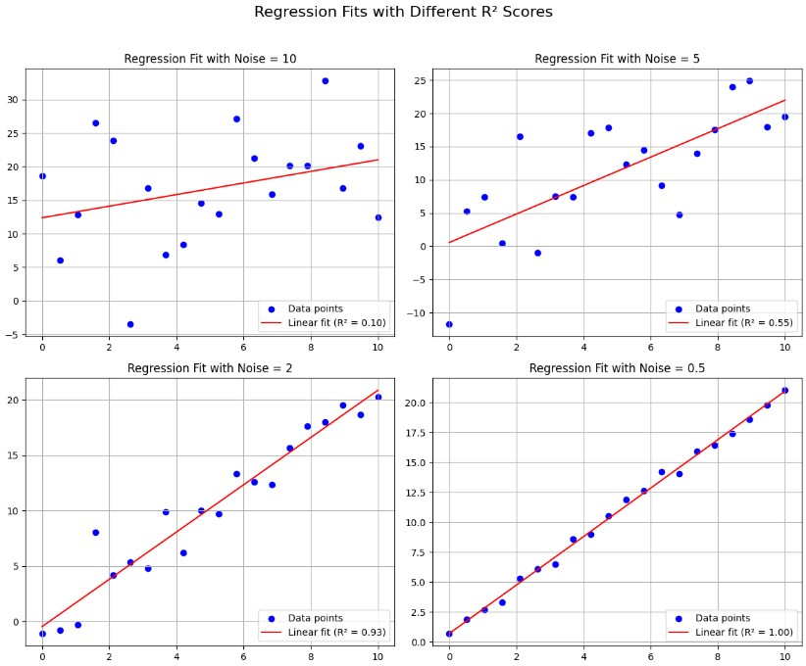
Code from jupyter n/b

Slide 7
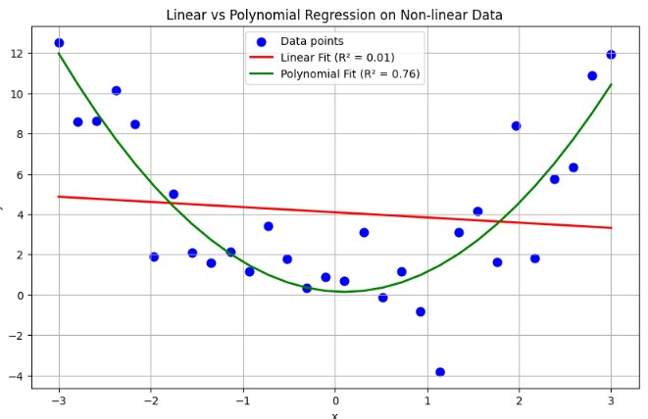
Code from jupyter n/b

Slide 8
When to use R-square ?
Use R-square when target scale is large
If target values are large (like revenue in millions, billions, etc), MAE might look large numerically.
R² is scale-free, so easier to compare.

Slide 9
Heading Goes Here
Fhdsklf
Fjdsklf
Fjskldf

