Slide 1
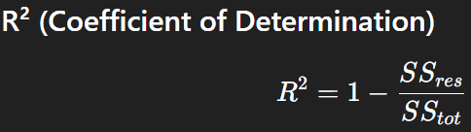

Adjusted R-Square
In regression models, especially Linear Regression, we use R² (R-squared) to measure how well the model explains the variability of the target variable.
Problem with R²:
R² tells us “What percentage of the variance in the target variable is explained by the model?”
Example:
R² = 0.80 → Model explains 80% of the variance.

Slide 2
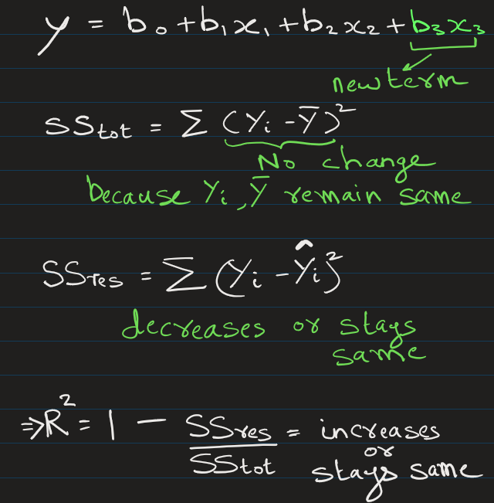
Adjusted R-Square
Problem with R²
If you keep adding more features (even useless ones):
R² never decreases
It either increases or stays the same
Why ?

Slide 3
So, by adding more features
R² either increases or stays the same
This may encourage overfitting
This is where Adjusted R² comes in.

Slide 4
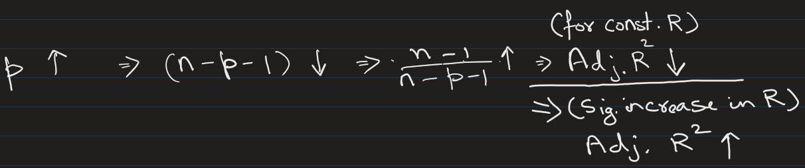
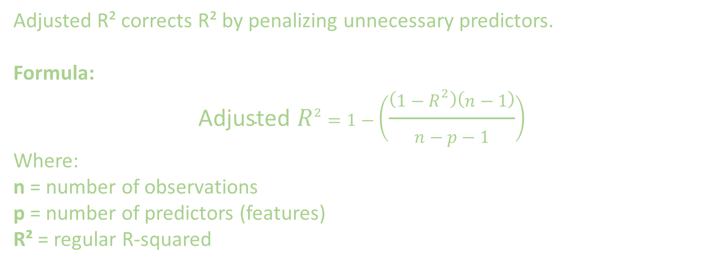
Adjusted R² corrects R² by penalizing unnecessary predictors.
Formula:
$$\text{Adjusted} R^{2}=1−\left(\frac{\left(1−R^{2}\right)\left(n−1\right)}{n−p−1}\right)$$
Where:
n = number of observations
p = number of predictors (features)
R² = regular R-squared

Slide 5
Key points of adjusted R²:
Increases only if new feature improves model significantly
Decreases if new feature adds little or no value
Rewards good features and penalizes unnecessary features

Slide 6


Simple Example
Even though R² increased (0.80 → 0.85), but adjusted R² dropped (0.78 → 0.74).
This means extra features are probably useless.
Model | Features | R² | Adjusted R²
Model 1 | 2 features | 0.80 | 0.78
Model 2 | 5 features | 0.85 | 0.74

Slide 7
Adjusted R-Square
When Should You Use Adjusted R²?
Use Adjusted R² when:
Comparing multiple regression models
Feature selection

Slide 8
STOP
Fhdsklf
Fjdsklf
Fjskldf

