Slide 1
ROC AUC Receiver Operating Characteristic Area under Curve

Slide 2
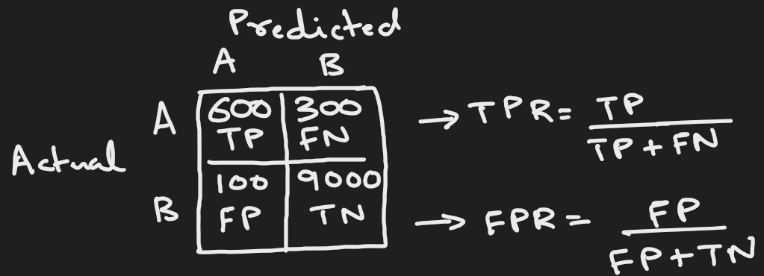
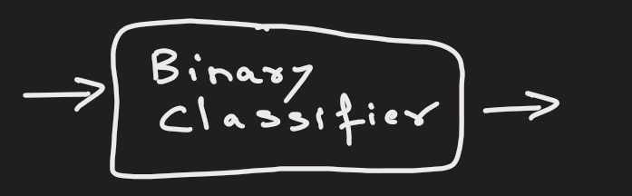
The ROC is a metric to evaluate the performance of binary classifiers.
ROC compares how many good positives we capture(TPR) vs how many mistakes we make(FPR).

Slide 3
Why ROC Exists ?
Most beginners think models output labels. But models actually output probability.
Person | Model Probability (of Cancer)
A | 0.95
B | 0.80
C | 0.60
D | 0.30
We convert probability → class using a threshold.
This threshold is generally 0.5: If prob. > 0.5, then cancer.
Based on this threshold: A,B,C have cancer and D does NOT have cancer

Slide 4
ROC shows what happens when we change the threshold?
Threshold Intuition
Threshold | Result
0.9 | Very strict
0.5 | Balanced
0.1 | Very lenient
Lower threshold (0.1) ⇒
Catch more positives ✅
But increase false alarms ❌

Slide 5
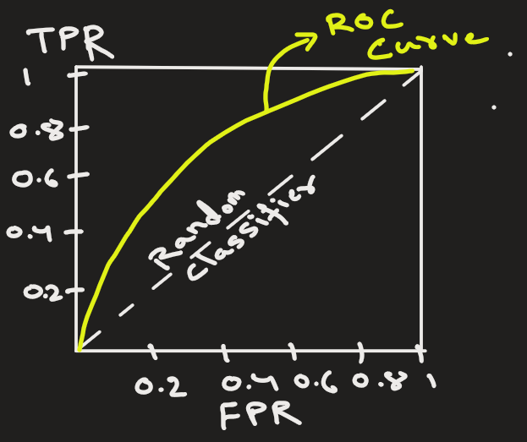
What is ROC Curve?
ROC = Receiver Operating Characteristic
The term comes from radar systems in WWII
ROC Curve plots
X-axis → False Positive Rate (FPR)
Y-axis → True Positive Rate (TPR)
for different thresholds.

Slide 6
TPR and FPR
You can derive TPR and FPR from a confusion matrix.
In the example confusion matrix for threshold=0.5:
TPR = 600 / ( 600 + 300) = 0.67
The model successfully detected 67% of all spam (A) emails
FPR = 100 / (100 + 9000) = 0.01
The model falsely flagged 1% of legitimate emails (B) as spam

Slide 7
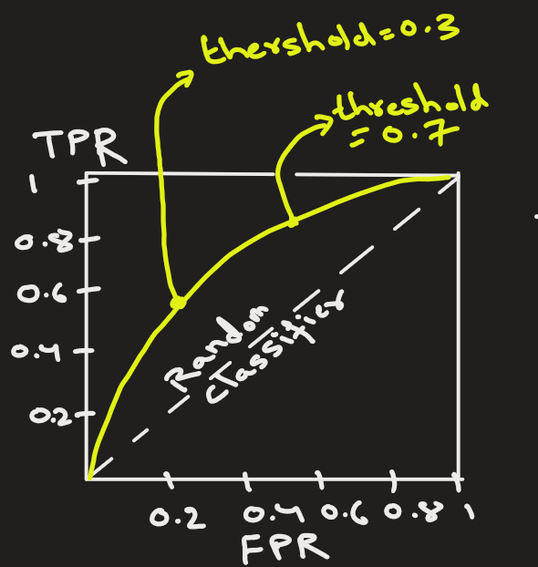
The ROC curve shows the performance of a binary classifier with different decision thresholds.
That is , it plots (FPR,TPR) for various thresholds.
Example:
For threshold=0.3,
(FPR, TPR) = (0.2, 0.6)
For threshold=0.7,
(FPR, TPR) = (0.6, 0.8)

Slide 8
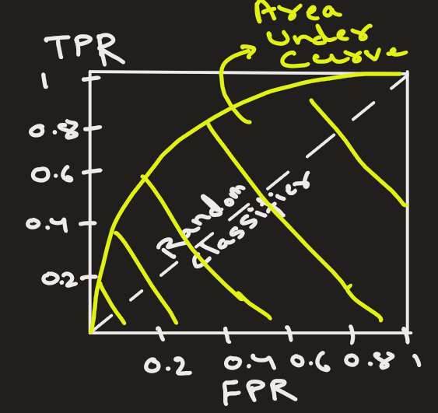
What is AUC ?
AUC = Area Under the Curve
It measures how good the model is at separating classes.
The ROC AUC score is a metric to evaluate the performance of binary classifiers.

Slide 9
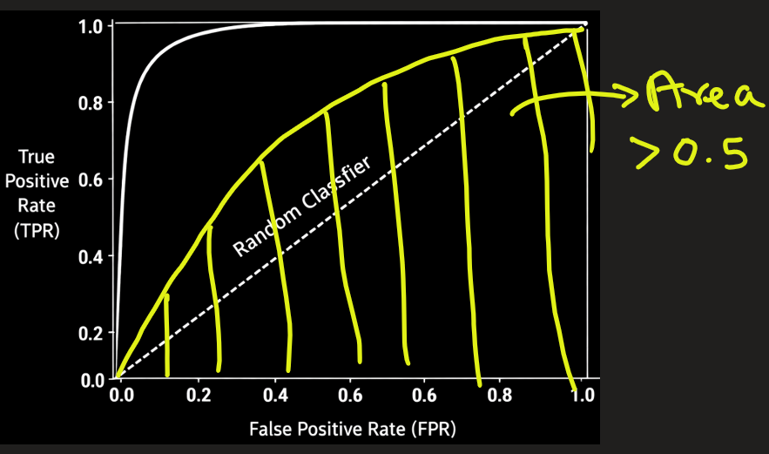
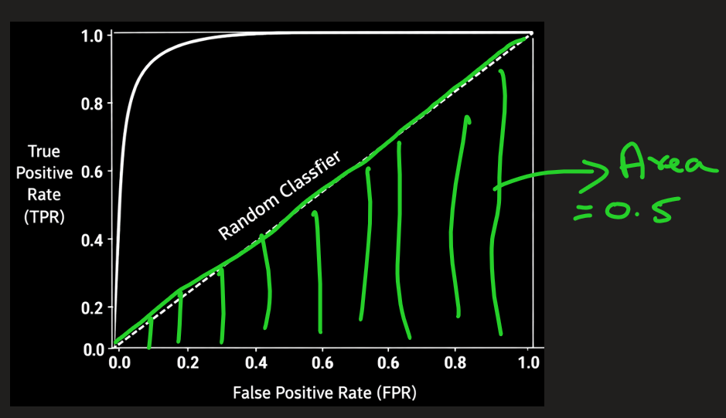
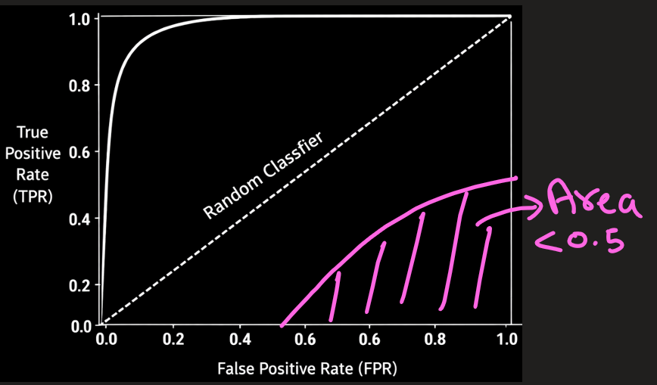
AUC | Meaning
1.0 | Perfect model
0.9 | Excellent
0.8 | Good
0.5 | Random guessing
< 0.5 | Worse than random
Perfect model would have an AUC of 1.
Random model would have an AUC of 0.5.
Bad model would have AUC < 0.5

Slide 10
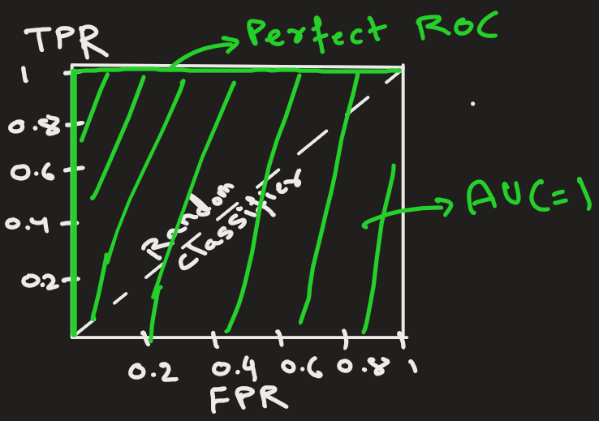
If our model is correct in all the predictions, all the time, it means that the TPR is always 1.0, and FPR is 0.
It finds all the cases and never gives false alarms.
Here AUC = 1.

Slide 11
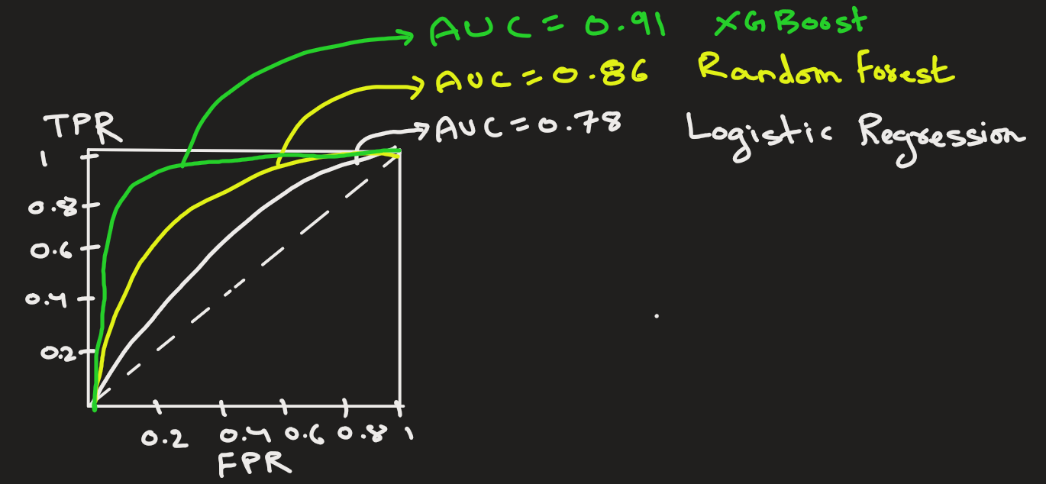
How to use AUC ?
Train multiple models
↓
Compare AUC scores
↓
Choose best ranking model
↓
Business selects threshold later
Model | AUC
Logistic Regression | 0.78
Random Forest | 0.86
XGBoost | 0.91 ✅

Slide 12
STOP

Slide 14
ROC vs Precision-Recall Curve
Use ROC for balanced datasets
Use PR Curve for highly imbalanced datasets

Slide 16
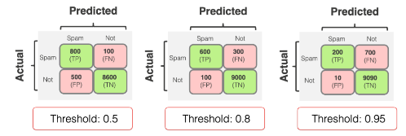
A probabilistic classification model returns a number from 0 to 1 for each object. For example, for each email, it predicts how likely this email is spam. For a given email, it can be 0.1, 0.55, 0.99, or any other number.
You then have to decide at which probability you convert this prediction to a label. For instance, you can label all emails with a predicted probability of over 0.5 as spam. Or, you can only apply this decision when the score is 0.8 or higher.
This choice is what sets the classification threshold.
As you change the threshold, you will usually get new combinations of errors of different types (and new confusion matrices)!

Slide 17
When you set the threshold higher, you make the model "more conservative." It assigns the True label when it is "more confident." But as a consequence, you typically lower recall: you detect fewer examples of the target class overall.
When you set the threshold lower, you make the model "less strict." It assigns the True label more often, even when "less confident." Consequently, you increase recall: you will detect more examples of the target class. However, this may also lead to lower precision, as the model may make more False Positive predictions.
TPR and FPR change in the same direction. The higher the recall (TPR), the higher the rate of false positive errors (FPR). The lower the recall, the fewer false alarms the model gives.
In the example above, the recall (TPR) decreases as we set the different decision higher: - 0.5 threshold: 800/(800+100)=0.89 - 0.8 threshold: 600/(600+300)=0.67 - 0.95 threshold: 200/(200+700)=0.22
The FPR also goes down: - 0.5 threshold: 500/(500+8600)=0.06 - 0.8 threshold: 100/(100+9000)=0.01 - 0.95 threshold: 10/(10+9090)=0.001

Slide 18
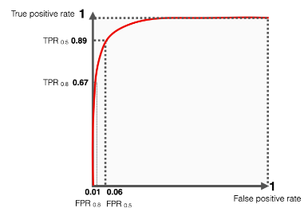
Plotting the ROC curve
The ROC curve illustrates this trade-off between the TPR and FPR we just explored. Unless your model is near-perfect, you have to balance the two. As you try to increase the TPR (i.e., correctly identify more positive cases), the FPR may also increase (i.e., you get more false alarms).
For example, the more spam you want to detect, the more legitimate emails you falsely flag as suspicious.
The ROC curve is a visual representation of this choice. Each point on the curve corresponds to a combination of TPR and FPR values at a specific decision threshold.
To create the curve, you should plot the FPR values as the x-axis and the TPR values as the y-axis.
If we continue with the example above, here is how it can look.
Since our imaginary model does fairly well, most values are "crowded" to the left.
The left side of the curve corresponds to the more "confident" thresholds: a higher threshold leads to lower recall and fewer false positive errors. The extreme point is when both recall and FPR are 0. In this case, there are no correct detections but also no false ones.
The right side of the curve represents the "less strict" scenarios when the threshold is low. Both recall and False Positive rates are higher, ultimately reaching 100%. If you put the threshold at 0, the model will always predict a positive class: both recall, and the FPR will be 1.

Slide 19
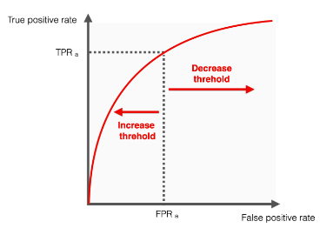
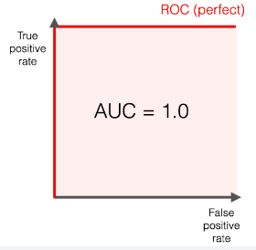
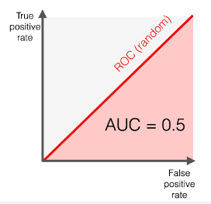
When you increase the threshold, you move left on the curve. If you decrease the threshold, you move to the right.
Continue from here: https://www.evidentlyai.com/classification-metrics/explain-roc-curve
If our model is correct in all the predictions, all the time, it means that the TPR is always 1.0, and FPR is 0. It finds all the cases and never gives false alarms.
Here AUC = 1
The worst-case scenario.
Let’s say our model is random. In other words, it cannot distinguish between the two classes, and its predictions are no better than chance.
A genuinely random model will predict the positive and negative classes with equal probability.
The ROC curve, in this case, will look like a diagonal line connecting points (0,0) and (1,1). For a random classifier, the TPR is equal to the FPR because it makes the same number of true and false positive predictions for any threshold value. As the classification threshold changes, the TPR goes up or down in the same proportion as the FPR.
Most real-world models will fall somewhere between the two extremes. The better the model can distinguish between positive and negative classes, the closer the curve is to the top left corner of the graph.

Slide 20
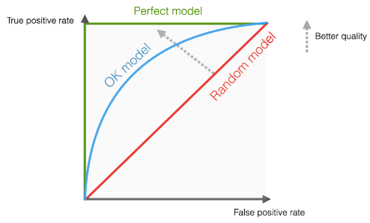
Real world scenario
Most real-world models will fall somewhere between the two extremes.
The better the model can distinguish between positive and negative classes, the closer the curve is to the top left corner of the graph.

Slide 21
ROC AUC pros
A single number. ROC AUC reflects the model quality in one number. It is convenient to use a single metric, especially when comparing multiple models.
Does not change with the classification threshold. Unlike precision and recall, ROC AUC stays the same. In fact, it sums up the performance across the different classification thresholds. It is a valuable "overall" quality measure, whereas precision and recall provide a quality "snapshot" at a given decision threshold.

Slide 22
ROC AUC pros
More tolerant to the drift in class balance. The ROC AUC generally remains more stable if the distribution of classes changes. This often happens in production use, for example, when fraud rates vary month-by-month. If they change significantly, the earlier chosen decision threshold might become inadequate. For example, if fraud becomes more prevalent, the recall of the fraud detection model might drop, as this metric uses the absolute number of actual fraud cases in the denominator. However, ROC AUC might remain stable, indicating that the model can still differentiate between the two classes despite the changes in their relative frequencies.
Scale-invariant. ROC AUC measures how well predictions are ranked rather than their absolute values. This way, it helps compare the quality of models that might output "different ranges" of predicted probabilities. It is typically relevant when you experiment with different models during the model training stage.

Slide 23
ROC AUC cons
ROC AUC is not intuitive. This metric can be hard to explain to business stakeholders and does not have an immediately interpretable meaning.
It does not consider the cost of errors. ROC AUC does not account for different types of errors and their consequences. In many scenarios, false negatives can be more costly than false positives, or vice versa. In this case, working to balance precision and recall and setting the appropriate classification threshold to minimize a certain type of error is often a more suitable approach. ROC AUC is not useful for this type of optimization.

Slide 24
ROC AUC cons
It can be misleading if the class imbalance is severe. When the positive class is very small, ROC AUC can give a false impression of high quality.
Imagine that a classifier predicts almost all instances as negative. TPR and FPR will be close to 0 because there are few positive predictions. As a result, the ROC curve will appear to "hug" the top left corner of the plot, giving the impression that the classifier is performing well and definitely better than random. However, though it correctly classifies most of the negative instances, it may miss most of the positives, which is likely more important for the model performance. In this case, it may be more appropriate to look at the precision-recall curve and rely on metrics like precision, recall, or F1-score to evaluate ML model quality.

Slide 25
When to use ROC AUC
During model training, it helps compare multiple ML models against each other.
ROC AUC is particularly useful when the goal is to rank predictions in order of their confidence level rather than produce well-calibrated probability estimates.

Slide 26
How to use ROC AUC ?
The ROC AUC score should be used with other metrics, such as precision and recall.

Slide 27
Heading Goes Here
Fhdsklf
Fjdsklf
Fjskldf

