Slide 1
Bias-Variance Tradeoff-overfitting

Slide 2
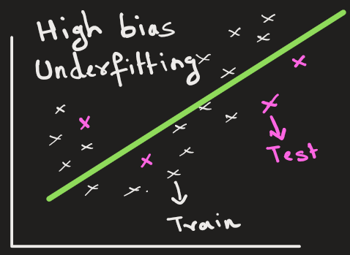
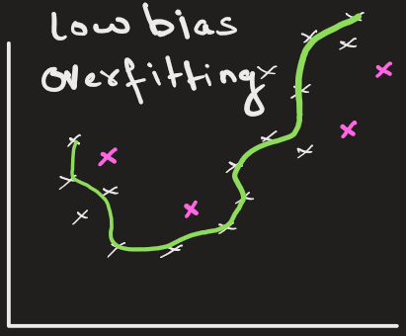
Bias: Is an error or differences between actual values and the predicted values
High bias: Model will not closely match the training dataset (underfit).
Here the model is too simple.
Model performs poorly on training data and also performs poorly on test data.
Low bias: Model will closely match the training dataset (overfit).
Here the model is too complex.
Model performs well on training data and performs poorly on test data.

Slide 3
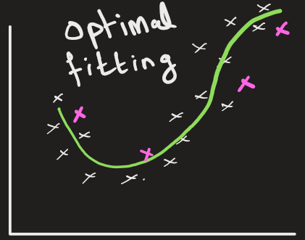
Underfitting: The model doesn’t learn enough.
Model is too simple (e.g., linear model for complex data)
Model has low accuracy on training data and low accuracy on test/unseen data
In ML, this is also called high bias
Overfitting: The model memorizes training data instead of generalizing.
Model is overly complex (e.g., deep trees, too many parameters in model, etc)
Model has high accuracy on training data but poor performance on test/unseen data.
In ML, this is also called high variance.

Slide 4
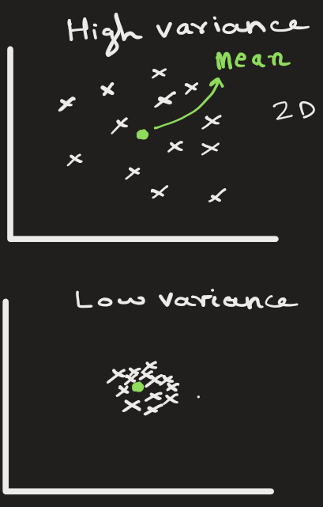
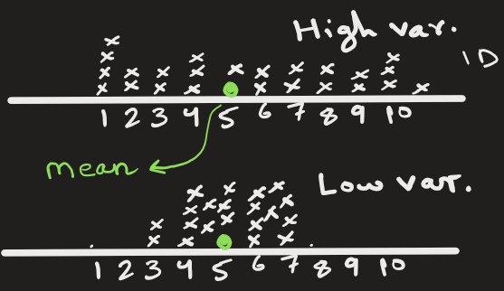
Variance:
Variance is the measure of spread in data from its mean position.
Below are 2 examples showing spread of data in 1D and 2D.

Slide 5
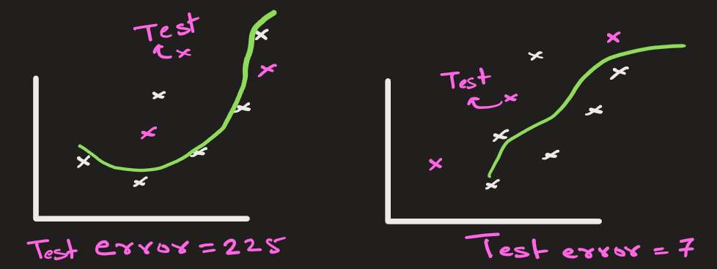
The variance in the model is the measure of variation in test error when we change the training data.
Here, the test error varies by huge amount when we change the training data. This model has high variance.
If the test error in the model varies by great amount when we change the training data, then the model is said to have high variance.

Slide 6
The model with high variance has a very complex fit to the training data and thus is not able to fit accurately on the test data, that it has not seen before. As a result, such models perform very well on training data but have high error rates on test data.

Slide 7
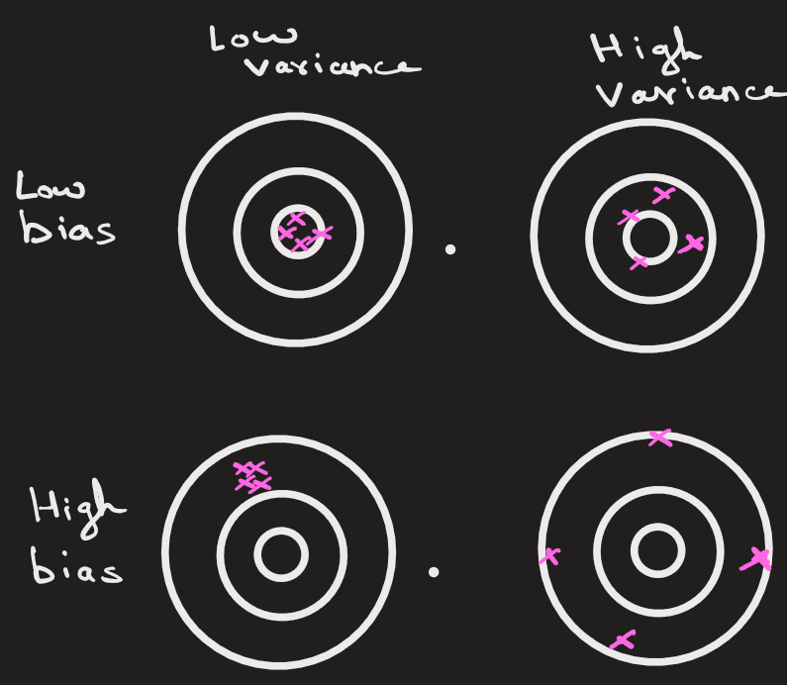
In the image below, the center circle represents the actual value of sample data points.
The red color points are the predicted value of the data points.

Slide 8
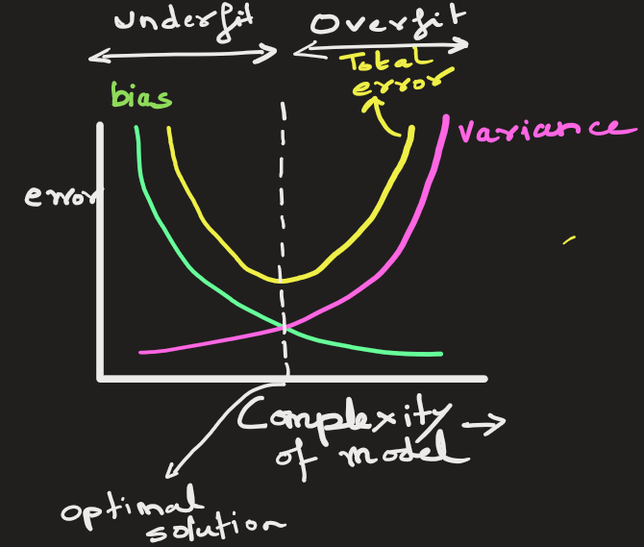
Bias-variance trade-off
As model becomes complex, the bias error decreases and variance increases
So, the total error, it decreases up to a certain point, then increases. This point is the optimal solution.
Ideally, we want low bias and low variance.
But this is not possible.
So, we pick a model that has acceptable amount of bias
and variance, such that total error is minimum.
This is called bias-variance trade-off.

Slide 9
Heading Goes Here
Fhdsklf
Fjdsklf
Fjskldf

