Slide 1
Confusion Matrix
Suppose you have following 16 labelled data that you feed to a classification ML model.
Feature_1 (ht) | Feature_2 (wt) | Actual_Target
2.5 | 1.2 | 0
1.0 | 3.1 | 0
3.3 | 2.9 | 0
0.8 | 0.5 | 0
2.1 | 1.8 | 0
3.0 | 3.5 | 1
2.8 | 2.2 | 1
1.5 | 2.7 | 1
3.6 | 3.0 | 1
2.9 | 1.9 | 1
1.2 | 0.9 | 0
0.6 | 1.4 | 0
2.7 | 2.5 | 1
1.8 | 1.0 | 1
3.1 | 2.8 | 1
2.0 | 0.7 | 0

Slide 2
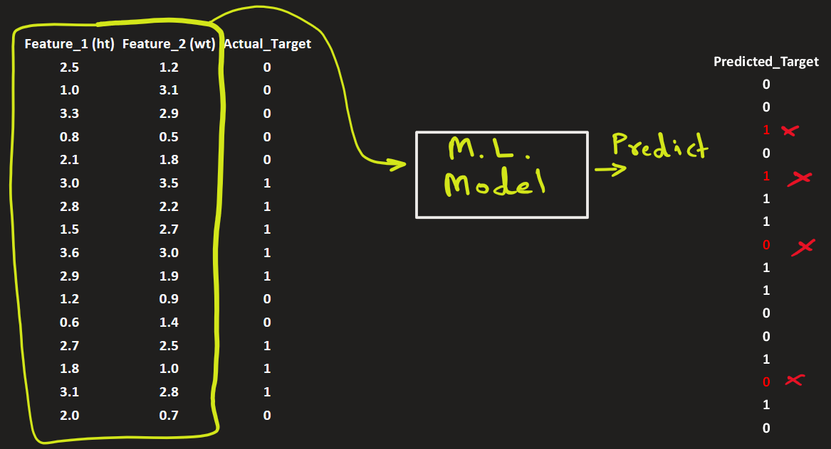
Confusion Matrix
Suppose you have following labelled data that you feed to a classification ML model.
It makes a prediction.
You compare the predicted target with the actual target. You find 4 misclassified targets

Slide 3
Confusion Matrix
Feature_1 (ht) | Feature_2 (wt) | Actual_Target | Predicted_Target
2.5 | 1.2 | 0 | 0
1.0 | 3.1 | 0 | 0
3.3 | 2.9 | 0 | 1
0.8 | 0.5 | 0 | 0
2.1 | 1.8 | 0 | 1
3.0 | 3.5 | 1 | 1
2.8 | 2.2 | 1 | 1
1.5 | 2.7 | 1 | 0
3.6 | 3.0 | 1 | 1
2.9 | 1.9 | 1 | 1
1.2 | 0.9 | 0 | 0
0.6 | 1.4 | 0 | 0
2.7 | 2.5 | 1 | 1
1.8 | 1.0 | 1 | 0
3.1 | 2.8 | 1 | 1
2.0 | 0.7 | 0 | 0
You create a matrix that show how many were classified correctly and incorrectly:
 |  | Predicted
 |  | 0 | 1
Actual | 0 | 6 | 2
 | 1 | 2 | 6
The on-diagonal were classified correctly.
The off-diagonal were misclassified.
This matrix is called confusion matrix.

Slide 4
Confusion Matrix
Confusion Matrix tells you how many were
correctly classified (i.e. True Negative and True Positive)
incorrectly classified (i.e. False Negative and False Positive)
 |  | Predicted
 |  | 0 | 1
Actual | 0 | TN = 6 | FP = 2
 | 1 | FN = 2 | TP = 6
Here,
TN = True Negative,
FP = False Positive,
etc..

Slide 5
Confusion Matrix
Or you can see the percentage instead of raw numbers.
Here you divide by total records, 16.
 |  | Predicted
 |  | 0 | 1
Actual | 0 | 6/16 = 37.5% | 2/16 = 12.5%
 | 1 | 2/16 = 12.5% | 6/16 = 37.5%

Slide 6
Confusion Matrix
Confusion matrix is not about accuracy — it is about understanding errors.
 |  | Predicted
 |  | 0 | 1
Actual | 0 | 6/16 = 37.5% | 2/16 = 12.5%
 | 1 | 2/16 = 12.5% | 6/16 = 37.5%

Slide 7
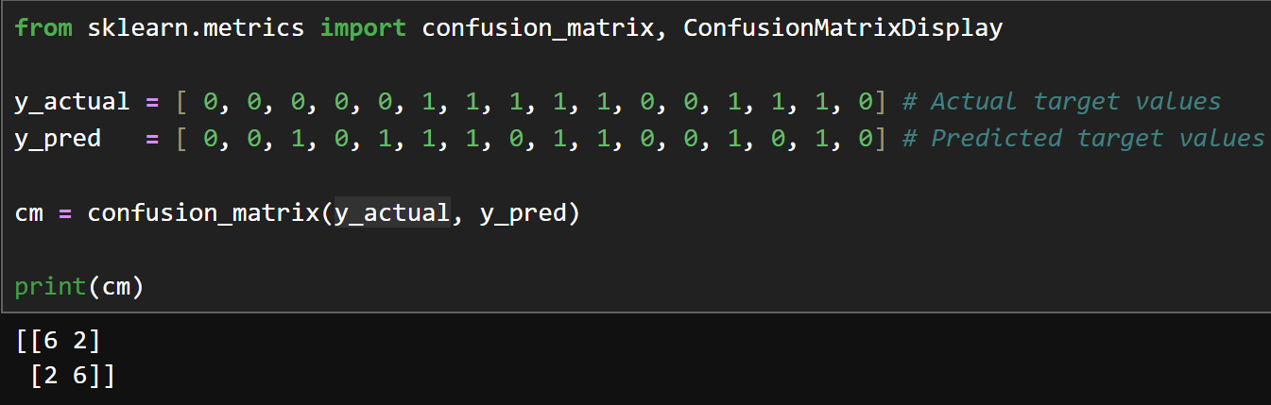
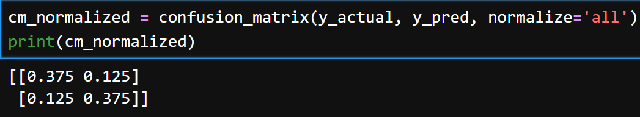
Confusion Matrix

Slide 8
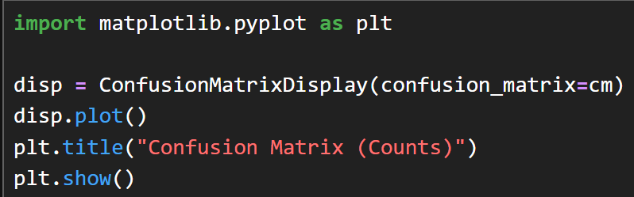
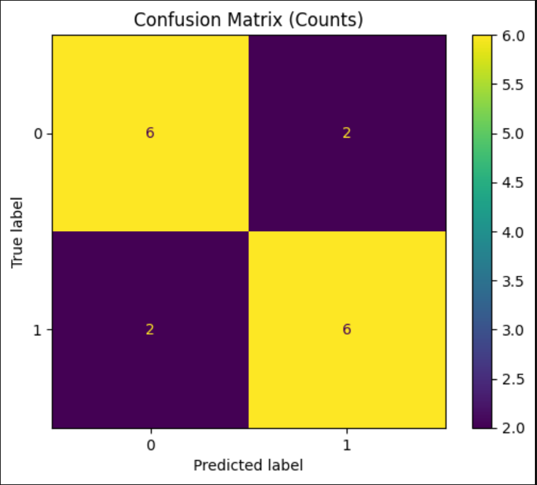
Confusion Matrix

Slide 9
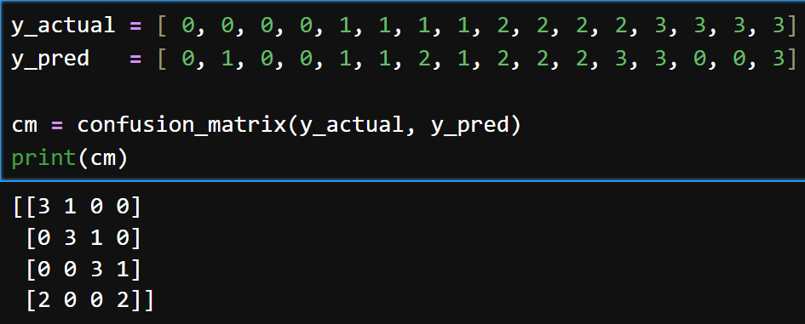
Confusion Matrix: 4 classes

Slide 10
Confusion Matrix: 4 classes

Slide 11
Confusion Matrix
Fcsdf

Slide 12
Heading Goes Here
Fhdsklf
Fjdsklf
Fjskldf

