Slide 1
Full Batch gradient descent vs
Stochastics Gradient Descent vs
Mini Batch gradient Descent

Slide 2
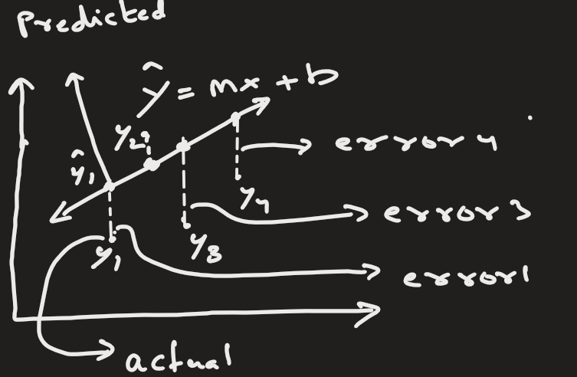


Gradient Descent (Key Idea):
Gradient Descent is an optimization algorithm used to:
Minimize a loss (error) function by updating model parameters.
We try to find parameters
that minimize error:
The idea:
Calculate slope (gradient) of loss
Move parameters in opposite direction of slope
Repeat until minimum error

Slide 3
Full Gradient Descent ( AKA Batch Gradient Descent)
Idea: Use ALL training data to compute gradient before updating parameters.

Slide 4
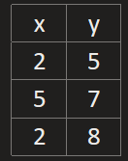

Working Algorithm (Step-by-Step)
Assume dataset:
Step 1 — Initialize parameters
Suppose we are working with linear regression model.
It needs m and b.
m = random number
b = random number
learning_rate = α

Slide 5
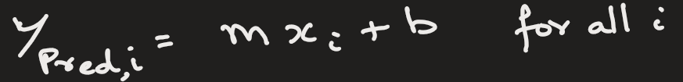
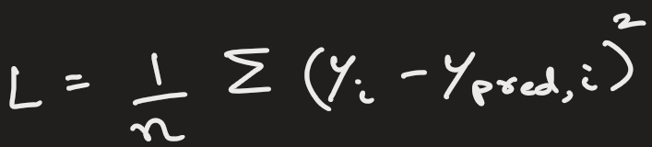
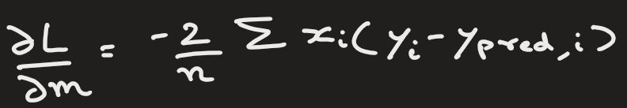
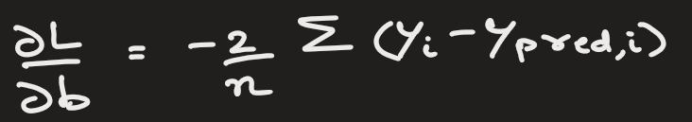
Step 2 — Loop until convergence
Step 2.1: Predict for ALL data
Step 2.2: Compute total loss
Step 2.3: Compute gradients using ALL samples

Slide 6
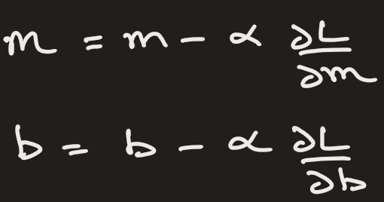
Step 2.4: Update parameters ONCE
This is one forward pass. That is, one epoch.
Step 2.5: Repeat
NOTE: Here, one update = one full dataset pass = one epoch

Slide 7
Disadvantages:
Very slow for large datasets
High memory usage
For example:
If we have 100K samples, then we do forward pass for 100K samples and compute loss for 100K samples.
If we have 10 features, then we have to compute 100K x 10 = 200K derivatives.
This is just for one pass.
We do this for many pass. That is lot of computations.

Slide 8
Stochastic Gradient Descent (SGD)
Idea
Instead of using all data, update parameters using ONE training example at a time.

Slide 9
Stochastic Gradient Descent (SGD)
Algorithm
Step 1 — Initialize parameters
m = random
b = random
learning_rate = α
Step 2 — Shuffle dataset
Important to avoid bias.

Slide 10
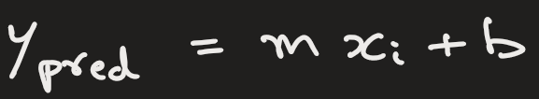
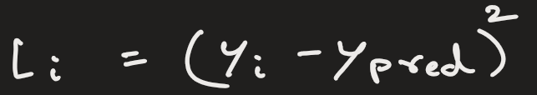
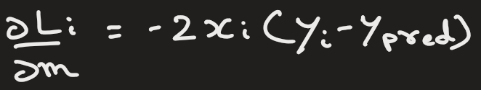
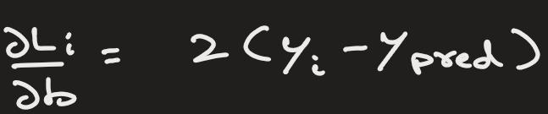
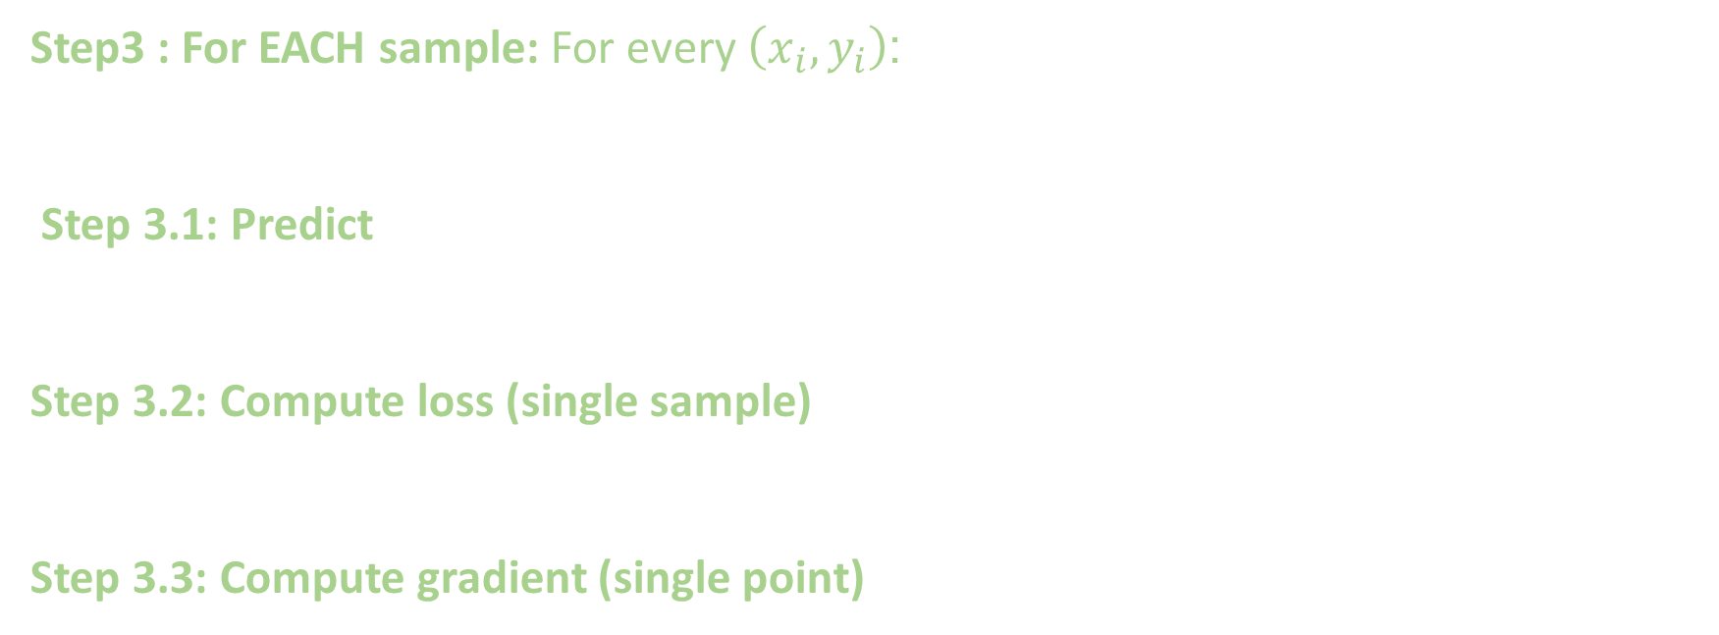
Stochastic Gradient Descent (SGD)
Step3 : For EACH sample: For every $\left(x_{i},y_{i}\right)$:
Step 3.1: Predict
Step 3.2: Compute loss (single sample)
Step 3.3: Compute gradient (single point)

Slide 11
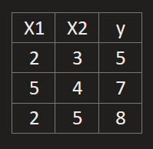
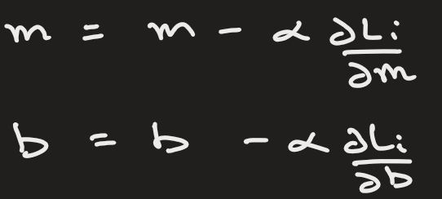
Stochastic Gradient Descent (SGD)
Step 3.4: Update immediately
Parameters change after EVERY sample.
Step 4 — Continue next random sample
NOTE: Many small updates instead of one big update

Slide 12
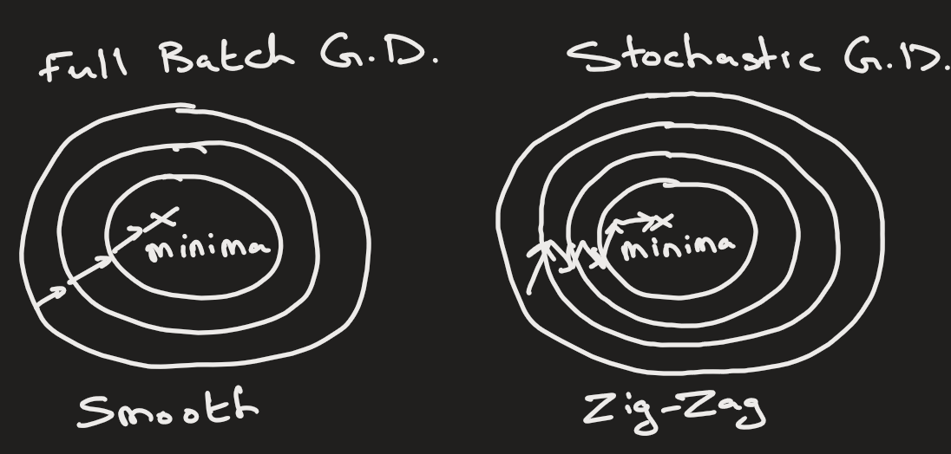
In Full Batch GD, we approach minima smoothly but it is slow.
In Stochastic GD, we approach minima in zig-zag path because we are randomly taking points. But it is fast.

Slide 13
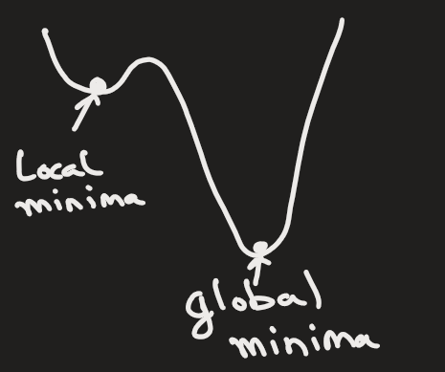
Advantages of SGD
Efficiency: Because it uses only one or a few data points to calculate the gradient, SGD can be much faster, especially for large datasets. Each step requires fewer computations, leading to quicker convergence.
Escaping Local Minima: The noisy updates in SGD, caused by the stochastic nature of the algorithm, can help the model escape local minima or saddle points, potentially leading to better solutions in non-convex optimization problems.

Slide 14
Advantages of SGD
Online Learning: SGD is well-suited for online learning where the model is trained incrementally as new data comes in, rather than on a static dataset.
Memory Efficiency: Since it does not require storing the entire dataset in memory for each iteration, SGD can handle much larger datasets than traditional gradient descent.

Slide 15
Feature | Full Gradient Descent | Stochastic Gradient Descent
Data used | Entire dataset | One sample
Updates | Few | Many
Speed | Slow | Fast
Memory Consumption | High | Low
Large datasets | Poor | Excellent
Escapes local minima | Hard | Easier

Slide 16
Mini-Batch Gradient Descent
Used in Industry.
Instead of ALL samples or ONE sample, we use small group of samples (batch)
Batch size = 32 / 64 / 128 / 256 samples

Slide 17
Mini-Batch Gradient Descent
Algorithm:
Step 1 — Initialize parameters
m = random
b = random
learning_rate = α
batch_size = k
Suppose we have 1000 samples, and k=10 batch.
Step 2 — Shuffle Dataset

Slide 18
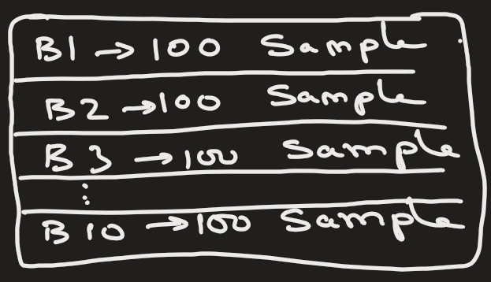
Mini-Batch Gradient Descent
Step 3 — Split into Mini-Batches
Here we have 1000 samples and 10 batch, so each batch will have 100 samples:
Batch 1 → 100 samples
Batch 2 → 100 samples
Batch 3 → 100 samples
…..

Slide 19
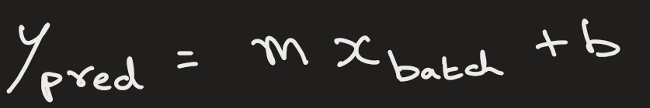
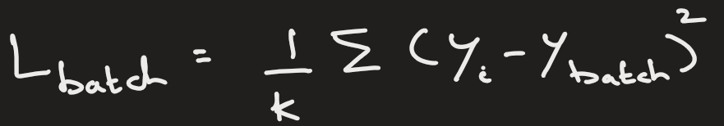
Mini-Batch Gradient Descent
Step 4 — For EACH mini-batch
Suppose batch contains k samples.
Step 4.1 — Predict for batch
(Compute predictions for all k samples)
Step 4.2 — Compute batch loss
Here, only the batch data is used.

Slide 20
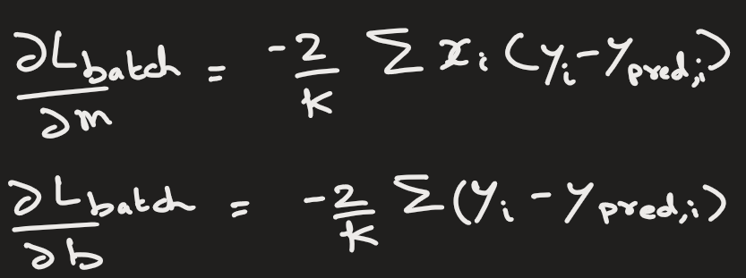
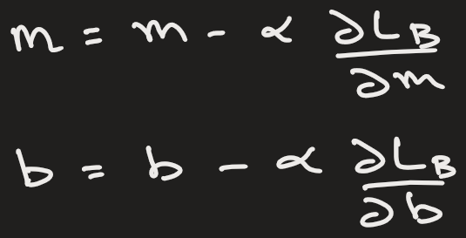
Mini-Batch Gradient Descent
Step 4.3 — Compute gradients (batch average)
Step 4.4 — Update parameters
Update happens after each mini-batch.

Slide 21
Mini-Batch Gradient Descent
Step 5 — Move to next batch
Repeat until all batches finished → 1 epoch complete

Slide 22
Mini-Batch Gradient Descent
Batch Size | Effect
Small | Better generalization
Large | Faster computation
Too large | Poor learning

Slide 23
Feature | Batch GD | SGD | Mini-Batch GD
Data used | All | 1 sample | Small batch
Speed | Slow | Very fast | Fast
Stability | Very stable | Noisy | Balanced ✅
GPU friendly | Poor | Poor | Excellent ✅
Industry usage | Rare | Rare | Standard ⭐

Slide 24
STOP

Slide 25
Mini-Batch Gradient Descent
Why Deep Learning Uses Mini-Batch GD
Neural networks require:
millions of samples
GPU parallelism
frequent updates
Mini-batch enables:
matrix operations
GPU acceleration

Slide 26
Challenges of SGD
Noisy Convergence: Since the gradient is estimated based on a single data point (or a small batch), the updates can be noisy, causing the cost function to fluctuate rather than steadily decrease. This makes convergence slower and more erratic than in batch gradient descent.
Learning Rate Tuning: SGD is highly sensitive to the choice of learning rate. A learning rate that is too large may cause the algorithm to diverge while one that is too small can slow down convergence. Adaptive methods like Adam and RMSprop address this by adjusting the learning rate dynamically during training.
Long Training Times: While each individual update is fast, the convergence might take a longer time overall since the steps are more erratic compared to batch gradient descent.

Slide 27
Heading Goes Here
Fhdsklf
Fjdsklf
Fjskldf

Slide 28
import numpy as np
def stochastic_gradient_descent(X, y, lr=0.01, epochs=100, tol=1e-6):
“””
Perform Stochastic Gradient Descent (SGD) to fit a line y = w*x + b
Parameters:
X (ndarray): Input features
y (ndarray): Target values
lr (float): Learning rate (step size for updates)
epochs (int): Number of iterations through the dataset
Returns:
w (float): Learned weight
b (float): Learned bias
“””
# Initialize parameters randomly
w = np.random.randn()
b = np.random.randn()
n = len(X)
prev_loss = float(‘inf’)
for epoch in range(epochs):
# Shuffle the data for each epoch
indices = np.arange(n)
np.random.shuffle(indices)
for i in indices:
xi = X[i]
yi = y[i]
# Prediction
y_pred = w * xi + b
# Compute gradients (derivatives)
dw = -2 * xi * (yi - y_pred) # derivative wrt w
db = -2 * (yi - y_pred) # derivative wrt b
# Update parameters
w -= lr * dw
b -= lr * db
# Compute loss at the end of the epoch
loss = np.mean((y - (w*X + b))**2)
# Check stopping condition
if abs(prev_loss - loss) < tol:
print(f”Stopped early at epoch {epoch+1}”)
break
prev_loss = loss
return w, b

