Slide 1
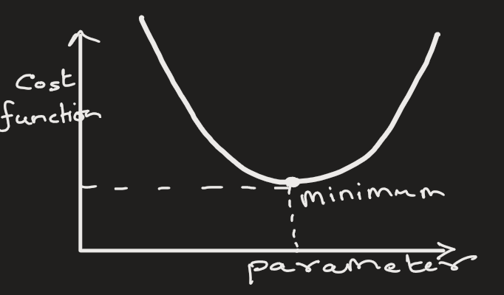
Gradient Descent
Gradient Descent is an iterative optimization algorithm used to find the minimum of a function.
In ML, this function is called Loss function or Cost function
This function measures how wrong the model’s predictions are.
It is the difference between actual value and predicted value.
GD is well suited for large datasets

Slide 2
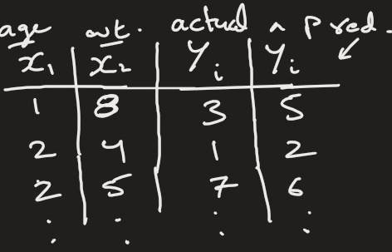
Gradient Descent
In ML, there is difference between actual numerical value and predicted numerical value.
Example:

Slide 3
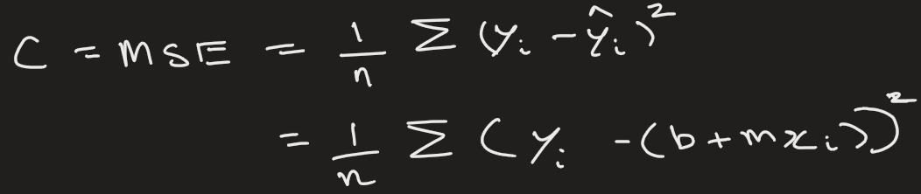
Gradient Descent
The goal of gradient descent is to adjust model parameters so that the loss becomes as small as possible.
In other words, find the parameters that makes the cost function minimum.
In linear regression, the cost function is given by,
Here we have to find parameter m and b,
such that C is minimum

Slide 4
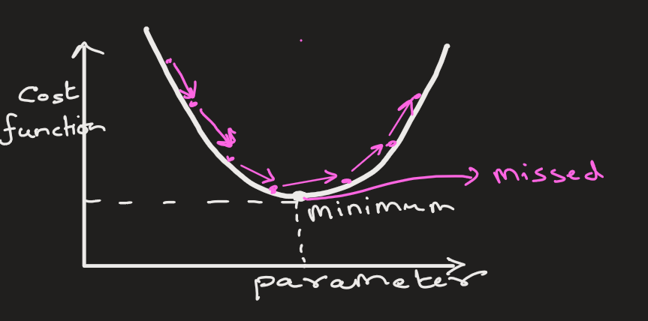
Gradient Descent
So, we start with some parameter and then keep changing it constant amount until we find the minima.
For example: start with b = 5
Next b = 5 - 1 = 4
Next b = 4 - 1 = 3
Next b = 3 - 1 = 2
and so on
There is a problem with this approach:
If we reduce parameter(say b), by fixed size then we may overshoot our minimum point and miss it completely.

Slide 5
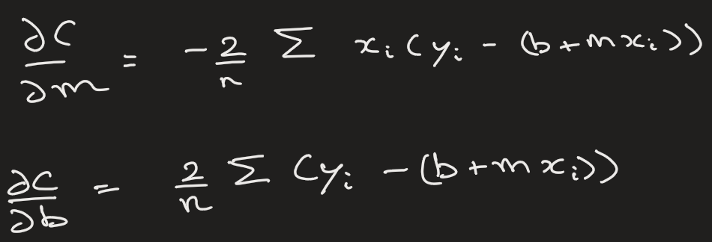
Gradient Descent
The solution is that we change the parameter not by a fixed value but by a variable rate that depends on the slope.
This rate is also known as learning rate.
The slope of C is given by

Slide 6
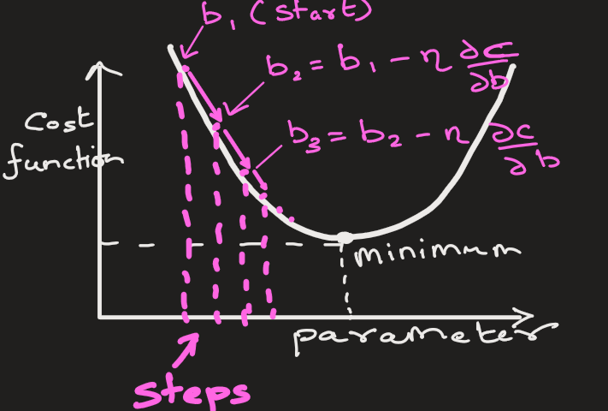
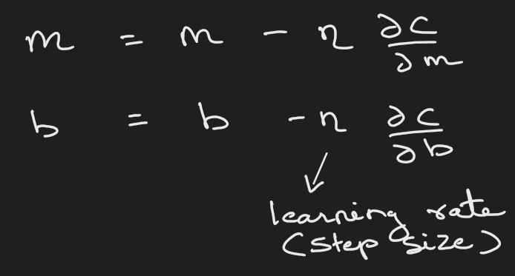
Gradient Descent
We find m and b by repetitively updating its value that depends on learning rate and slope,
, and then calculating the cost function.
We keep doing this until we find m and b where cost is minimum

Slide 7
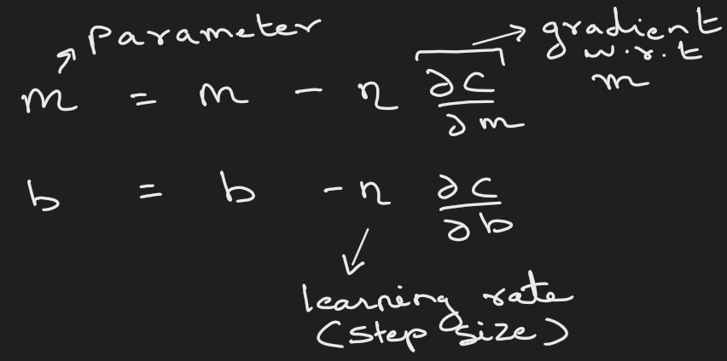
Gradient Descent
How Gradient Descent Works (Step-by-Step)
Initialize parameters (weights) randomly
Compute loss using current parameters
Compute gradient (how loss changes w.r.t parameters)
Update parameters
Repeat until convergence

Slide 8
Heading Goes Here
Fhdsklf
Fjdsklf
Fjskldf

