Slide 1
Loss function – Cost Function
Loss Function is the error for ONE data point
Cost Function is the average error for ALL data points

Slide 2
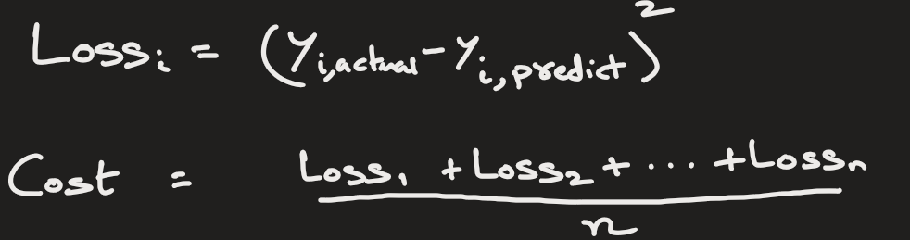
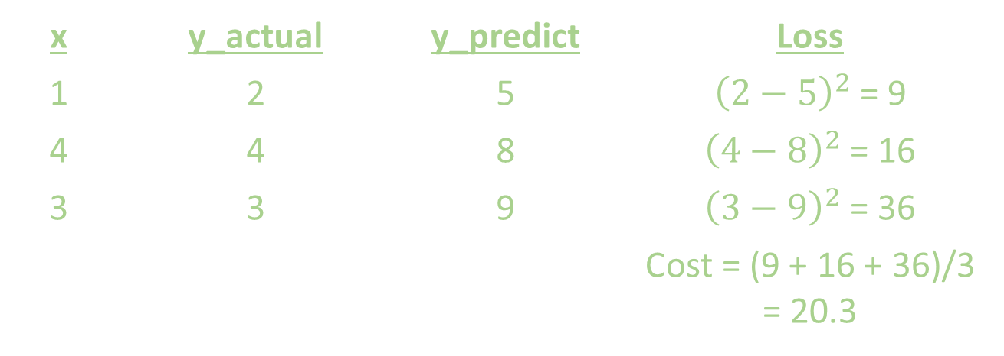
Loss function – Cost Function
Example: Linear Regression
Loss (Squared Error):
For 1 data
Cost(Mean Squared Error – MSE)
For all data
x | y_actual | y_predict | Loss
1 | 2 | 5 | ${\left(2−5\right)}^{2}$ = 9
4 | 4 | 8 | ${\left(4−8\right)}^{2}$ = 16
3 | 3 | 9 | ${\left(3−9\right)}^{2}$ = 36
 |  |  | Cost = (9 + 16 + 36)/3 = 20.3

Slide 3

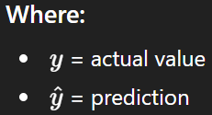

Example of Loss function:
1) Squared Error - SE (Used in Linear regression):
Cost Function -> Mean Squared Error - MSE
It is the average of squared error for all n samples
Used in house price prediction, salary prediction, etc.
Penalizes large errors heavily (because of square)
Smooth and differentiable → good for gradient descent
Sensitive to outliers

Slide 4
Loss function – Cost Function
NOTE: Some authors define loss function to be same as cost function
That is, loss function = the average error for ALL data points

Slide 5


2) Absolute Error –AE (Used in Linear regression):
Cost Function -> Mean Absolute Error - MAE
It is the average of absolute error for all n samples
x | y_actual | y_predict | Loss
1 | 2 | 5 | | 2 – 5 |= 3
4 | 4 | 8 | | 4 – 8 |= 4
3 | 3 | 9 | | 3 – 9 |= 6
 |  |  | Cost (MAE) = (3 + 4 + 6)/3 = 4.3

Slide 6
Mean Absolute Error - MAE
Less sensitive to outliers, because there no squaring

Slide 7

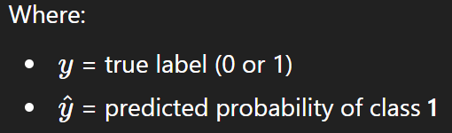
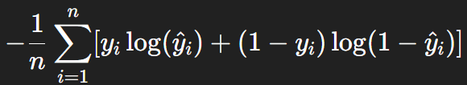
3) Binary Cross Entropy (Used in classification):
Here y is 0 or 1.
Cost Function: It is the average of binary cross entropy for all n samples
Use case: Spam detection, Disease prediction, Fraud detection
Penalizes confident wrong predictions heavily

Slide 8
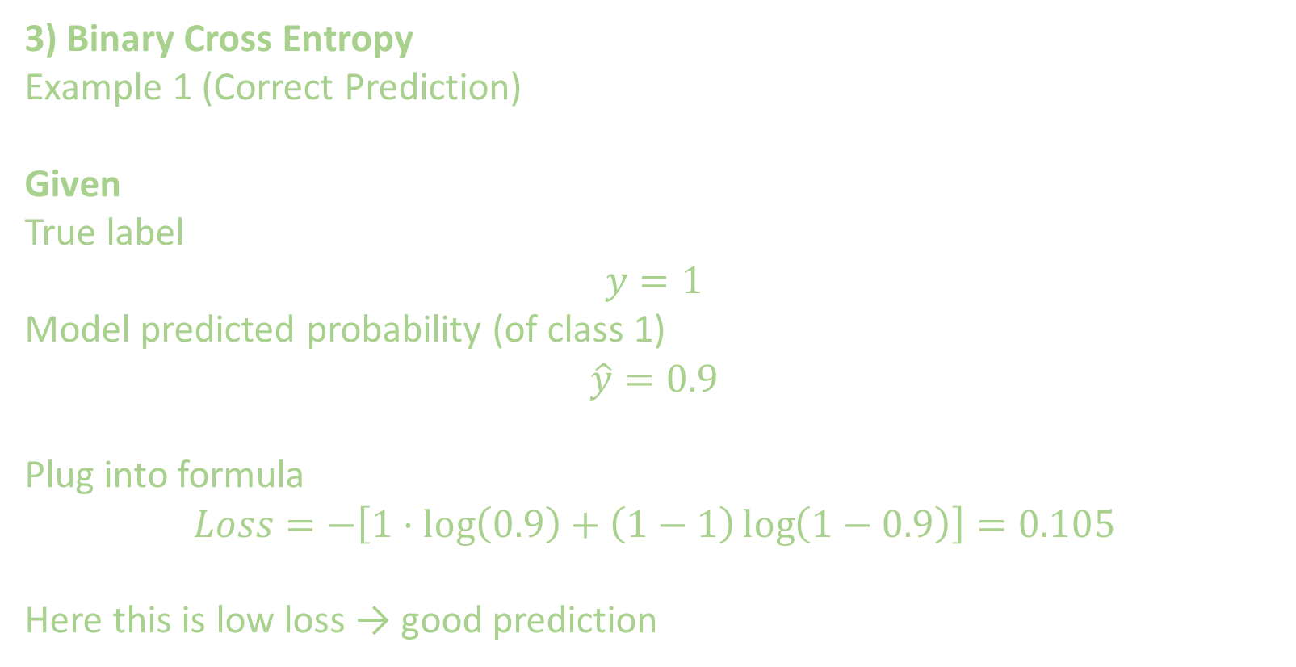
3) Binary Cross Entropy
Example 1 (Correct Prediction)
Given
True label
$$y=1$$
Model predicted probability (of class 1)
$$\hat{y}=0.9$$
Plug into formula
$$Loss=−\left[1⋅\log\left(0.9\right)+\left(1−1\right)\log\left(1−0.9\right)\right]=0.105$$
Here this is low loss → good prediction

Slide 9
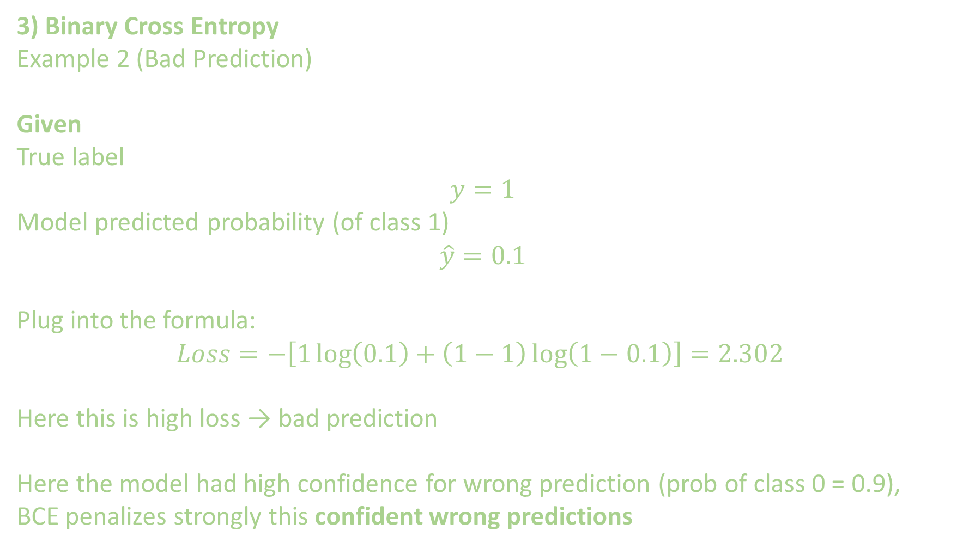
3) Binary Cross Entropy
Example 2 (Bad Prediction)
Given
True label
$$y=1$$
Model predicted probability (of class 1)
$$\hat{y}=0.1$$
Plug into the formula:
$$Loss=−\left[1\log\left(0.1\right)+\left(1−1\right)\log\left(1−0.1\right)\right]=2.302$$
Here this is high loss → bad prediction
Here the model had high confidence for wrong prediction (prob of class 0 = 0.9),
BCE penalizes strongly this confident wrong predictions

Slide 10

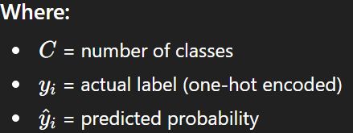
4) Categorical Cross Entropy Loss:
Used in multi-class classification, i.e. there are more than 2 classes.
For example, in digit recognition (0 – 9), animal classification (dog-cat-snake)

Slide 11


5) Hinge Loss (Used in classification by SVM):
Example: If y = 1 and $\hat{y}=0.$3, then
Loss = max( 0, 1 – 1x0.3 )
= max( 0, 0.7)
= 0.7

Slide 12
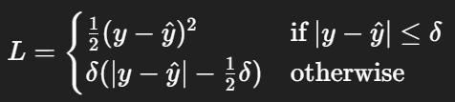
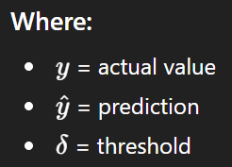
6) Huber Loss (Regression):
It combines advantages of MSE + MAE.

Slide 13

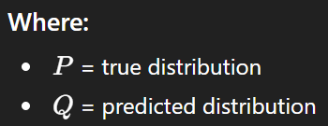
7) KL Divergence Loss:
Measures difference between probability distributions.
It is used in, VAEs, Generative AI, Knowledge distillation
It essentially tells you how much information is lost when using Q instead of P.

Slide 14
STOP

Slide 15

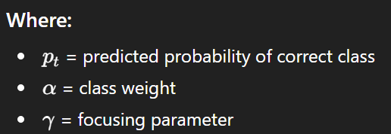
8) Focal Loss:
It is used for imbalanced classification problems.
Example
Fraud detection
Cancer detection

Slide 16


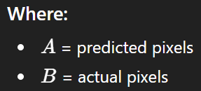
9) Dice Loss (Image Segmentation):
Measures overlap between prediction and ground truth.

