Slide 1
API Application Programming Interface

Slide 2
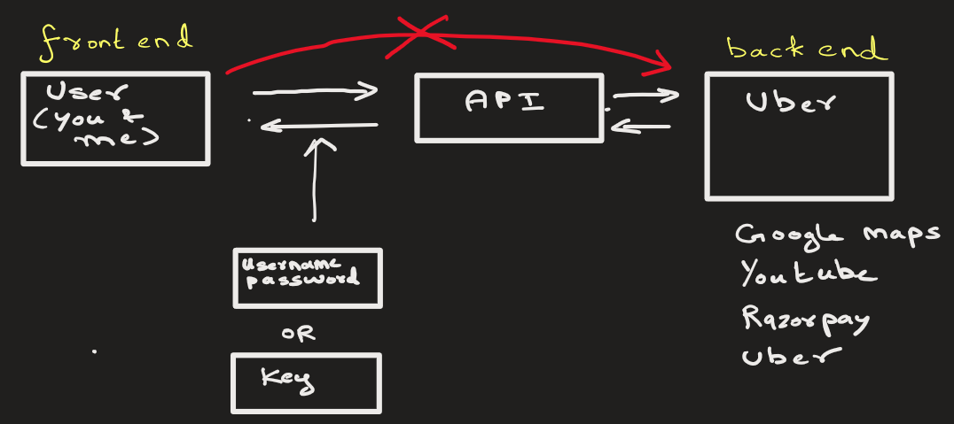
API allows one program (Python) to talk to another software (Server)

Slide 3
The companies provide API so that the user can access certain information from their database.
The backend does not want everybody accessing every information from their database. So, they provide API endpoints.

Slide 4
Uber may provide different API endpoints for different services:
Get Price estimate: https://api.uber.com/estimates/price
View Payment history: https://api.uber.com/estimates/phistory/?id=231
Company may limit request limits to 100 per hours

Slide 5





Key terms
Client (Python) - user
API Endpoint (URL) - https://jsonplaceholder.typicode.com/users
HTTP Method (GET) - Or POST, etc.
Response (JSON)

Slide 6
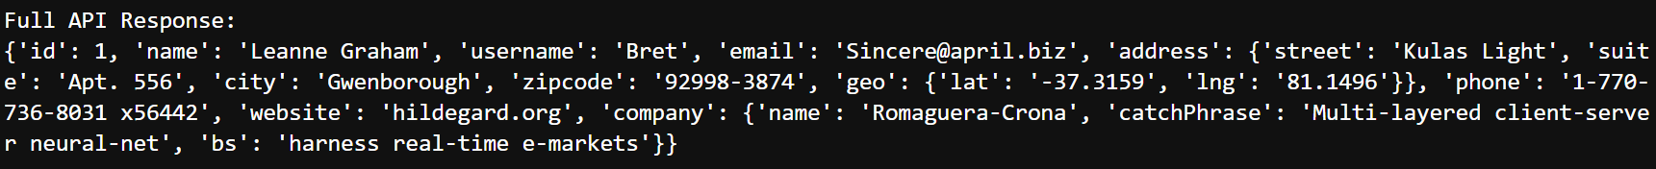
Example of Response (JSON)

Slide 7
How to use API ?
Ans: Read API –Docs provided by the company. It can be tedious.

